Slide 1
Linear Power Supply
Team Sagittarius
Progress Review
2021 DEC
Index | Name
190285J | Kahawalage A.P.P.
190280N | Jegakumaran P.
190286M | Kajhanan K.
190301H | Karunanayaka Y.S.

Slide 2
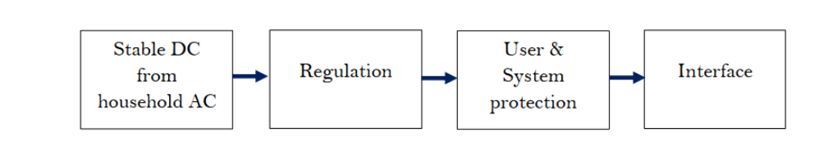
Problem breakdown
We recognized 4 main requirements to complete the Linear Power Supply.

Slide 3
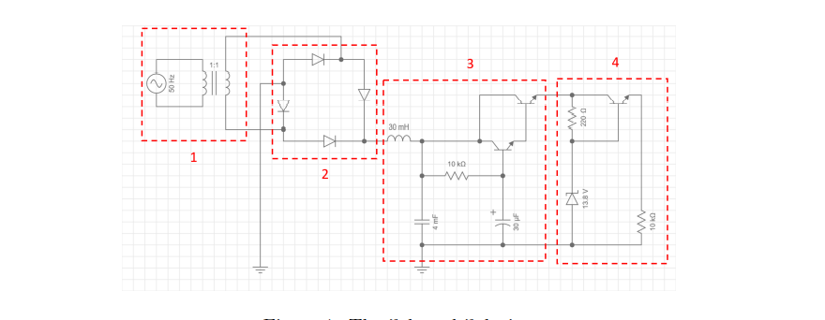
Conversion stage
Our First solution

Slide 4
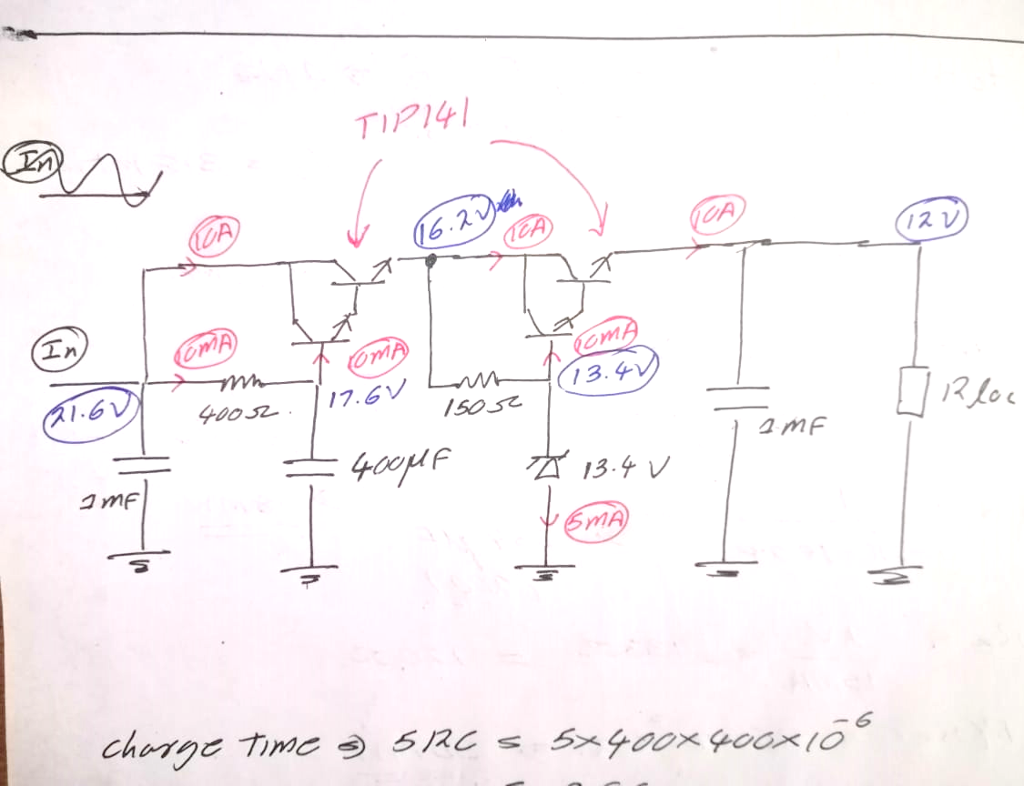
Calculation of required values
1. Reducing the AC 230 V to a suitable value
2. Use a high-power full bridge rectifier to rectify
3. Use LC low pass filter to filter out the AC component
4. Filtered current is the base current for the 2N3904 transistor then it will provide a base current for the TIP141 Darlington transistor
5. Datasheets of these transistors show 10A collector current is possible
6. We have a very stable base current, a stable collector current also can be expected
7. Zener diode used to regulate to 13.8V because there will be a 2V drop at the BE.
8. Protection circuits needs this 11.8 minimum voltage is required to supply 10V after protection circuits.
The maximum voltage we can have in the input is 19.2V
(after rectifying)

Slide 5
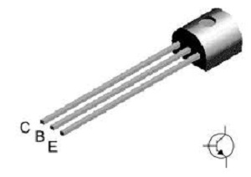
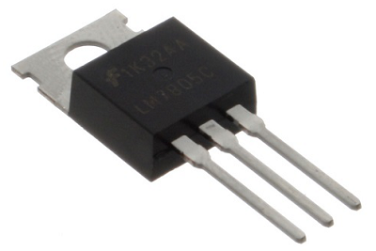
BJT, MOSFET comparison
BJTs | MOSFETs
Made for low power / currents | Made for high power / current
Current controlled | Voltage controlled
Low input impedance (kilo ohm) | Nearly infinite input impedance (mega ohm)

Slide 6
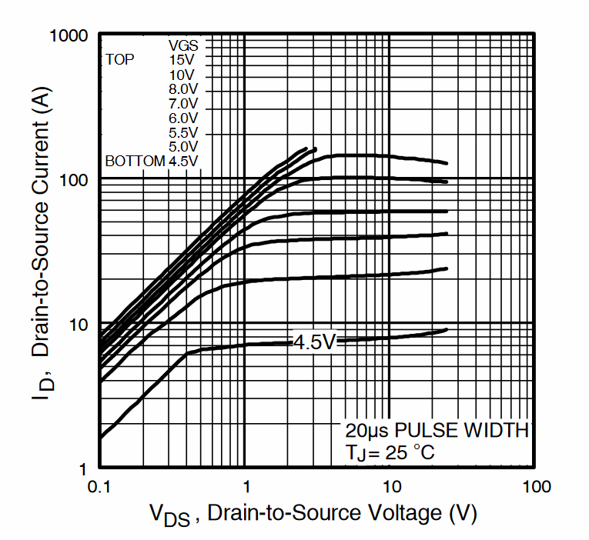
Using a MOSFET instead of Darlington Pairs
Now the voltage drop around the MOSFET is only 0.3V (At 5V V_{GS} )

Slide 7
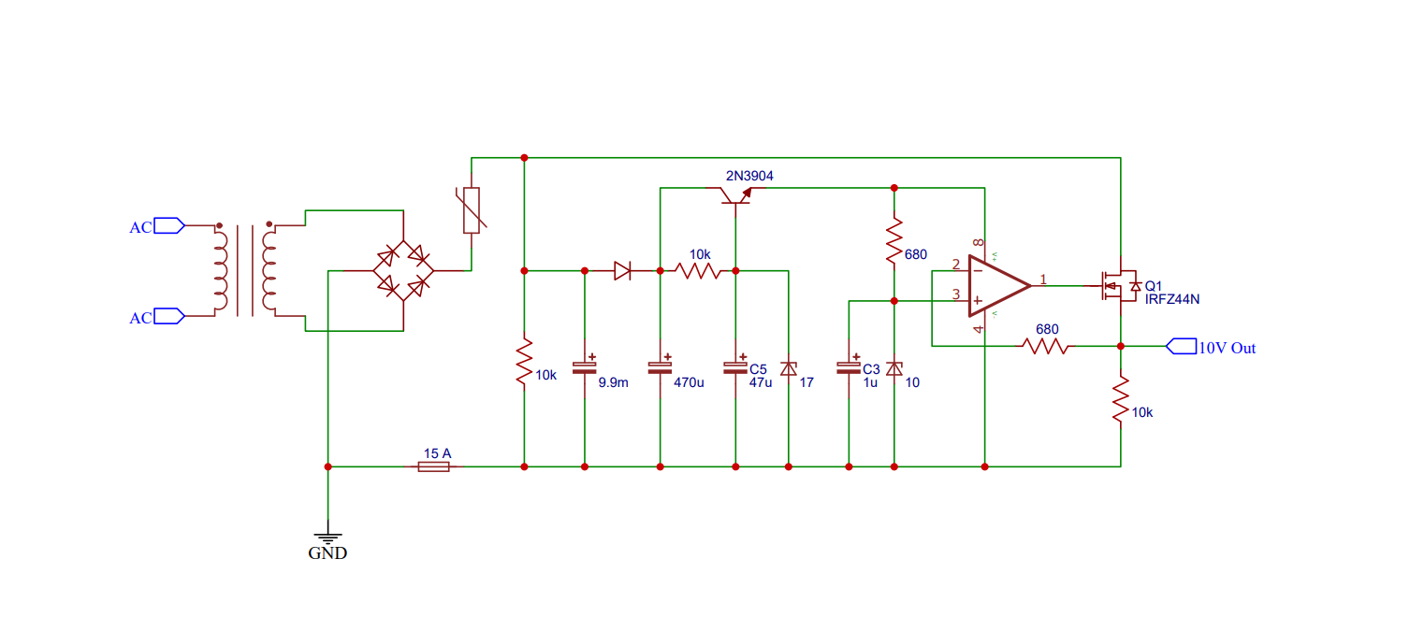
New Solution for basic functionality (No protection)

Slide 8
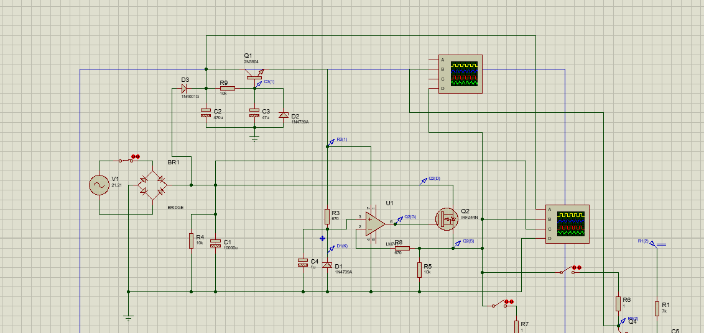
Simulation in Proteus

Slide 9
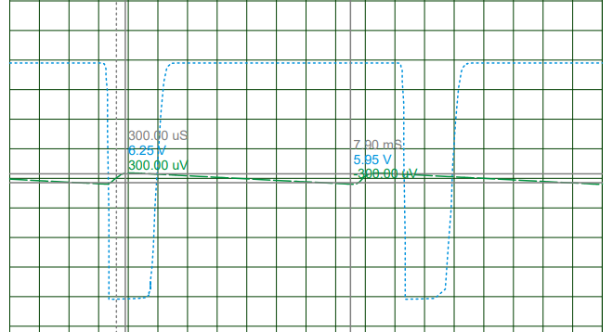
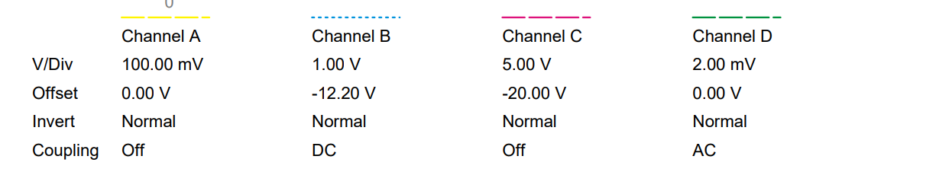
Results

Slide 10
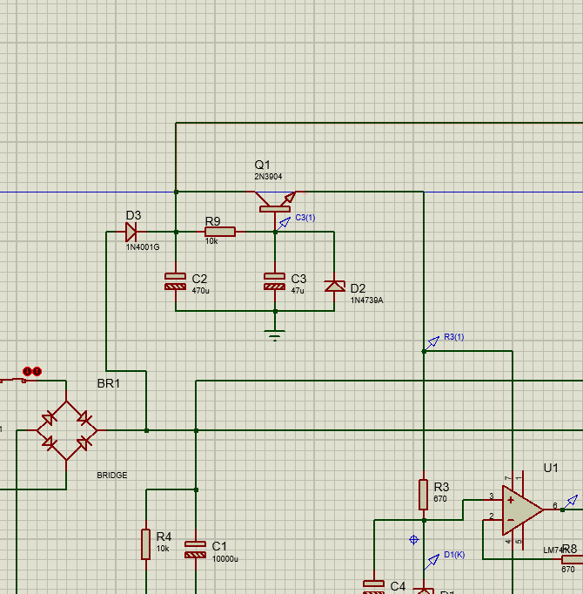
Power supply for the OP-AMP
As we are using an op amp separate power should be given to it.

Slide 11
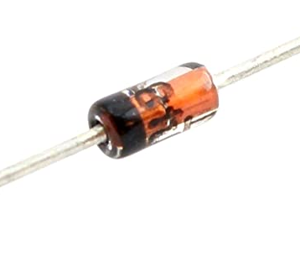
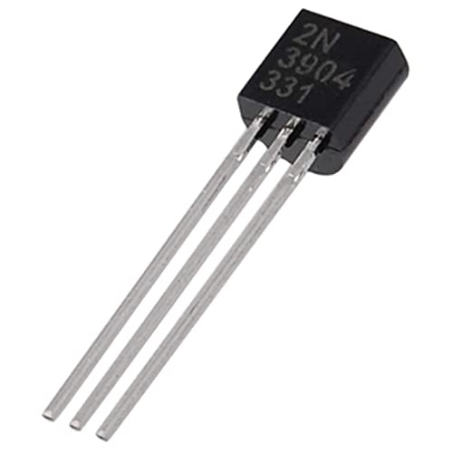
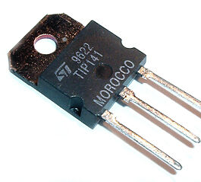
Selected Parts
The Darlington pair : TIP141 https://www.onsemi.com/pdf/datasheet/tip140-d.pdf
NPN BJT transistor : 2N3904 https://www.onsemi.com/pdf/datasheet/2n3903-d.pdf
Zener Diode : BZX79C15 https://datasheetspdf.com/pdffile/994603/TaiwanSemiconductor/BZX79C15/1
High power bridge rectifier
https://www.bc-robotics.com/shop/bridge-rectifier-50a-1000v

Slide 12
Other Aspects to Develop
Overcurrent protection
Mechanism to limit the current at 10A, even when user short circuited.
Undervoltage management
LPS will stop functioning and will indicate its low power
Overvoltage management
LPS will switch off, in a case of high power as a protective measure
Inrush current
At the beginning, when capacitors are charging higher currents will be through diodes
Reverse voltage from user
Protect LPS from users accidentally, connecting power supplies
Automatic cooling fan
MOSFETS will be cooled down when needed, with temperature sensors

Slide 13

Thank you!

