Slide 1
Kshetrajna
Private adaptive intelligence
for Windows
A local assistant that learns app routines and explains its suggestions.
Team SankatMochan
Hackathon prototype v0.3
01
Notes:
Kshetrajna is our experimental Windows workload and file assistant. Its name means the knower of the field. We connect the user's workflow to system pressure and local files while keeping decisions under their control. Source: https://github.com/Team-SankatMochan/KSHETRAJNA-OS, commit 61666c8, README.md and src/kshetrajna/.

Slide 2
The problem
Daily work spans apps, system resources and files.
Resource pressure
Scattered context
Users inspect CPU and RAM separately from what they are trying to do.
The files relevant to a workflow sit apart from app activity and system tools.
Kshetrajna brings those signals into one local dashboard.
02
Notes:
A developer may switch between an editor, a browser and a terminal while background work consumes resources. Task Manager can show load, and Explorer can show files, but the user still connects those observations manually. This is the problem our prototype addresses. This is a product hypothesis, not a market statistic.

Slide 3
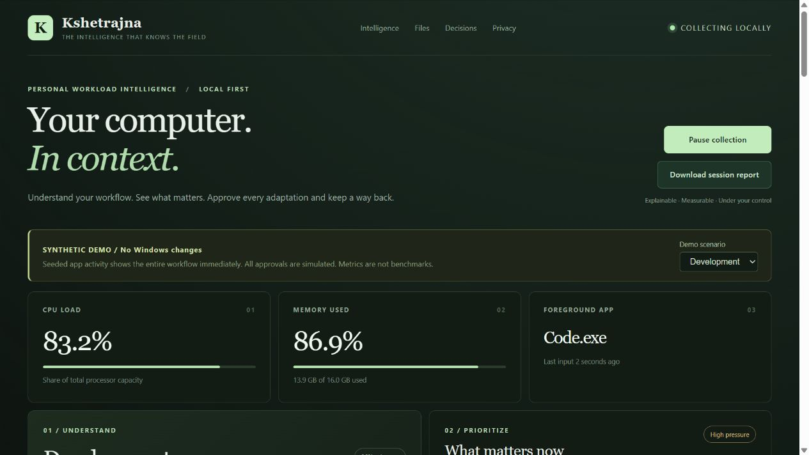
The working dashboard
System view
CPU, RAM and foreground activity
Personal context
Workflow routines and relevant local files
Screenshot: synthetic demo. Live observation requires user consent.
03
Notes:
This screenshot comes from the current v0.3 application running on localhost in synthetic demo mode. CPU and memory figures in it are seeded demonstration data, not Snapdragon benchmarks or measured gains. The live mode collects real Windows observations after opt-in. Source: https://github.com/Team-SankatMochan/KSHETRAJNA-OS/tree/main/src/kshetrajna/web and demo.py.

Slide 4
Workflow and file intelligence
App routines
Local file catalog
Recognizes recurring app groups and the order in which apps appear.
Indexes approved folders with metadata and bounded text excerpts.
Next-app suggestions
Relevant files
Uses recent session history and withholds weak predictions.
Offers keyword search and explains why a file matches the current context.
Reviewed move/rename API includes a journal and conflict-aware undo.
04
Notes:
Workflow learning groups stable app visits into sessions, counts recurring ordered routines and weights recent transitions. Predictions abstain for weak or ambiguous evidence. They use counts and rules, not an LLM or calibrated probabilities. File indexing covers user-approved roots and bounded text excerpts. Contextual file ranking combines keyword overlap and metadata. Reviewed rename/move actions with journaling and conflict-aware undo exist in the backend/API; the organizer UI remains a next step. Sources: patterns.py, file_service.py, file_insights.py, context_files.py, file_actions.py, web/files.js at commit 61666c8.

Slide 5
Consent and privacy
User-controlled collection
Local processing
Live observation starts only after opt-in. Pause, retention and deletion controls remain visible.
Python and SQLite run on the laptop. The dashboard binds to loopback.
Reviewed resource trials
Recorded outcomes
Eligible CPU-priority changes require approval and expire after 60 seconds.
The journal keeps approvals and undo status. Before/after deltas are observations.
Telemetry excludes keystrokes, URLs and window titles. File excerpts require approved folders.
05
Notes:
Live collection is off by default. Users can pause it, select retention and delete telemetry history. Approved folder indexing is a separate source of data and can include bounded text excerpts. SQLite data stays in the Windows user profile and is not application-encrypted. Priority changes are individually reviewed 60-second trials on one eligible background process, with manual/timed undo and restart recovery. Recovery can fail and child-process inheritance is outside rollback scope. Maintenance backend actions have different reversibility limits and their dashboard UI is incomplete, so this pitch does not claim every system operation can be undone. Sources: config.py, collector.py, actions.py, storage.py, service.py, maintenance.py, server.py.

Slide 6
Windows ARM64 architecture
Python 3.13
Workflow rules and session-based prediction
Win32 via ctypes
CPU/RAM, processes and foreground activity
SQLite
Local telemetry, file catalog and action journals
HTML / CSS / JS
Browser dashboard at 127.0.0.1
Test device: HP Snapdragon X (X126100), 16 GB RAM, ARM64
All 61 tests passed on the Snapdragon ARM64 laptop. The NPU is not used.
06
Notes:
The implementation uses Python 3.13's standard library with ctypes calls into Win32, two local SQLite catalogs and static HTML/CSS/JavaScript served by a loopback HTTP server. There are zero third-party runtime packages. Pointer-sized Win32 bindings reduce architecture-specific dependencies. The user reports that all 61 automated tests passed on the pictured Snapdragon ARM64 laptop. The supplied photo identifies an HP laptop with processor label Snapdragon X - X126100, Qualcomm Oryon 2.96 GHz, 16 GB RAM, and a 64-bit ARM-based system; it does not identify the HP model. The NPU is not used. Sources: pyproject.toml, telemetry.py, storage.py, file_storage.py, server.py, docs/SNAPDRAGON.md and user's supplied System/About photo. The ARM64 device test result comes from the user, not a test run independently observed by this assistant. Interpreter architecture and performance measurements are not established by that report.

Slide 7
Validation and next steps
61
0
tests passed on the Snapdragon ARM64 laptop
third-party runtime packages
Next: device diagnostics, organizer UI and controlled performance trials.
Demo: run_demo.cmd Live mode: run.cmd
https://github.com/Team-SankatMochan/KSHETRAJNA-OS
07
Notes:
We ran the current repository's entire unit-test suite on the Windows x64 development machine: 61 tests passed in 29.768 seconds on 30 September 2026, at commit 61666c8. Tests cover storage, privacy gates, workflow behavior, approval/recovery, file scanning, file actions, and HTTP integration using controlled fixtures and doubles. The user also reports that all 61 automated tests passed on their Snapdragon ARM64 laptop. These tests do not establish performance gains. The GitHub repository is public and origin/main matches local HEAD. Next steps include recording device diagnostics and controlled performance experiments. The device-test result is user-reported; no ARM64 runtime transcript or timing report was supplied. Reviewed file actions currently expose a backend/API; completing the organizer panel is next. Source: local x64 unittest run, git/gh verification, and the user-confirmed Snapdragon device test in this conversation.

