Slide 1

Health Care Support Chatbot
Team : TechLegionz

Slide 2
HealthCare Support Chatbot Problem Statement: Use of Al based Chat bots for providing health related information. Category: Software. Organization: Ministry of Health and Family Welfare. Team Name: TechLegionz. Problem Code : SS43. Team Leader Name : Needa Shaikh. Technology Bucket : Healthcare and Biomedical Devices . College Code: 1-3513297631
IDEA/ Problem Solution:
The Solution to the given Problem statement is that we have created a chatbot that responds to the queries by the user/patient by searching the Dataset for responses and this dataset will be in the form of .JSON file.
Our chatbot is capable enough to interpret to all queries of the user/patient, analyze them and understand the intent of the queries. The chatbot shall search the entire dataset for response to the medical query.
ChatBot will also be able to tackle and response to gibberish phrases by the user which is possible due to an appropriate Fallback Content.
Chatbot gets trained owing to previously entered medical information and becomes more capable of responding to forthcoming medical queries.
The Database has been maintained using MySQL and will be integrated with the NLP engine using Dialogflow API’s which can accomplish word embedding language modeling, part-of-speech tagging, intent and entity detection.

Slide 3
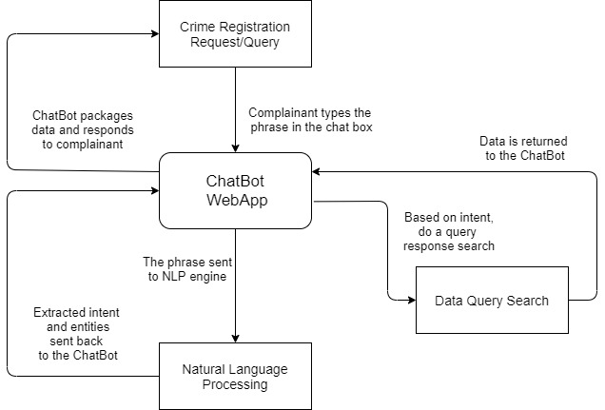
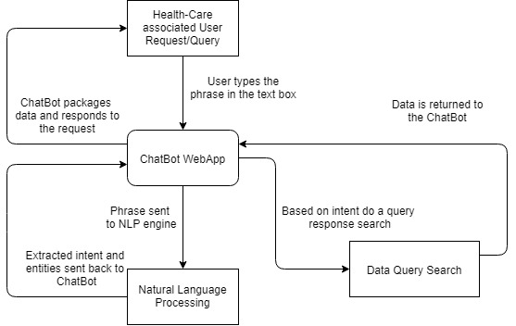
FLOW CHART:
Technology
Stack:
Platform: A desktop Website
Coding Language: Python
Framework: Django/ Flask
Database: MySQL/ MariaDB
Other tools used: NLP engine for Language Processing.

Slide 4
Idea / Approach details
Use Case:
HealthCare Request/Query
ChatBot MAIN
User
NLP engine
intent
Follow up response to the user/patient.
entity
Database
Query resolution search
Database update after Chatbot and User interaction

Slide 5
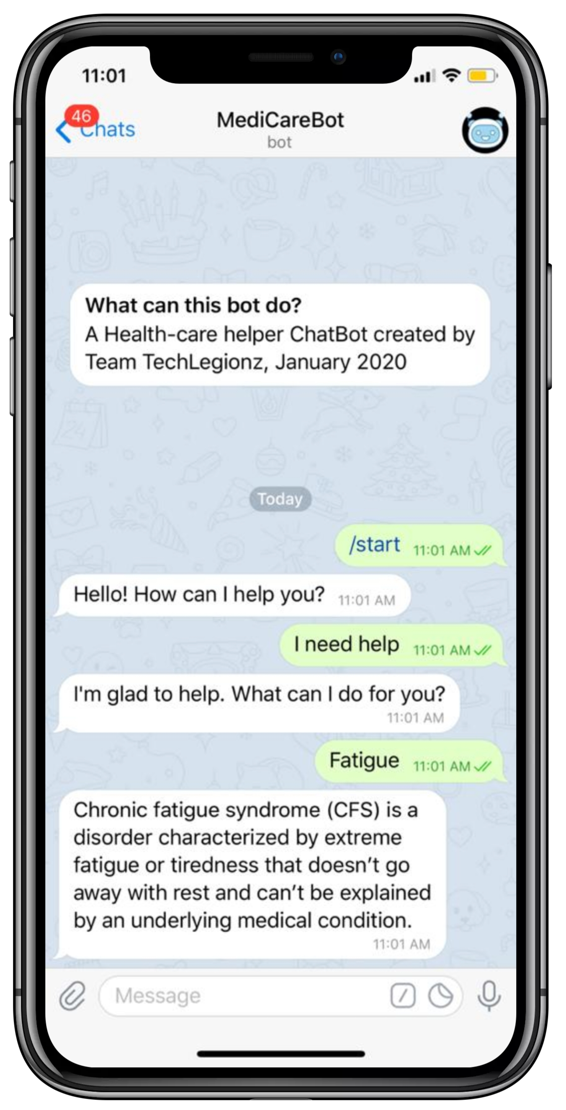
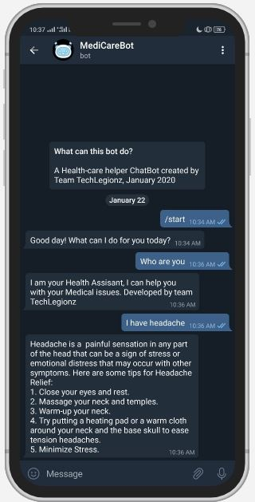
Prototype
iOS
Android

