Slide 1
Investigation of Typical Failures In Road Pavement And Minimize This Failure By Using Advanced Nanotechnology Material- NANO CLAY
Prathamesh chavan
Under guidance -preeda chaturabong

Slide 2
ABSTRACT
Pavement failure is a serious problem for road and traffic sector in almost every country, the most affecting causes of bituminous pavement failures have been studied in this paper. The paper describes the lessons learnt from pavement failures and problems experienced. Failures of bituminous pavements are caused due to many reasons or combination of reasons. Application of advanced nanotechnology material for reducing cracks and failure in bitumen pavement .the advanced nanotechnology material uses as per indian climate for reduction of pavement failure and describe the which nanotechnology material use for various failure.

Slide 3
INTRODUCTION
Failure- For rapid economical, social and cultural development of any country, a good system of transportation is very essential. Transportation system comprises of good network of roads, railways, well developed waterways and airways. Pavement failure occurs when an asphalt surface no longer holds its original shape and develops material stress which causes issues. Pavement failure issues include cracking, potholes, depressions, rutting, shoving, upheavals, and ravelling.
Nanotechnology The investigation of about Nano science and different nanoparticles potential points of interest of Nano silica, smaller scale silica, carbon nanotubes, Nano TiO2, Nano phosphorus and their execution in transportation field are shown in this paper. The article additionally accentuates on the modern request and utilization of

Slide 4
OBJECTIVES OF THE STUDY
To investigate the typical failures of flexible pavement .
Analysis of mixing nano clay in different percentage in asphalt binder.

Slide 5
TYPES OF FAILURE
Rutting
• Cracking
– Longitudinal
• Fatigue cracking
– Alligator cracking
• Joint construction cracking
• Edge (verge) cracking
• Block Cracking
• Potholes
• Bleeding
• Ravelling
• Stripping
• Corrugation and shoving
• Depressions
• Segregation

Slide 6
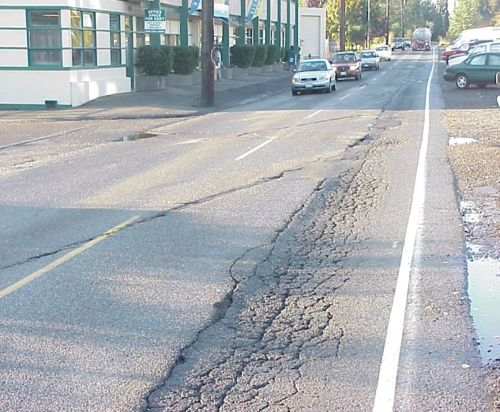
Rutting
Rutting is channelled depressions in an asphalt surface that form over time from exceeded weight limits and improper base construction. Over time heavy vehicles will begin to compact the asphalt along a roadway creating tire ruts. If rutting forms in an asphalt surface the base must be repaired or restructured to account for heavier vehicle traffic.
There are two types of rutting that can occur;
Pavement Rutting
Subgrade Rutting

Slide 7
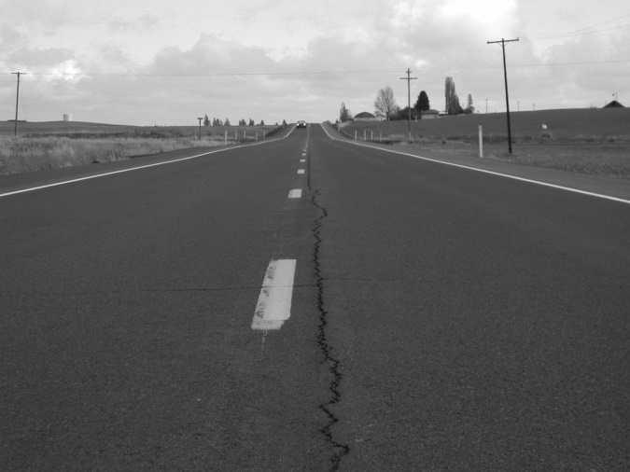
Cracking
Longitudinal
Longitudinal cracks occur parallel to the centerline of the pavement. They can be caused by: a poorly constructed joint; shrinkage of the asphalt layer; cracks reflecting up from an underlying layer; and longitudinal segregation due to improper paver operation. These cracks are not load-related.

Slide 8
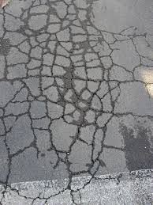
Fatigue cracking
Alligator cracking
Alligator cracking forms when the subgrade and asphalt base begins to compress from bearing heavy vehicles. Alligator cracking is commonly found at intersections where vehicles are stopped for a continuous amount of time. Initial cracks will form and spread through water intrusion and further asphalt base compression.

Slide 9
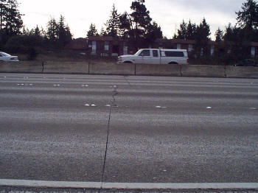
Joint construction cracking
These are cracks in a flexible pavement overlay of a rigid pavement . They occur directly over the underlying rigid pavement joints. Joint reflection cracking does not include reflection cracks that occur away from an underlying joint or from any other type of base

Slide 10
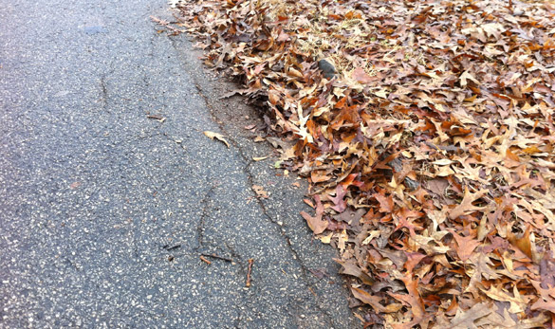
Edge Cracking
Edge cracking forms along the edge of a road and is typically caused by water damage, insufficient base material, and heavy road usage. Edge Cracks travel along the inside edge of a pavement surface within one or two feet. The most common cause for this type of crack is poor drainage conditions and lack of support at the pavement edge. As a result underlying base materials settle and become weakened. Heavy vegetation along the pavement edge and heavy traffic can also be the instigator of edge cracking.

Slide 11
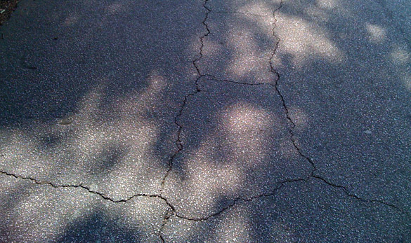
Block Cracking
Block cracking is formed by seasonal temperature differences that cause the asphalt to expand and contract. Block cracking will form if an asphalt surface has too rigid of a mix design that does not give the surface room for seasonal density changes.

Slide 12
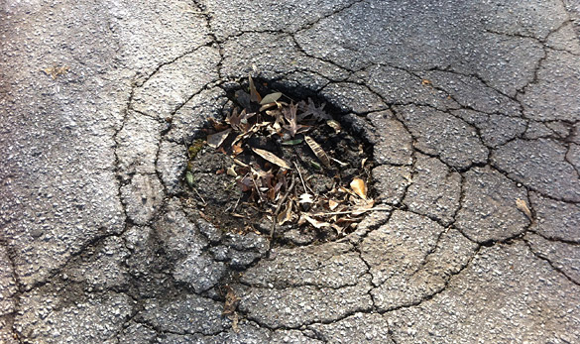
Potholes
Potholes are the result of moisture infiltration and usually the end result of untreated alligator cracking. As alligator cracking becomes severe, the interconnected cracks create small chunks of pavement, which can be dislodged as vehicles drive over them. The remaining hole after the pavement chunk is dislodged is called a pothole.

Slide 13
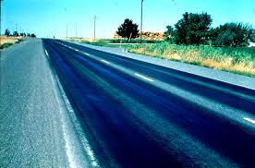
Bleeding
This problem is generally caused by the presence of excessive binder content in the mix and also using the binder with too low viscosity or an improperly applied seal coat. Bleeding occurs more often in hot weather when the bituminous binder is less viscous and the traffic forces the asphalt to the surface.

Slide 14
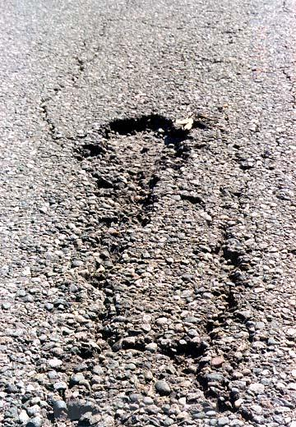
Ravelling
Ravelling is caused by the continued intrusion of water and the degradation of an asphalt top coat. Once the top layer of asphalt bitumen wears down water and sunlight will continue to damage the asphalt surface causing the bond between asphalt bitumen and aggregate rock to break.

Slide 15
Stripping
A general definition of stripping is "the breaking of the adhesive bond between the aggregate surface anti asphalt " in an asphaltic pavement or mixture.
Stripping is a complex problem dependent on many variables, including the type and use of mix, asphalt characteristics, aggregate characteristics, environment, traffic, construction practice, and the use of anti-strip additives; however, the presence of moisture is the common factor to all stripping.

Slide 16
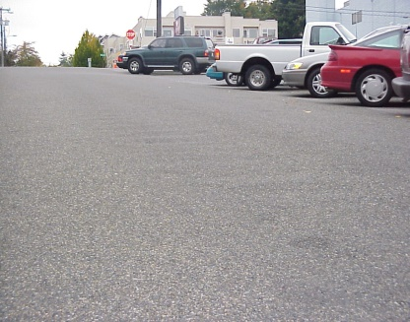
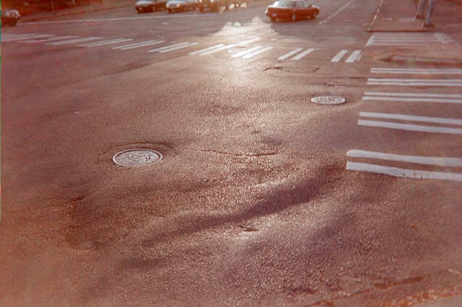
Corrugation and shoving
A form of plastic movement typified by ripples (corrugation) or an abrupt wave (shoving) across the pavement surface. The distortion is perpendicular to the traffic direction. Usually occurs at points where traffic starts and stops (corrugation) or areas where HMA abuts a rigid object (shoving).
Corrugations on a steep city street
Shoving at a busy intersection

Slide 17
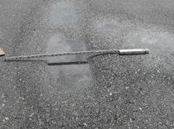
Depressions
Localized pavement surface areas with slightly lower elevations than the surrounding pavement. Depressions are very noticeable after a rain when they fill with water.
Roughness, depressions filled with substantial water can cause vehicle hydroplaning.

Slide 18
CAUSES OF FAILURE IN FLEXIABLE PAVEMENT
Heavy channelized traffic and overloading
Inadequate compaction of mix at the surface or underlying surface
Unstable asphalt material
Poor subgrade
Poor flexible pavement design
High temperature
Defects in quality of materials
Defects in construction method
Inadequate surface or subsurface drainage
Settlement of foundation of embankment
Environmental factors like heavy rain, water Environmental factors like heavy rain, water table frost, snow table frost, snow

Slide 19
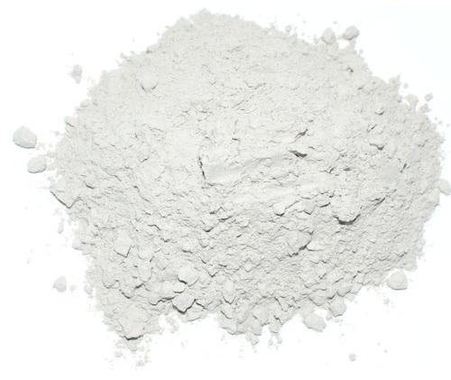
Nano clay
Clays are used in architecture, industry, and agriculture throughout prehistoric times. It remains one of the essential minerals for industry. Ceramists have used nano clay without knowing nanoparticles, and they improved the science of clays since antiquity. Furthermore, many applications have been found recently, and resulting indications of nanoclays are reduction of cost and improvement of product quality. Clay minerals can be described as fine-grained hydrous silicates with sheet-like structure, so they are stacked over one another. Different from clays, nanoclays are clay minerals in nanometer range at least one dimension with high aspect ratio.
MATERIALS-
Bitumen penetration grade 60/70
Nano clay in different percentage 6%,8%,10%

Slide 20
EXPERIMENTAL PROCEDURE
Prepration of asphalt binder with nano clay
To adding a nano clay material percentage of 6%,8%,10% at temperature 140⁰ C, stirring the asphalt for 5 min at temperature raise 160⁰C slowly and continuous stirring at 160 °C for two hours until it achieves a completely homogenous asphalt blend .
Nano clay treatment
To collecting the residue 75 micron for the adding in asphalt binder.
As per standard procedure - nanoclay (OMMT) was prepared by a cationic exchange process in an aqueous solution by vigorously stirring 25 g Na⁺–MMT dispersed in 800 ml of distilled water at 80 °C with 10 g cetyltrimethylammonium bromide for 2 h. The precipitate was filtered and washed several times with warm distilled water until no chloride ions were detected with 0.1 N AgNO₃ solution. It was then dried at 60 °C for 24 h.

Slide 21
. Preparation of asphalt nanoclay composite
The asphalt nanoclay composite was prepared using a high-shear mixer. The asphalt was first heated to 160 °C to a fluid state and the surfactant-modified nanoclay, (6%, 8%, and 10 wt%) was added to the system and mixed at 2500 rpm for 3 h to disperse the intercalated OMMT nanoclay. And finally completely homogenous asphalt blends are obtained to produce good pavement.
Test
By physical and mechanical properties we usetest
Penetration test
Softing test (Ring and Ball test )
Tensile strength test

Slide 22
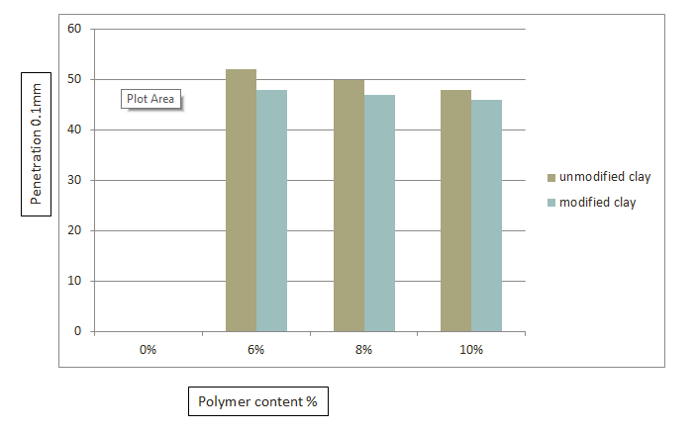
Penetration test

Slide 23
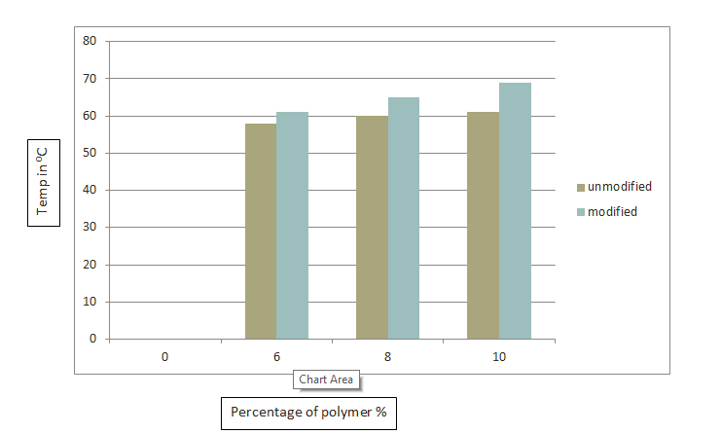
Softing test

Slide 24
results
Binder no | Modified clay % | Penetration in mm | Softing point in ⁰C
1 | 0% | 0 | 0
2 | 6% | 48 | 64
3 | 8% | 46 | 65
4 | 10% | 45 aspected | 68 aspected

Slide 25
Tensile strength test
The tensile stress values for all modified binders were increased with increasing clay content up to 8% compared with the control binder, while, the strain values for all modified binders were decreased with increasing polymer content up to 8% as compared with the control binder. Conclude that use of nano clay provide reinforcement in tensile strength properties of asphalt binder and increase the potential for low temperature cracking.
To addition of 6% and 8% nanoclay in bitumen decrease in strain failure 64% to 74% respectively and stiffness behavior of nanoclay produced bond chain within the binder that produced increases in toughness as increases percentage of nanoclay in asphalt binder.If nanoclay increased up to 10% compared with the controlled binder,the toughness and binding properties will be gain in asphalt.

Slide 26
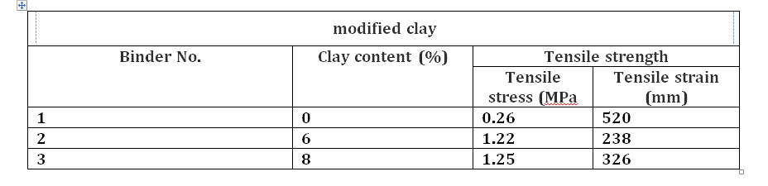

Slide 27
Benefits of nanoclay in asphalt
1.mprove the durability of asphalt pavements
2.Decrease maintenance requirements
3.Improve the properties of asphalt mixtures at low temperature
4.Save energy and cost

Slide 28
Limitation
1.Highly skilled labour for adding the nanoparticle in correct proportion to make mixture.
2. we have to modified the nano clay material for use in bitumen
3. Nano clay we should not use at it is , because pavement will be some failures

Slide 29
CONCLUSION
The use of advanced nanotechnology material in flexible pavement for reduction of failure in pavement.
In india no more use of nanotechnological material in pavement .for advancement in construction of road adopt new type of construction
It was easily available in india .
The more durable road can be construct in india and cost reduction also .
The decrease in penetration value is 25% compared with the control binder.

