Slide 1
JS Apps Team "Watchmen"

Slide 2
Introduction
Search a city
Get the weather forecast
Don’t walk out of your home unprepared ☺
Detailed weather forecast around the world in seconds

Slide 3
Introduction
Register to have full access to the app
Login to have access to your profile
Enjoy the weather ☺
Detailed weather forecast around the world in seconds

Slide 4

Weather app
Live demo

Slide 5
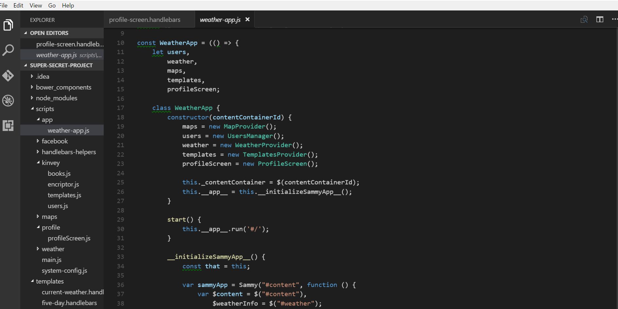
How we did it?
Used Kinvey
Used Handlebars
Used Bootstrap
Used Sammy.js
Used jQuery
Used Mocha and Chai

Slide 6
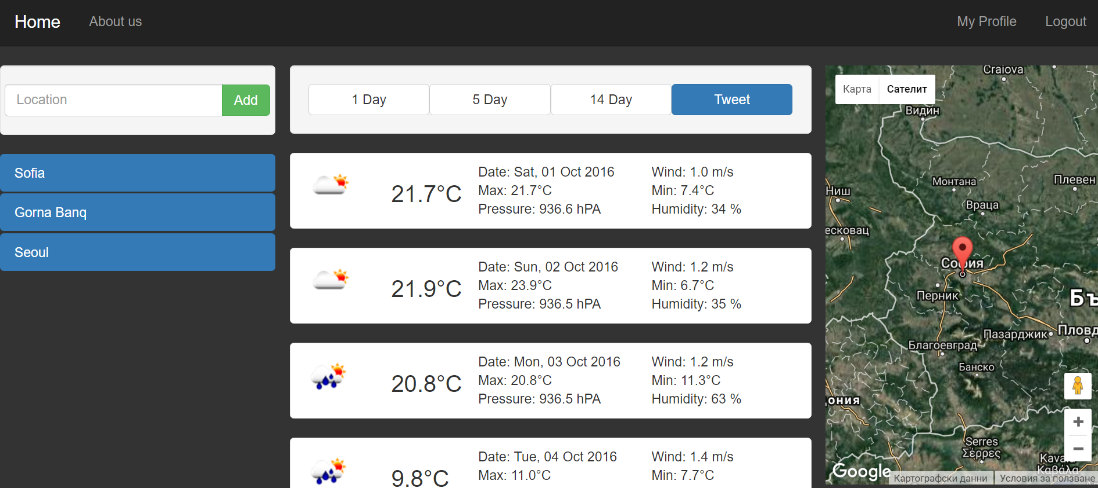
How we did it?
Best practices of high-quality code followed (naming, modules, strong cohesion, loose coupling)
OOP Design (objects, modules, data hiding)
Possible sharing to social media
Used GIT
Hosted on
http://team-watchmen.herokuapp.com/#/

Slide 7
Source code
Click me

Slide 8
Thanks!
Any questions?

