Slide 1


Quick Reaction

Slide 2
1
Why?
2
How?
목차
3
Table of Contents
What’s different?
4
And?

Slide 3

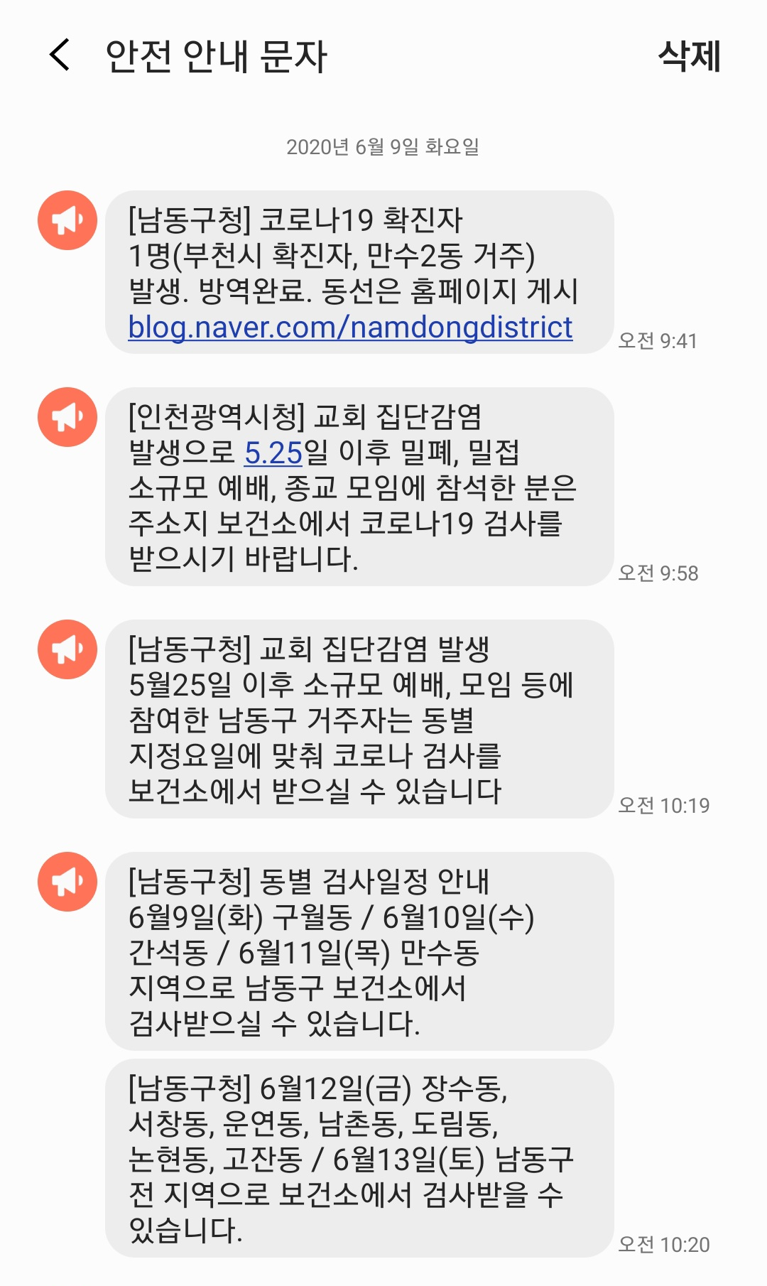
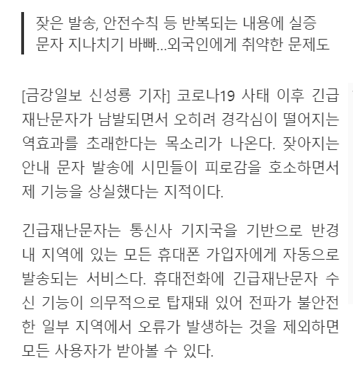
Why?

Slide 4
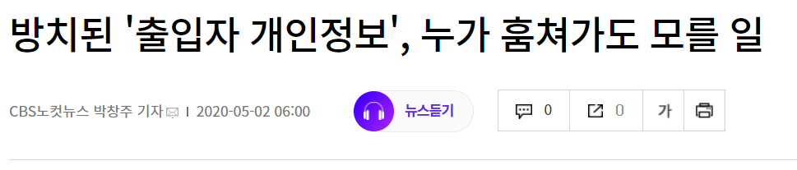
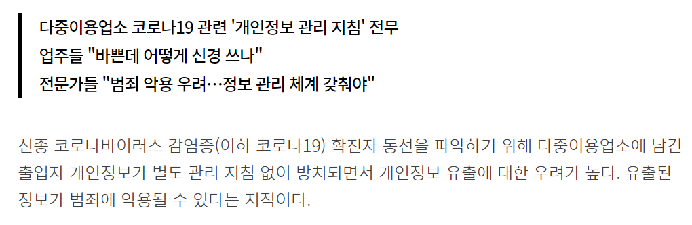
Why?

Slide 5
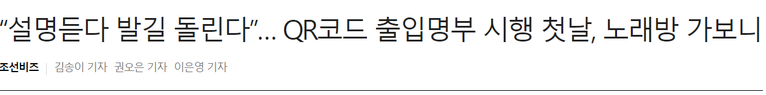
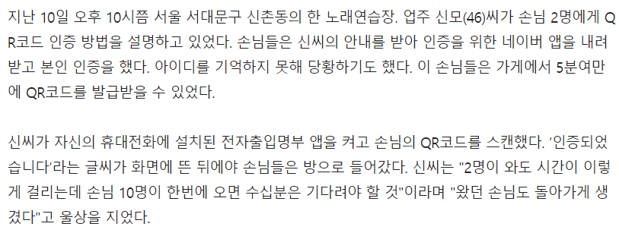
Why?

Slide 6

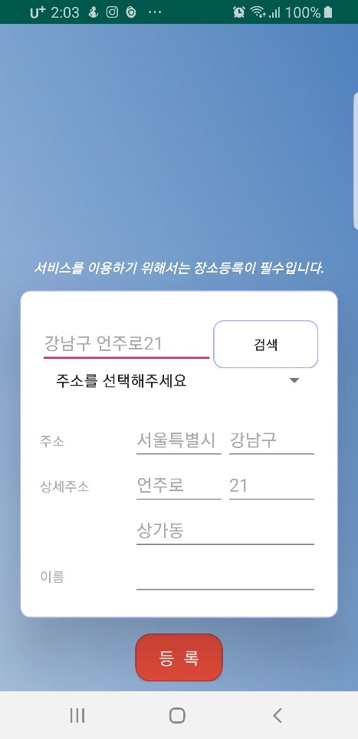

How?

Slide 7
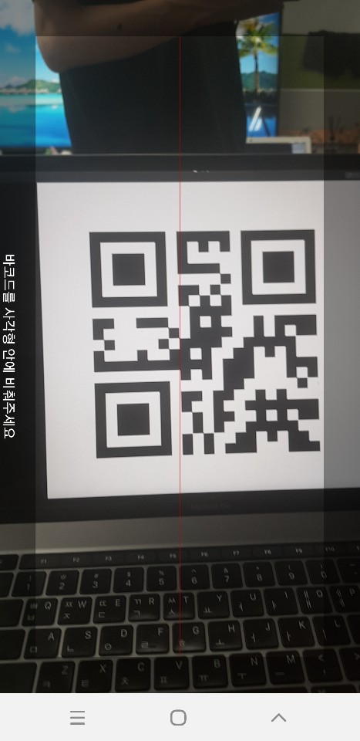
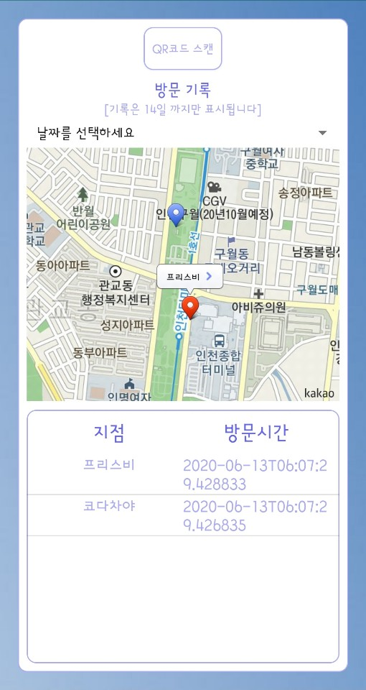
How?

Slide 8
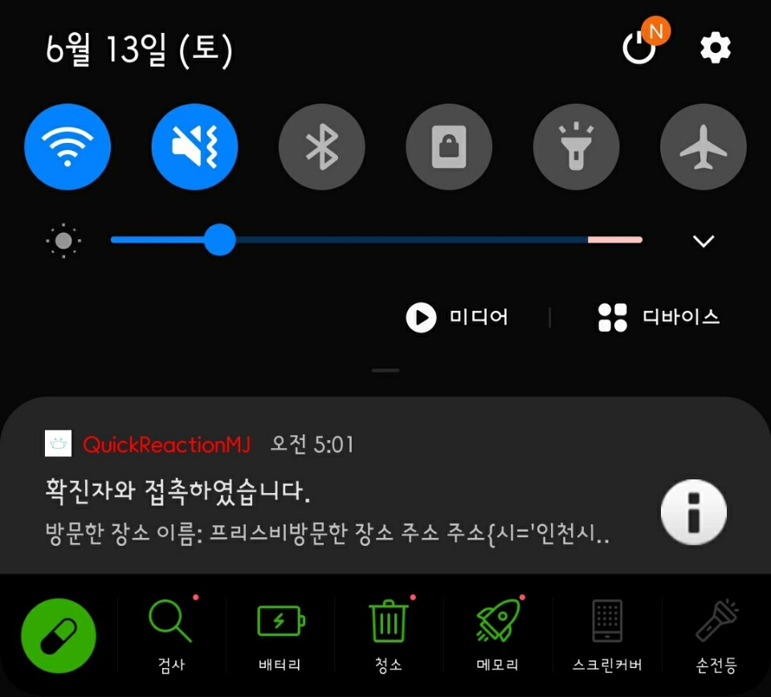
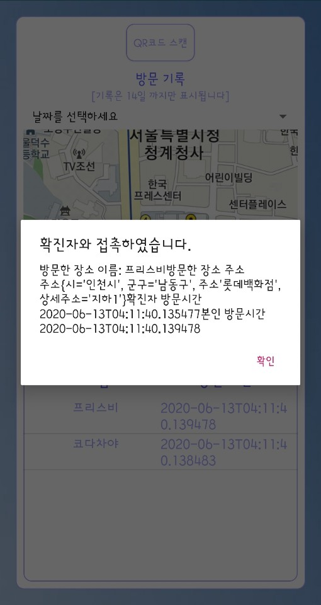
How?

Slide 9





How?
-
-
-
-

Slide 10
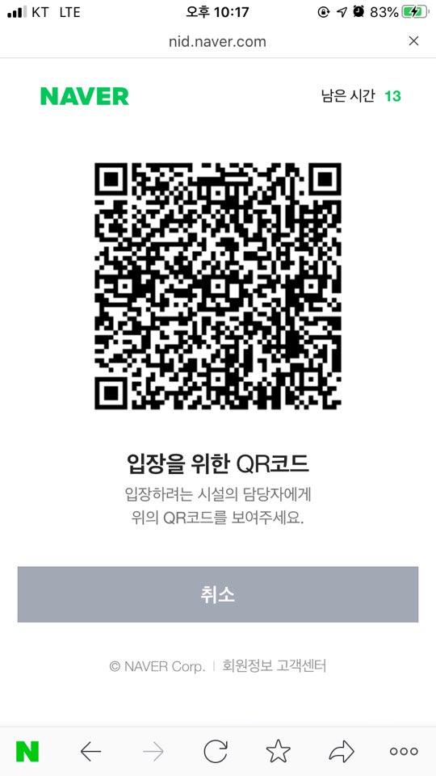

What’s different ?
장소의 QR코드를 입력해주세요

Slide 11
And?
모든 사람이
필수 기능을
&
어렵지않게
넘어

Slide 12

Thanks

