Slide 1
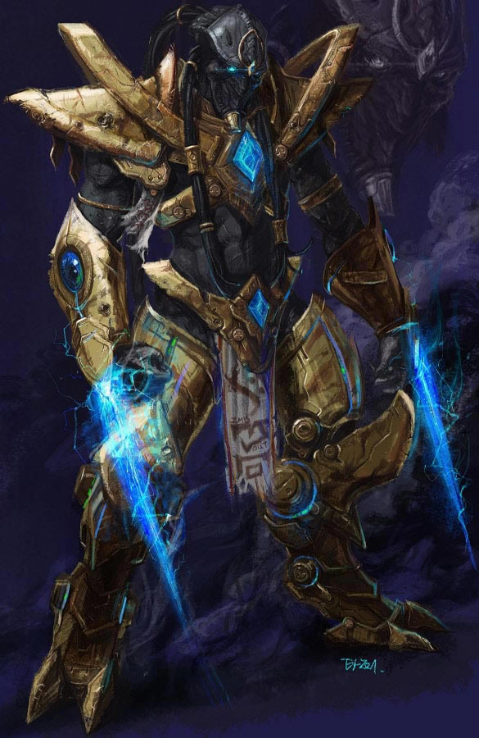
Team Zealot

Slide 2
Team members
Ивайло Ботушаров (encounter)
Крум Тюкенов (Overon)
Мартин Николов (martin.nikolov)
Тодор Вягов (RANOPILE)
Янко Ванов (IankoVanov)
TEAM ZEALOT

Slide 3
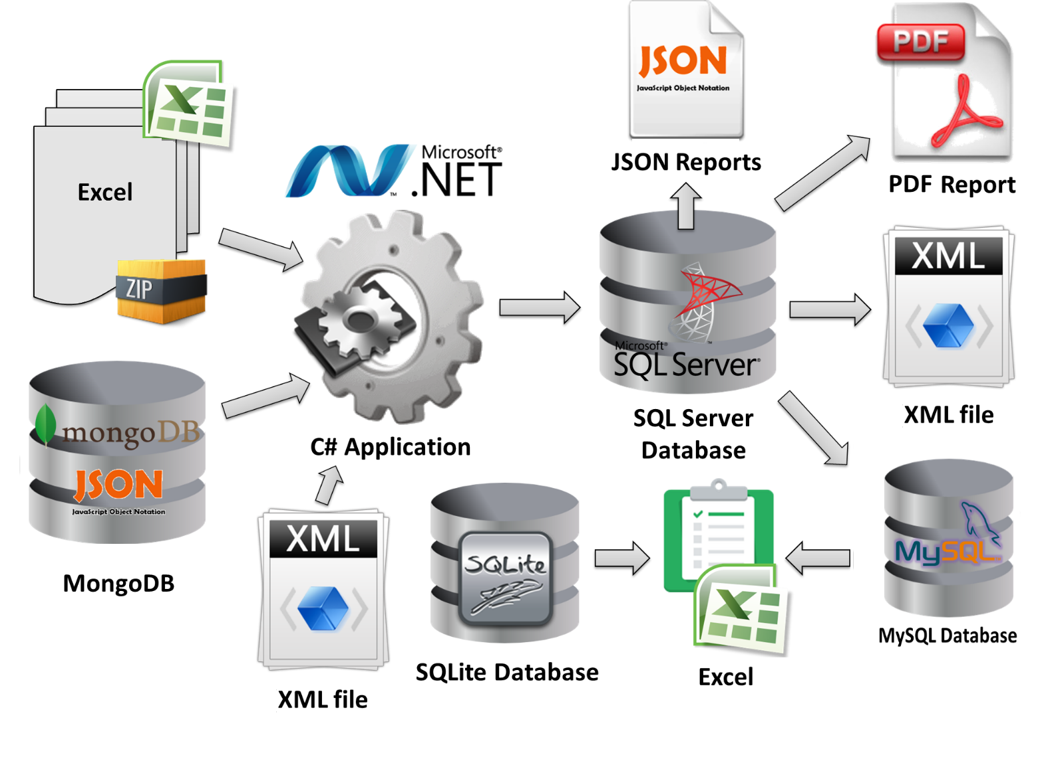

Slide 4
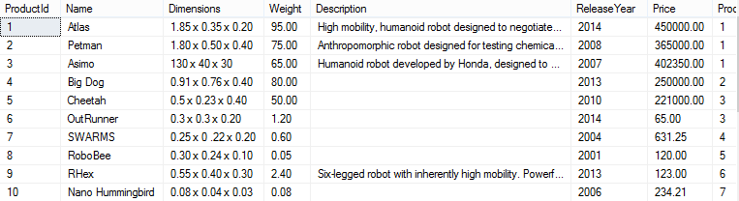
Project Contents
The server contains the following data:
Robots with characteristics. Each robot has its own type to show main purpose of robot.
Manufacturers, Stores, Sales reports

Slide 5
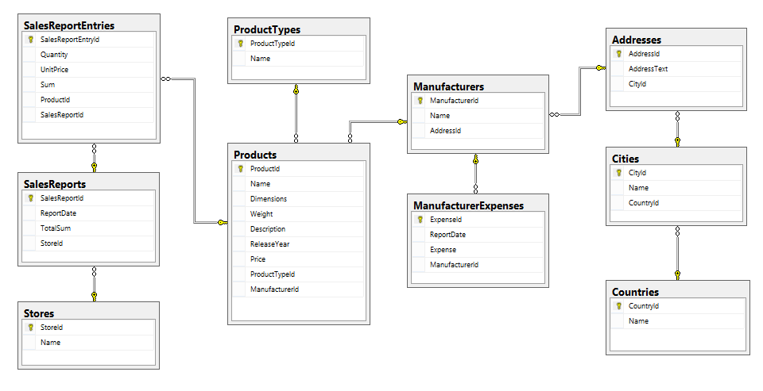
Database schema

Slide 6
Common Design patterns
Repository pattern
Uow – RobotsFactoryData
Factory – XML, Excel, Json, Pdf generators
Etc.
Code first and Database first approaches
MongoDb and MySQL are up in cloud.

Slide 7
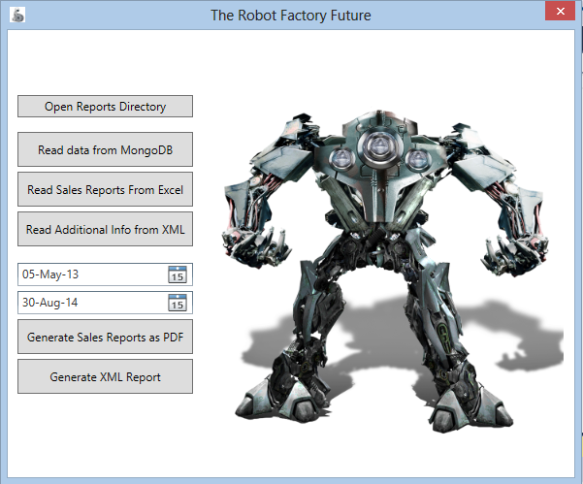
The project consists of several logically divided projects. It also provides
console and WPF clients.

Slide 8
GitHub:
https://github.com/Team-Zealot-Databases

