Slide 1
Car sharing Eco-system
INFO 5100 APPLICATION ENGINEERING AND DEVELOPMENT FINAL PROJECT

Slide 2
Why Need The Eco-system
Use idle cars
Convenience for people have no car
Unemployed can become drivers

Slide 3
WorkAreas
Company
Driver
Lessee
Lessor
System Admin

Slide 4
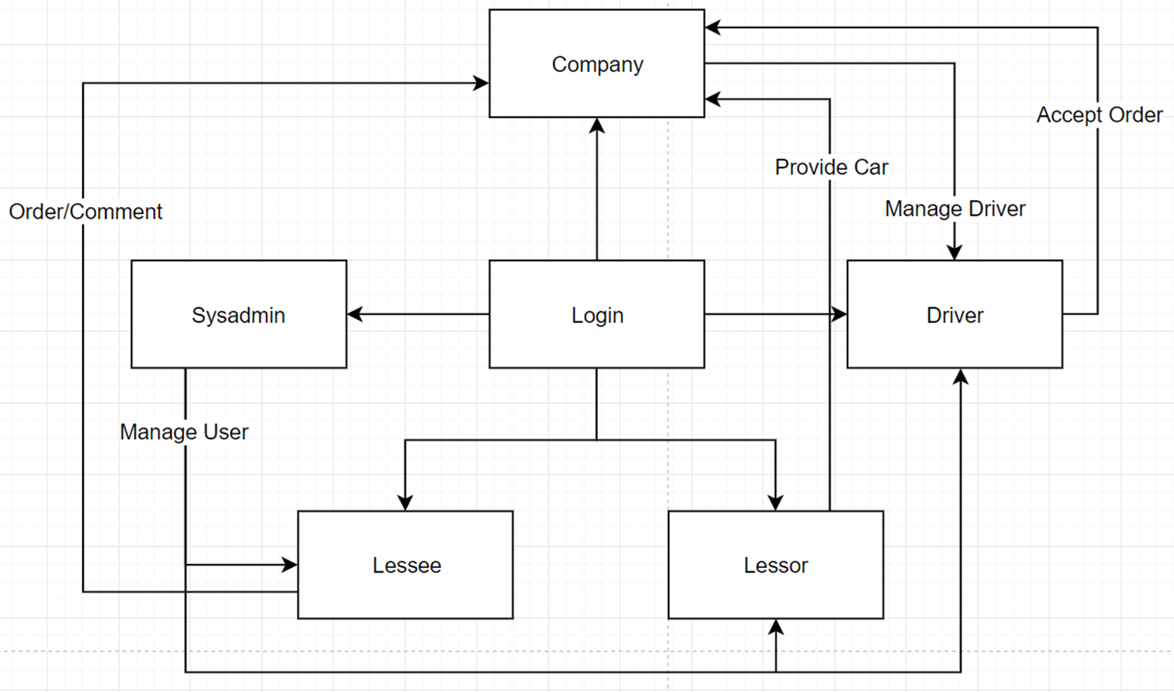
Overview

Slide 5
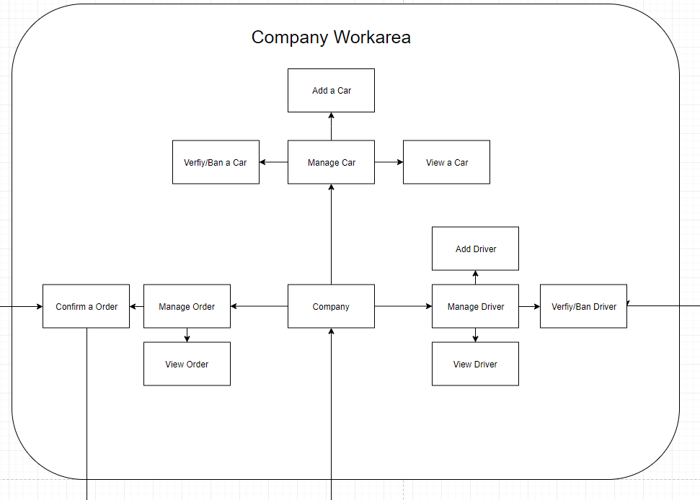
Company

Slide 6
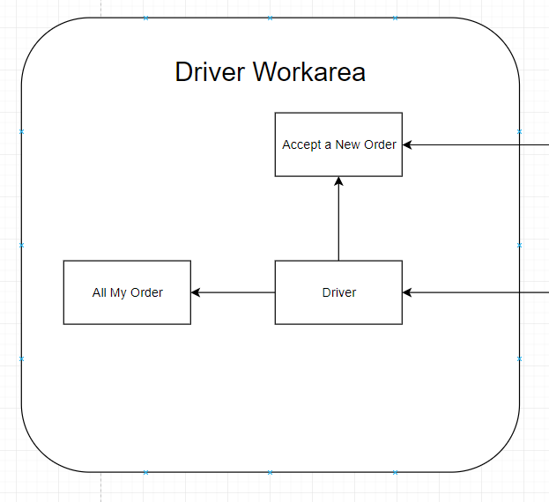
Driver

Slide 7
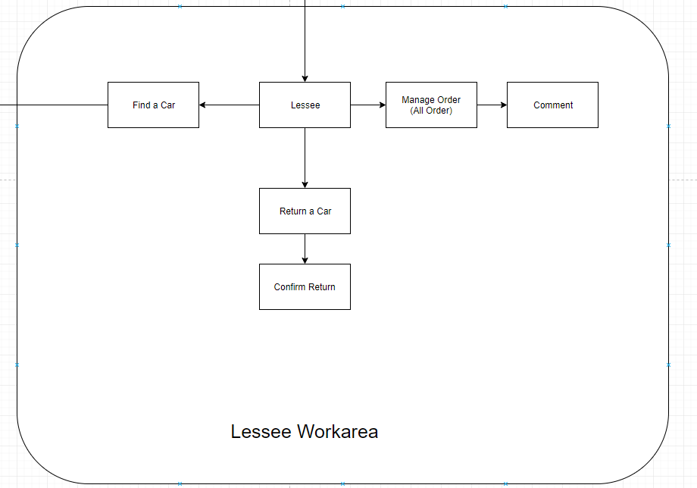
Lessee

Slide 8
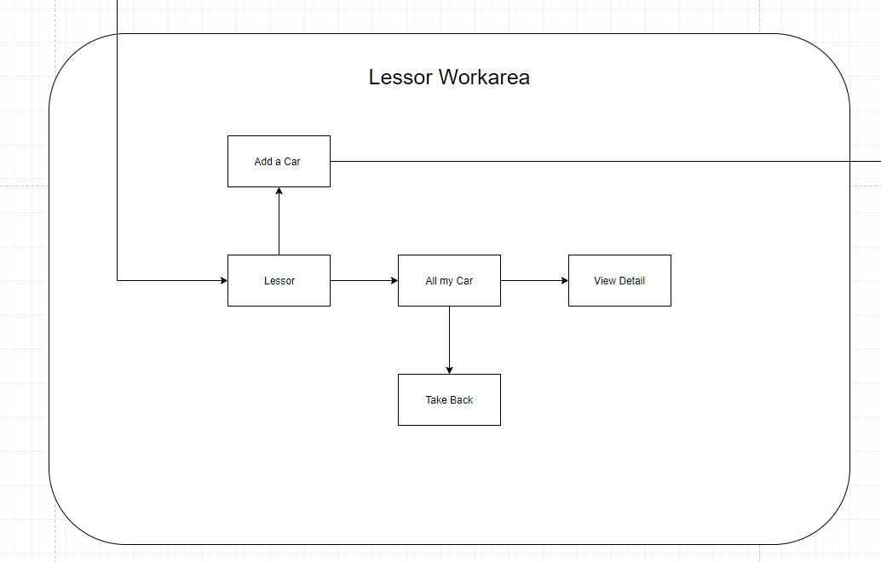
Lessor

Slide 9
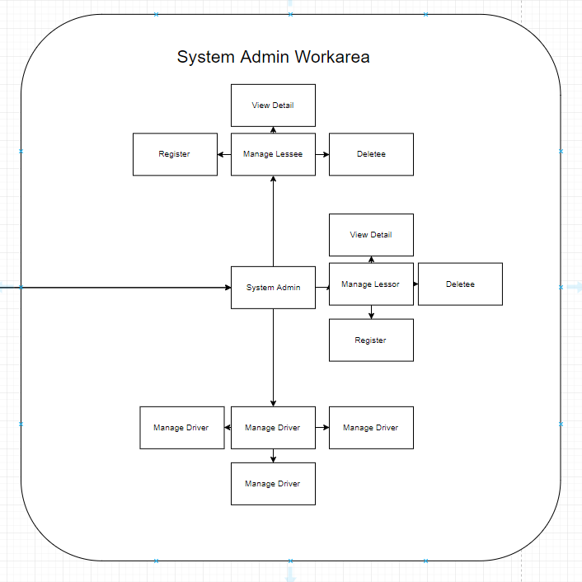
System Admin

Slide 10
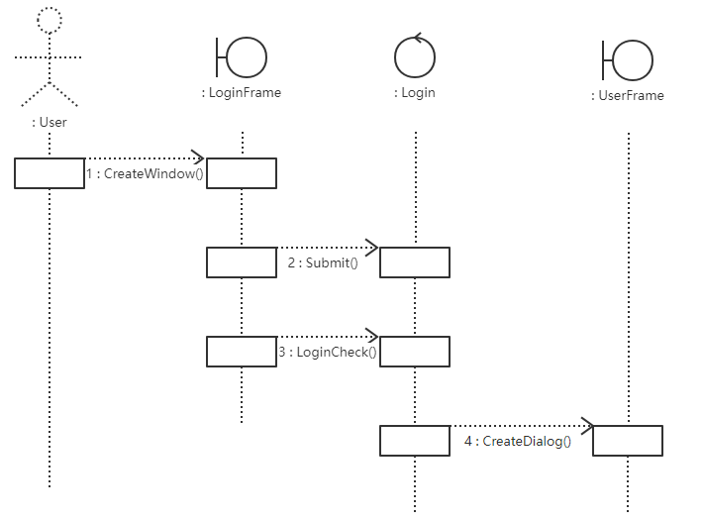
Sequence Chart: Login

Slide 11
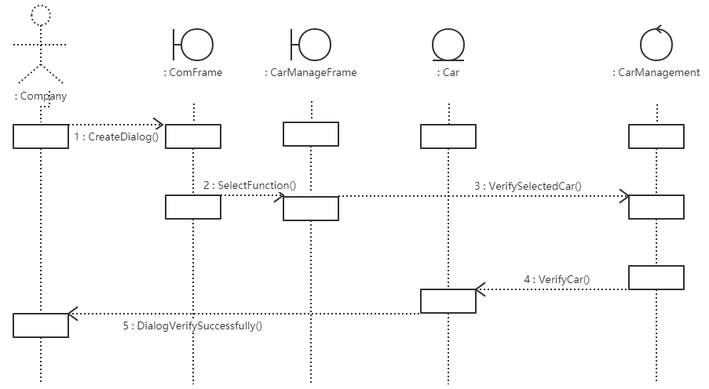
Sequence Chart: Verify

Slide 12
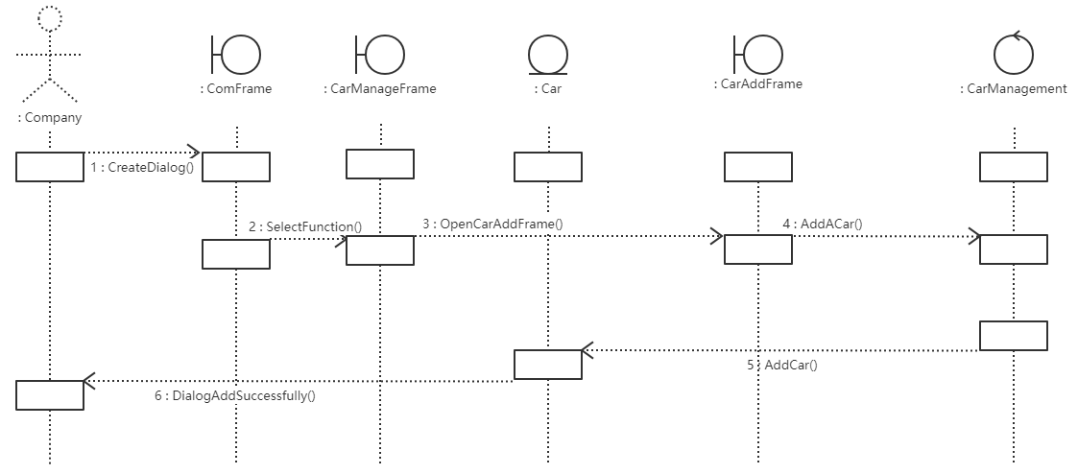
Sequence Chart: Add

Slide 13
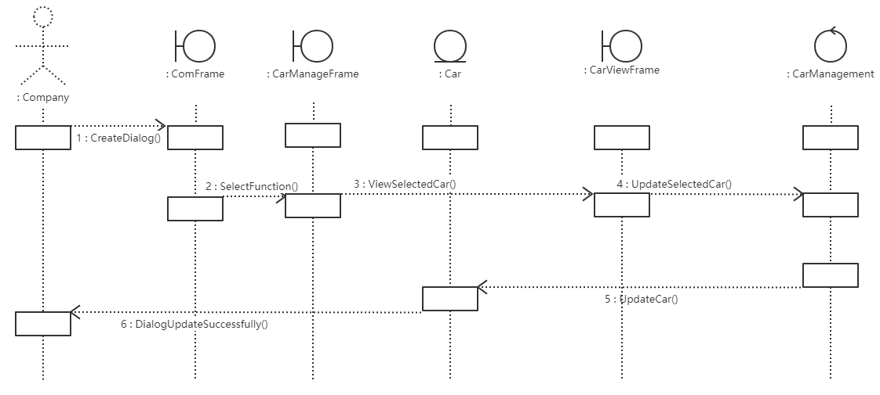
Sequence Chart: View

Slide 14
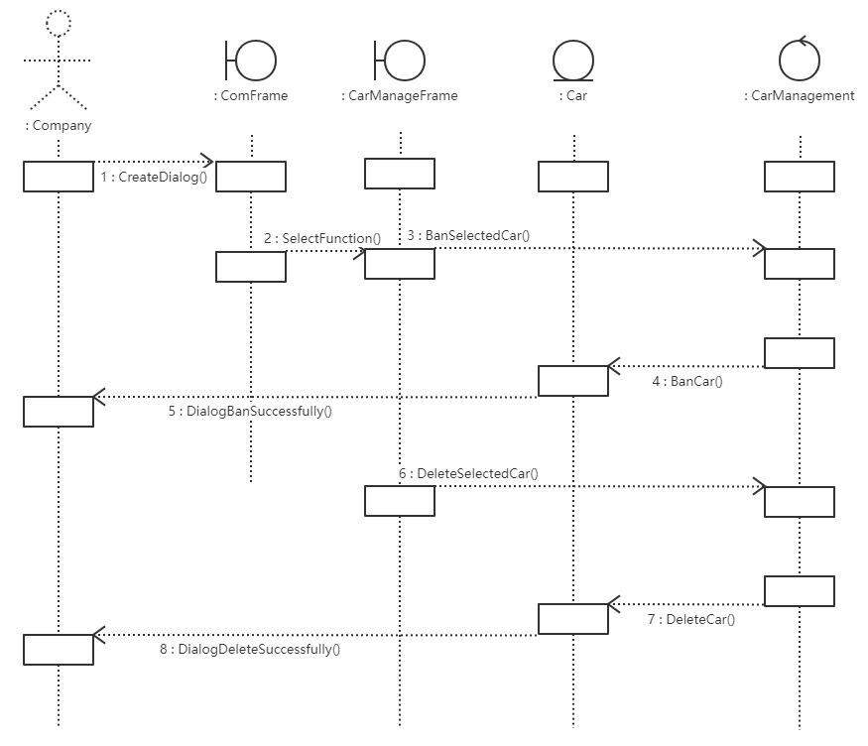
Sequence Chart: Ban or Delete

Slide 15
Thank you

