Slide 1
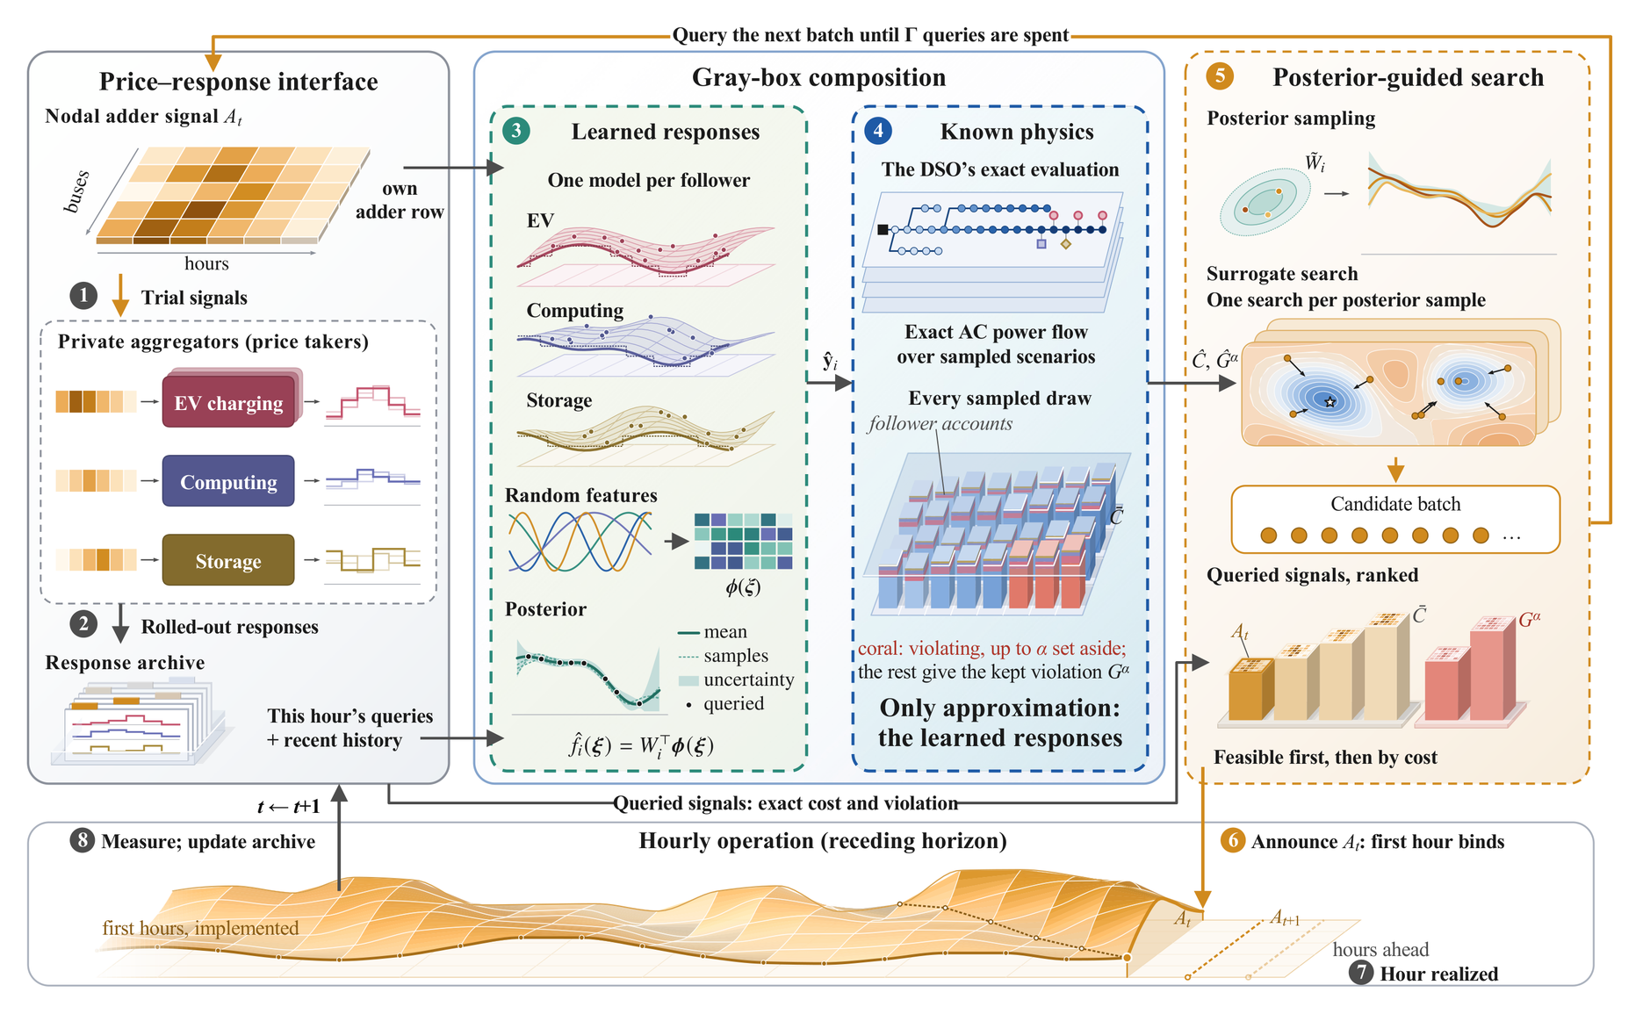
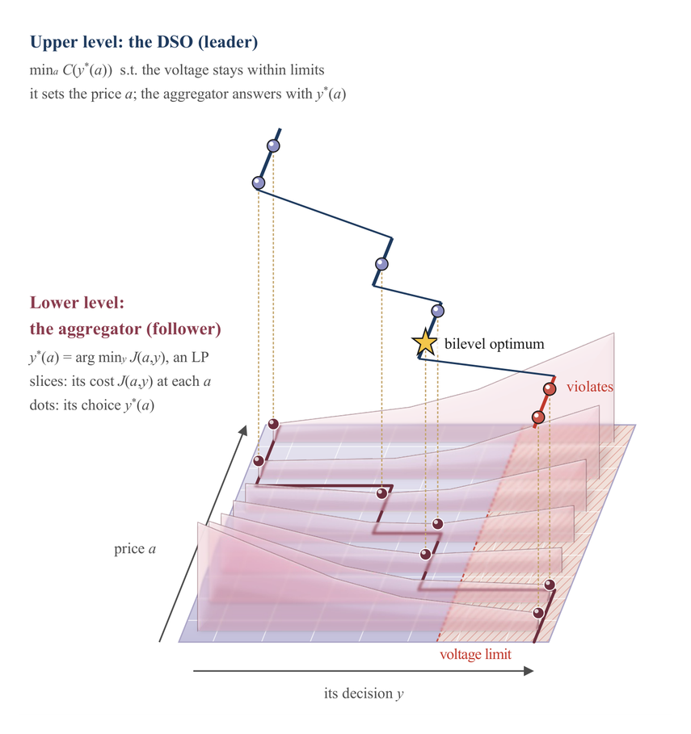
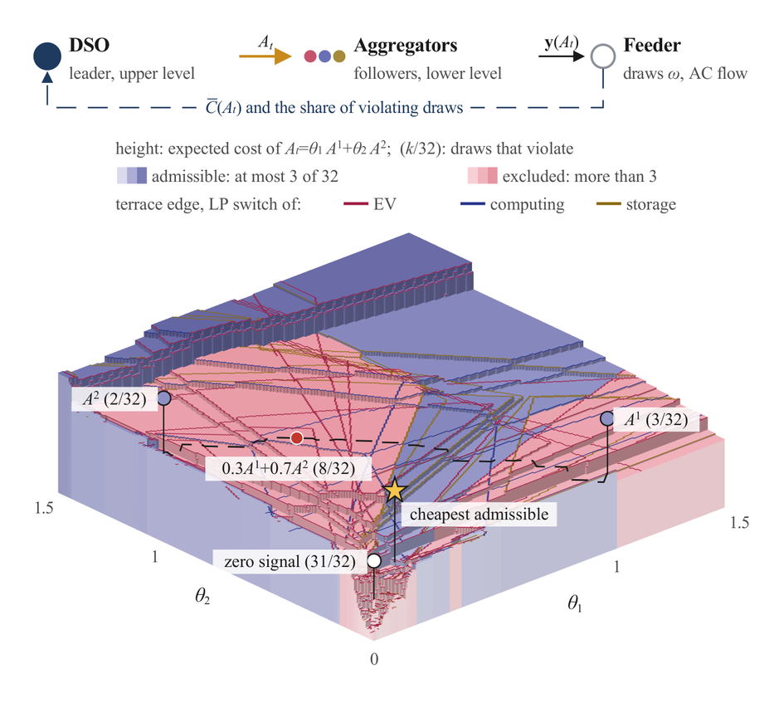
Drawing research
figures with AI
01
Generate many styles
02
Pick one
03
Draw components in Python
04
Assemble with python-pptx

Slide 2
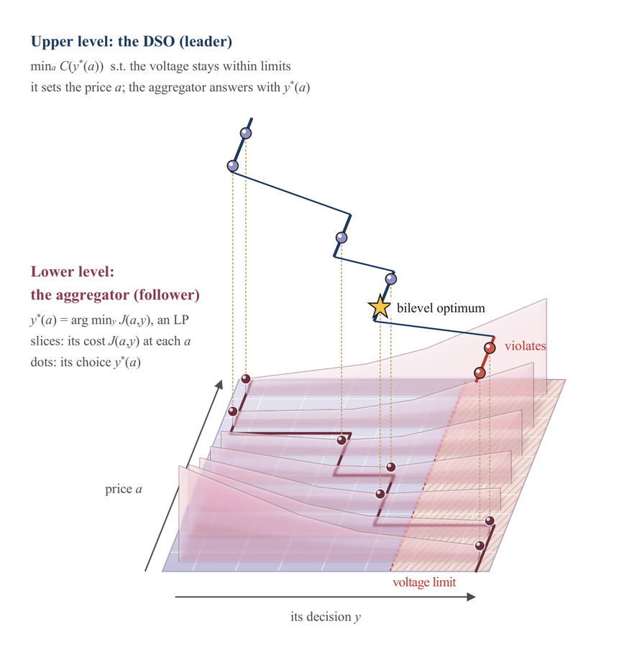
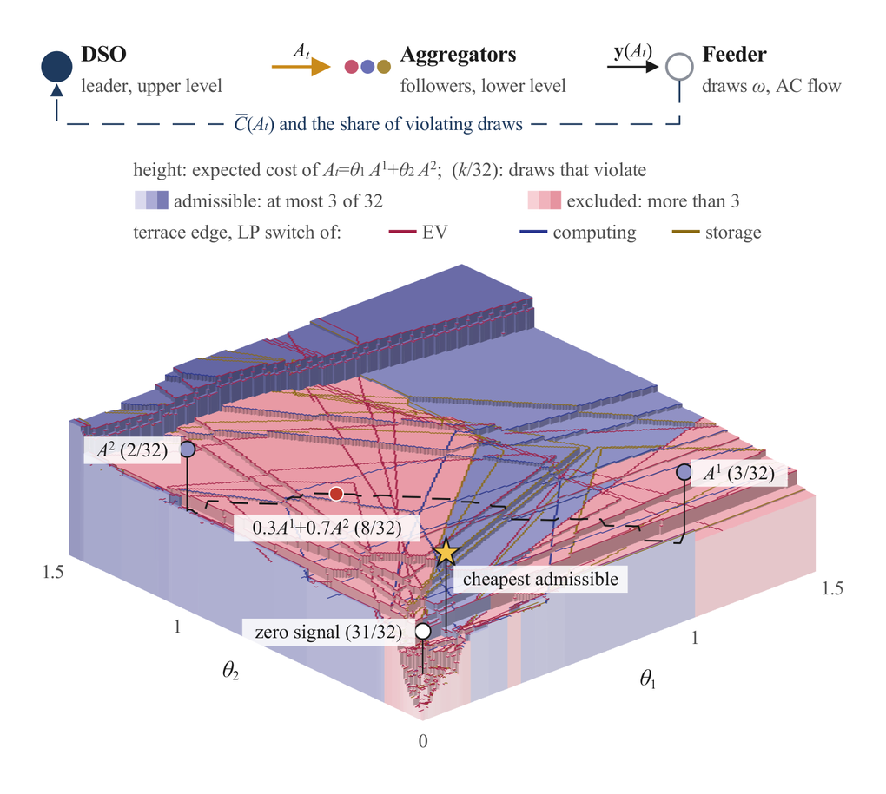
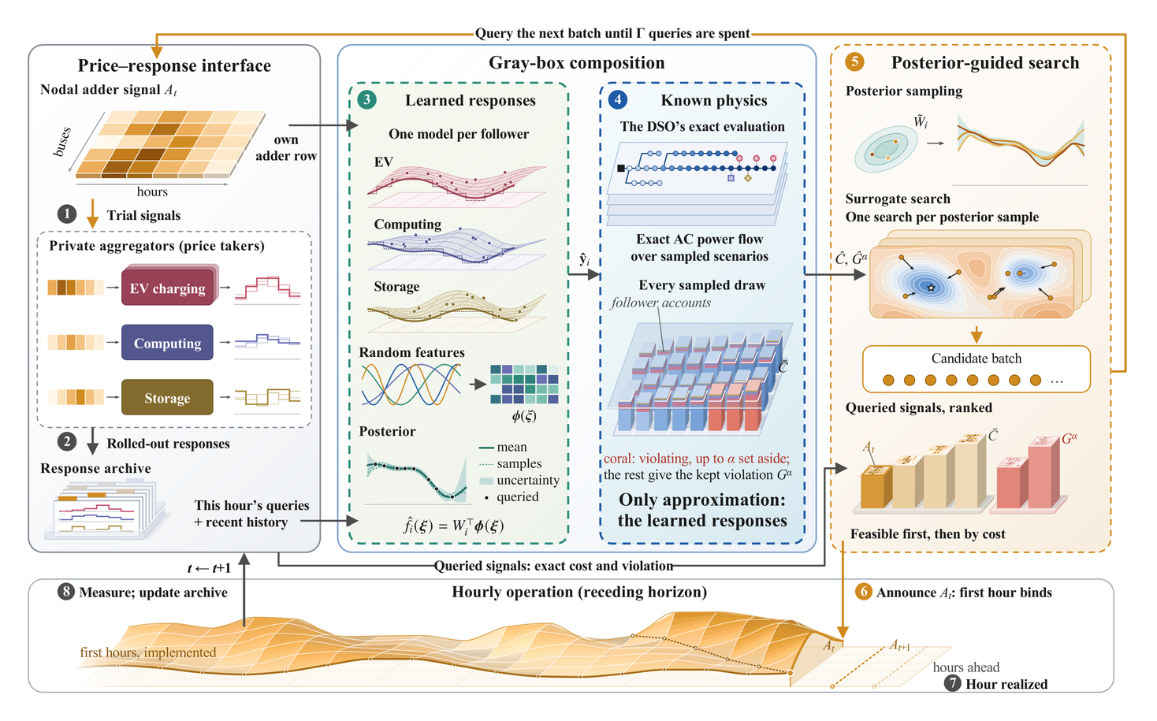
Three schematic figures, all drawn with code
Fig. 1 Bilevel structure
Fig. 2 Decision landscape
Fig. 3 Method framework
2

Slide 3
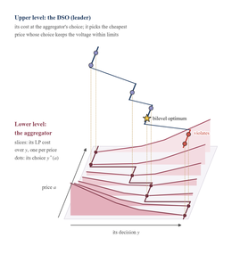
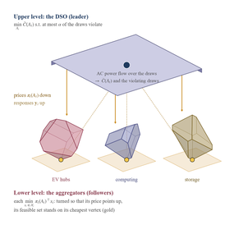

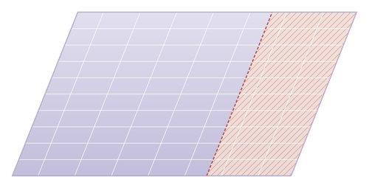
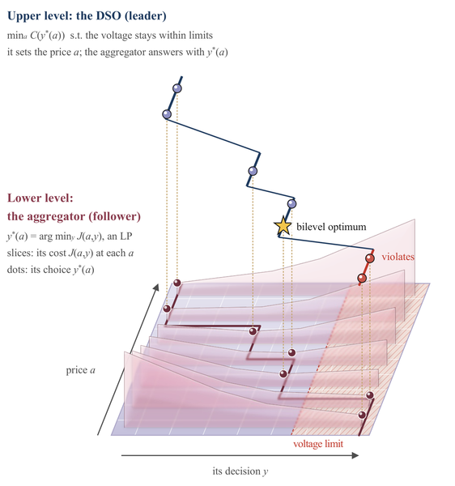
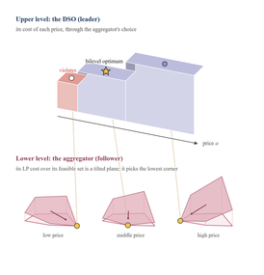
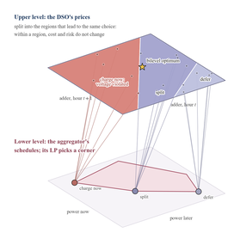
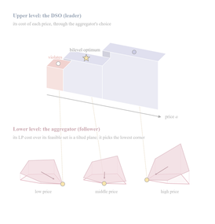

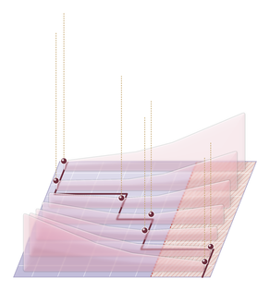
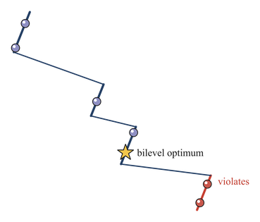
Four steps to one schematic figure
Example: Fig. 1
Step 1
Step 2
Step 3
Step 4
Generate many styles
Pick one
Draw components
in Python
Assemble with
python-pptx
Ask the AI for 3–7 versions, as different as possible
Say what you like about one; if you can't, let the AI offer options
Split it into small components, one piece of code each
Put them on a paper-sized slide as one editable figure
The AI draws and writes the code; you choose and ask for changes
3

Slide 4
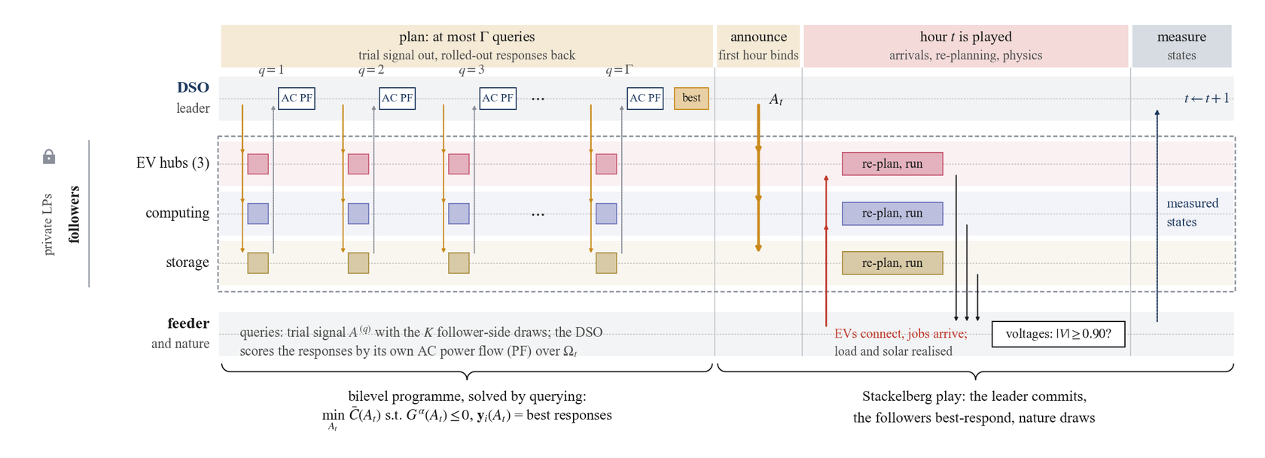
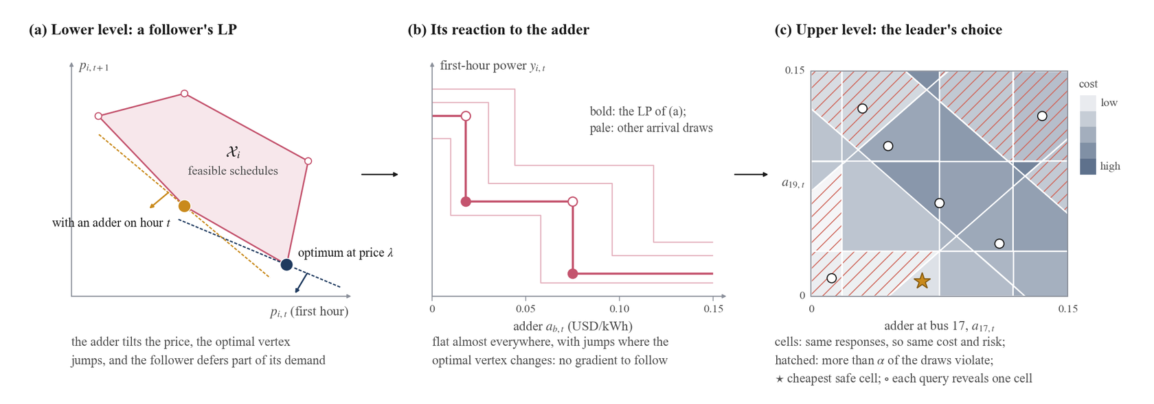
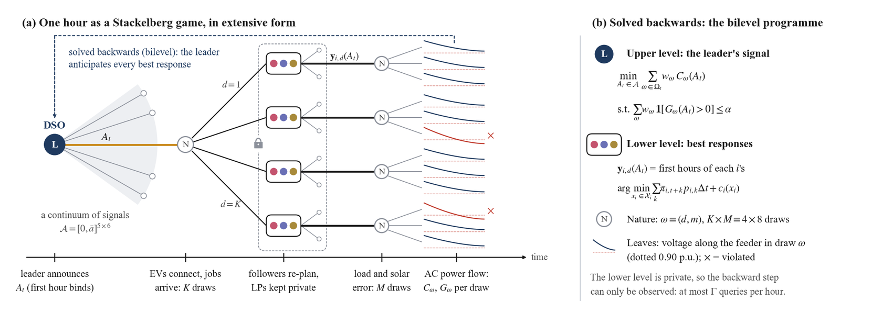
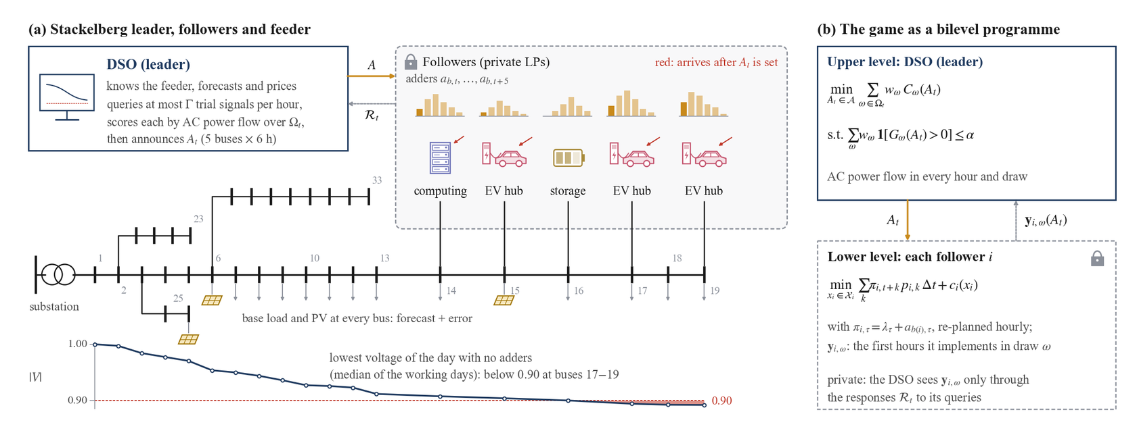
01
Generate many styles
Ask the AI for several versions
in very different styles at once,
and compare them side by side

Slide 5
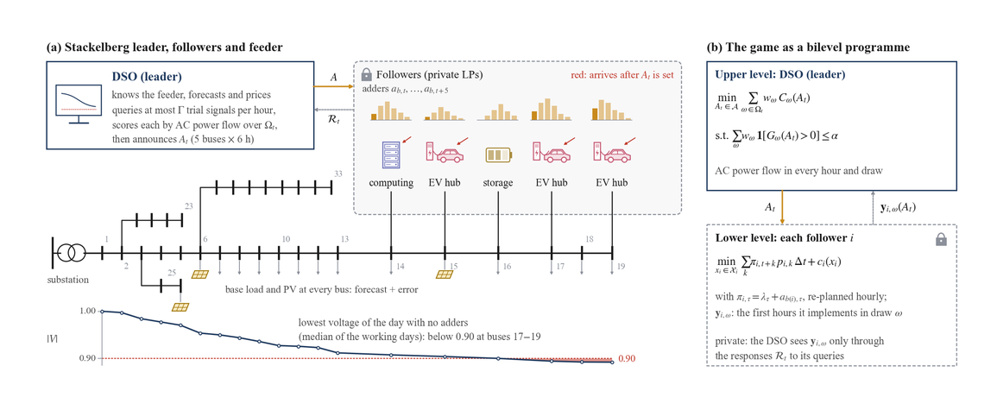
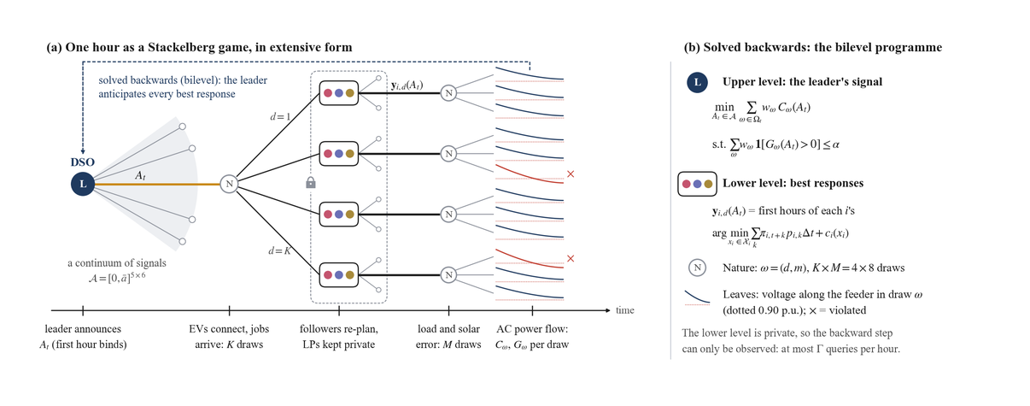
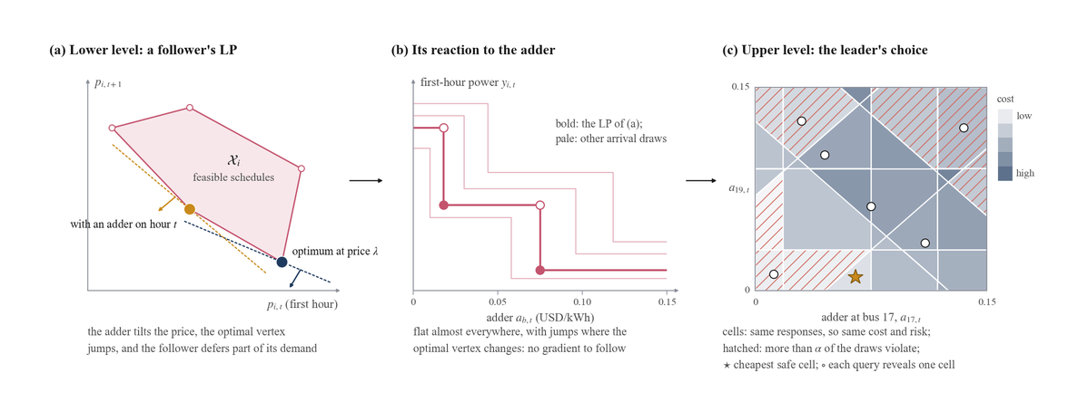
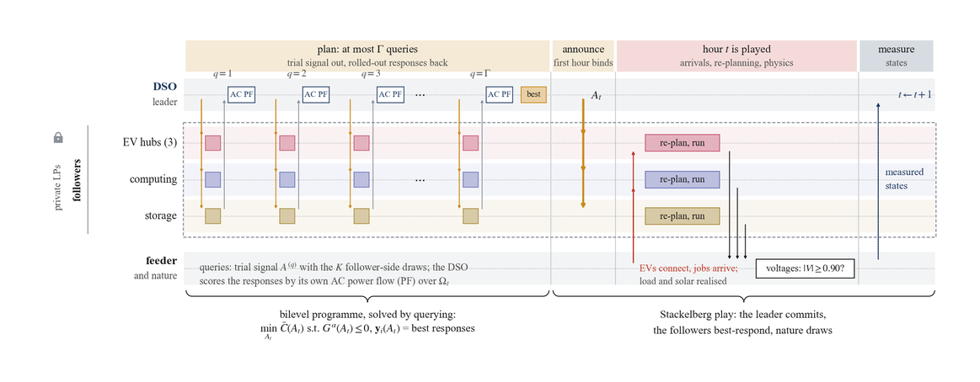
Step 1 · Generate many styles
Four versions at once, in clearly different styles
Fig. 2, round 1: the same problem drawn in four completely different ways
A
B
“Still looks a bit simple…
could you give me a few more
versions to choose from?”
C
D
The AI's four versions
A Engineering diagram
B Game tree
C Math structure
D Timeline swim lanes
5

Slide 6
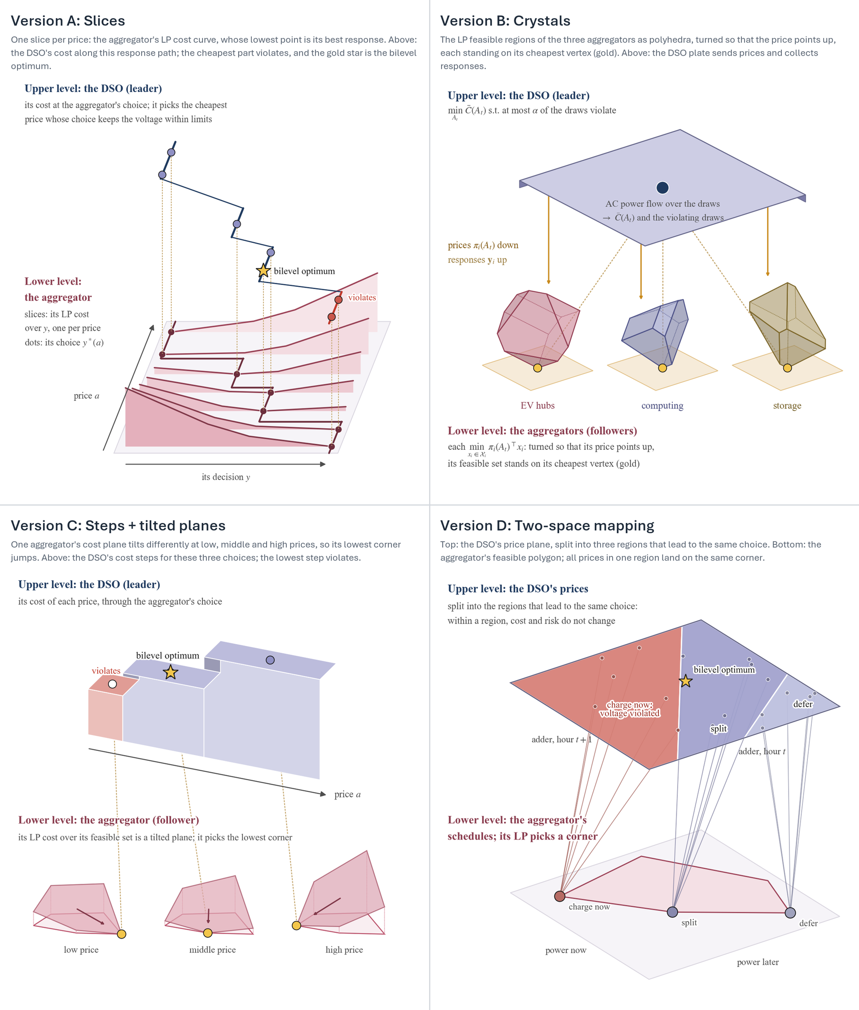
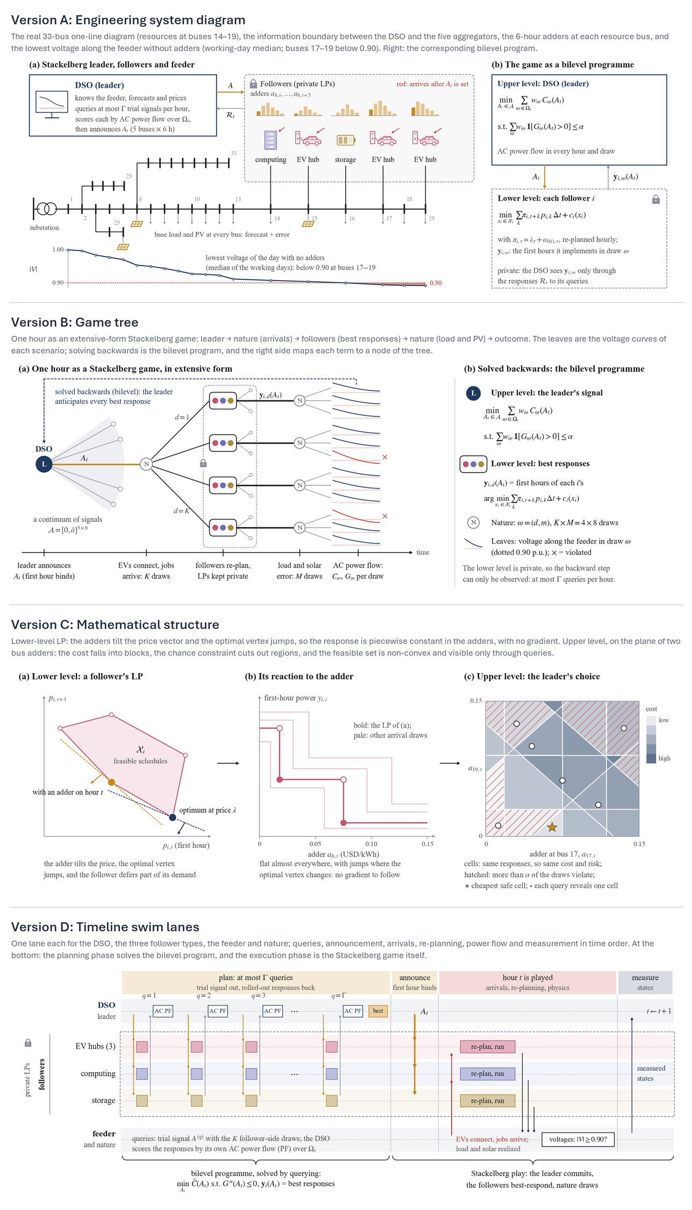
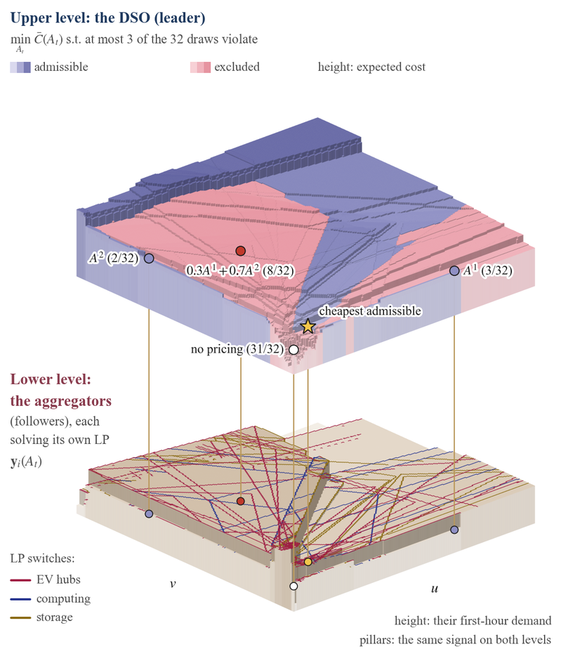
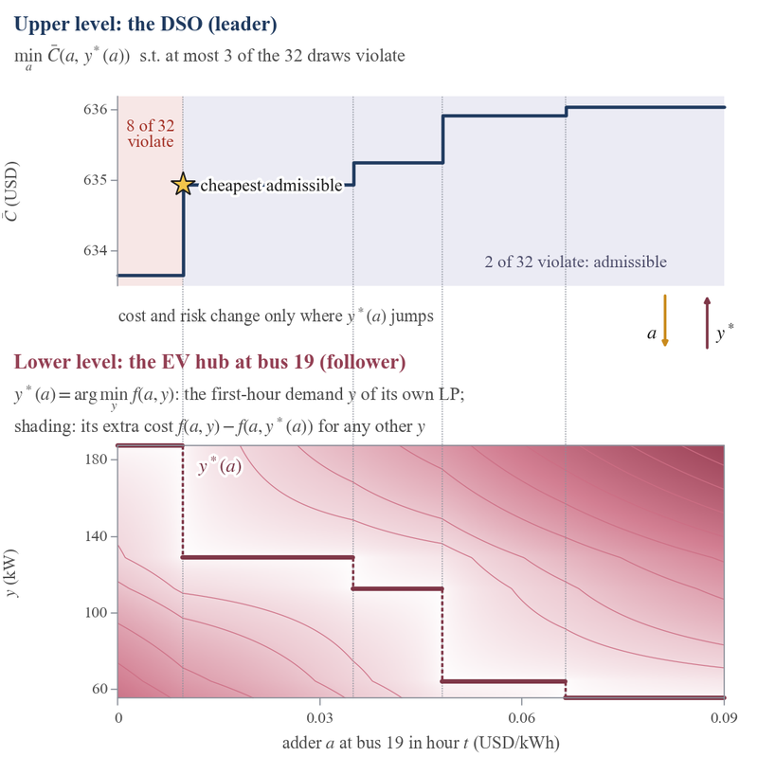

Slide 7
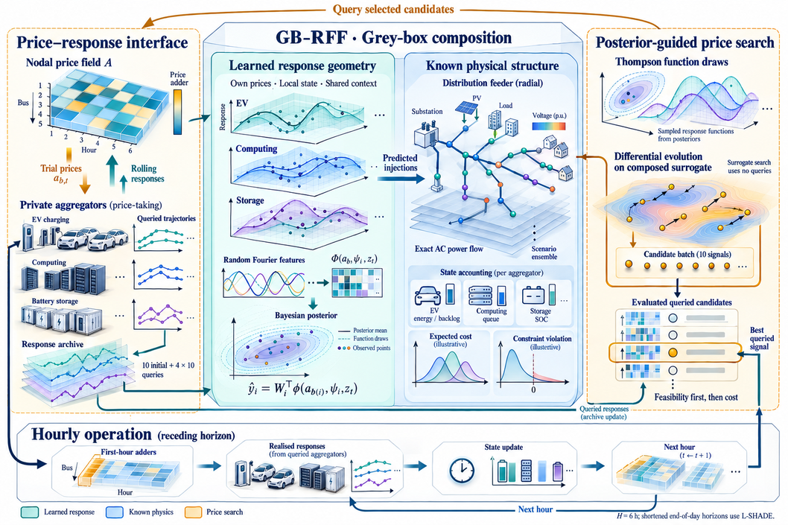
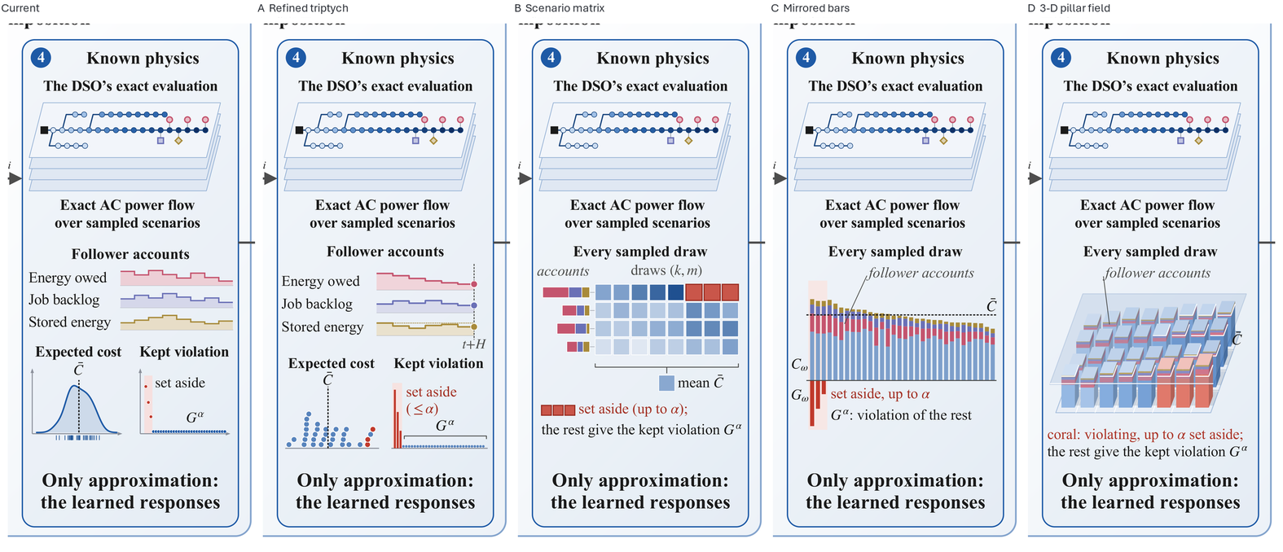
Step 1 · Generate many styles
Two ways to get styles: images, or drafts drawn by code
AI draws images
for finding a direction
AI writes code for drafts
for final figures
Several images in seconds; good for a feel
The chosen draft is already code to keep editing
Details are off, and text is often garbled
Sizes and fonts match the paper from the start
Journals rarely accept them; reference only
Slower than drawing images
Approach: images first to find a feel, then code for a few proper drafts
7

Slide 8
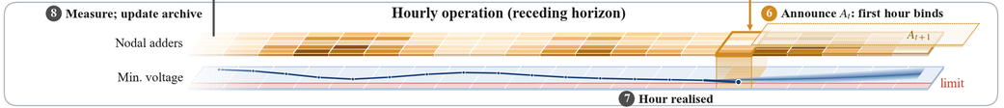
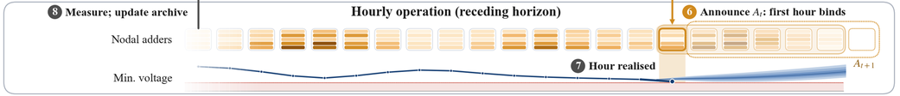
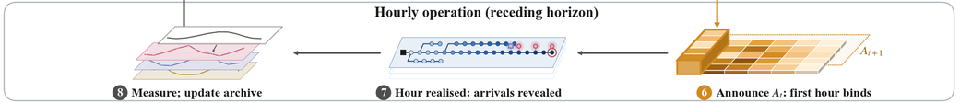
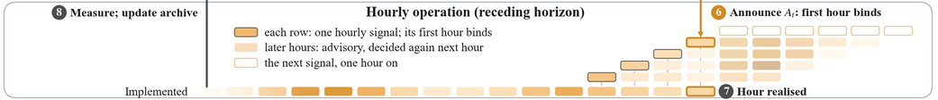
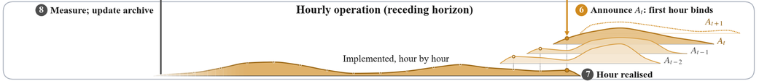
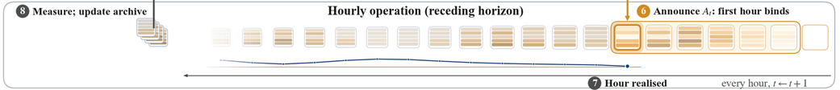
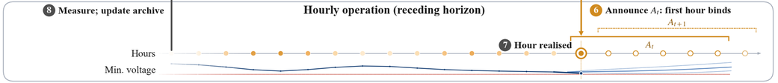
Step 1 · Generate many styles
Not satisfied? Keep asking
The band at the bottom of Fig. 3: three versions were not enough, so it went to seven
“It still doesn't look very good”
Round 1 · 3 versions
A
Layered 3-D
→ The AI offered three directions: layered 3-D, flat and simple, step by step
B
Flat and simple
“Make a few more styles, then I'll choose”
C
Step-by-step
Round 2 · 4 more
→ The AI added 4 more: 7 in total (A–G)
D
Textbook staircase
“They all look pretty ordinary”
E
Ridge line
F
Card conveyor
→ The AI stopped guessing and asked what feel you want (step 2)
G
Minimal line art
8

Slide 9
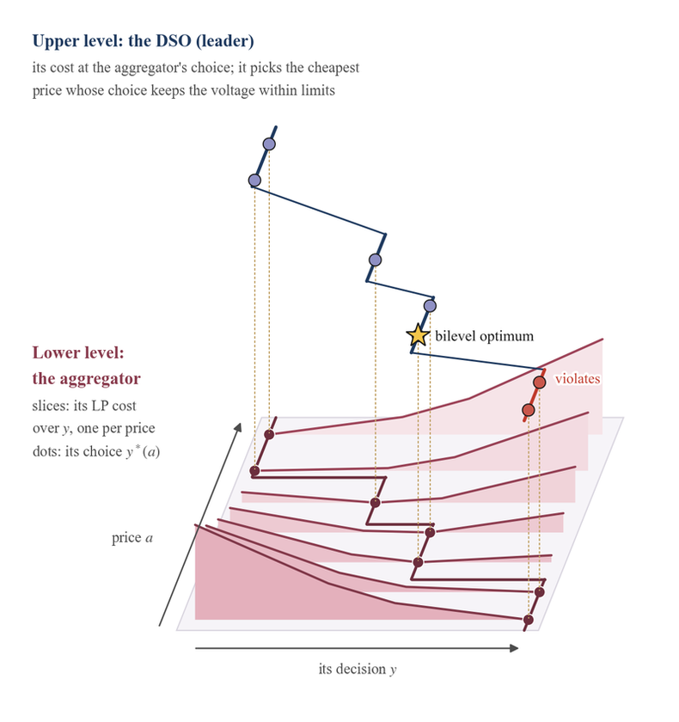
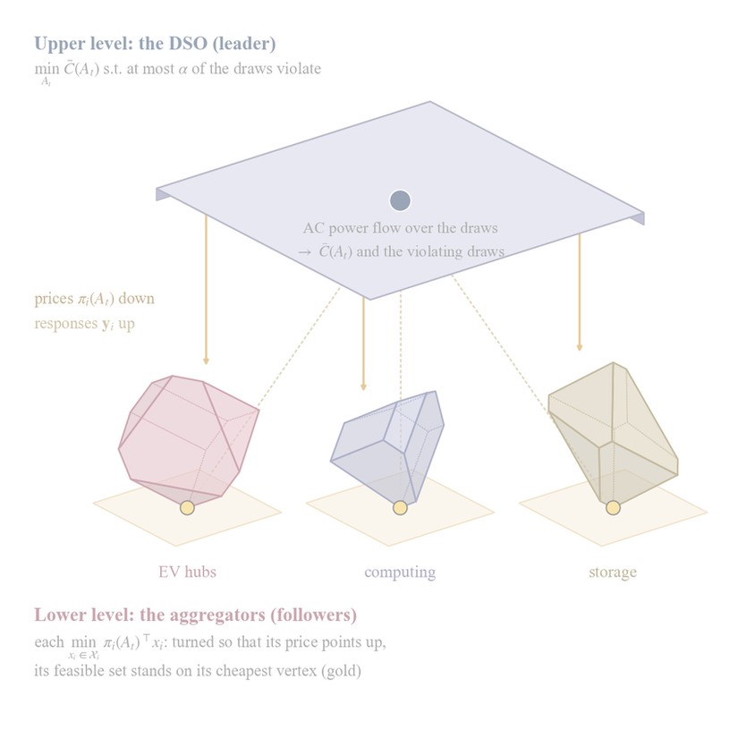
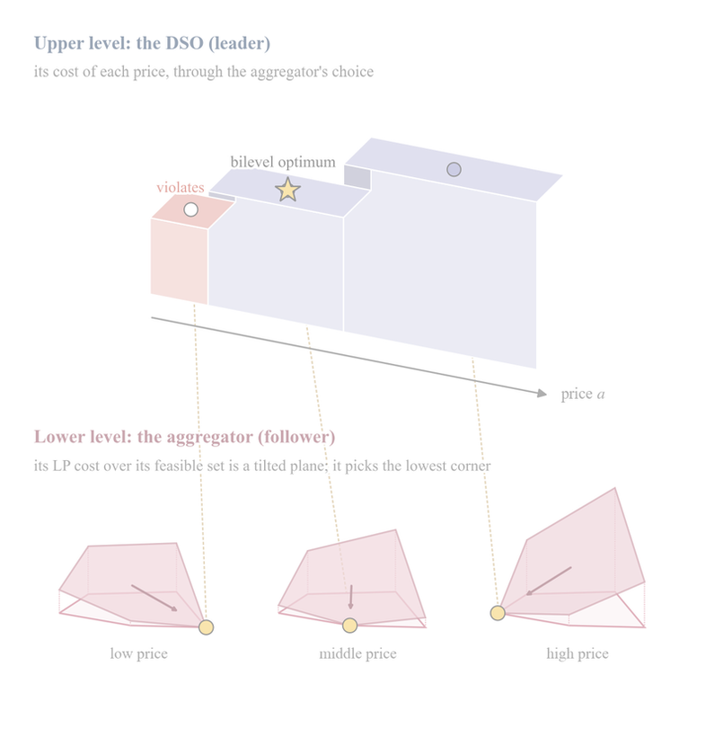
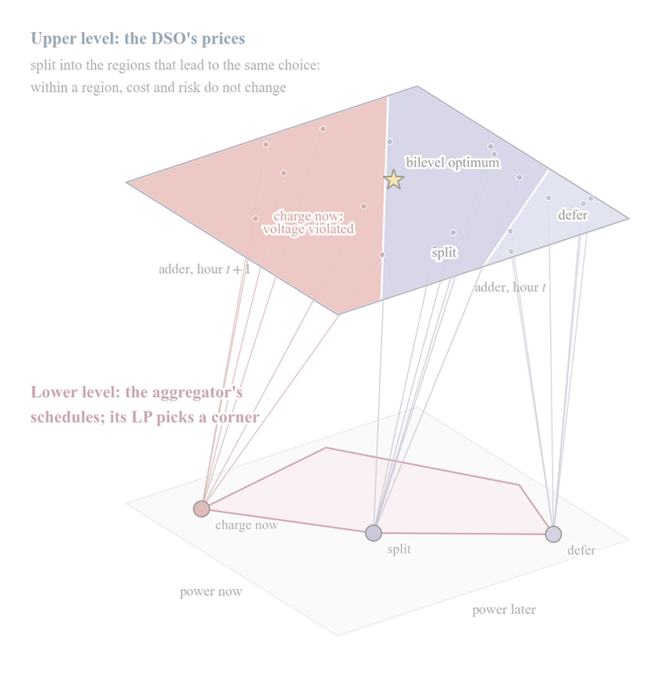
Chosen
02
Pick one
Ask yourself four questions;
if you can't say what you want,
let the AI offer options, or give
it a reference image

Slide 10
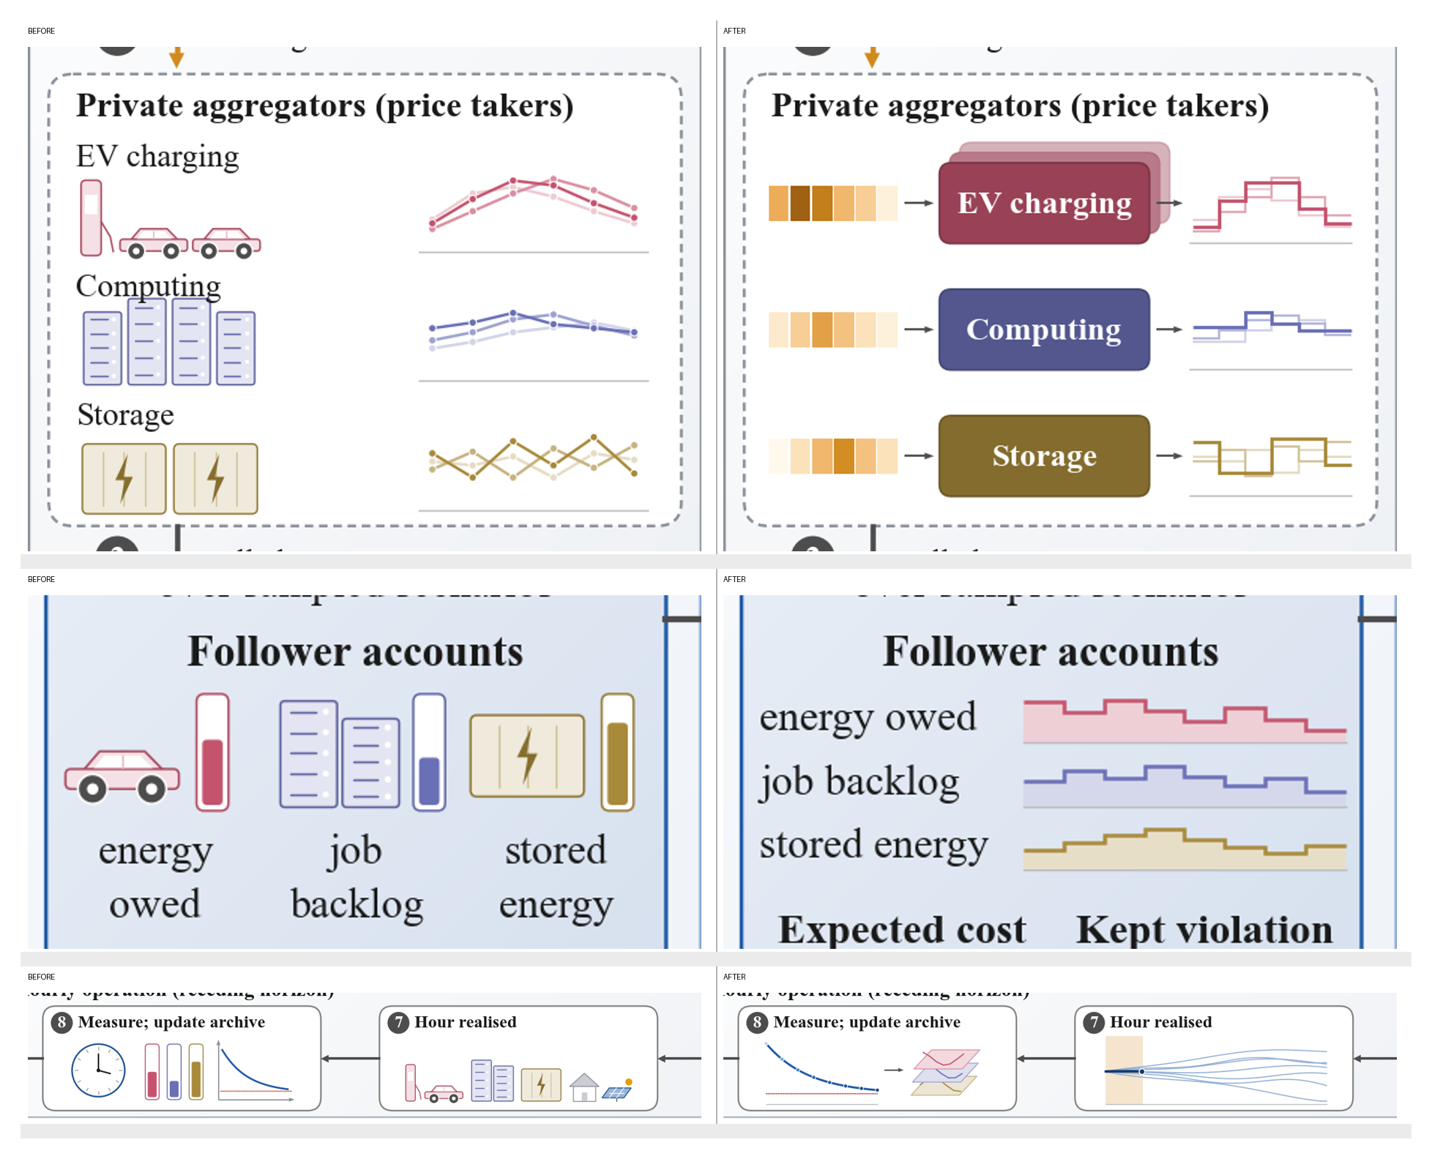
Step 2 · Pick one
Ask four questions
1
Is the message clear at a glance?
One look shows the main subject and which way to read
2
Is it distinct from the other figures?
All four Fig. 2 versions avoid elements of the framework figure
3
Does it look like an ‘AI figure’?
Cartoon icons, flashy gradients and glow effects are giveaways
4
Is it legible at print size?
View it at final size: no text smaller than 7 pt
Left: cartoon icons look AI-made Right: abstract, consistent with the figure
10

Slide 11
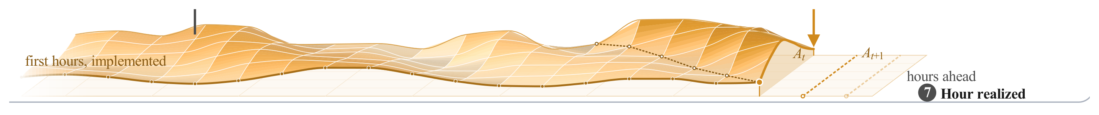
Step 2 · Pick one
Can't say what you like? Let the AI offer options
Bottom of Fig. 3, after saying “not pretty” three times
Me
They all look pretty ordinary
Can't describe the feel you want?
Let the AI give you options
AI
The AI asks; you click
Before making one focused version, I'd like to know what kind of ‘not ordinary’ you mean. Which is closest?
You click once, and the AI focuses on that direction
As rich as the three panels above
One large 3-D mathematical figure
← I clicked this
I have a reference image
↓ The bottom of Fig. 3, made in this direction
11

Slide 12
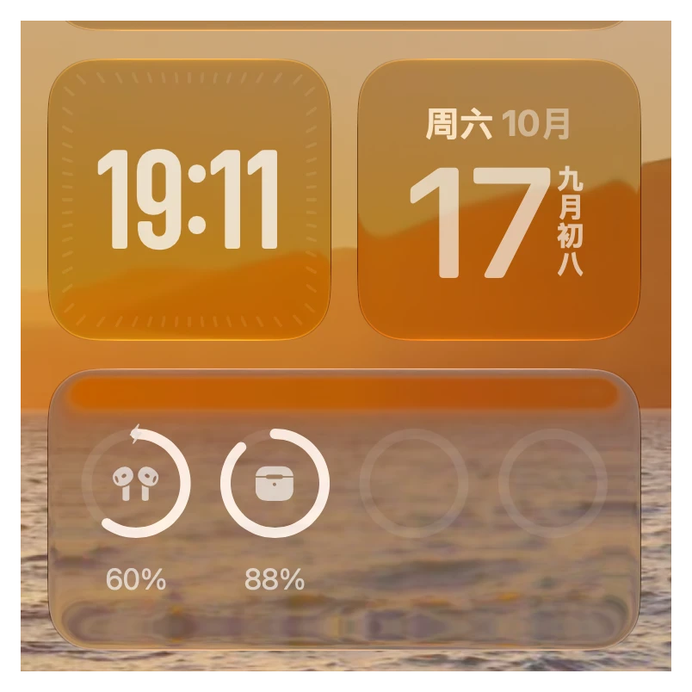
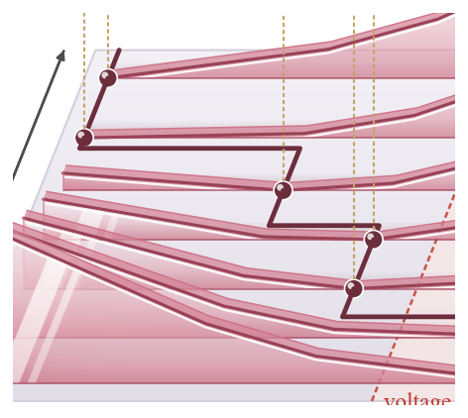
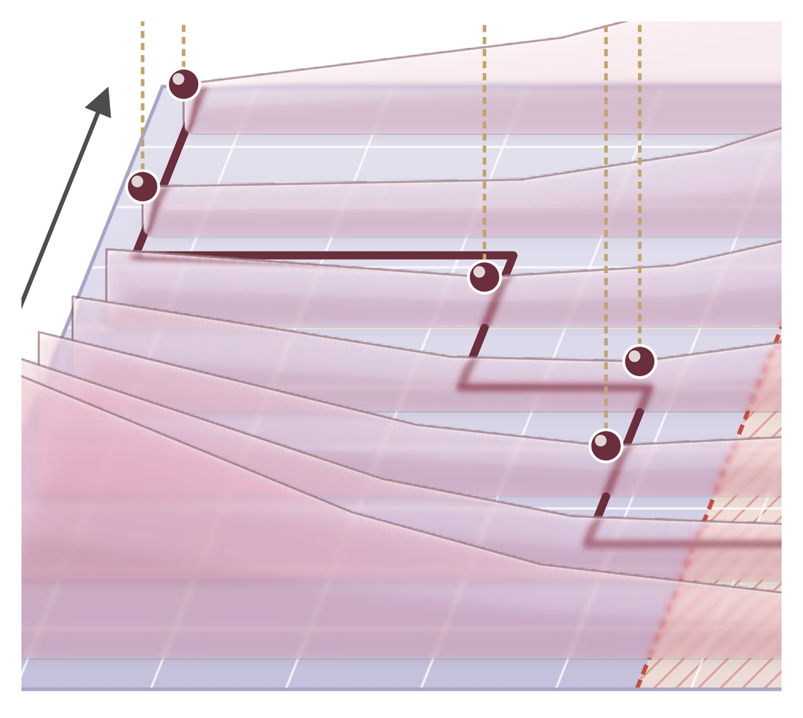
Step 2 · Pick one
Or simply give it a reference image
Fig. 1: “It still doesn't look great. You could use Apple's liquid-glass effect as a reference.”
Fig. 1, zoomed in
Reference image
Before: just translucent
After: frosted, with bright edges
The lines behind stay sharp; no sense of glass
The paths behind blur through the glass
12

Slide 13
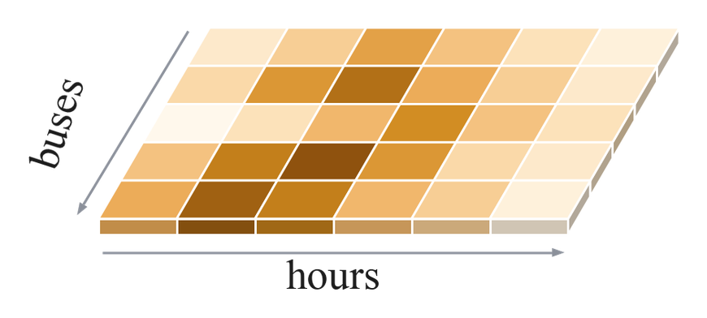
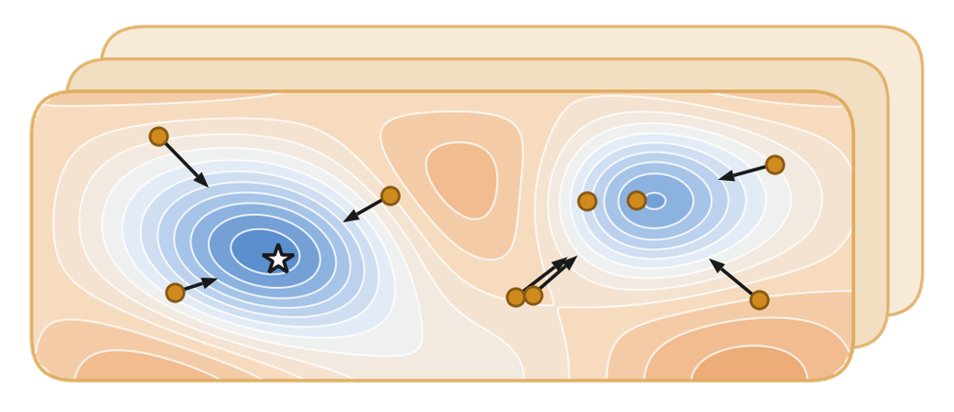
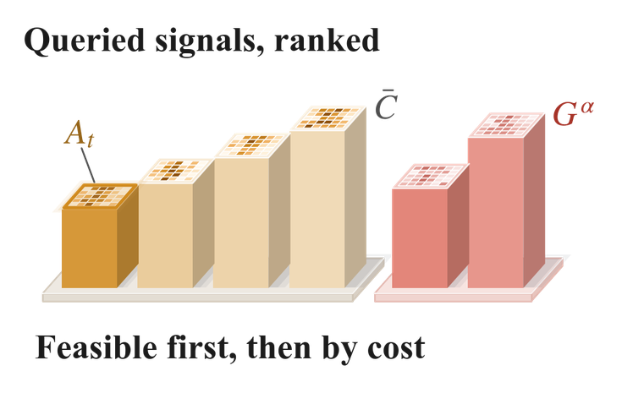
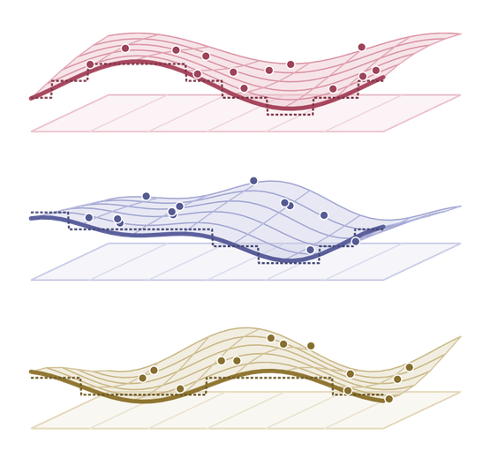
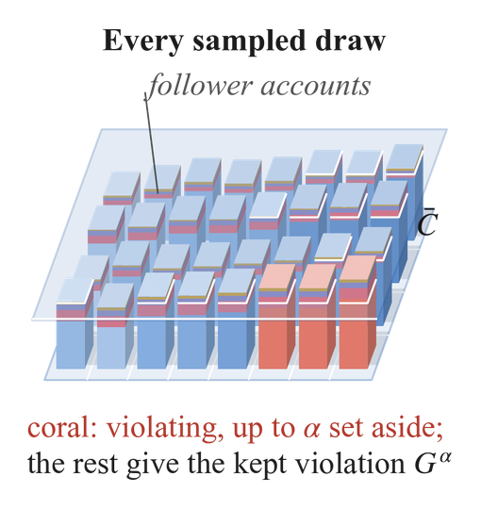



03
Draw components
in Python
Split the chosen version into
small components, one piece
of code each

Slide 14

Step 3 · Draw components in Python
First, split Fig. 3 into 13 components
One component, one figure
Drawn with matplotlib: 13 components, 13 pieces of code
Canvas = its print size
Coordinates in mm, so line widths and font sizes are as printed
Boxes, titles, arrows: later
They are drawn in PPT in step 4
14

Slide 15






Step 3 · Draw components in Python
Each component is a separate small figure
1
2
3
4
5
6
15

Slide 16







Step 3 · Draw components in Python
Change one, redraw only that one
7
8
9
10
11
12
13
16

Slide 17






Step 3 · Draw components in Python
3-D look: oblique projection + three shades
Used for the heat-map slab, the archive cards, the pillar field and the ranked pillars
① Floor and grid
② Cast shadow
③ Right face: darker
④ Front face: base colour
⑤ Top: lighter, bright edge
No 3-D engine
Each face is a polygon of four computed corners, drawn back to front so nearer faces cover farther ones
Three shades
One base colour: mix white into the top and black into the side, then add a soft shadow
17

Slide 18





Step 3 · Draw components in Python
Heat-map slab: colour by value, then add thickness
Component 1: the adder signal at the top left of Fig. 3
① Top: colour each cell by value
② Front: extrude the slab
③ Right side: darker still
④ Arrows with text replace axes
A flat heat map takes one line
ax.imshow(A, cmap=cmap)
Drawn obliquely, with thickness
To match the other 3-D parts: the top coloured by value, the front 18% darker, the side 30% darker
18

Slide 19





Step 3 · Draw components in Python
Surfaces: sample a function, tile small patches
The three response surfaces of component 4, and the decision surface of component 13
① Floor and grid
② Translucent patches
③ Add grid lines
④ Front edge, dashes, samples
Height is a simple function
Sines and Gaussians are enough; a schematic shows no values
Translucent patches, back to front
Then the grid lines and a thick line along the front
The decision surface adds lighting
Each patch is shaded by the angle between its normal and the light
19

Slide 20




Step 3 · Draw components in Python
Fig. 1: three components, stacked bottom up
1
2
3
20

Slide 21






Step 3 · Draw components in Python
Glass: not drawn, but image processing
Component 2 of Fig. 1: render what lies behind as an image, then process it step by step
① What lies behind
② Blur: frosting
③ Edge refraction
④ Brighten, tint
⑤ Highlights, thin lines
Seven panes, back to front
Each new pane treats the current image as its ‘background’, so the panes show through one another
The only bitmap in the figure
600 dpi; everything else is vector
21

Slide 22




Step 3 · Draw components in Python
Fig. 2: the terrain is 58,081 small pillars
1
2
3
22

Slide 23

04
Assemble with
python-pptx
Put the components back on a
paper-sized slide; boxes, text and
arrows stay editable PPT shapes

Slide 24



Step 4 · Assemble with python-pptx
The PPT page is the figure in the paper
+
=
Native PPT shapes
Components drawn in Python
Fig. 3 in the paper
Boxes, titles, arrows, numbers
Converted into PPT's own vector shapes
Exported from PowerPoint as PDF
24

Slide 25


Step 4 · Assemble with python-pptx
python-pptx: a few lines each for a box, text and a component
④ Component
③ Connector
② Text
① Box
25

Slide 26
The AI draws and writes the code;
you choose and ask for changes
01
Generate many styles
02
Pick one
03
Draw components
in Python
04
Assemble with
python-pptx

Slide 27
















实验结果图

