Slide 1

STOCK MARKET PREDICTION
DSCI 6007 – TEAM 1

Slide 2




TEAM MEMBERS
Nithish Kumar Mayavan
Vinaykumar Reddy
Moku
Sri Sai Durga
Myneni
Sri Sai Bhavana
Pakalapati
Data Scientist
Data Engineer
Machine Learning Engineer
Data Analyst

Slide 3
PROBLEM STATEMENT
How can we leverage stock price prediction to optimize our investment strategy in Google stocks?
Can stock price prediction help us identify strategic opportunities for Google stock investments in the long term?

Slide 4
SOLUTION
Develop a stock price prediction model tailored to Google stocks, incorporating historical price data, relevant financial indicators, and external factors affecting Google's performance. Implement the model within our investment decision-making process to identify optimal entry and exit points for Google stock investments
Creation of a comprehensive stock price prediction model for Google over the long term, incorporating macroeconomic trends, industry advancements, and Google's strategic endeavors. Employ this model to pinpoint potential growth prospects or periods of undervaluation for Google stocks, thereby informing strategic investment choices aimed at optimizing returns in the long run.

Slide 5

BUSINESS MODEL

Slide 6
BUSINESS UNDERSTANDING
Predicting stock prices aids in making informed investment decisions, managing risks, and maximizing returns.
Financial Decision-making
Understanding stock trends and patterns provides insights into market behavior and economic indicators.
Market Analysis
Accurate predictions enhance investor confidence and trust in the stock market.
Investor Confidence

Slide 7
DATA UNDERSTANDING
Time Period: The data spans from 2004 to 2022
Price Movement:
Open Price: The price at which the stock started trading each day.
High Price: The highest price reached during the trading day.
Low Price: The lowest price reached during the trading day.
Close Price: The price at which the stock ended trading each day.
Volume: Indicates the number of shares traded on each trading day.
Trends: Analyzing how the open, high, low, and close prices change over time can reveal trends such as bullish (increasing prices), bearish (decreasing prices), or sideways (stable prices).
Market Sentiment: High trading volumes may indicate increased investor interest or activity in the stock. Large price movements, especially when coupled with high volume, might signify significant market events or news affecting the stock
.Technical Analysis: Traders might use this data to perform technical analysis, looking for patterns or signals that could help predict future price movements.
Investment Decisions: Investors and traders may use this data to make decisions about buying, selling, or holding the stock based on their investment strategies and goals

Slide 8


PROJECT PIPELINE
Data Collection
Data Cleaning
Amazon Sagemaker
Exploratory Data Analysis
Implementation
Data Preparation

Slide 9
Data Collection
Time Period: The data spans from 2004 to 2022
Price Movement:
Open Price: The price at which the stock started trading each day.
High Price: The highest price reached during the trading day.
Low Price: The lowest price reached during the trading day.
Close Price: The price at which the stock ended trading each day.
Volume: Indicates the number of shares traded on each trading day.

Slide 10
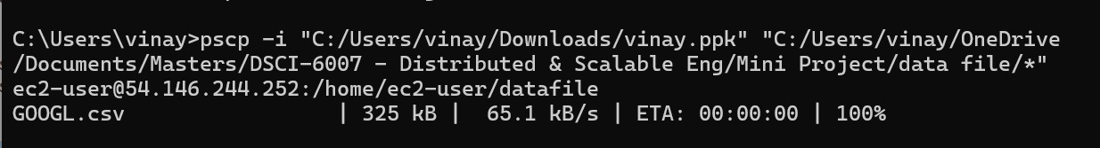
AWS EC2 Instance
Uploaded the data file from local to AWS Instance.

Slide 11
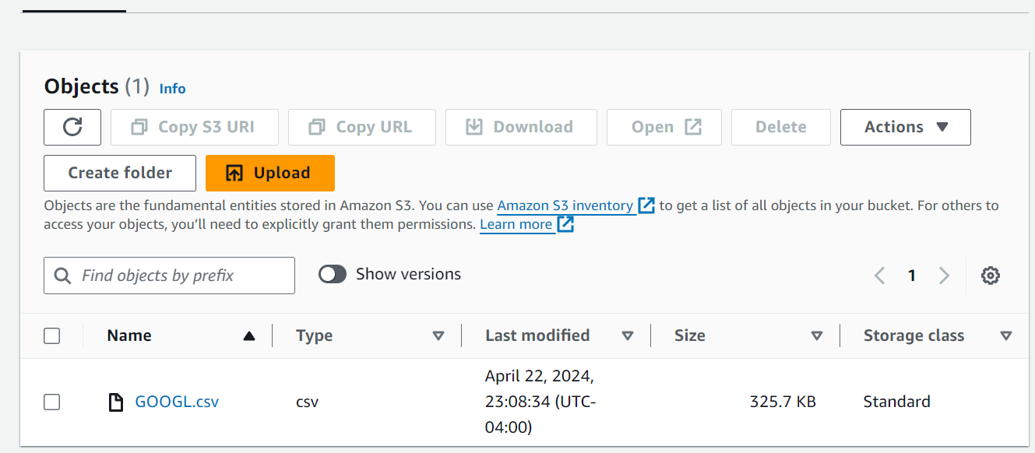
S3 Bucket
Loaded the data file from EC2 instance to S3 Bucket to process.

Slide 12
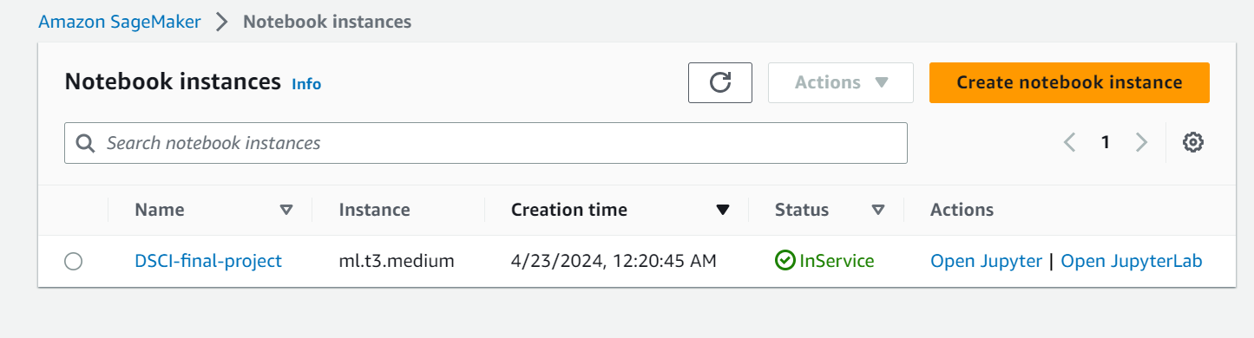
Jupyter Notebook in Amazon Sagemaker
Open the jupyter notebook using the Amazon Sagemaker

Slide 13
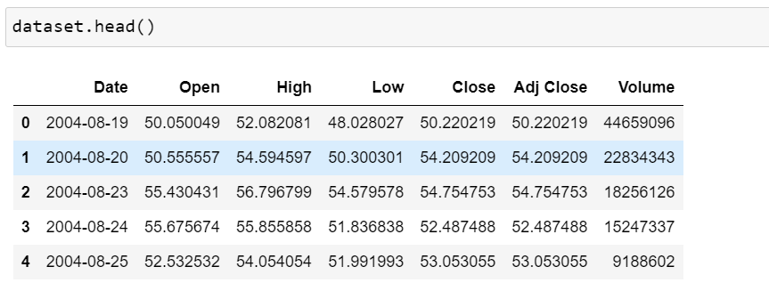
Data Processing

Slide 14
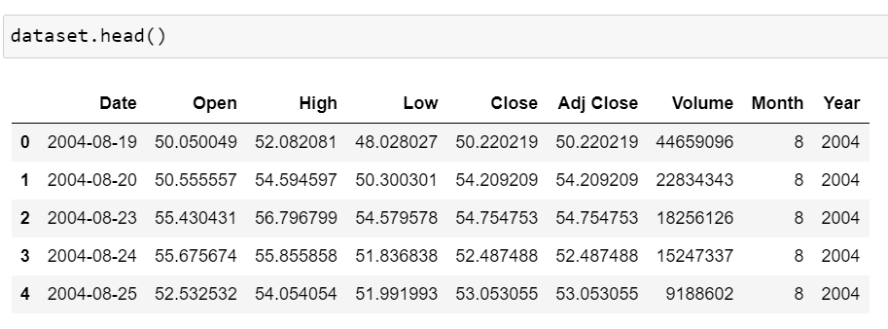
Processed the data by changing the date to datetime format and extracted the Month and Year fields form the Date.

Slide 15
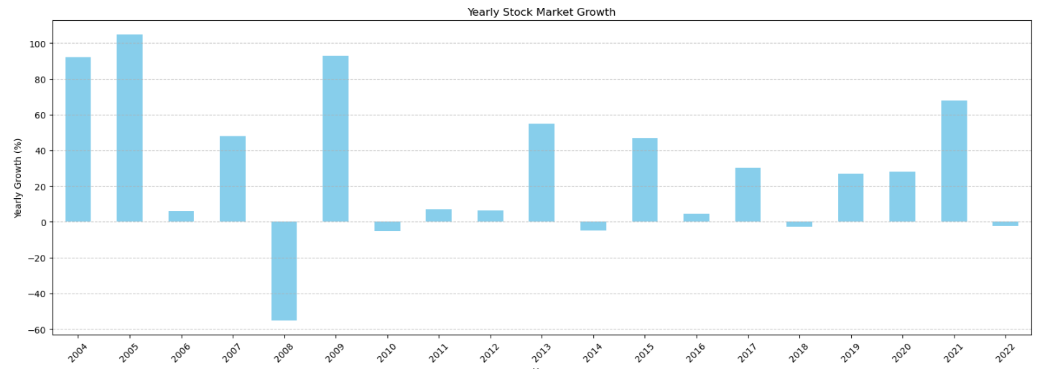
Yearly growth of the Google Stock Market

Slide 16
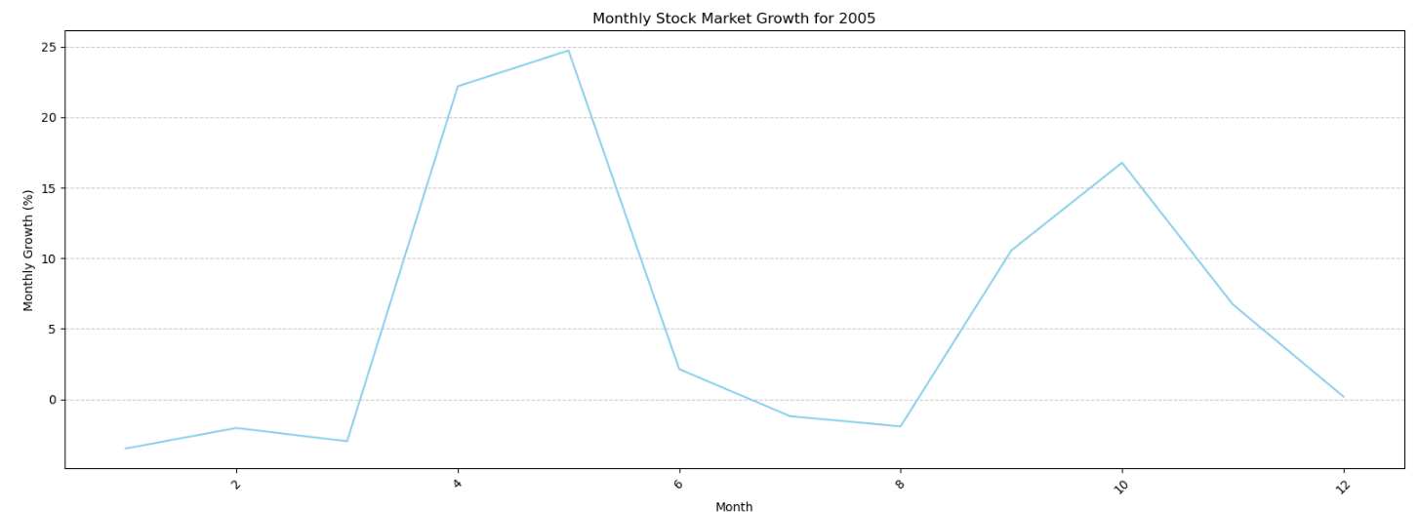
Monthly growth of the Google Stock Market
Plotted the monthly growth for a specified year. Example – 2005

Slide 17
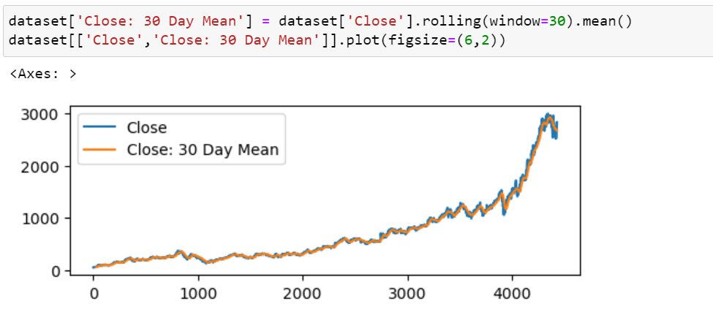
Below code calculates and visualizes the 30-day moving average of stock closing prices, which can help smooth out short-term fluctuations and reveal underlying trends in the data.

Slide 18
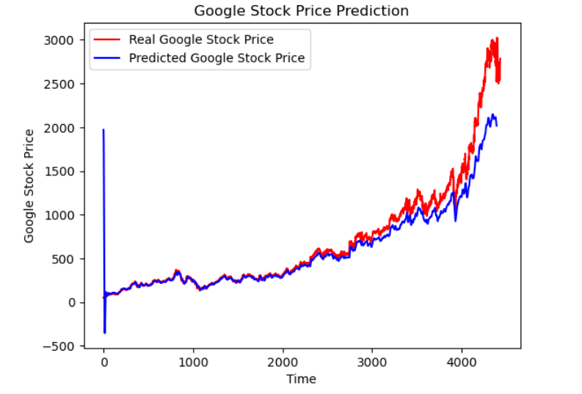
Google Stock Real Vs Predicted

Slide 19






TECHNOLOGIES
AMAZON EC2

Slide 20
CHALLENGES
Market Volatility
The unpredictable nature of the stock market poses challenges in accurately predicting stock prices.
Data Quality and Integrity
Ensuring the accuracy and reliability of data sources for effective prediction models.
Regulatory Impacts
Adapting to regulatory changes and compliance requirements that influence stock prices.

Slide 21
THANK YOU

