Slide 1

Distributed and Scalable Data Engineering (DSCI-6007)
Flight Delay Analysis

Slide 2
TEAM#10
Team Members:
• HARI VISHAL REDDY ANEKALLU
APPLICATION DEVELOPER
• VIJAYA BHARGAVI PEDINEEDI
DATA SCIENTIST.
• TRINADH NANDMURI
DATA VISUALIZATION.
• SRI SAI SINGALA-
DATA MODELING.

Slide 3
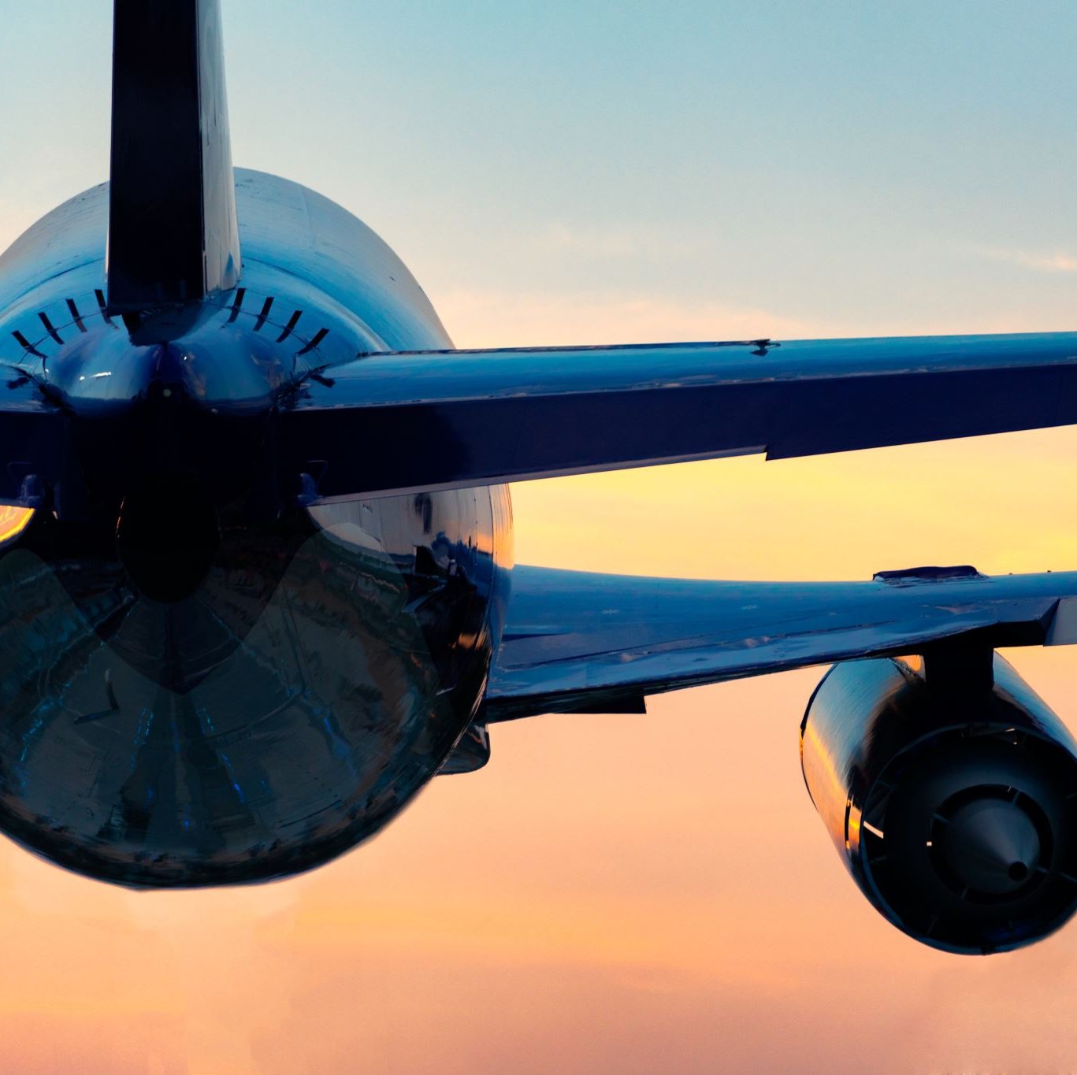
What are Flight Delays
Flight delays are one of the most widespread issues on the planet.
Unavoidable flight delays have a big impact on the airlines' profits and losses.
These days, a lot of businesses rely on various airlines to connect them with other parts of the globe, and the aviation sector is crucial to the global transportation sector as well.
Statistics show that 20% of airline flights are postponed or cancelled each year, costing passengers $20 billion in lost time and money.
The objective of this project is to investigate the approaches used to develop models for forecasting flight delays caused by various causes

Slide 4
Can we solve this?
It is possible to skip a scheduled event or an important meeting due to flight delays.
The profitability and losses of the airlines are significantly impacted by unavoidable flight delays.
Many companies now depend on different airlines to connect them to other parts of the world, and the aviation industry is essential to the global transportation industry as well.
In order to combat this, airlines can address the underlying causes of the delays with precise flight delay forecasting, which also enables passengers to be fully prepared for the disruption to their journey.

Slide 5
Methodology
This analysis aims to anticipate a delay. To forecast a delay, we will use the airline data from the airline dataset
First, we'll look at the data and perform some simple analysis.
Python will be used by us to interact with, access, and visualize our data.
Additionally, we'll train machine learning models utilizing the data. Later, an application will be developed and released utilizing the trained machine learning model, allowing any user to provide input to predict whether the flight will be delayed or not.

Slide 6
DATA UNDERSTANDING
The information comes from the Bureau of Transportation Statistics(BTS) of the U.S. Department of Transportation (DOT) .
The U.S. Department of Transportation's (DOT) Bureau of Transportation Statistics tracks the domestic flight schedule performance of major airlines (BTS).
The DOT's monthly Air Travel Consumer Report, which is normally released 30 days after the month's end, also includes a summary of the number of on-time, delayed, canceled, and diverted flights in addition to the summary tables provided on this website.
BTS began gathering data on the causes of flight delays in June 2003.
The general public has access to raw data and summary statistics when the Air Travel Consumer Report is created.

Slide 7

MODELING & DEPLOYMENT
With the help of the sklearn library's train test split () method, we first divided the data into train and test data sets.
Pandas are used for data cleaning and data wrangling.
The data generated during data preparation is used to train the machine learning models.
Application deployment is done using the flask server.

Slide 8
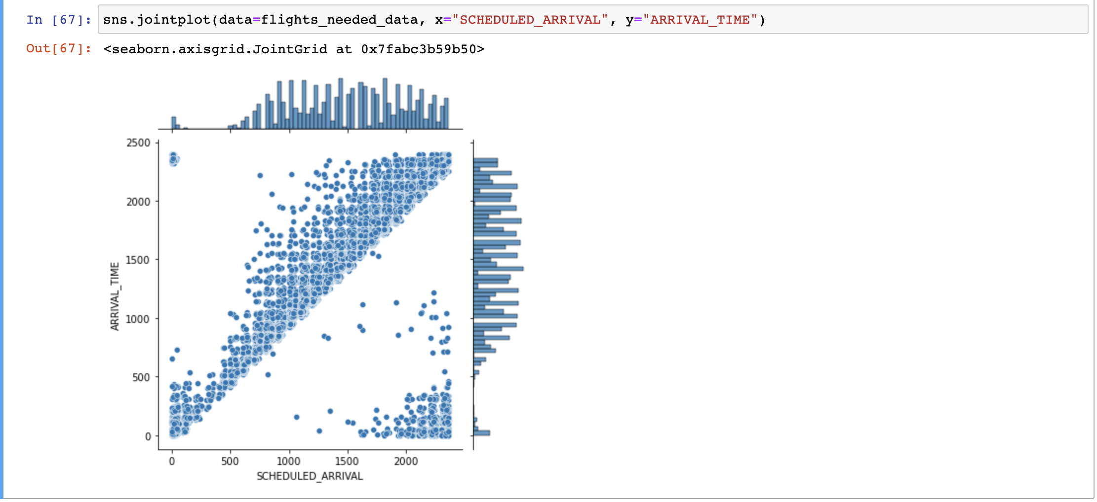
SNAPSHOTS OF THE CODE AND OUTPUTS

Slide 9
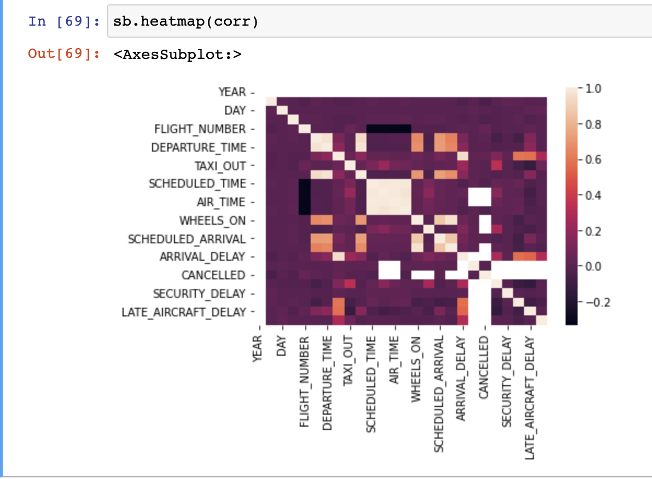
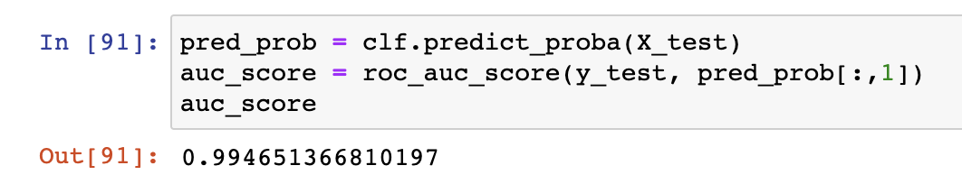
SNAPSHOTS OF THE CODE AND OUTPUTS

Slide 10

SOURCE FILES & SUBMISSION LINKS
https://github.com/Team10-Unicorn/AIRLINE_DELAY_ANALYSIS.git

Slide 11

Thank You

