Slide 1
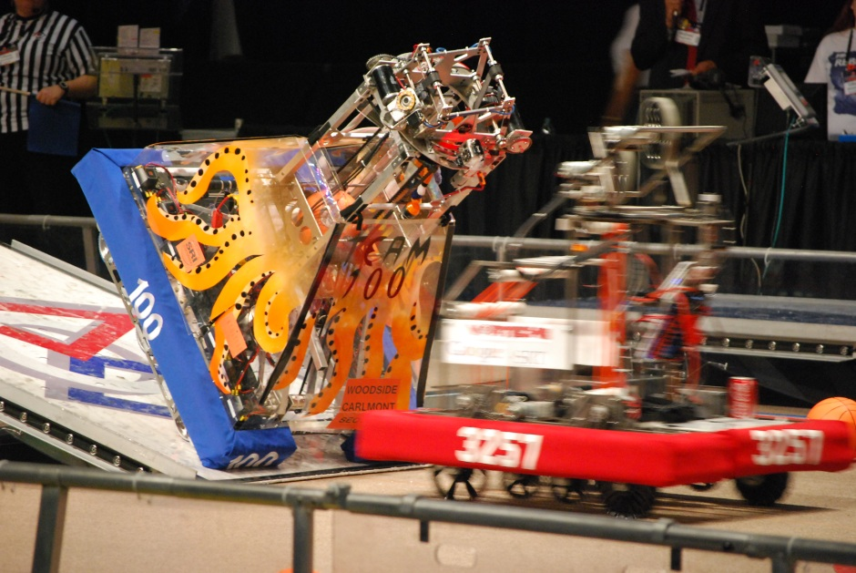
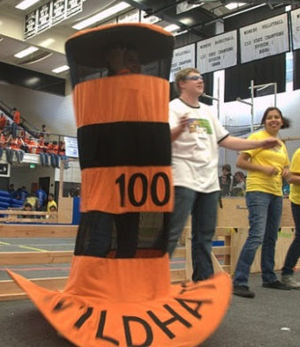
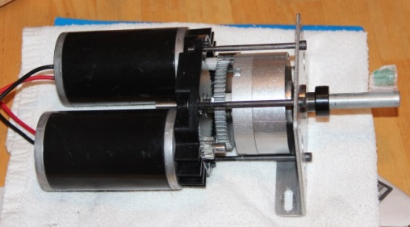
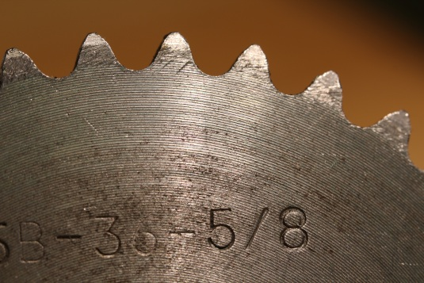
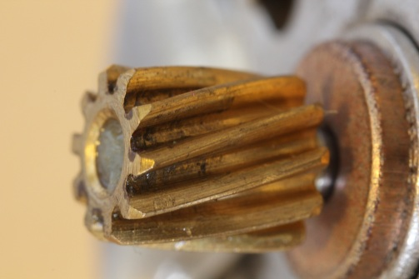
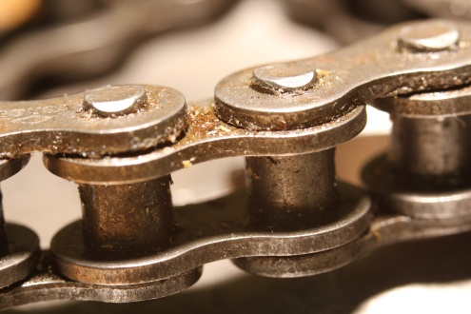
Why Prototype? What is Prototyping?

Slide 2
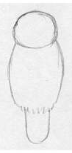
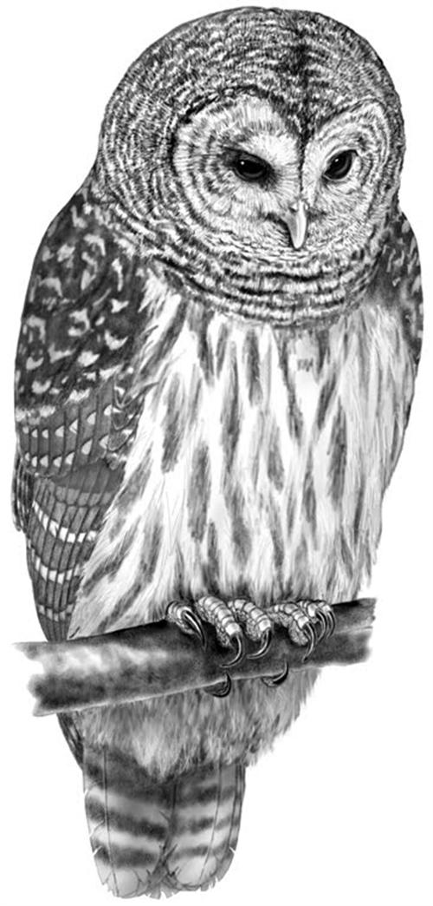
How to draw an Owl Draw some circles…………….draw the rest of the Owl
Design is Hard! True innovation is disruptive, messy, and hard to achieve!

Slide 3
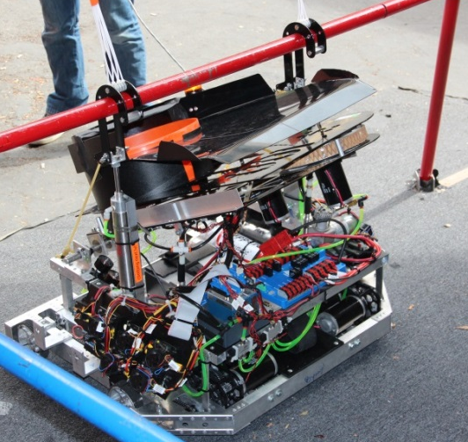
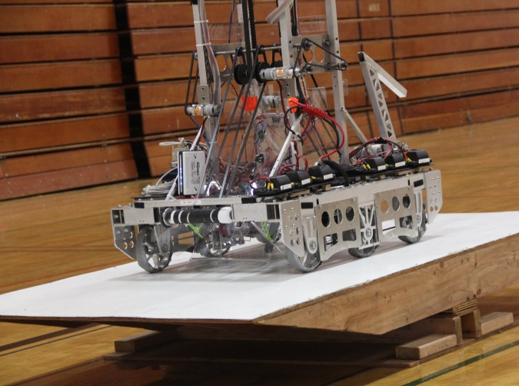
Why Prototype?
The value of Prototypes
Is an idea feasible?
Should we use this idea/approach?
Reduce risk!!!!!
Technical
Schedule
Pull risk forward / focus on unknown areas
Figure out how to “solve” the game
Determine level of difficulty
Proof of concept
Shape, Motion, Size
Try several ideas
Others?
If necessity is the mother of invention, iteration is the mother of excellent
If you build your prototype again would it be:
Faster to build?
Better?
Different?
What kind of prototypes have you worked on?
English / History classes
Field elements (balance bridge, pyramid, etc.)
Electronics breadboard
Virtual

Slide 4
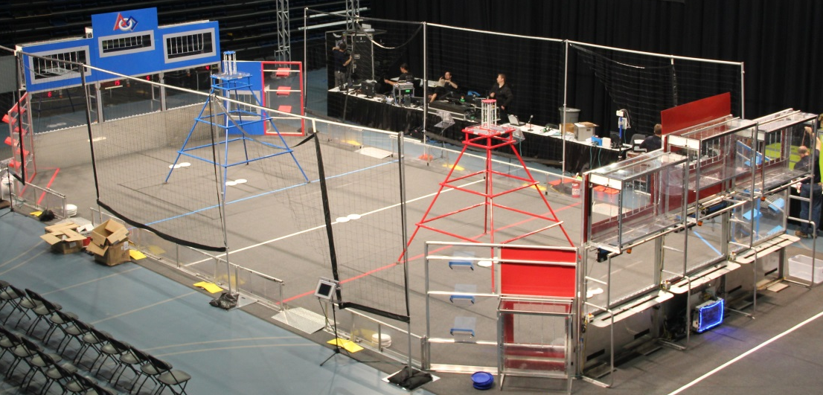
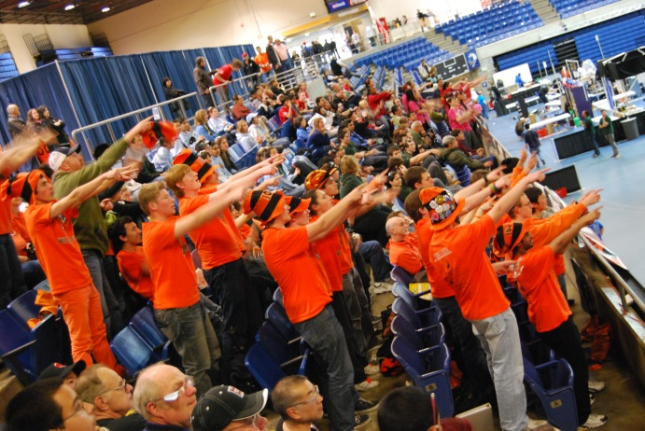
Common Game Tasks
The Game!
Acquire Objects
Usually balls, sometimes other objects
Grabbers, rollers, scoops, suction cups
Move Objects Around
Goals, ramps, mobile platforms
Hooks, latches, clamps
Obstacles
Climb over ramps and steps
Limbo under bars
Hang from bars
Move Autonomously
Knock over objects
Get into some position
It is a game - think about how to win
Year over year much the same
Must show all design elements work before incorporating into the robot design
Don’t fall into the identify theorem trap: if A worked and B worked then A=C “should” work

Slide 5
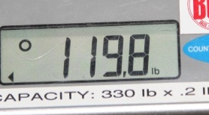
What do you want to learn from your prototype?
Prototypes are Expensive!
Time, Resources, Money
BUT!!! Changing later is way worse!
You don’t know what you know until you have a prototype
What did your prototype tell you?
What did your prototype teach you?
What questions did you ask your prototype?
What questions did you not ask your prototype?
Before you start a prototype
ask!
Why? What? How?
End Goal?
How / what is needed?
Visualize success
Climber prototype
Climb – what does this mean?
We proved we could lift, this is not the same as “climb”!
What is the “end goal”?
Shooter prototype
10’ away, 3’ off ground, 5’ up
Think in engineering terms!
Speed, Velocity, Mass, Time, Current, Angle, Distance, Energy, Torque, Power, Gravity, RPM, etc., etc.
How do you measure results? What results?
Break down into subsystems for prototyping?
Can’t throw random stuff together! (usually)

Slide 6
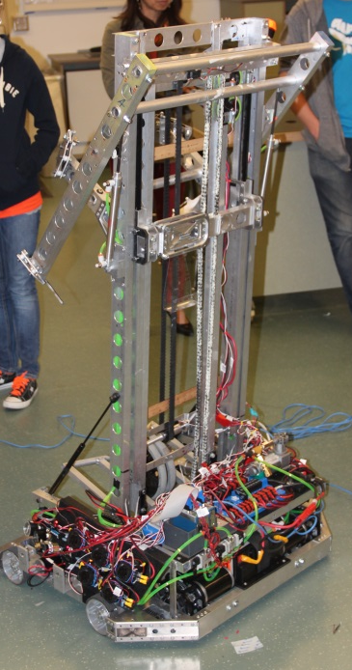
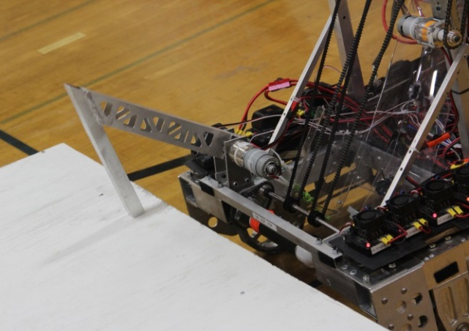
Designing your Prototype
Tradeoffs
Not necessarily CAD
Foam, Paper, Whiteboard, cardboard, hand sketches, humanbots, etc.
“Designing” a prototype (quickly) can/will lead to a go-no/go decision on whether or not to proceed with a physical prototype (is this idea good enough for a prototype?)
Building a “bad” prototype may/will create a false result meaning a good approach gets disqualified and/or a bad result moves forward
The key to deciding upon a design is to evaluate the
tradeoffs
With any FIRST robot, when you choose on function or ability, you usually have to give something
Making the right choices based on your analysis will determine the fate of your season
e.g. Speed vs. Power, Complexity vs. Durability, Goals vs. Balls
K.I.S.S. – teams who try to do more than they’re capable of, tend to fail

Slide 7
Prototype Exercise (part 1)
For the exercise assume the same game rules/field as 2013 (use your imagination, answer your own questions)
Items will be handed out and a brief explanation of items will be given (each group will have different items/goals)
Brainstorm your approach to achieve goal
(Hurry!)
Stop for discussion and further instruction…

Slide 8
Prototype Exercise (part 2)
Down select to one idea
General your questions, measures, success criteria
(Hurry!)
Stop for discussion and further instruction…

Slide 9
Prototype Exercise (part 3)
Design your prototype …except…switch!
(Hurry!)
Stop for discussion…

Slide 10
Closing Thoughts…
Where the prototype questions from the other team:
Clear?
Asking about engineering units?
Could you design and build a prototype from these questions?
What questions did you think were missing?
Comments/questions?
Thanks & acknowledgements:
Team 1114 design presentations
Intuitive Surgical tour presentations

