Slide 1
FIRST Robotics and the Design Process
Andrew Blatner with material from Team 1114 and Karthik Kanagasabapathy

Slide 2
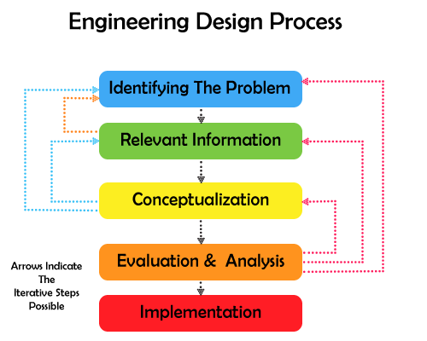

Slide 3
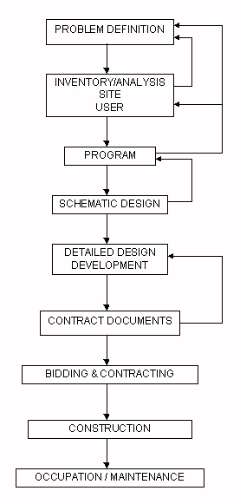
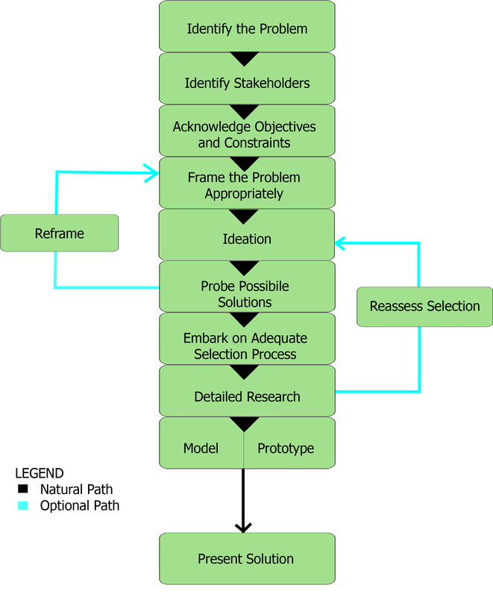

Slide 4
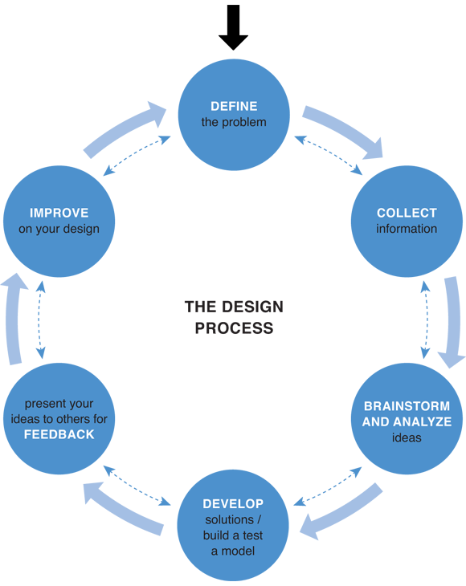

Slide 5
Identify the Problem
Clear solution-neutral problem statement
Example: A company has several acres of lawn that they must maintain. They ask a gardener what kind of lawnmower would be best.
What’s wrong with this?
Why a lawnmower? What about goats?
Better question: How can we best keep the grass short?

Slide 6
Identify the Problem
Constraints: Limits on the design
Weight, size, number of motors, battery type, cost, safety
Criteria: Requirements of the design
Score basketballs, balance bridge, drive speed,

Slide 7
Identify the Problem
In the 2012 FRC game:
Rules said we could have opening in bumpers and single 14” extension
We immediately jumped to roller intake through opening and 14” bridge mechanism
What’s wrong here?
Unnecessarily constrained the problem
Overlooked not going through bumpers, but over
Many teams combined intake and bridge mechanism into one

Slide 8
Identify the Problem
Shooter: Focused on distance and accuracy
Problem: You didn’t get points for shooting far or accurately
Points came from SCORING
Should have focused on how to best score
Shoot straight at backboard with fast backspin

Slide 9
Brainstorming
Collect as many ideas as possible
As individual, then as group
All ideas heard one at a time
NO criticism at this stage: kills creativity
Build off each other’s ideas
Should be relaxed, free atmosphere

Slide 10
Brainstorming
Large number of ideas wanted
Out of the ordinary ideas wanted
Combine and improve ideas
Keep all ideas concise and short
Shouldn’t have lengthy and detailed descriptions

Slide 11
Conceptualization
Evaluating brainstormed ideas
Rough designs, sketches, outlines
Do not write out every detail, dimension, etc.
Determining most plausible solutions
Important to visualize solutions

Slide 12
Prototyping
Taking selected ideas to build and test functional models
Important to test for the right qualities and the right problem
Why it’s critical to correctly identify the problem
2012 season
We prototyped for accuracy and distance
Not for scoring ability

Slide 13
Iteration
Core!!! to the design process
Cyclic process of prototyping, testing, analyzing, and refining
Taking ideas and modifying them based on tests and new information

Slide 14
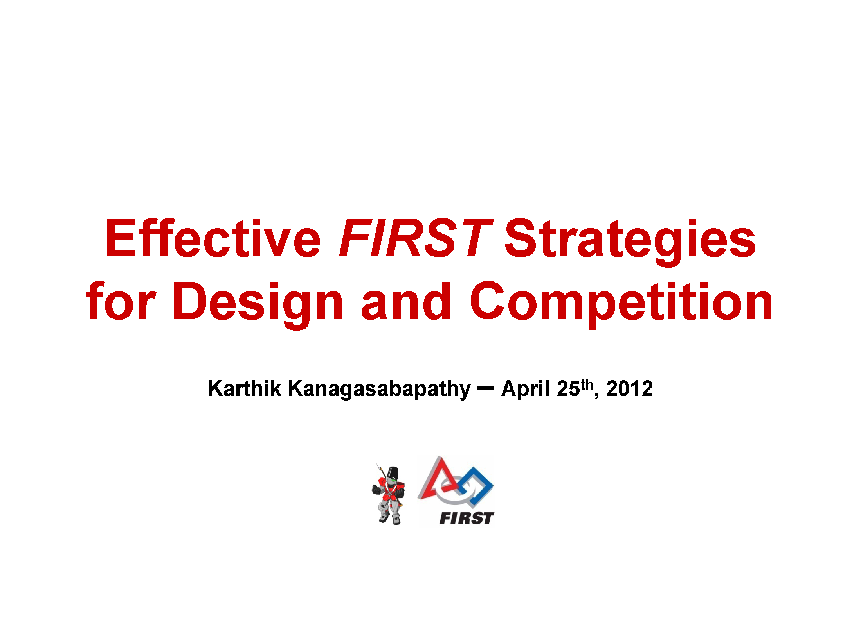

Slide 15
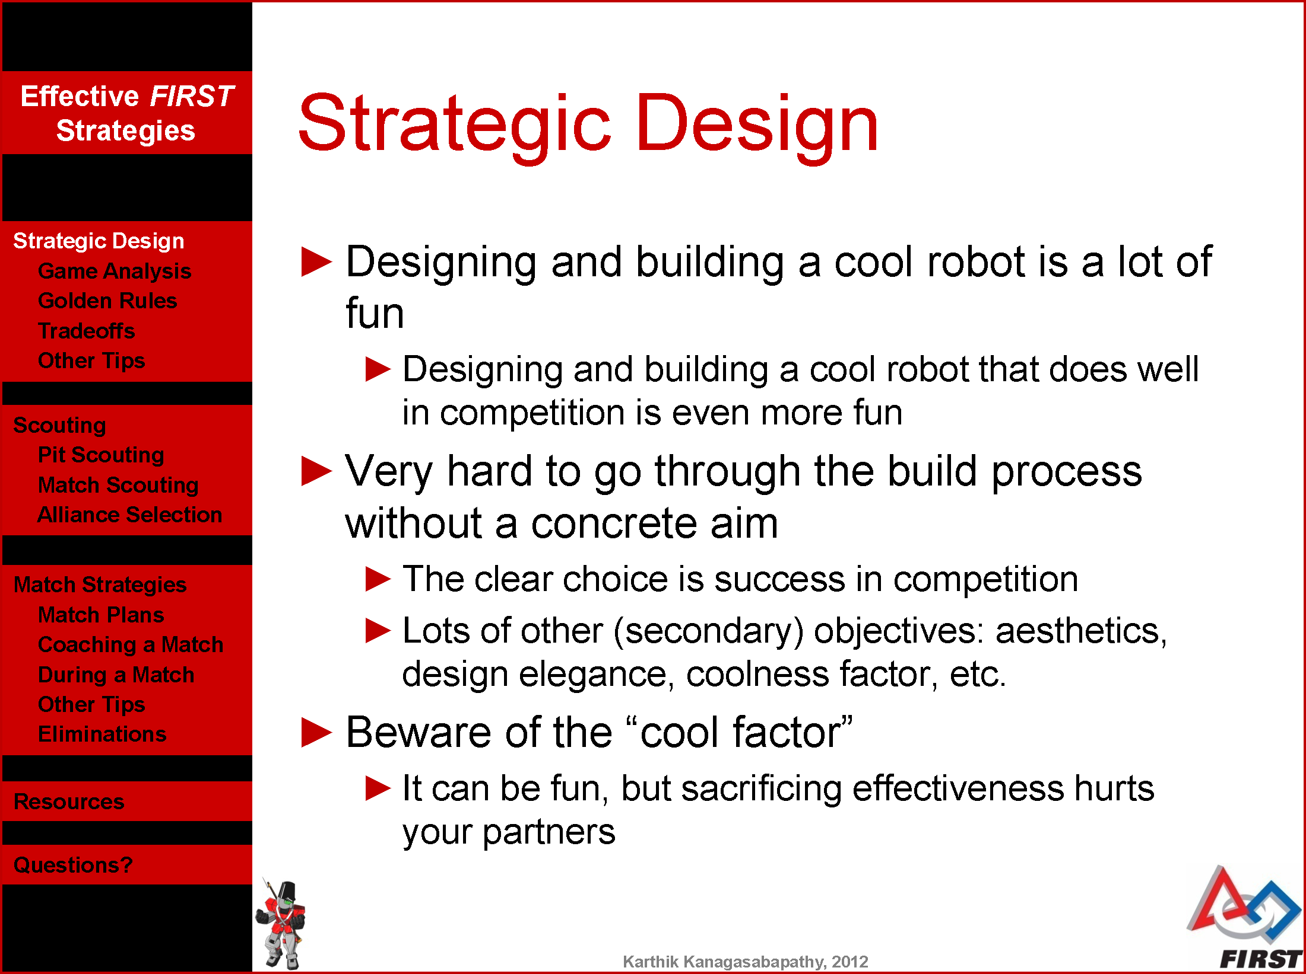

Slide 16
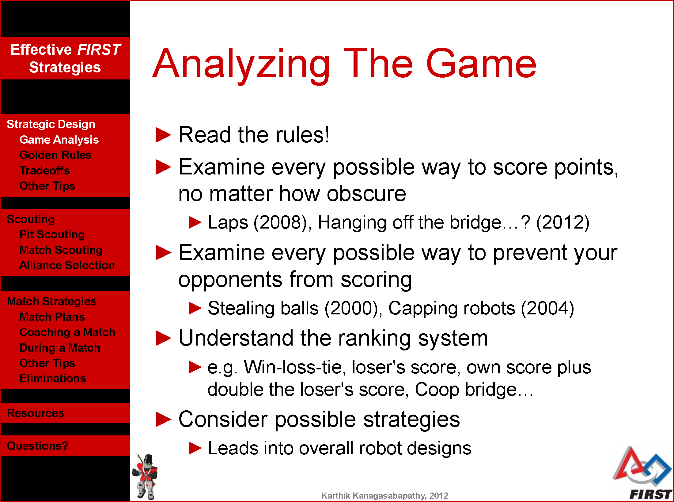

Slide 17
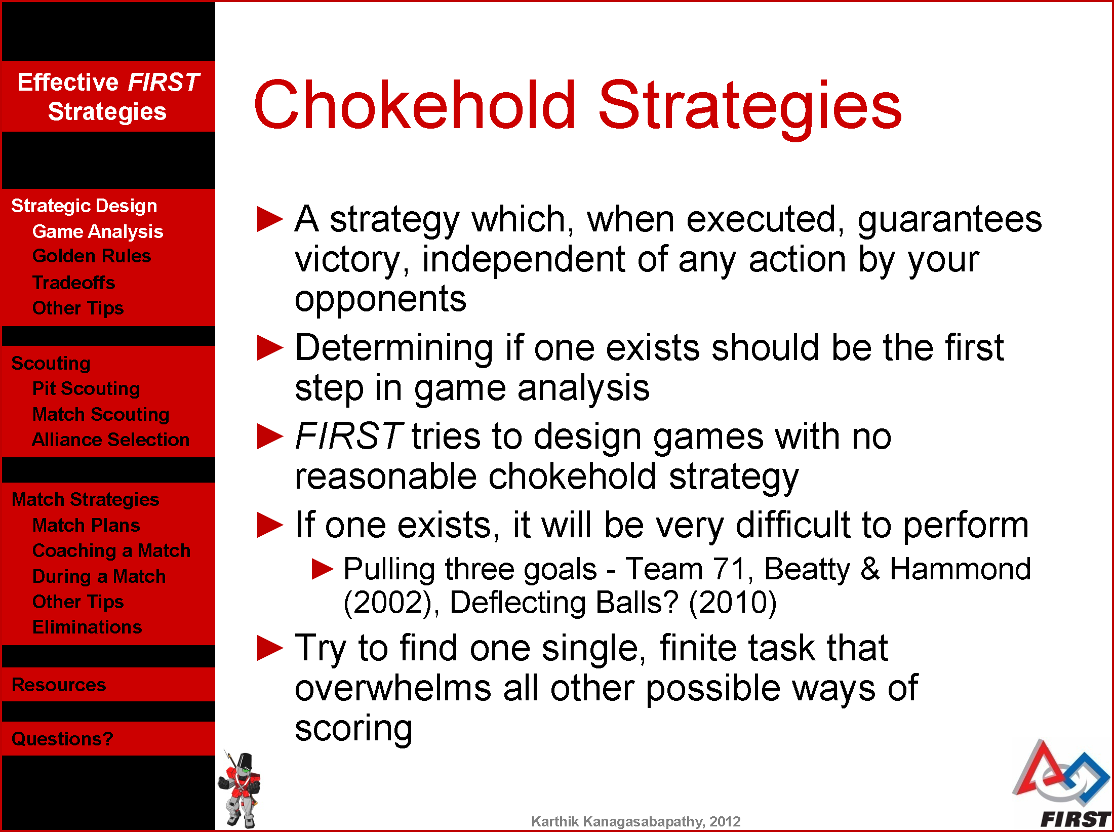

Slide 18
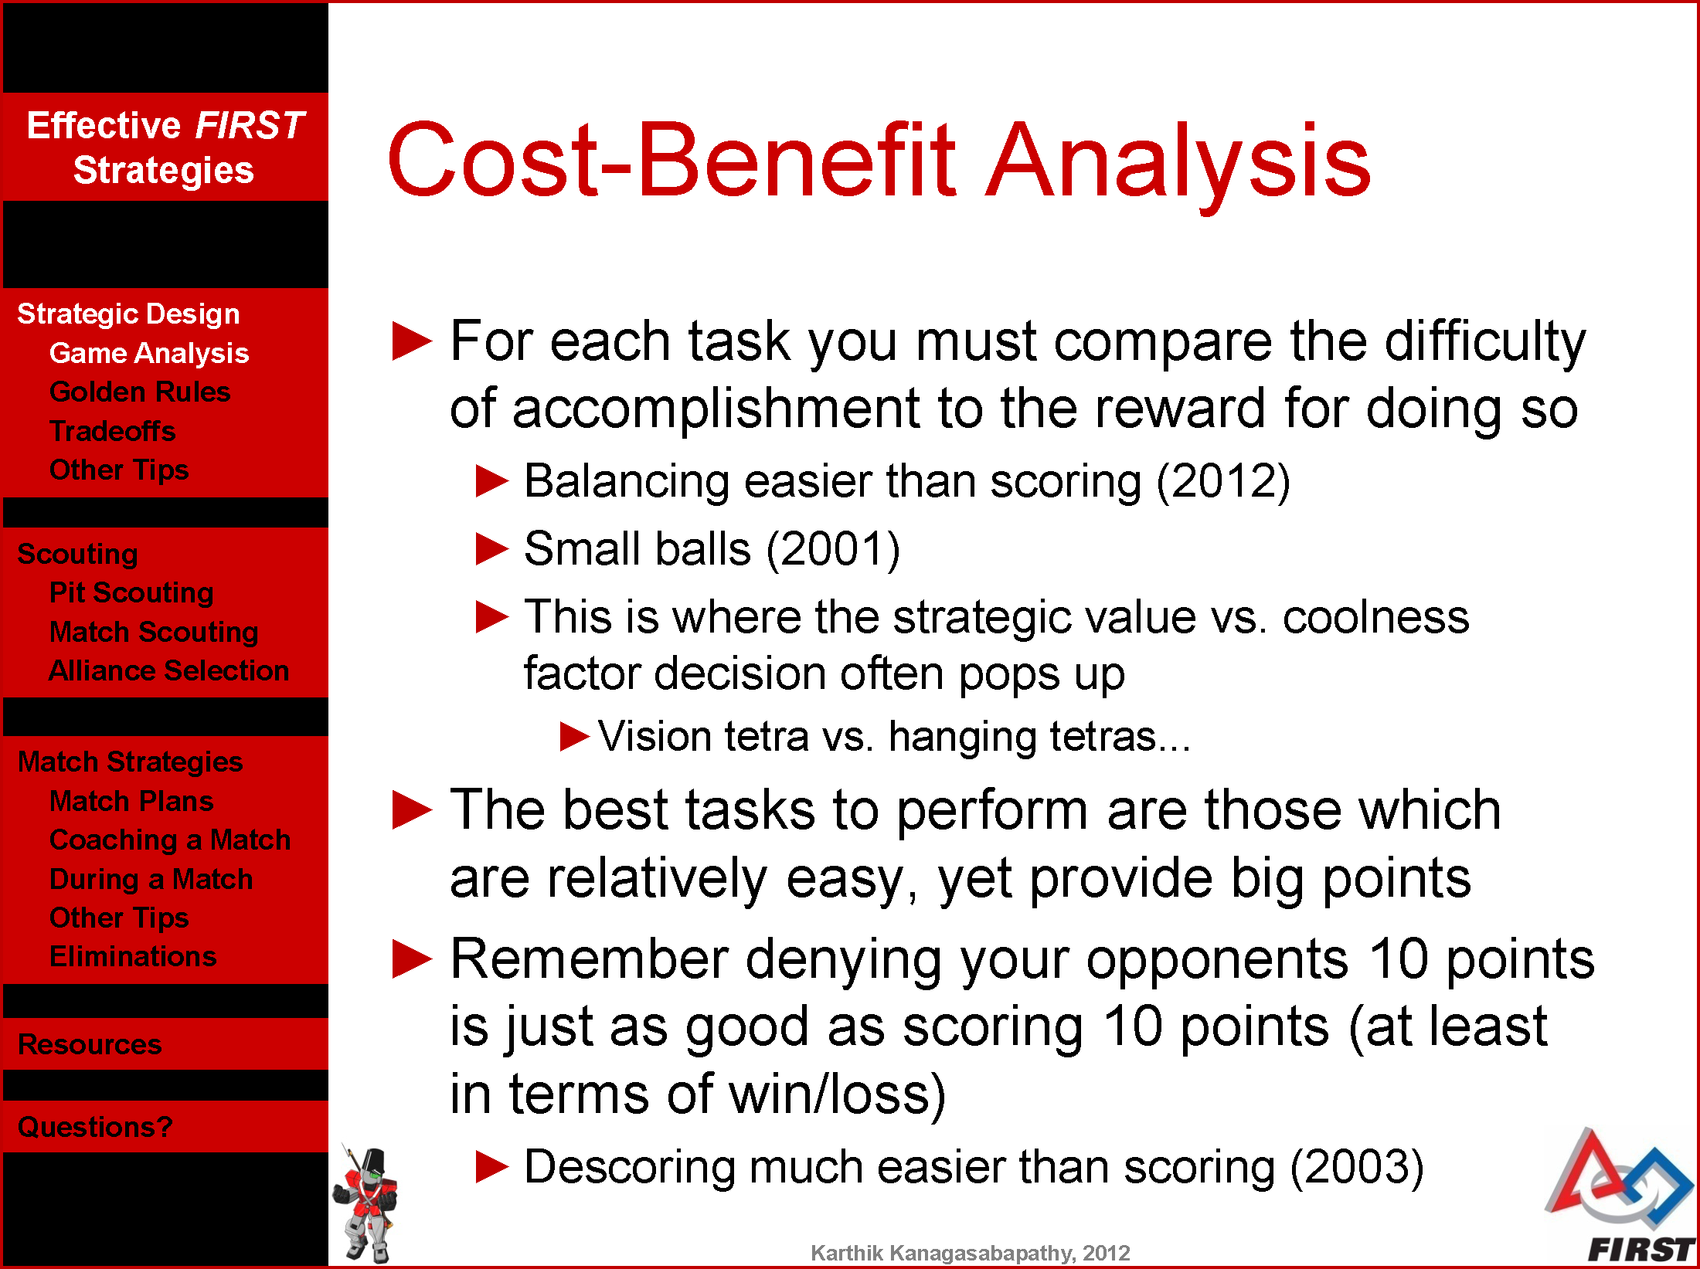

Slide 19
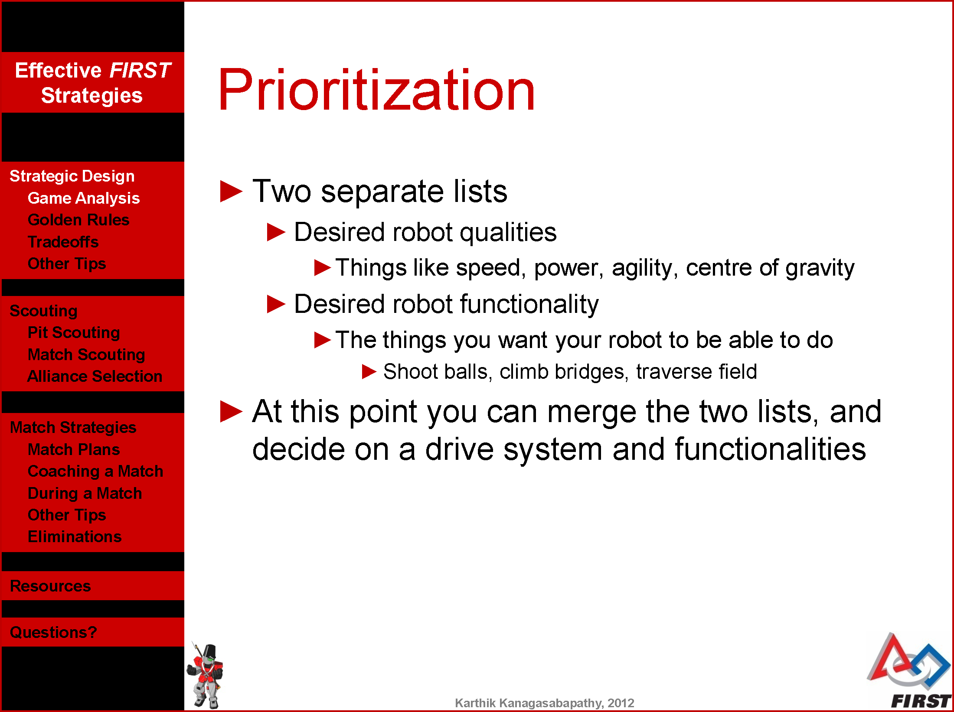

Slide 20
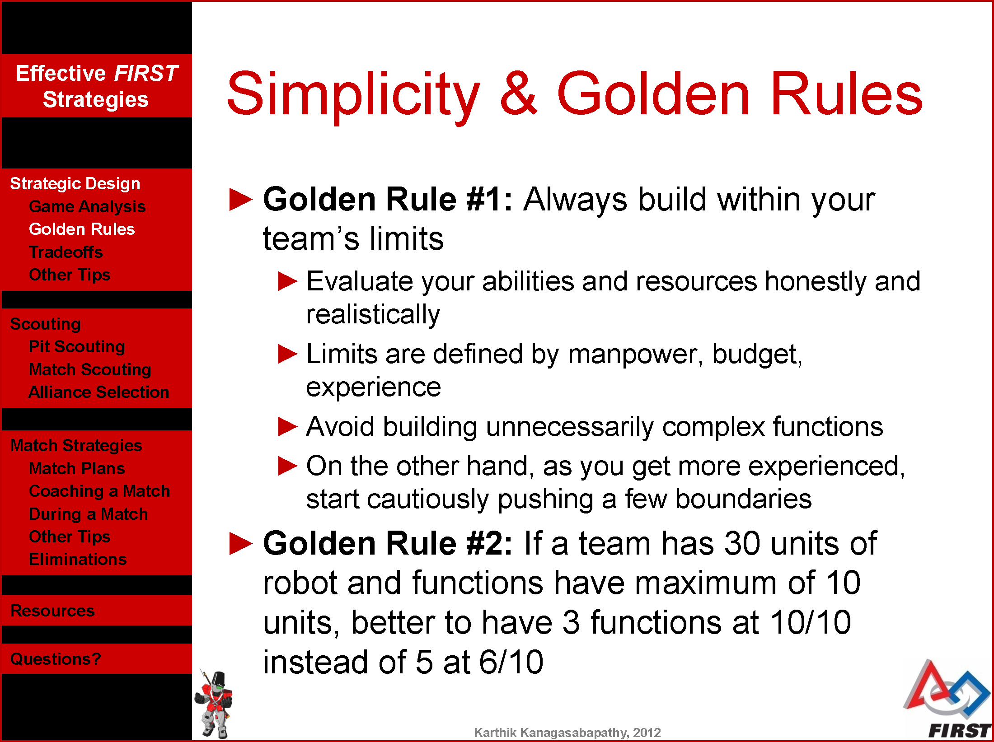

Slide 21
Golden Rule #2
It’s better to have 3 excellent mechanisms than 5 mediocre ones
K.I.S.S – Keep It Super Simple (or Safe)
Excellent mechanisms take more resources, so you can’t have as many
Will still make your robot better at what it does

Slide 22
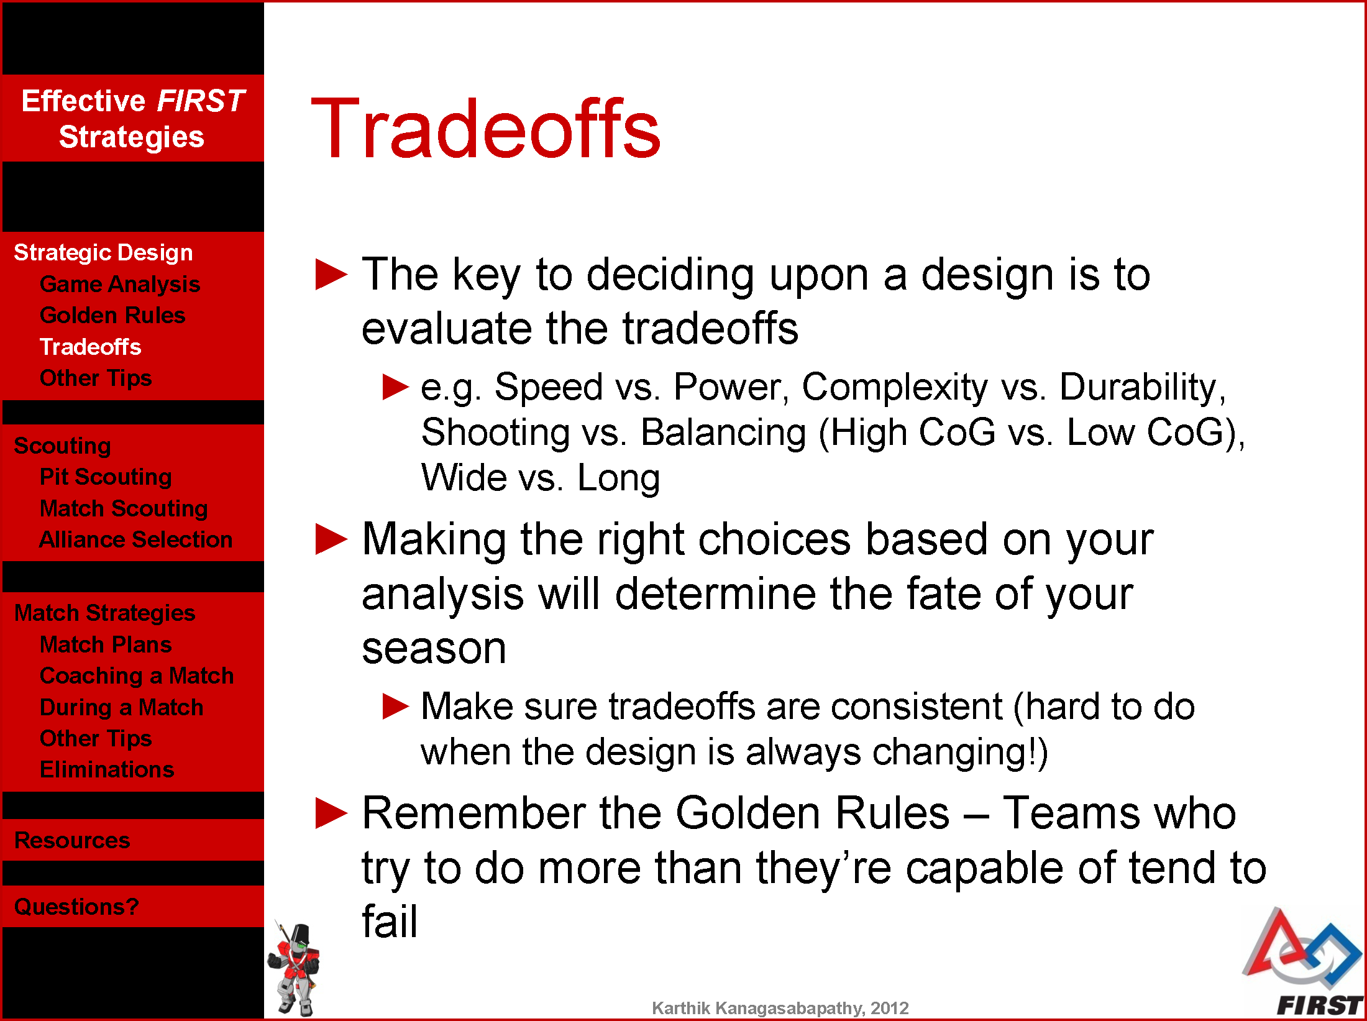

Slide 23
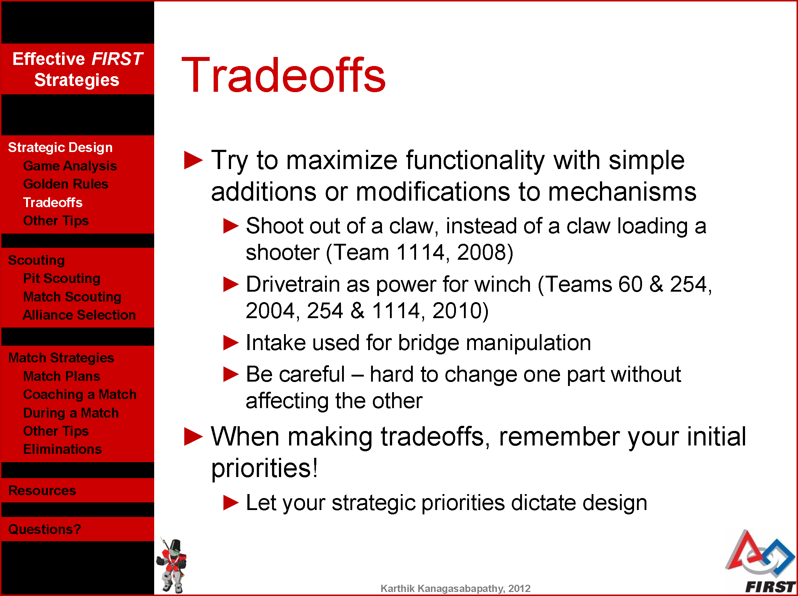

Slide 24
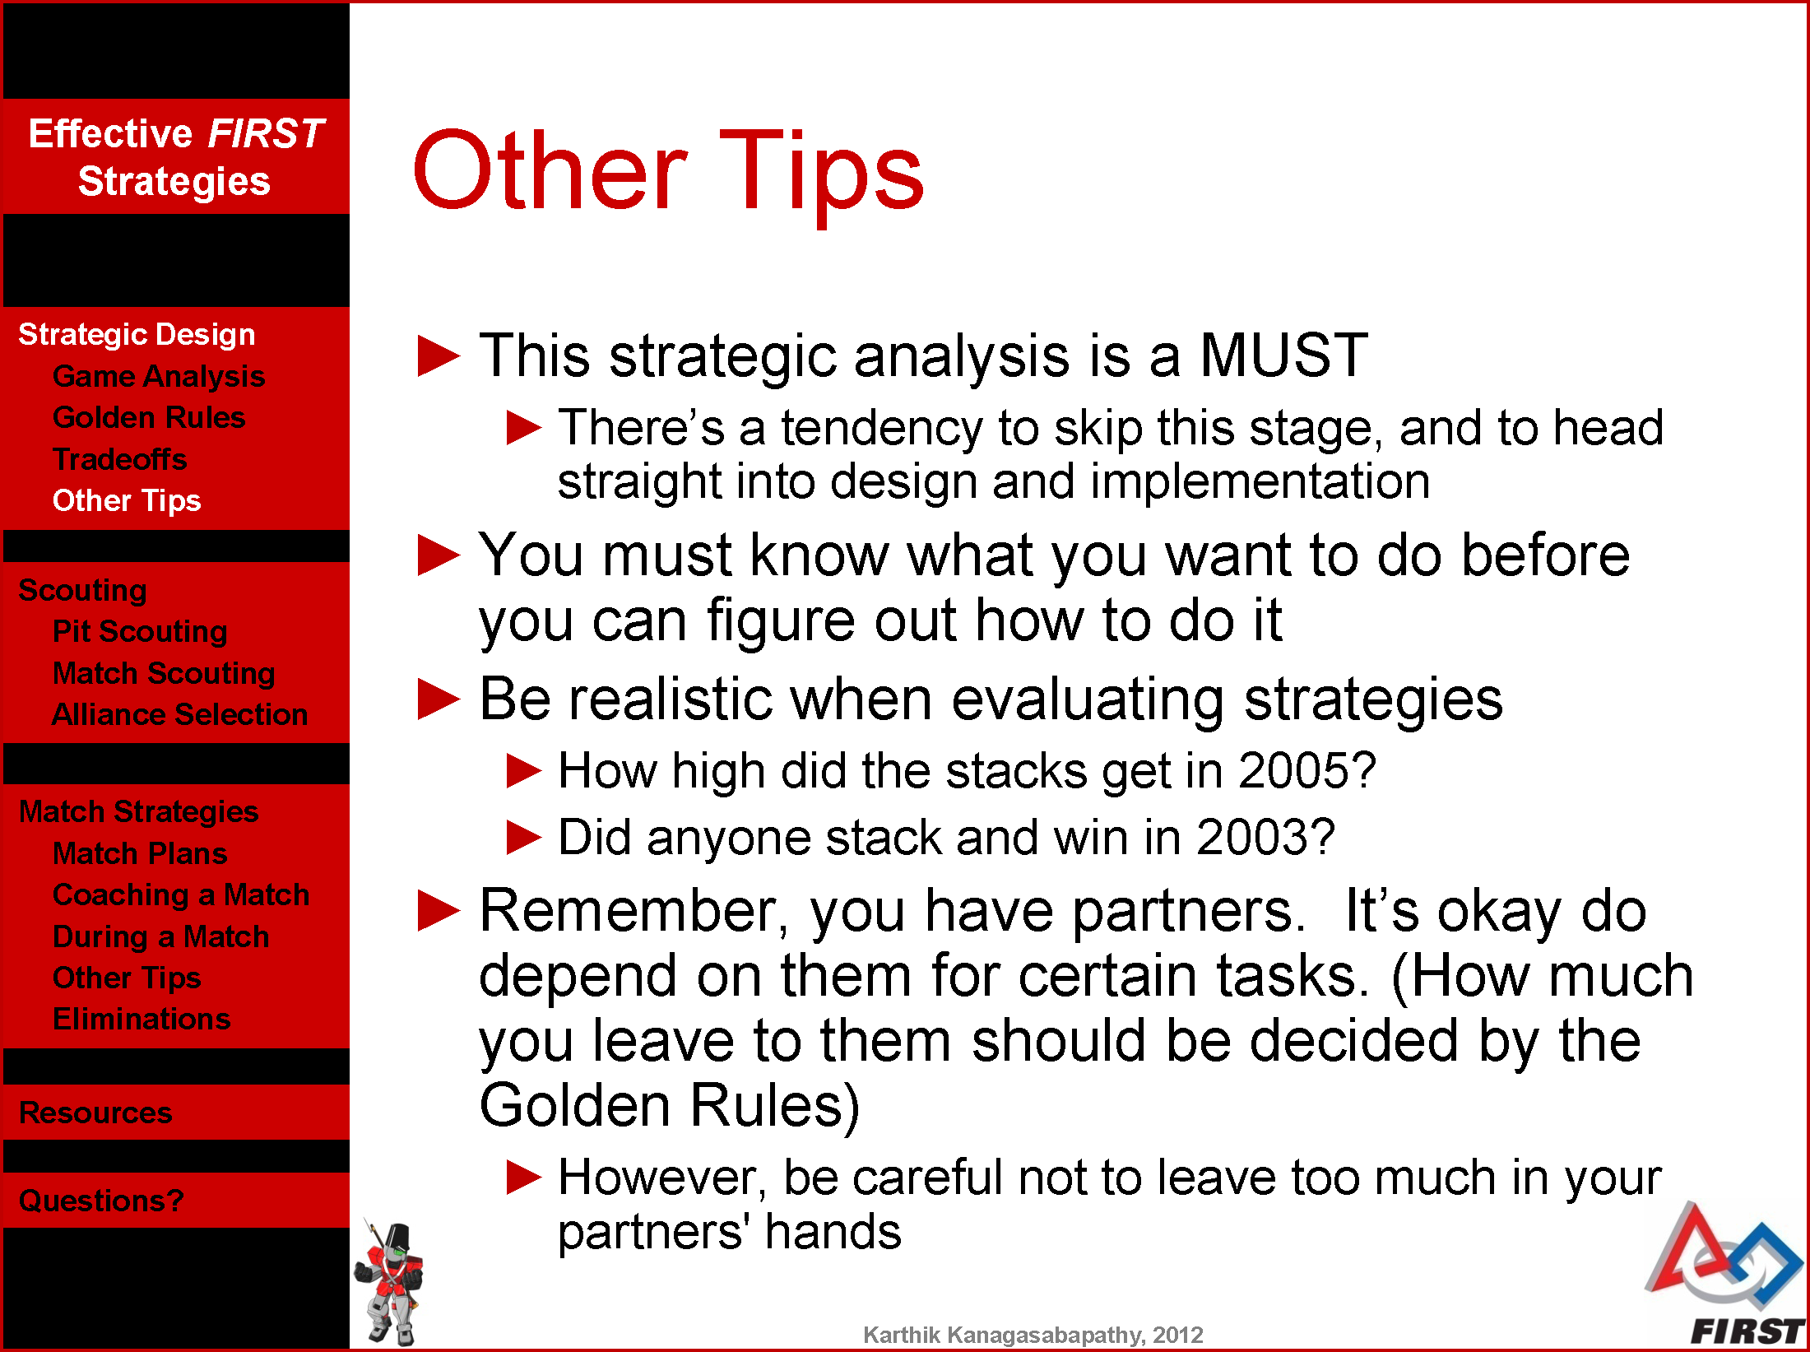

Slide 25
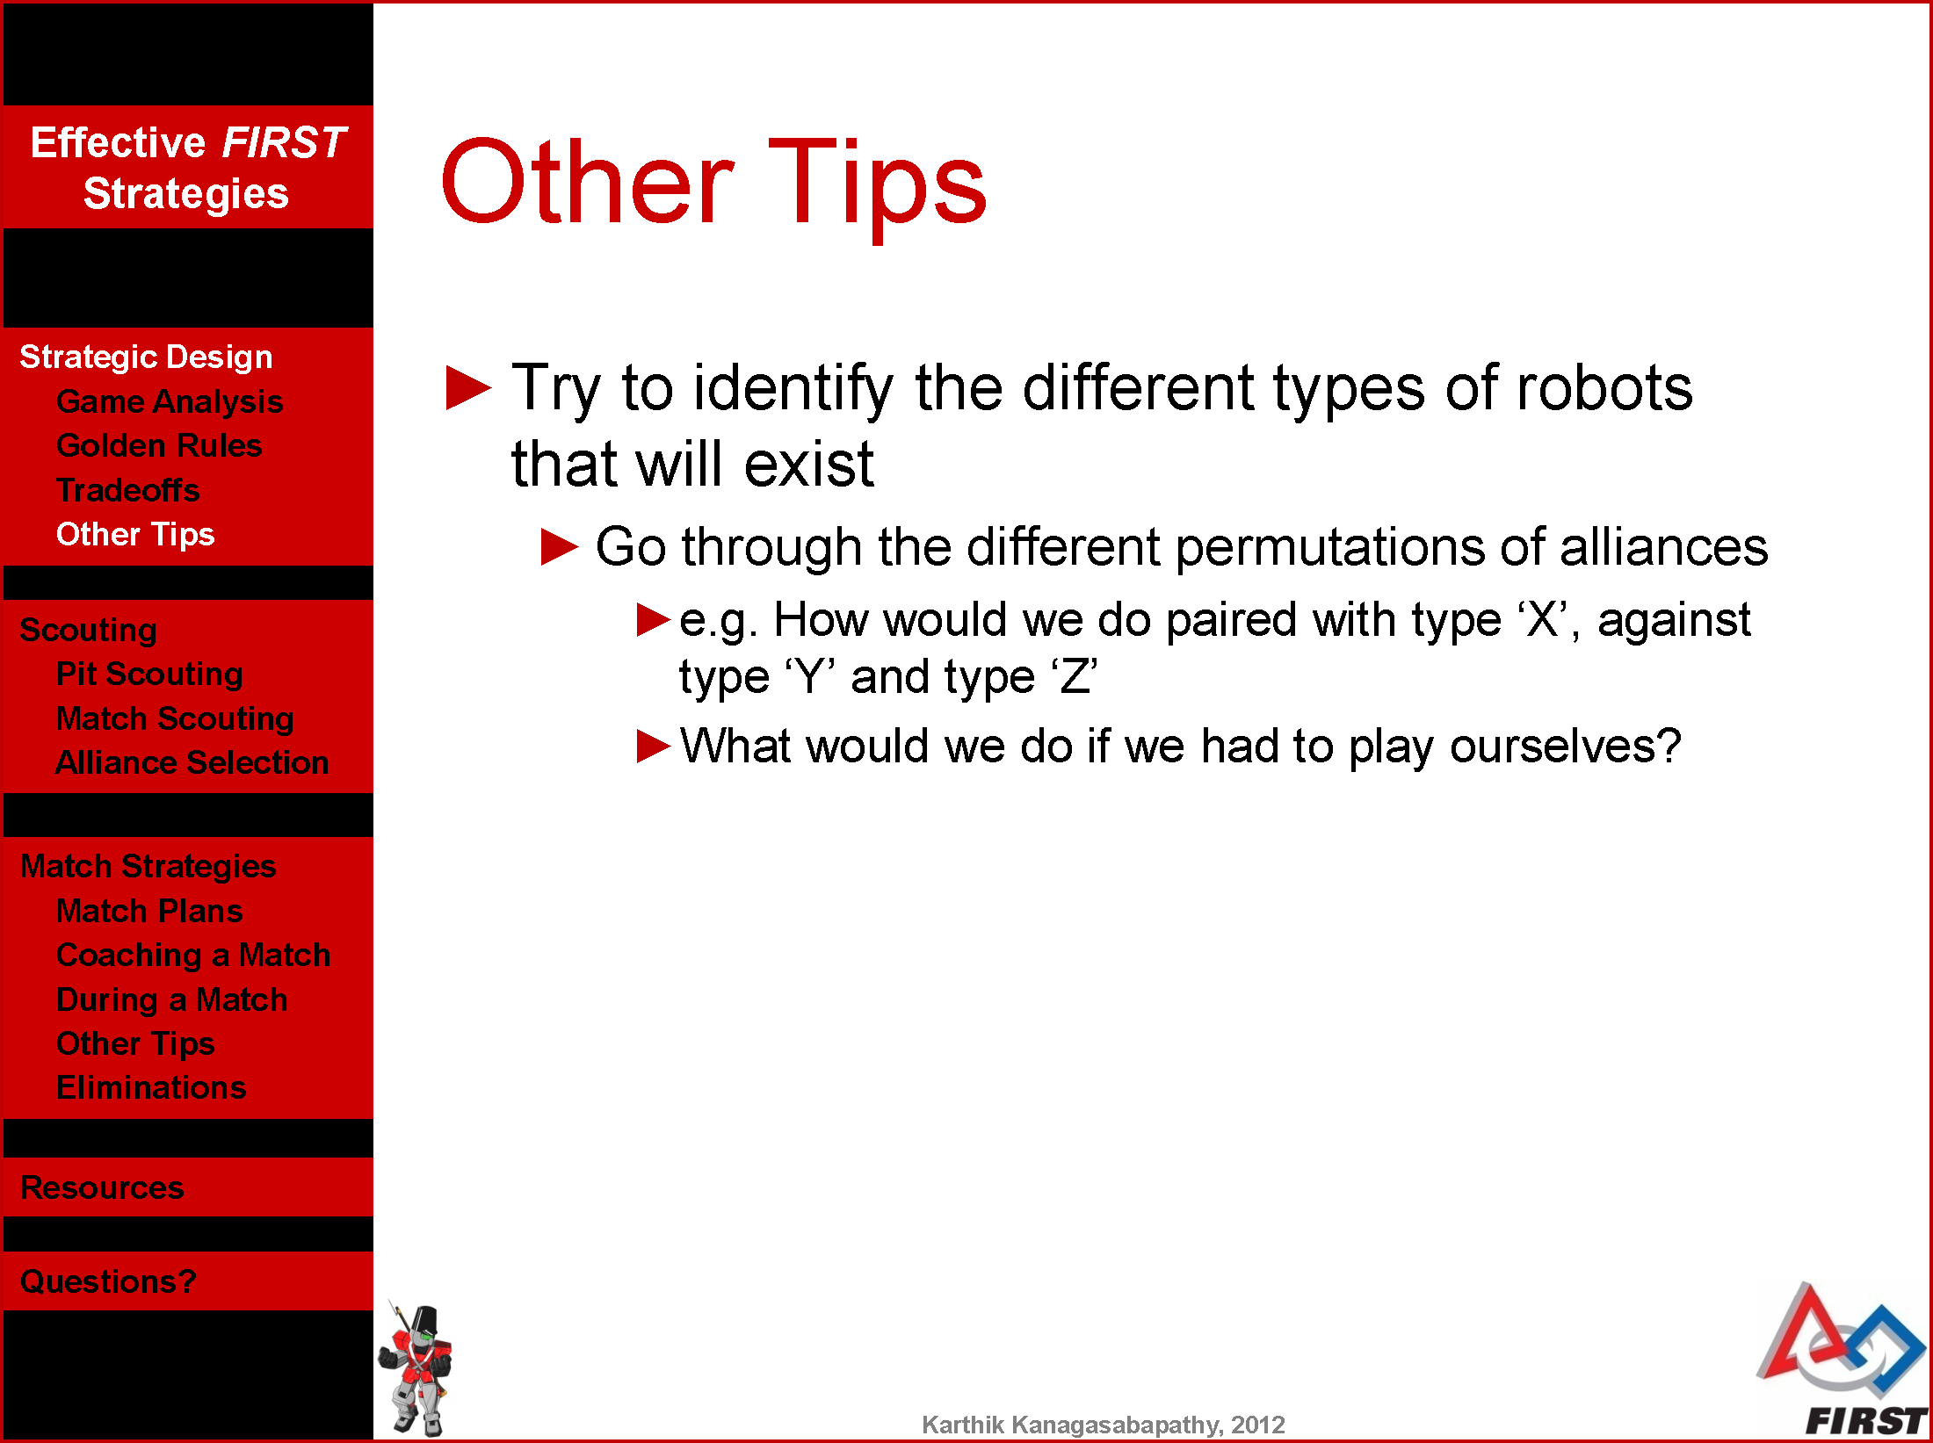

Slide 26
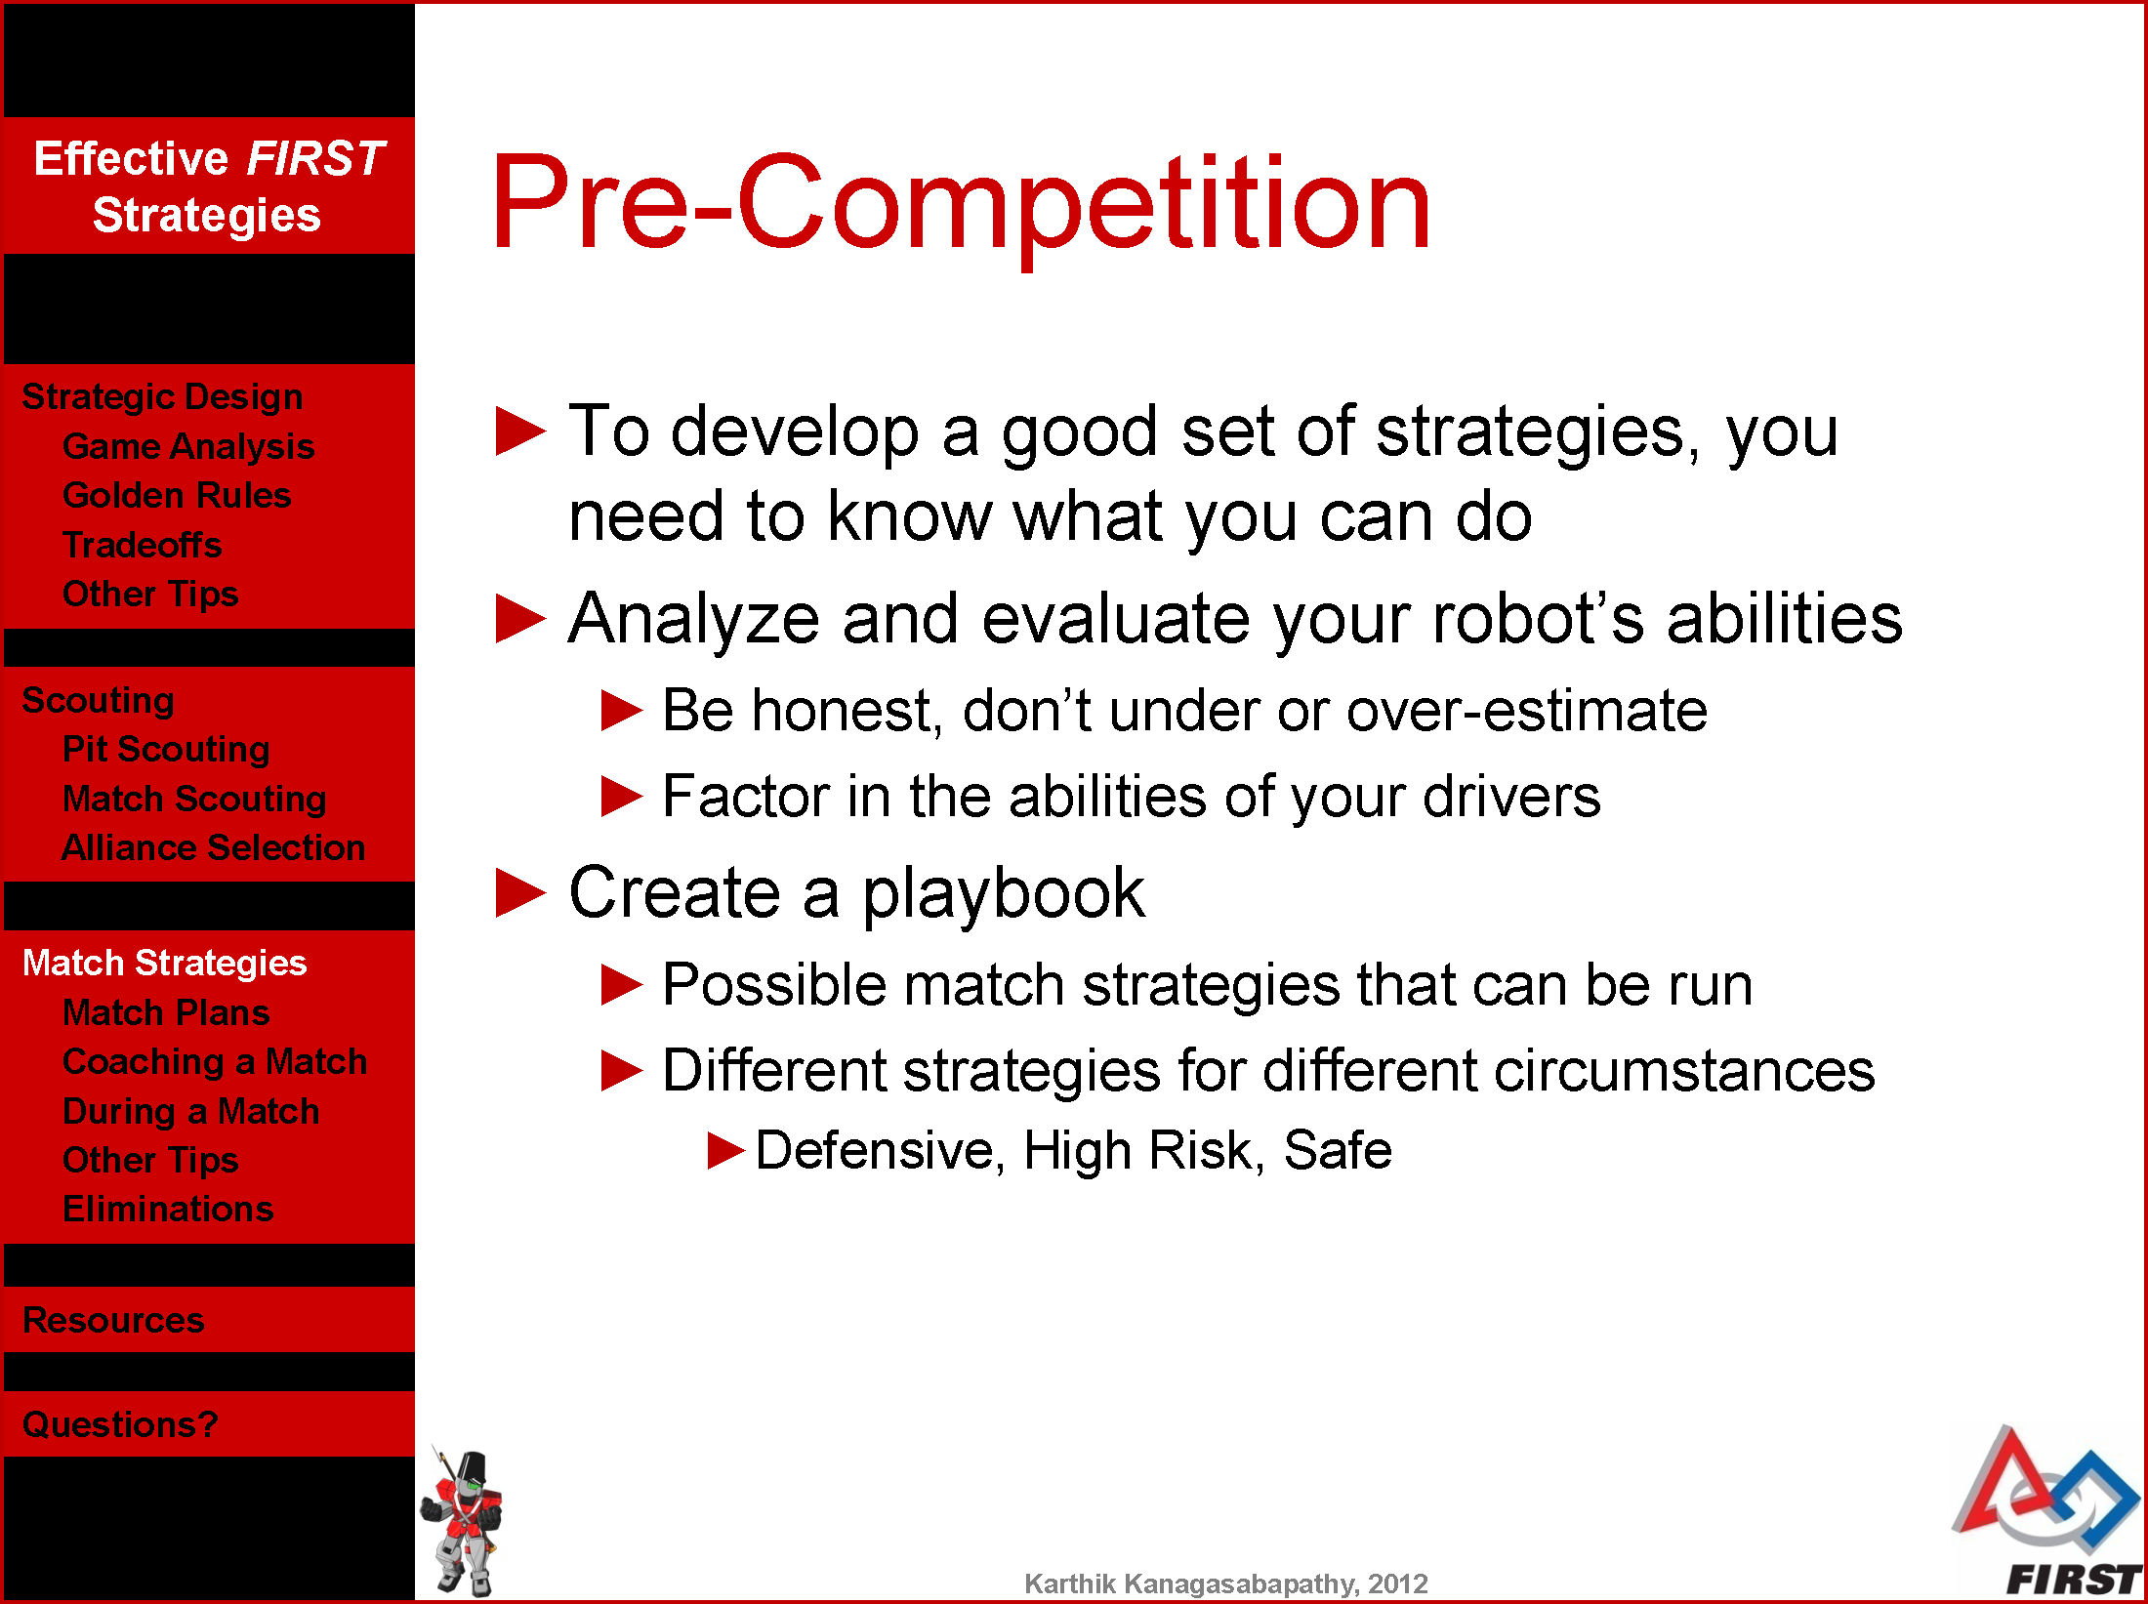

Slide 27
