Slide 1
2016 Software

Slide 2
Strategy
Get max points in autonomous
Shooting in the high goal
Driving through simple defenses
Scaling the wall

Slide 3
Requirements List
Drive the robot
Shoot the ball
Scale
Retrieve the ball

Slide 4
Robot components that software must control
Drivetrain
Wheels pull in ball and then push it back out
Rising and lowering of the arm
Piston pushes ball into the wheels
Telescoping arm
Winch
?something for pushing the hook?

Slide 5
Functions for Controller
Pull in ball (hold)
Toggle shooter
Auto aim
Raising/Lowering arm
Pushing/Pulling arm
Piston to push ball
Winch (multiple buttons?)
Analog/Joystick driving

Slide 6
Robot Sensors
Camera?
  To see/vision on autonomous mode (track the defenses/batter)
  Track (distance/azimuth/elevation) to the high goal
  Track other robots?
NavX 9 axis navigation system
  Auto align through the defenses
  Get robot to a location in autonomous mode
Selector
  Five different positions (autonomous)
Encoders
  For drive
  Winch
Limit switches?

Slide 7
Autonomous Functions
Option 1: Touch outer works (2 points)
Option 2: Just crossing defense (12 points)
Option 3: Damage a defense (22 points)
Option 4: Cross defense and shoot (22 points)
  5 different starting positions
  Drive forward (to and across defense)
  Initiate pre-shooting sequence (revving wheels, raising and extending arm)
  Find where to rotate to (dependent on starting position)
  Drive again (to batter)
  Rotate again (align with goal)
  Auto aim and shoot
Option 5: Damage defense and shoot (32 points)

Slide 8
Auto Aim
Identify target (reflective tape, shape)
Align with target
Determine distance
Adjust shooting arm based on distance
(Autonomous) Shoot the ball

Slide 9
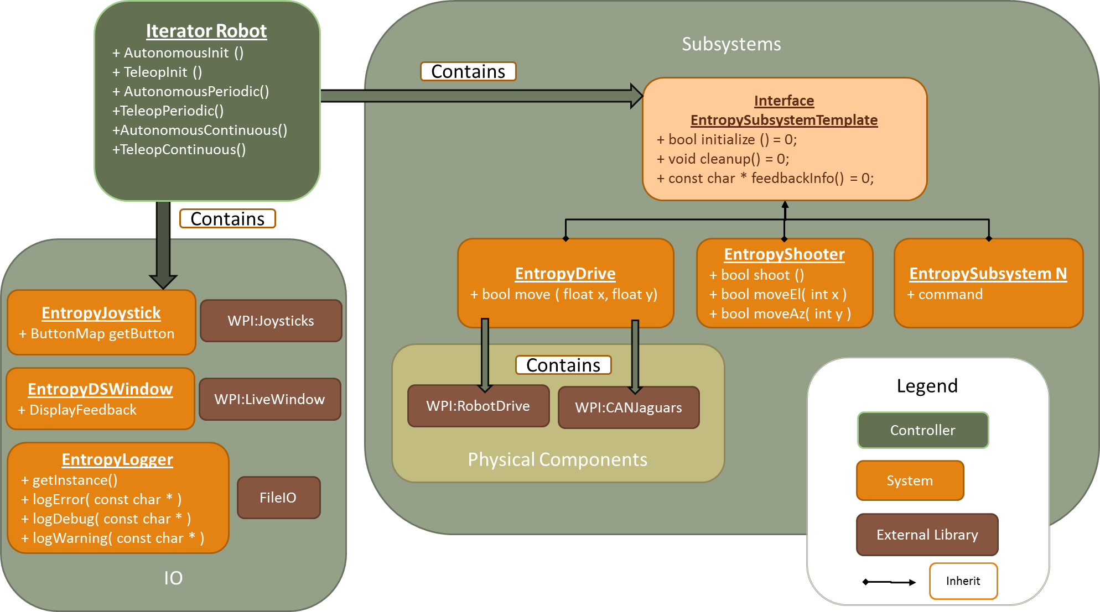

Slide 10
Software Components
RoboRIO
  Modes (anonymous, teleop)
  Subsystems(drive, arm, shooter, wench, …)
  Commands (aim, shoot, pickupBall,…)
Vision Processor (Raspberry PI)
  Find target
  Estimate distance and angle
  Find Ball
Communications & driver station
  Vision window
  Message passing library (roboRIO, PI, DriverStation)
Miscellaneous stuff
  Operating Systems
  Tools
  WPILIB
  Libraries (OpenCV)

Slide 11
Agenda for tonight
Figure out what the software will have to do. These are software requirements based on the game rules, our robot design and strategy. These will be documented in a short presentation we will give to the entire team on Wednesday.
Create a software concept that includes what sensors we could use and how we can use them to implement our strategy.
Construct a preliminary design for our software. We will start with last year’s baseline and make changes to support the new electrical/mechanical design. There have been some preseason work on an autonomous framework that we could incorporate. This design will also be presented to the team.
Finish configuring the developer laptops with the 2016 Java software toolkit. Justin has completed most of them already.
Add a vision toolkit (GRIP, Python & OpenCV) to the 5 developer laptops and any computers you be able to use. All the software is free and open source.
Agree on a configuration management system and set it up (where we keep the software)
Conduct a vision tutorial and configure the three new raspberry PI computers that the team purchased to this year’s competition

