Slide 1
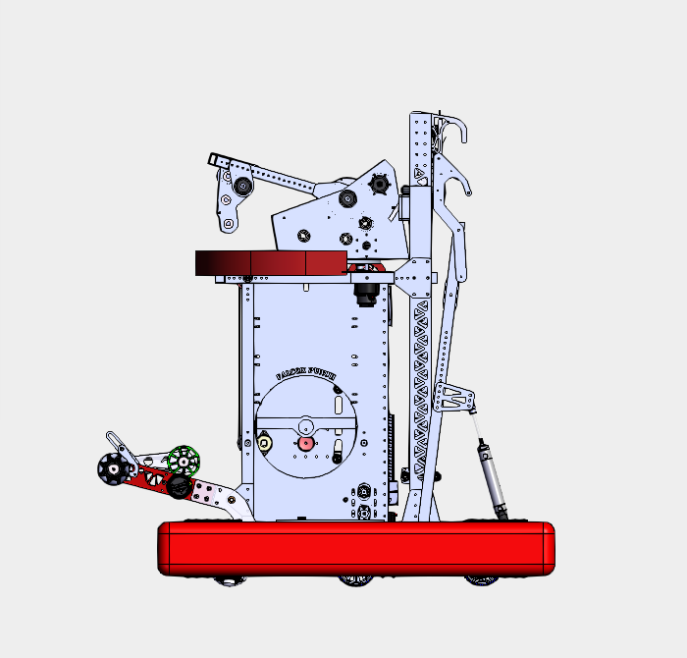
SHOOTER WHEEL
SHOOTER HOOD
TURRET
CLIMBER
INDEXER
MONKEYBAR
BLOCKER
INTAKE
POOPER
HOPPER
DRIVETRAIN

