Slide 1
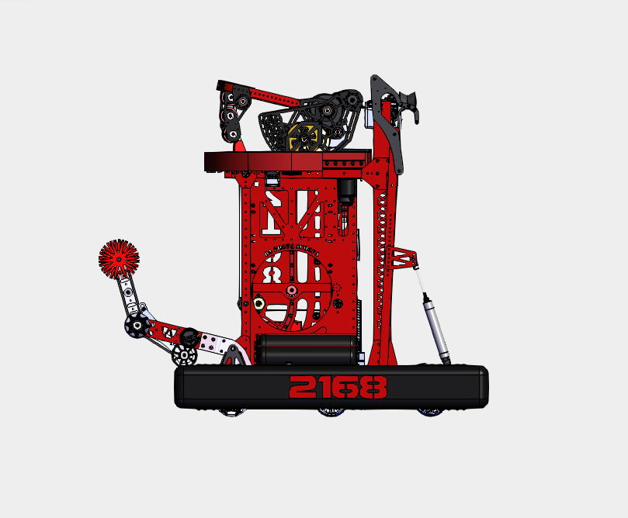
SHOOTER WHEEL
SHOOTER HOOD
TURRET
CLIMBER
INDEXER
MONKEYBAR
INTAKE
POOPER
HOPPER
DRIVETRAIN
FORWARD

