Slide 1
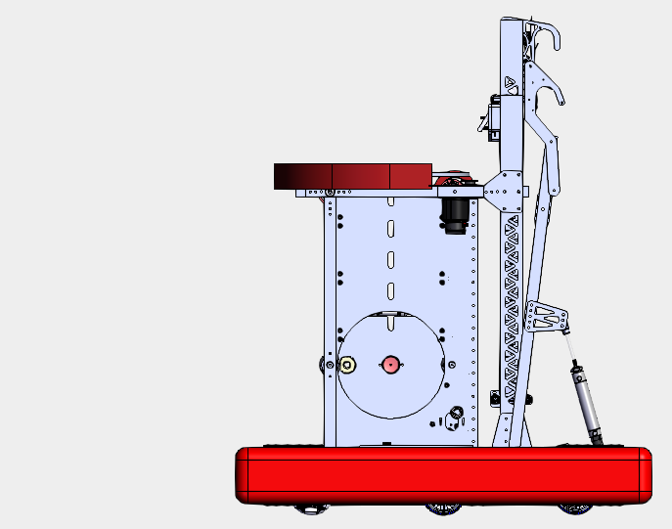
SHOOTER HOOD
SHOOTER WHEEL
TURRET
CLIMBER
INDEXER
MONKEYBAR
BLOCKER
POOPER
INTAKE
HOPPER
DRIVETRAIN

