Slide 1

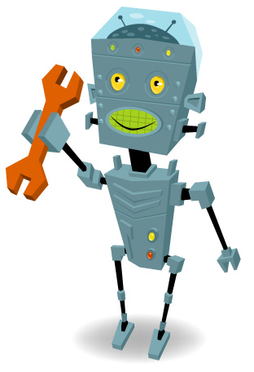
FIRST Robotics
Kick-off Meeting!
July ^{th}, 2018

Slide 2
Introductions
Mentors -
    Mrs. Hitchen, Mr. Olson
Team Leads-
    Tyler, Conner, Chris

Slide 3
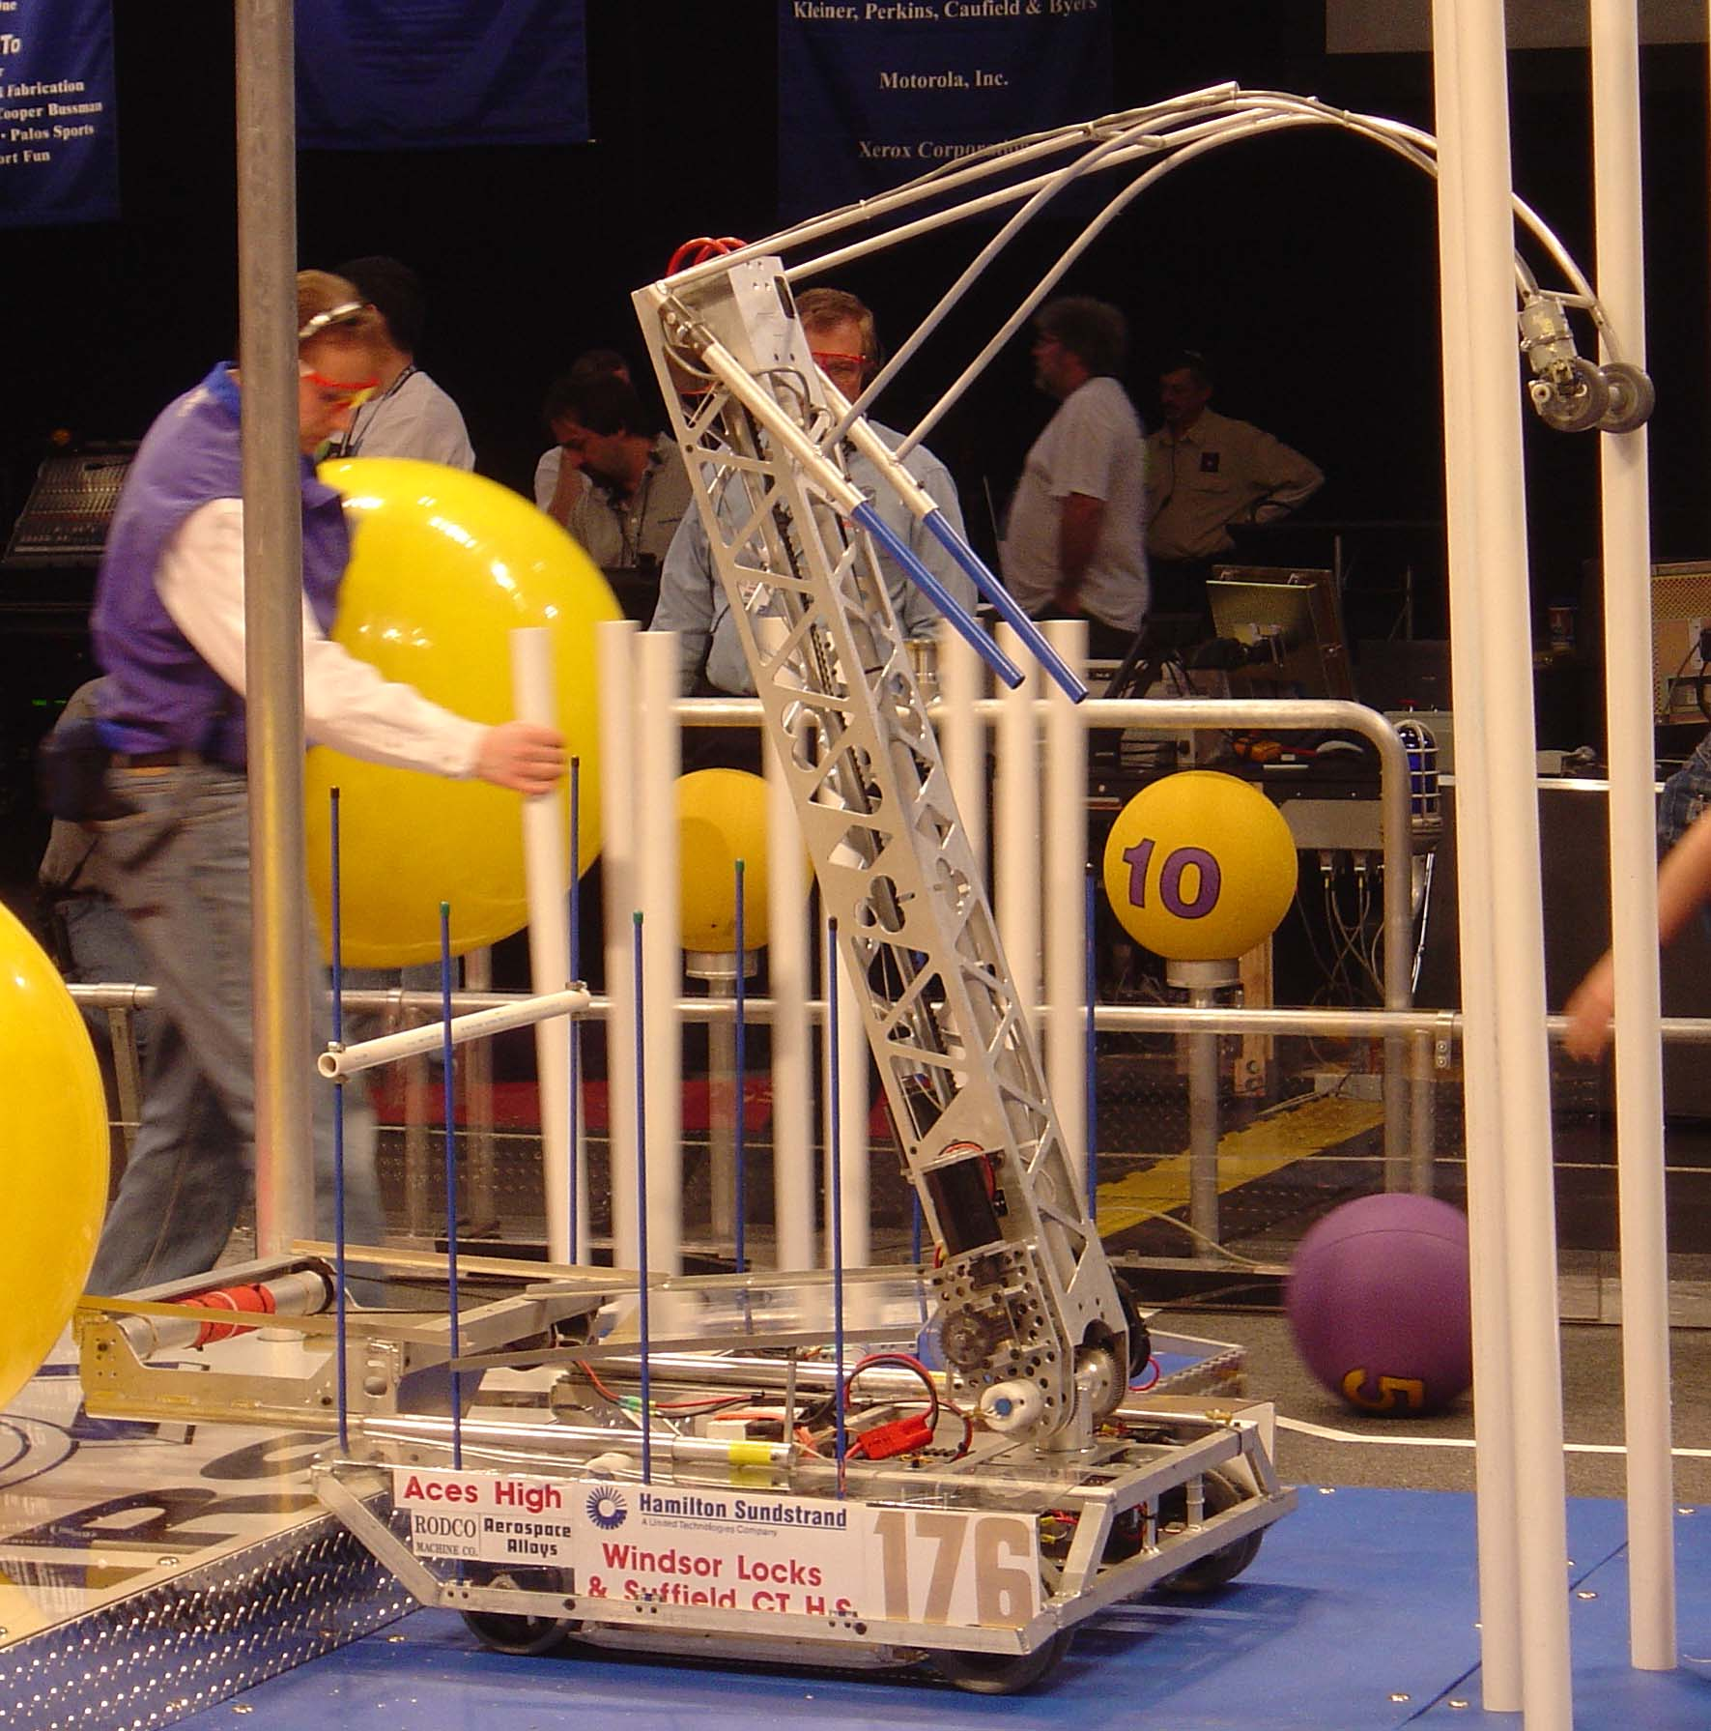
Overview
FIRST
Year Schedule
Meetings
Sub-teams
To Do
Activity

Slide 4
F.I.R.S.T.
For
Inspiration & Recognition of
Science & Technology
What does this mean?
It means that we are here to Inspire high school students by involving them in the engineering process.

Slide 5
Inspiration
“I tell you and you forget…”
“I show you and you remember…”
“I involve you and you learn…”

Slide 6
Year’s Schedule
      Meetings held once a week
June-Sept Recruiting & Organizing
Sept-Dec Team building
Jan-Feb Design and Build
March-April Competition Time!!
Competitions are Thurs-Sat. and teams can attend 1-5 regional competitions (based on location and timing) and one national competition (based on qualification)
*Note: this is team commitment time, not individual

Slide 7
Summer Meetings
If you have time to be involved over the summer, these are the plans
July 29th – 30 min roundtable
  Update on tasks, budget
August 12th – 30 min roundtable
  Update on tasks, budget, fundraising ideas
August 26 (?)
  Finalize recruiting & demos
  Finalize tasks & activities

Slide 8
Preseason Meetings
Team Meetings:
  2 to 2.5 hours after work 1/week
  Quick Team/Subteam Discussion
  Teambuilding Activity (most)
  Learning Activity (most)
Subteam Meetings:
  On an as needed basis, recommended 1/week
  Time & Location are up to subteam

Slide 9
Subteams
Mechanical/Fabrication
Electrical/Programming
3D Animation
Webpage
Strategy/Drive/Rules
Spirit/Logo
Fundraising
Business/Marketing
Photography/Videography/Documentation
Team Leads
Chairman’s Award

Slide 10
Mechanical/Fabrication
Mechanical Design of all subassemblies
Fabrication and Assembly of all subassemblies
Preseason: Mechanical Meeting Activities, Drive Train & Arm

Slide 11
Electrical/Programming
Electrical Layout of all components
Wiring of Motors
Programming the controller
Driver Controls
Preseason: Electrical & Programming Meeting Activities, Access Software

Slide 12
3D Animation
Create an entry for the 3D Animation Competition
Uses Autodesk Inventor
Preseason: Obtain & Learn Autodesk Inventor, start as much of the animation as possible

Slide 13
Webpage
Design & Implement a Team webpage for Information & Announcements
Preseason: Find domain & space for webpage, get webpage up and running, help students with webdesign/layout

Slide 14
Strategy/Drive/Rules
Know all game rules
Train the drive team (drivers and coaches must be members of this team)
Develop game and alliance strategies
Preseason: Read last year’s manual, Meeting Game/Strategy Activities, Locate all potential drive team members

Slide 15
Spirit/Logo
Develop the team Name and Logo Art
Ideally this is a student design
Create the submission to FIRST
Create all signs & robot decals with the logo
Buttons & Spirit Paraphernalia
Preseason: Locate Vendors, come up with team name/ideas & logo

Slide 16
Fundraising
Develop & Organize Fundraisers for the team
Keep track of Fundraising budgets and distribution
Preseason: FUNDRAISE!!!, keep track of fundraising budgets

Slide 17
Business/Marketing
Budgeting
Harris/Team Marketing
Business Aspects & Planning for the team
Travel Arrangements
Preseason: Arrange budget, make travel arrangements, plan

Slide 18
Photo/Video/Documentation
Take and Log all Photographs and Video of team events/meetings
Work with Marketing team and Spirit/Logo team to create Team Paraphernalia
Keep track of all team Documentation
Preseason: Photo/Video all activities, fundraisers, etc. Develop a system for team documentation (online?)

Slide 19
Team Leads
2 Harris Representatives
2-3 High School Faculty
2 Parents
2 Students
Responsible for running team meetings, activities, and making sure that all subteams are on track
Controls the schedule
All FIRST interaction and submissions

Slide 20
Chairman’s Award
This will be a small group, responsible for understanding what goes in to a chairman’s award submission for FIRST, and getting ideas to implement it for 2006
This team will not meet regularly

Slide 21
To Do!!
Tasks for Summer Handout
Team Preseason Projects
Team Preseason Competitions
Tasks

Slide 22


Activity!!
Balloon Rocket
Competition!

Slide 23
Thanks for Coming!

