Slide 1


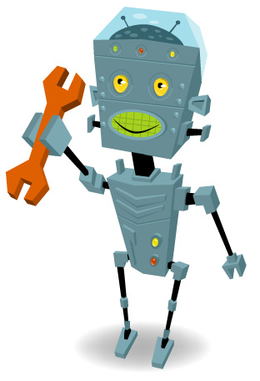
FIRST Robotics Team
Recruiting Meeting
6/23/04

Slide 2
Point of Contact
Kim O’Toole: Systems Engineer X3353 kotoole@harris.com
  HS Founding member of UTC Team 176
  Founded Clarkson University Team 229
  Volunteered for FIRST 2000-2002
Assistance from Teams
  #229 Clarkson Univ. (Potsdam, NY)
  #891 Syracuse Research Corp (Syr, NY)

Slide 3
What is FIRST?
FIRST stands for For Inspiration and Recognition of Science and Technology
The Goal of FIRST is to use Corporate and Community involvement to inspire High School students to pursue Science and Technology

Slide 4
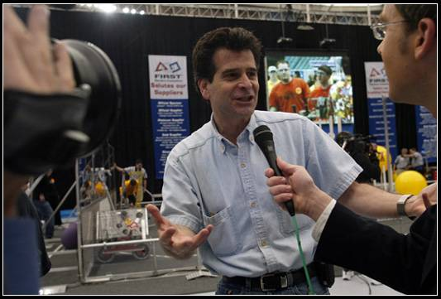
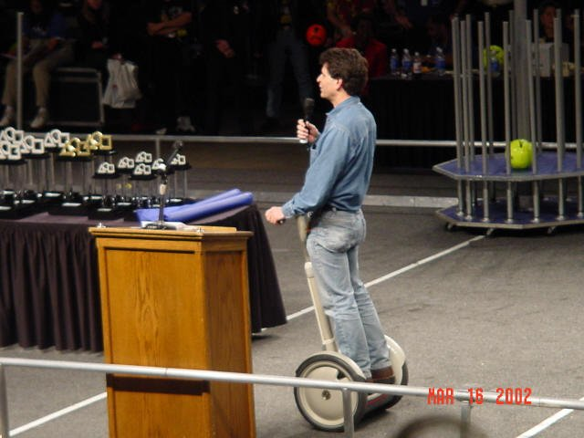
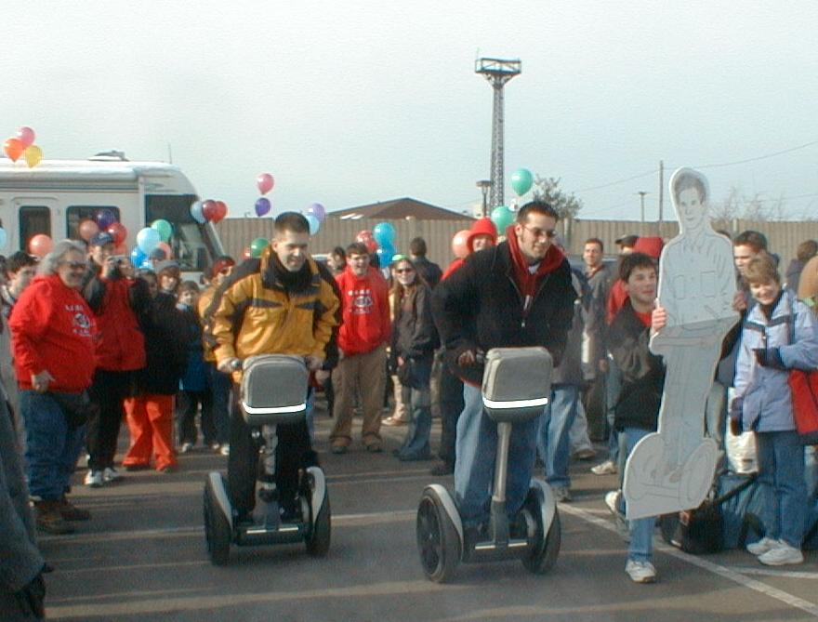
About FIRST
Founded By Dean
Kamen – Inventor
Extraordinaire!

Slide 5
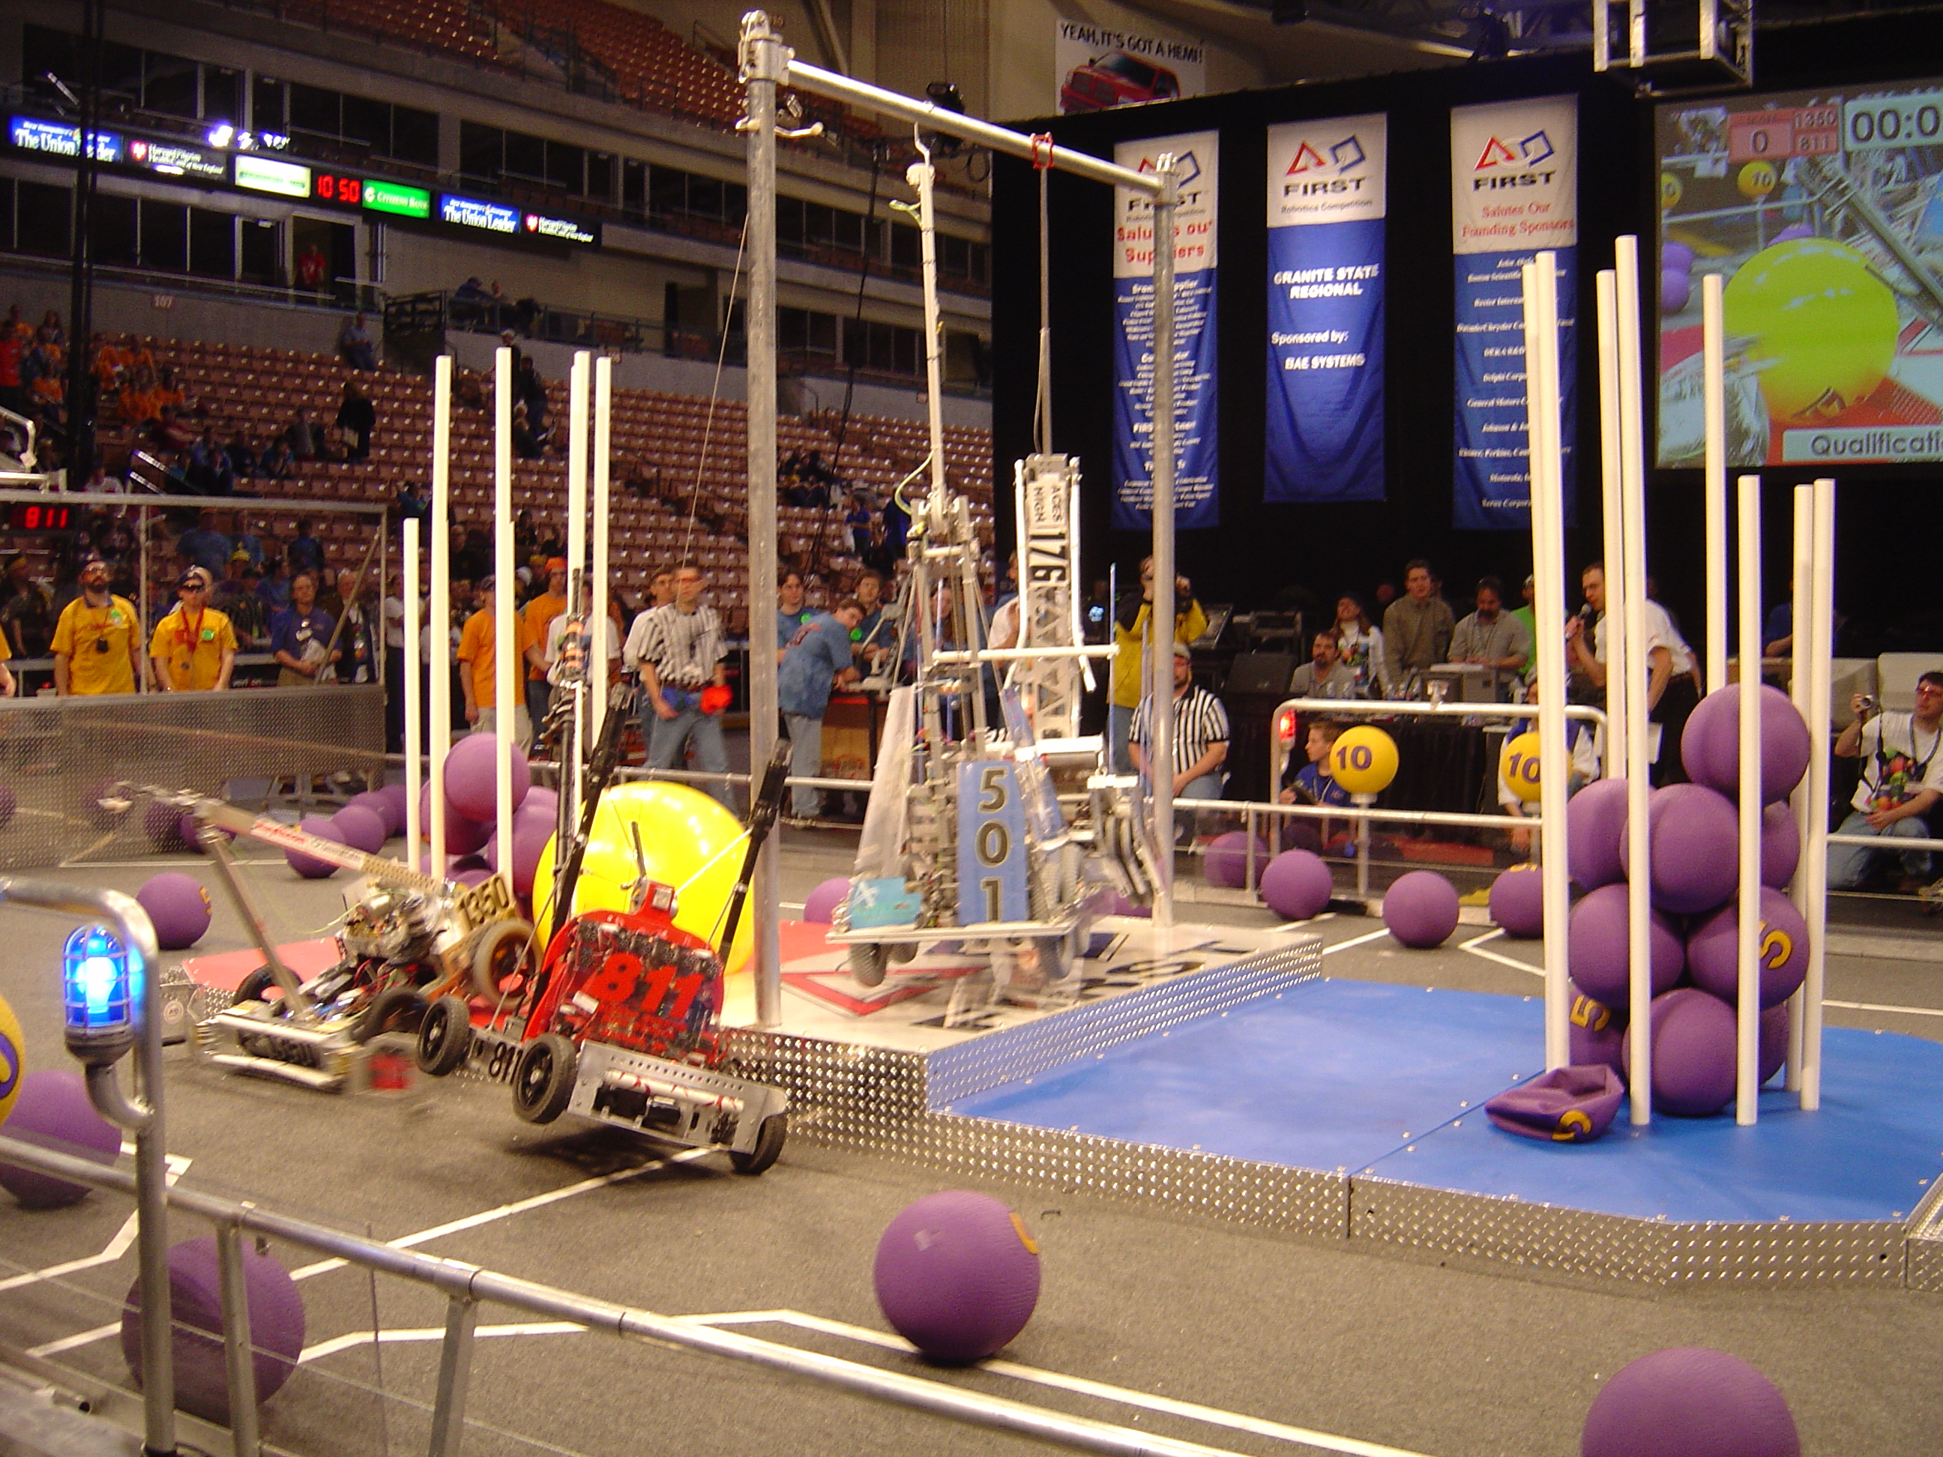
What is FIRST?
FIRST is based around a 6 week design and build period in which teams create a robot which will compete in a sporting event like competition

Slide 6
About FIRST
There are now almost 1000 teams in all 50 states, North America, South America, and Europe, with sponsors like NASA, Kodak, Bausch & Lomb, BAE, UTC, GM, Lockheed Martin, Boeing and more!
Harris GCSD sponsors the South Brevard Team #386

Slide 7
Harris & FIRST
Sponsoring Penfield High School
Working with Judy Graham – parent and St. John Fisher Professor
Full Support from Principal Mark Van Vliet
Penfield Teacher – Linda Martina

Slide 8
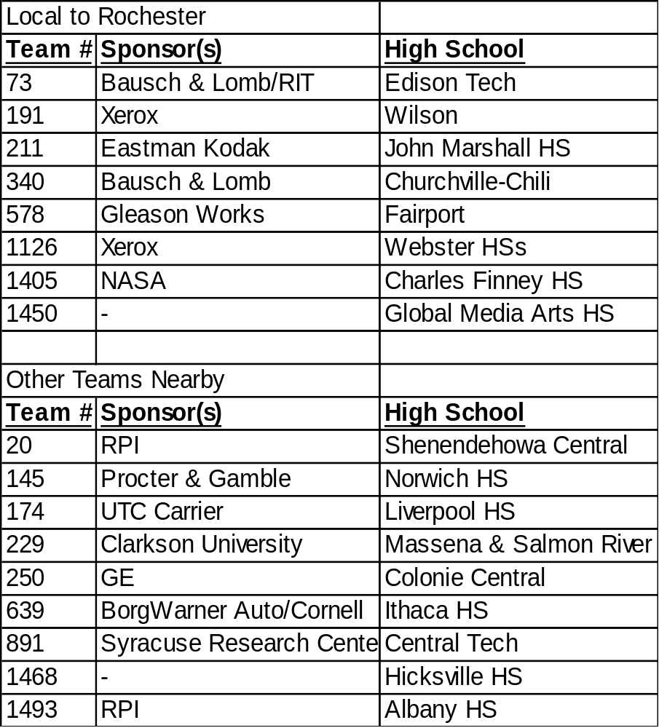
Local Teams

Slide 9
Approximate Schedule
June-Sept ’04 Recruiting & Organizing
Sept-Dec ’04 Team building Meetings held once a week at night
Jan-Feb ’05 Design and Build Phase: 3-5 nights a week, weekends as needed
March-April ’05 Competition Time!! Competitions are Thurs-Sat. and teams can attend 1-5 regional competitions (based on location and timing) and one national competition (based on qualification)

Slide 10
Sample Schedule
June-Sept ’04
Team Organization
Meetings: As Required
Sept-Dec ’04
Team Building
Meetings: 1/wk (TH?)
Jan-Feb ’05
Design & Build
Meetings: Team & Build 2/wk (M/W?), Subteams (A/R), Weekend Building 1/wk (Sa?)
March-April ‘05
Competition Time!!
Meetings: As Required
Competitions: TH-Sa
(likely 2 Competitions)

Slide 11
Time Commitment
Preseason – You should be able to attend team meetings 1/wk. Additional subteam work is optional.
Inseason – You should be able to attend meetings 2/wk for the six weeks. Additional subteam and design work will require extra time.

Slide 12
Team Specialties
Electrical
Mechanical
Programming
Fabrication
Animation
Web Design
Logo/Art
Coaching
Strategy
Fundraising
Spirit
Business
Marketing
Photo/Video

Slide 13
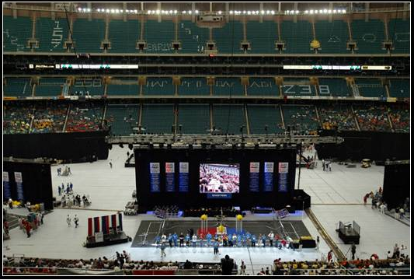
The Arena 2004 – Georgia Dome!

Slide 14
How to Get Involved
Sign up on Sign-In Sheet
Email me at kotoole@harris.com with any questions
Fill out the Info Sheet
Attend the Kick-Off Meeting
If you know of anyone interested and not present, have them email me as well.

Slide 15
Thanks for
Coming!!

