Slide 1

The Software Team: What You Need To Know
Notes:
Say your name

Slide 2

What is FIRST?
FIRST – For Inspiration and Recognition of Science and Technology
About 3000 active FRC teams around the world
Notes:
Inspires students to become future science and technology leaders through engaging mentor-based programs
Four programs, FRC, FTC, FLL, and Jr. FLL
Teams come from all around the world
California has a lot of FRC teams, compared to other regions

Slide 3
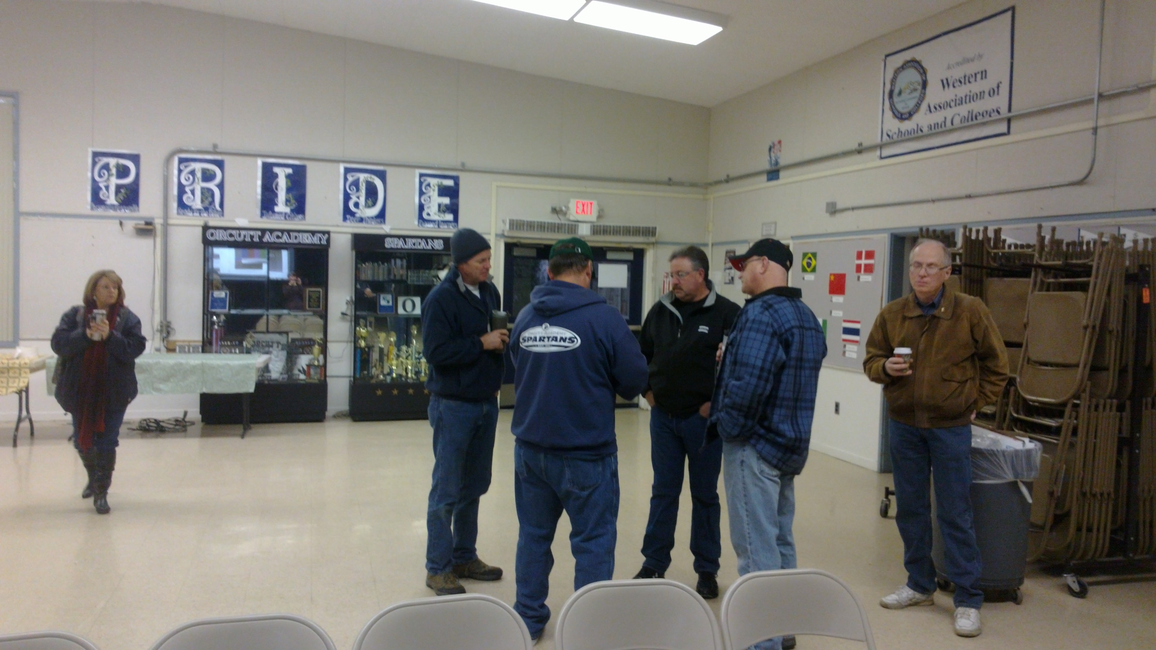
FIRST Robotics Competition
Kickoff: January 9th, 2016 at 7:30 am
Competitions we've attended
  Central Valley Regional (Madera, CA)
  Los Angeles Regional (Long Beach, CA)
  Inland Empire (San Bernardino, CA)
  Ventura Regional (Ventura, CA)
  Championship (Saint Louis, MO)
Mentors At 2015 Kickoff
Notes:
Kickoff occurs in January every year
Teams watch a live video feed describing the upcoming game, and begin designing their robots
All teams have exactly six weeks to prepare their robots for competition
Teams can attend multiple competitions
We usually attend two or three
Moving to the district model
More levels to the hierarchy
At 3512, students build the robot, but often with considerable input from mentors

Slide 4
We're part of Spartatroniks
One of the three major robot-related subteams
Responsible for the control system, and integration with the other elements.
We program things
  Actually, we “engineer software”
Every year, we expand slightly beyond our current abilities
Business
Electrical
Outreach
Mechanical
Software
Notes:
We work closely with the electrical subteam to integrate the control system
Discuss the improvements to quality, processes, and capabilities we've made over the past two years (last bullet point)

Slide 5
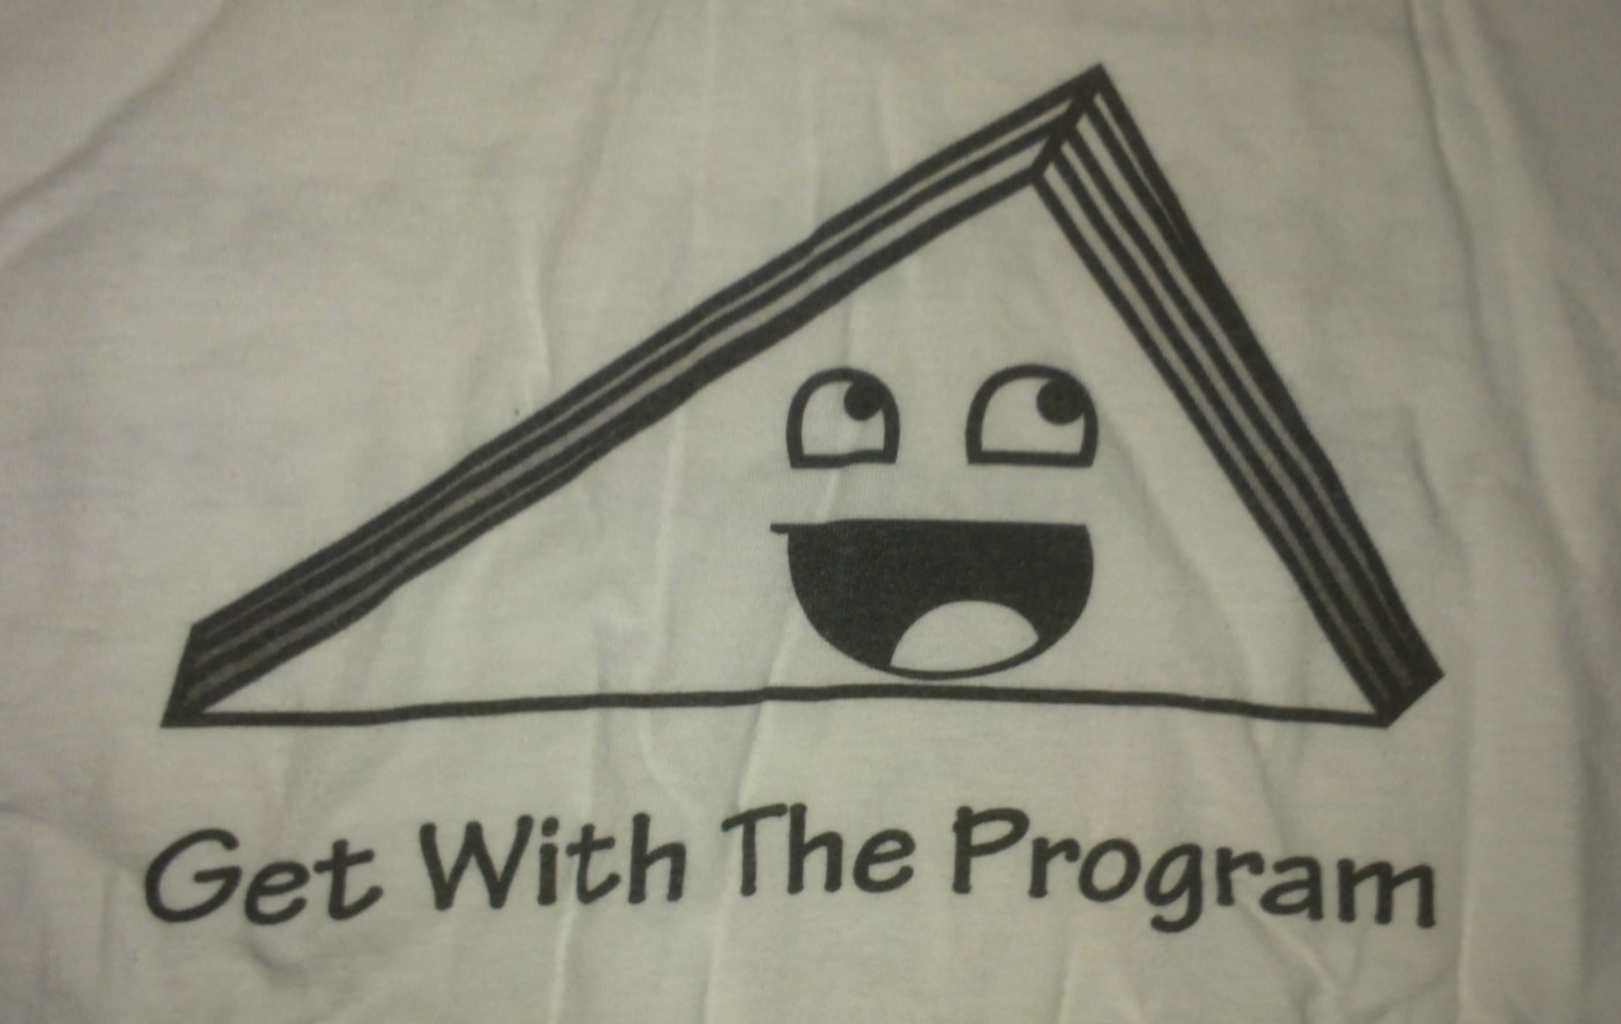
Triangleman
T-shirt with the software team's mascot
Notes:
Originally a block of scrap wood, Triangleman has become the official mascot of the software team
Triangleman represents our subteam and our culture

Slide 6
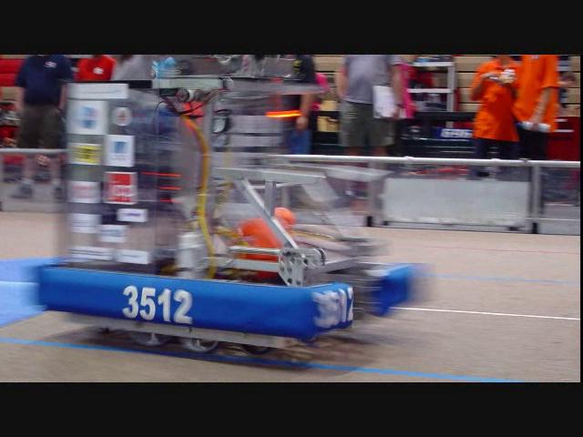
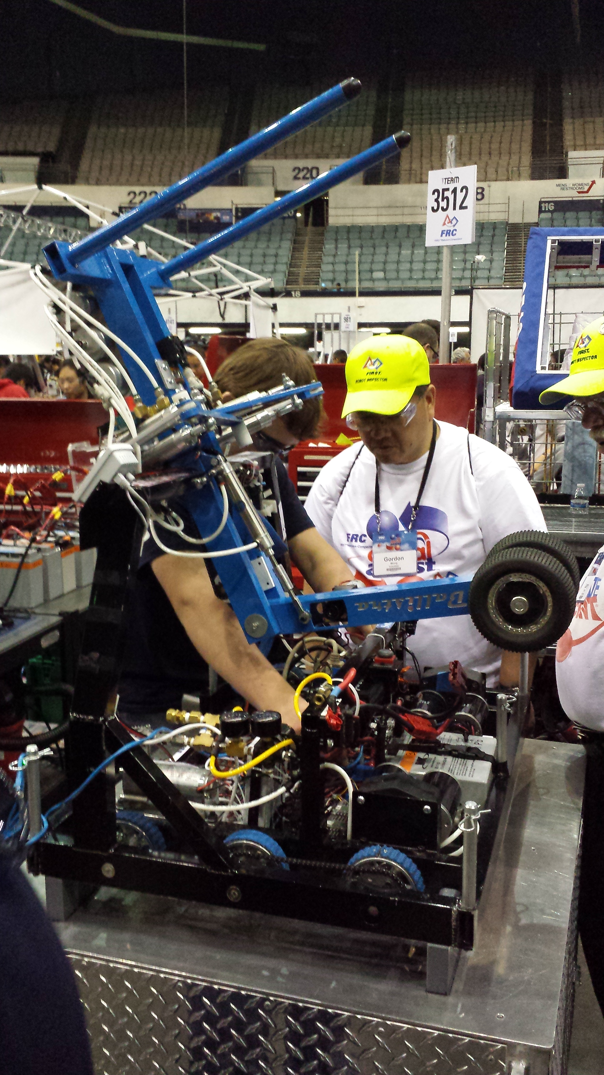
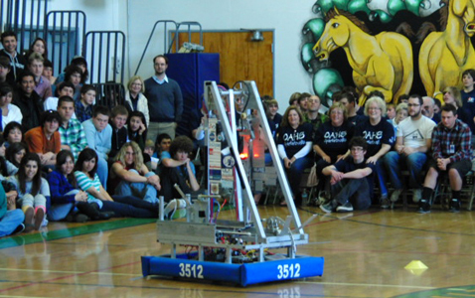
Our History
This will be our fifth season!
  2011 – Logomotion
    Hanging tubes on racks
  2012 – Rebound Rumble
    Shooting hoops
  2013 – Ultimate Ascent
    Tossing frisbees
  2014 – Aerial Assist
    Chucking yoga balls
  2015 – Recycle Rush
    Stacking totes and cans
Leonidas (2012)
Ballistra (2014)
Thermopylae (2011)
Notes:
Personal experience with the team

Slide 7
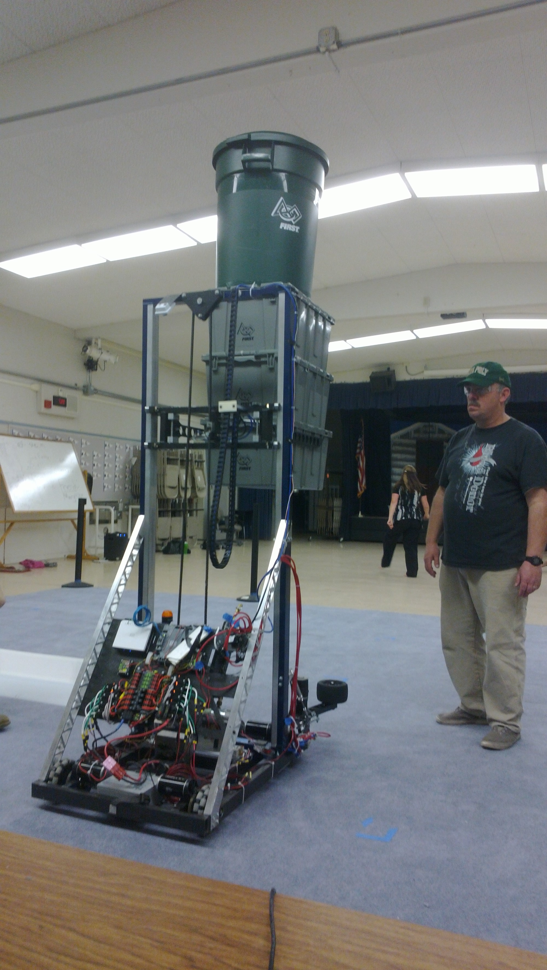
Talos – 2015
Team coach Gerrit Hull ready to catch falling objects during testing
Notes:
Elevator
Lifts up to six totes with a can
Controlled by PID and trapezoidal motion profiles
An encoder before the gearbox tracks position
A switch at the bottom “zeros” the encoder accumulator
Drivers can choose predefined levels (setpoints) with buttons
Auto stacking
Driver can press a button which causes the robot to pick up the bins underneath it
Procedure
Set level just above bins
Press auto stacking button
Releases totes
Moves to ground level
Grabs totes
Moves up to storage level
Implemented with a state machine
Provided significant competitive advantage
Drive train
Implements “Cheezy Drive”
Driver specifies a forward speed with one joystick, and a turning radius with another
Provides a smoother experience for the drivers
Most advanced control system we've built so far

Slide 8
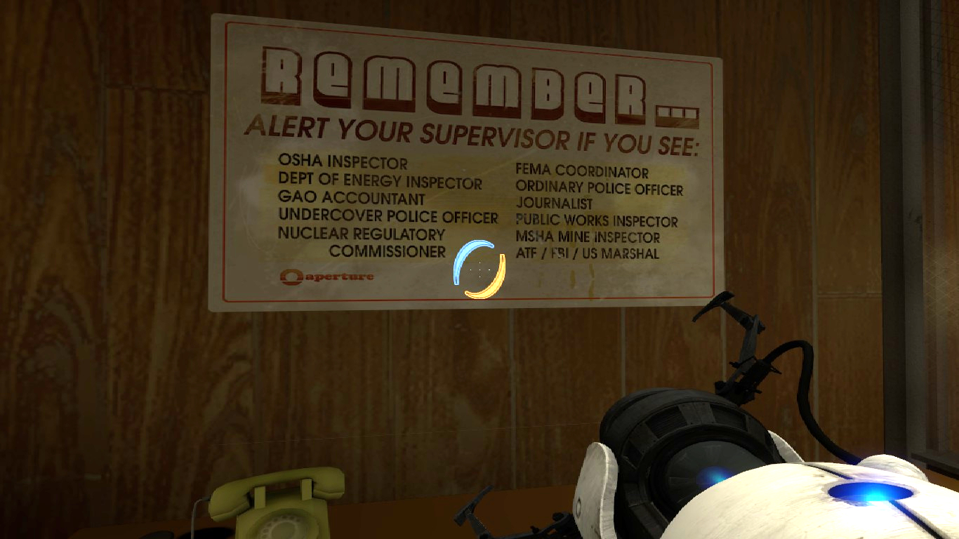
Build Season Timeline
Watch game video release, receive KoP
  Contribute to robot design / prototyping
Get RoboRIO up and running
  Create a complete test setup, get a basic system fully operational
Identify challenges/problems, and begin solving them
Be ready for hardware when it becomes ready
Test the code on the hardware
Make changes as requested
Provide support to other subteams (testing for hardware/electrical)
Go away! We're busy testing.

Slide 9
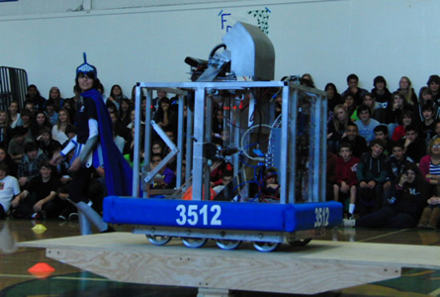
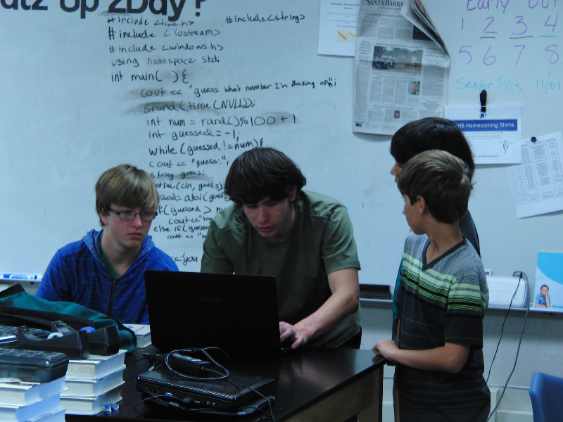
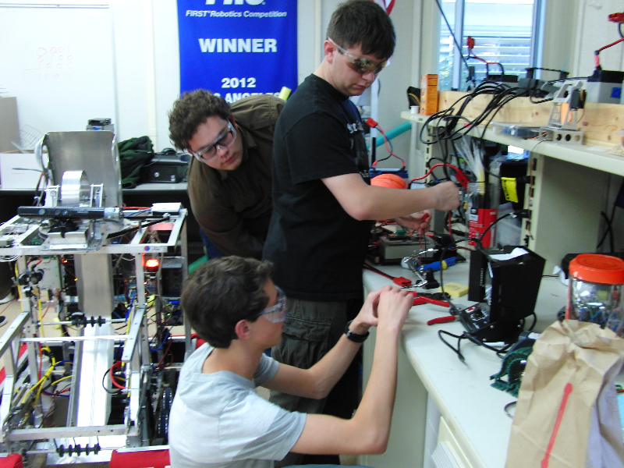
Ribbit!
Harrison working with some new recruits
Electrical monkeys at work
Notes:
We hold school-wide rallies every year after we finish the robot

Slide 10
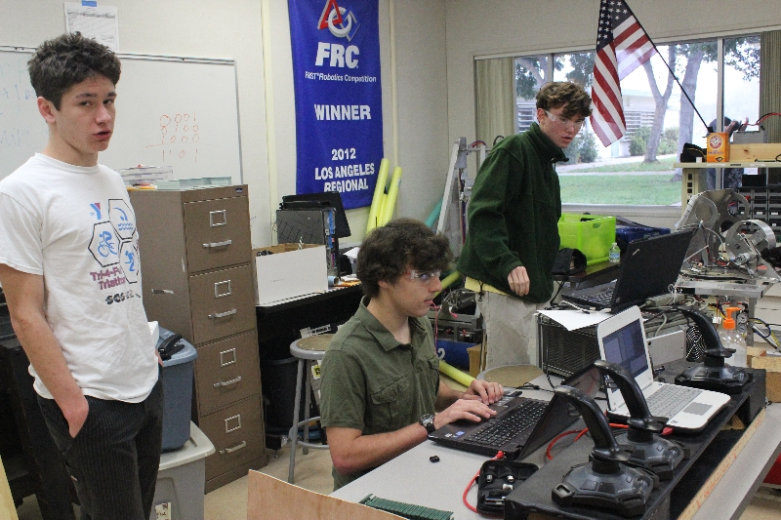
What We Do
We program robots
  Write the code (instructions) that enable the drivers to efficiently control the robot
  Look for ways to improve the drivers' interaction with the robot
  Use algorithms in software to enable the use of more versatile hardware (PID controllers, motion profiles, Kalman filters, state machines)
Test the system
  Ensure that all systems (software, electrical, and mechanical) are fully functional
  Analyze problems, fix them, and prevent them from recurring
A typical day on the software team
Notes:
We use PID controllers to make the robot perform actions repeatably.
Leonidas' flywheel, Talos' elevator
Motion profiles provide a more predictable response for PID controllers.
They change the setpoint over time toward a goal (trapezoidal motion profiles have a velocity graph over time that's shaped like a trapezoid).
Kalman Filters are state estimators which provide estimates of unknown states based on noisy inputs.
Cynisca's flywheel
State machines are used to automate sequences of actions.
Talos' elevator auto-stacking code

Slide 11
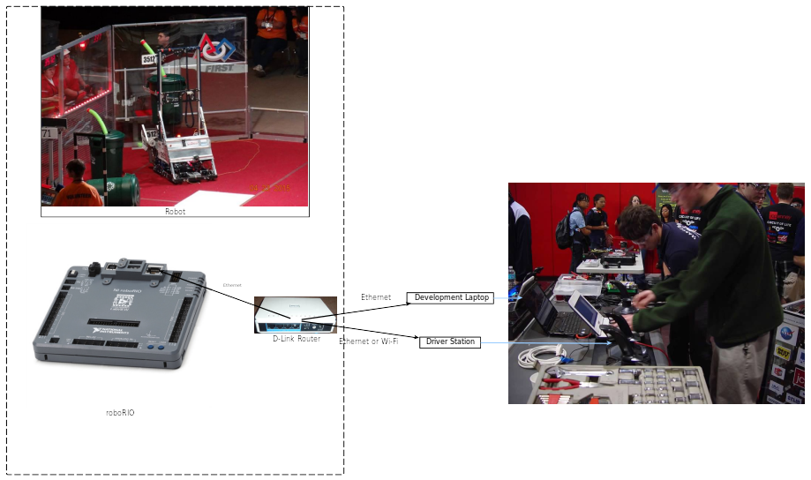
Basic Control System
Notes:
Components
RoboRIO controls the robot and runs our code
Connects to the Driver's Station via UDP
Drivers control the robot state using joysticks on the Driver's Station console
During actual match play, the FMS controls the robot state (Enabled / Disabled)
Field Management System communicates with the Driver's Station via Ethernet
Driver's Station communicates with the robot via 802.11 (WiFi) access points on the field
For testing, we either connect the DS computer directly to an access point on the robot, or we use Ethernet

Slide 12
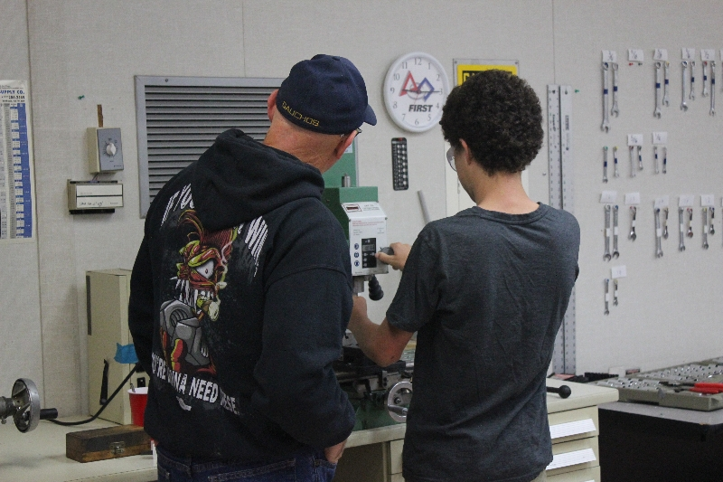
Tools We Use
Linux
  Target and development system
Toolchain
  arm-frc-linux-gnueabi-gcc
  Vendor supplied packages available for Windows and several Linux distributions
Eclipse + vim
CMake
Git
WPILib
  Super nice hardware abstraction layer
RoboRIO
  ARM v7 embedded Linux machine
  Contains an Altera Spartan FPGA with a FIRST-supplied image for mechanical safety and control
The mechanical guys using their tools
Notes:
We primarily develop on Linux using these tools
Code runs on the roboRIO, and embedded ARM / Linux system with an FPGA
We build code and deploy it over Ethernet / SSH using FIRST-provided Eclipse plugins
We build our code on top of WPILib, a library that provides the basic tools we need to write working robot code
WPILib makes it easy to do basic things, but also enables more advanced techniques

Slide 13
#ifndef ROBOT_HPP
#define ROBOT_HPP
#include <chrono>
using namespace std::chrono_literals;
#include <SampleRobot.h>
#include <Joystick.h>
#include <Solenoid.h>
#include <Timer.h>
#include "Subsystems/DriveTrain.hpp"
#include "Subsystems/Elevator.hpp"
#include "ButtonTracker.hpp"
#include "Settings.hpp"
#include "DSDisplay.hpp"
#include "LiveGrapherHost/GraphHost.hpp"
class Robot : public SampleRobot {
public:
Robot();
void OperatorControl();
void Autonomous();
void Disabled();
void AutoNoop();
void AutoDriveForward();
void AutoResetElevator();
void AutoOneCanLeft();
void AutoOneCanCenter();
void AutoOneCanRight();
void AutoOneTote();
void AutoMotionProfile();
void DS_PrintOut();
static float applyDeadband(float value, float deadband);
private:
Settings settings{"/home/lvuser/RobotSettings.txt"};
DriveTrain robotDrive;
Elevator ev;
Joystick driveStick1{0};
Joystick driveStick2{1};
Joystick evStick{2};
ButtonTracker drive1Buttons{0};
ButtonTracker drive2Buttons{1};
ButtonTracker evButtons{2};
Timer autoTimer;
Timer displayTimer;
// Used for sending data to the Driver Station
DSDisplay& dsDisplay{DSDisplay::getInstance(settings.getInt("DS_Port"))};
// The LiveGrapher host
GraphHost pidGraph{3513};
};
#endif // ROBOT_HPP
WPILib header includes
Subsystems (in house)
Keeps track of Joystick button states (in house)
Overridden from SampleRobot. These are called by WPILib on state changes
Logging and user feedback (in house)
Notes:
This is the core of our 2015 robot code
This is the header of the Robot class
The Robot class is instantiated by WPILib, forming our interface to WPILib
WPILib calls these overridden functions to signal changes to the Driver's Station's state
Subsystems are (mostly) implemented in their own classes
The Robot class handles their coordination

Slide 14
Called when driver or FMS enables robot in Operator Control mode
…
void Robot::OperatorControl() {
while (IsEnabled() && IsOperatorControl()) {
if (driveStick2.GetRawButton(2)) {
robotDrive.drive(driveStick1.GetY(), driveStick2.GetX(), true);
}
else {
robotDrive.drive(driveStick1.GetY(), driveStick2.GetX());
}
// Open/close tines
if (evButtons.releasedButton(1)) {
ev.elevatorGrab(!ev.isElevatorGrabbed());
}
// Open/close intake
if (evButtons.releasedButton(2)) {
ev.intakeGrab(!ev.isIntakeGrabbed());
}
// Start auto-stacking mode
if (evButtons.releasedButton(3)) {
ev.stackTotes();
}
…
std::this_thread::sleep_for(10ms);
}
}
…
START_ROBOT_CLASS(Robot);
Loop handles input, processing, and control with a period of about 0.01 seconds
Drive the wheels with values from the joysticks
Handles elevator operation (there is more!)
More
Macro that makes an instance of Robot. Essentially
int main() { // Make a Robot }
Notes:
This is an excerpt from the loop that runs in when the robot is enabled in operator controlled mode
The loop polls the various subsystems and handles input and output
We wait 10ms each loop cycle to prevent CPU saturation
WPILib is based on a polling paradigm

Slide 15
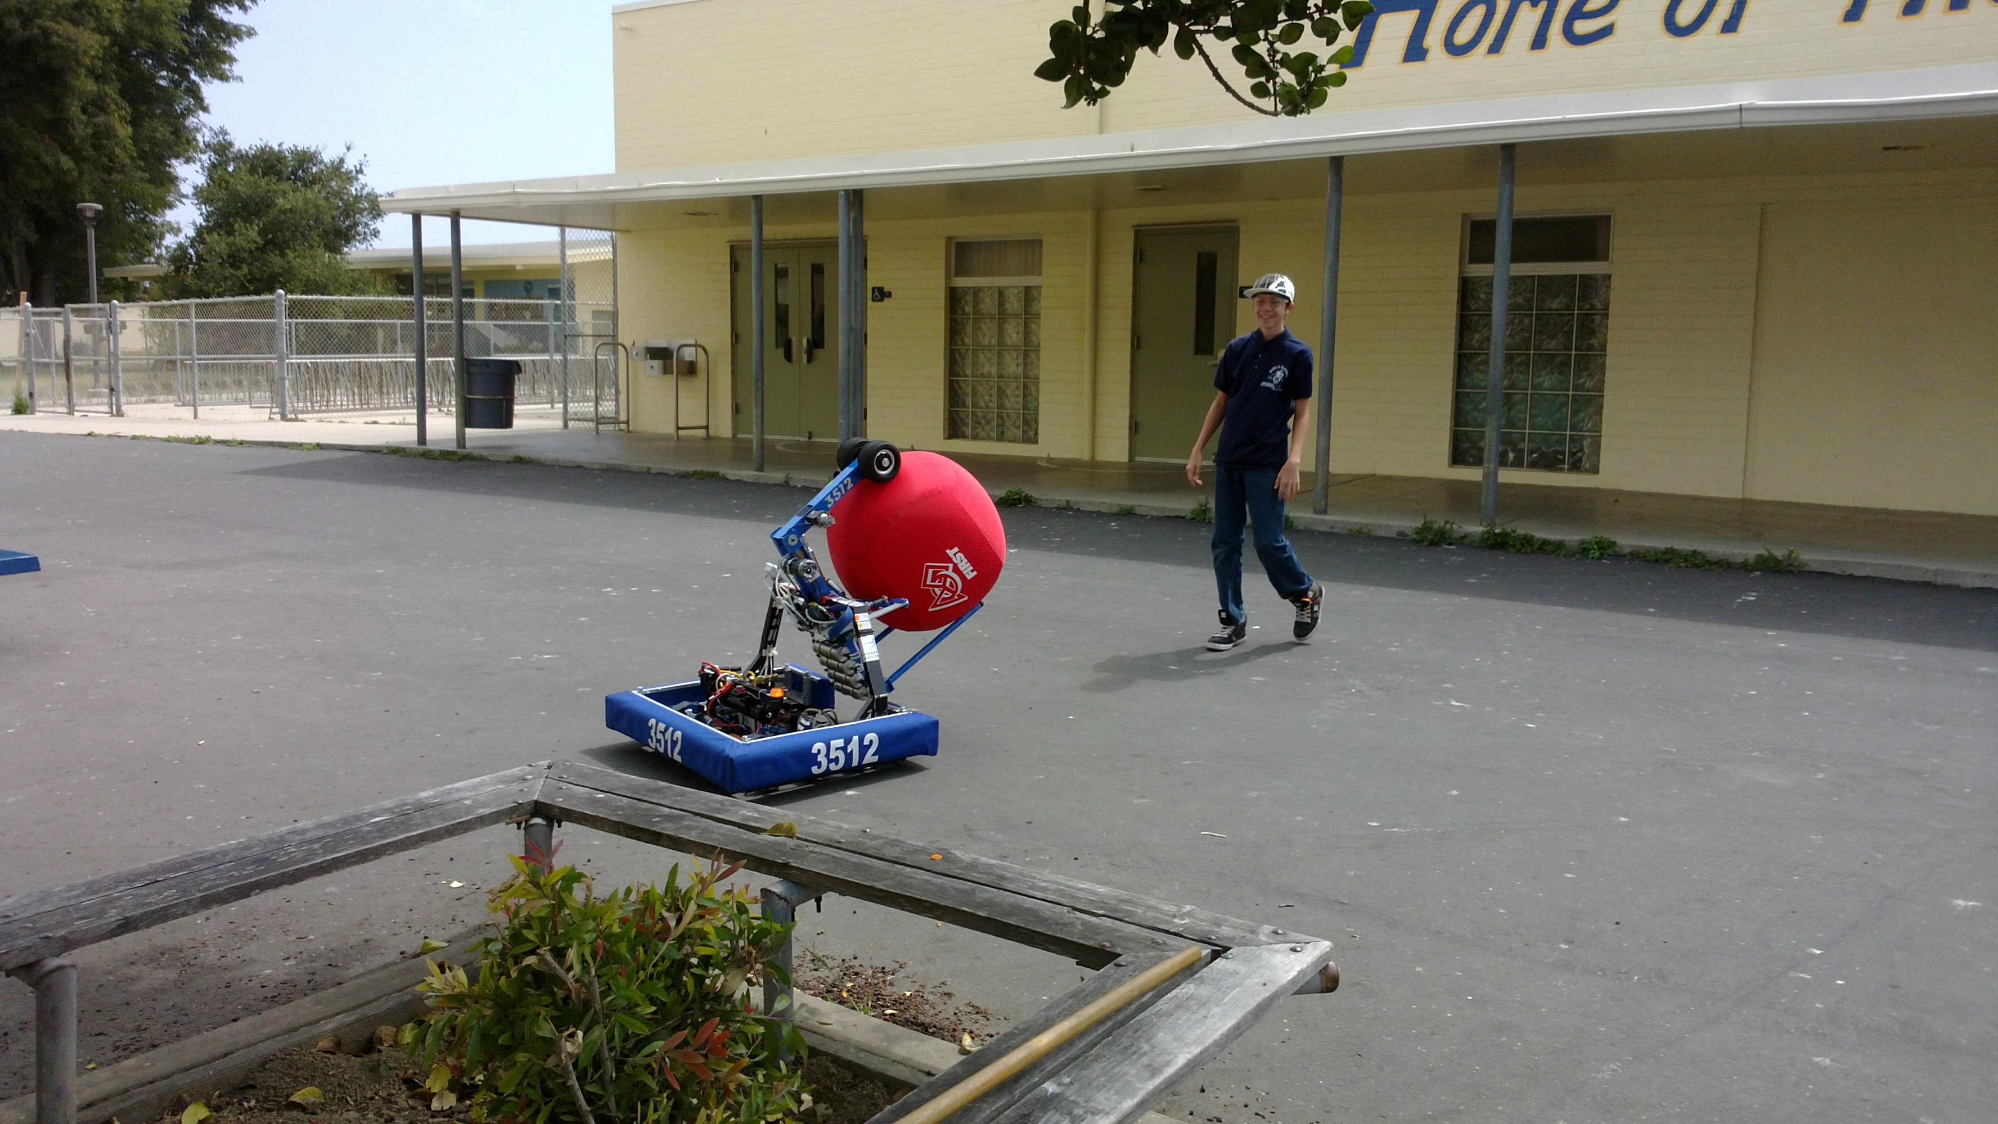
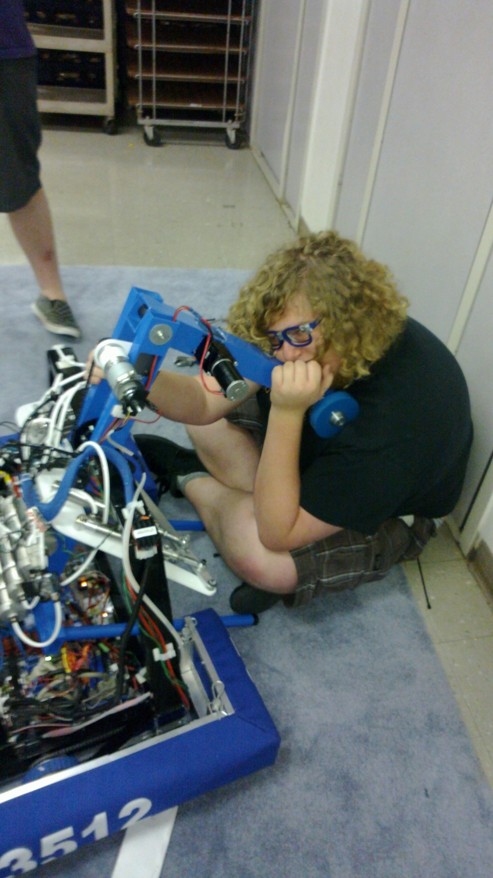
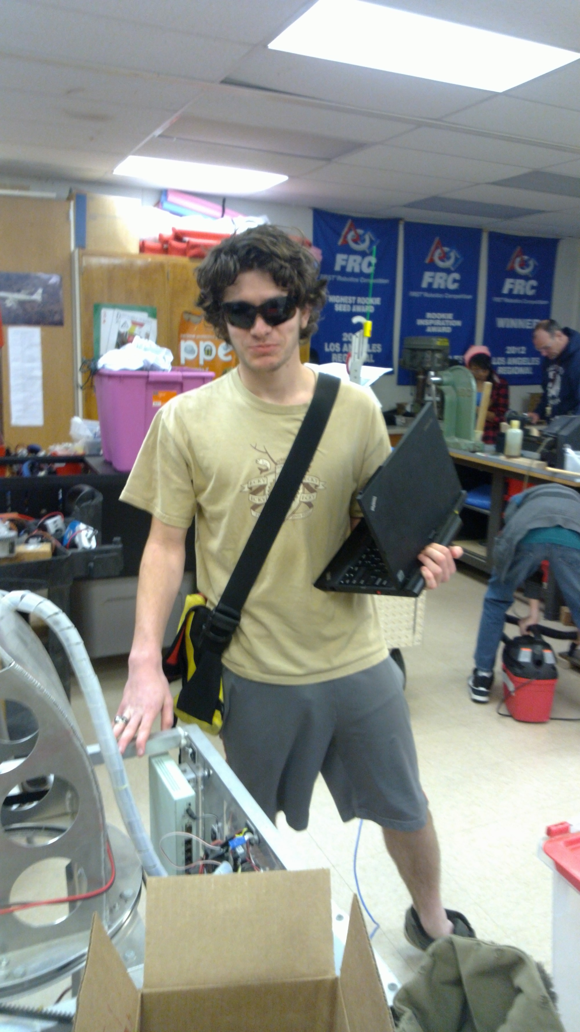
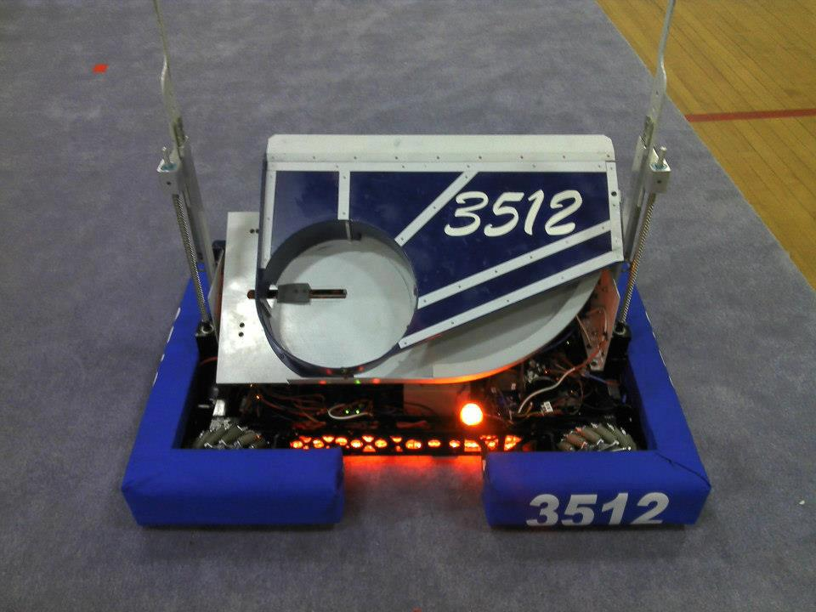
Ballistra in action at an outreach event
Cap'n Kremer and Ballistra (2014)
Testing in the MU during the final days of build season
Harrison Miller (Verra) in sunglasses
Cynisca (2013)
Notes:
Build season can be fun
We end up staying late
Especially for the software team
We get two days to do testing
Very super fun

Slide 16
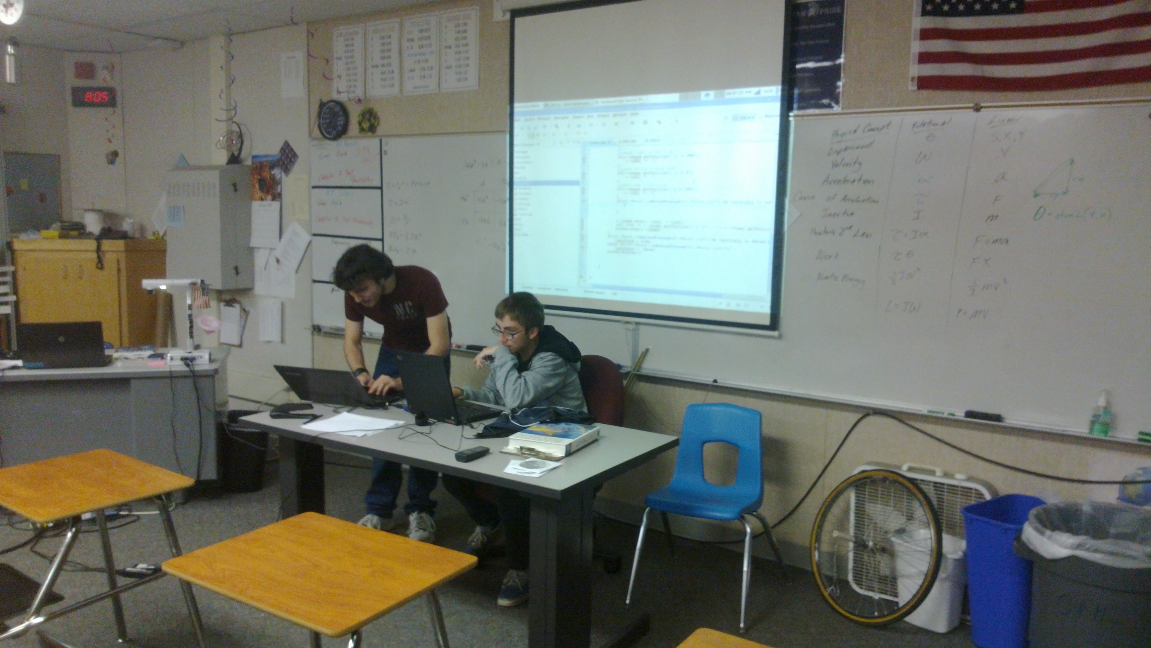
Role of a Software Mentor
Inspire students to improve their skills and contribute
Encourage students to take charge of the project, and make decisions for themselves
Help students advance their software engineering and programming skills in an informal environment
Avoid taking charge, making project decisions, or contributing large amounts of code
Provide advice and guidance (and sometimes code) when critical
Have fun while contributing to an awesome program!
Tyler Veness mentoring a student (Nicholas 'Larz' DeBruno)
Notes:
The goal of FIRST is to inspire students to achieve and pursue careers in science and technology. It is the mentor's job to inspire students, and be a catalyst for their achievements
These guidelines were outlined by our previous software mentor and software lead
They apply to FIRST in general, but our software team in particular has a history of adhering to them

Slide 17
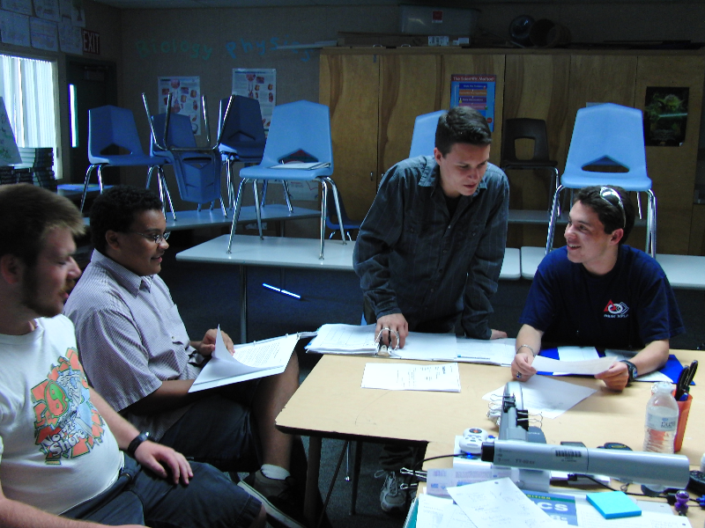
What to do next...?
Get involved!
  Show up to a build session
  Contact us
    William Ward (william.ward805@gmail.com)
    Tyler Veness (calcmogul@gmail.com)
      Previous software mentor
    Alan Fisher (acf@unixcube.org)
    #3512 on irc.quakenet.org
The Business Team getting involved in something
Notes:
Please get involved! We need a software mentor!
It's lots of fun!
Show up sometime! We'll have build session dates soon.
We're on IRC 24/7, so come say hi

