Slide 1
The Software Team: What you need to know
Alan Fisher
Tyler Veness
William Ward

Slide 2

We're part of Spartatroniks
One of the three major robot-related subteams
Responsible for the control system, and integration with the other elements.
We program things
  Actually, we “engineer software”
Every year, we expand slightly beyond our current abilities
Business
Electrical
Outreach
Mechanical
Software

Slide 3
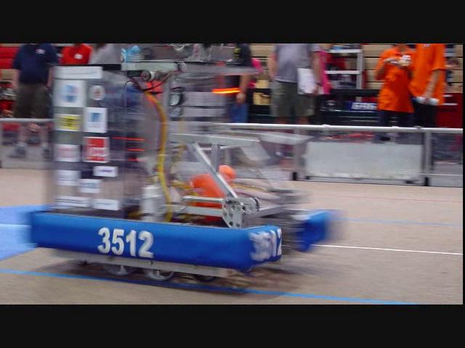
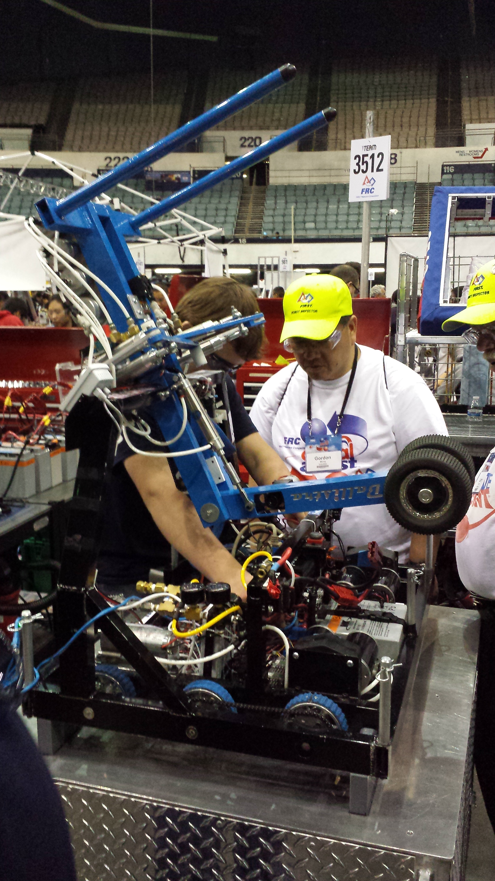
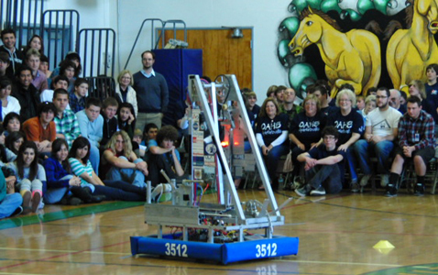
Our History
This will be our fifth season!
  2011 – Logomotion
    Hanging tubes on racks
  2012 – Rebound Rumble
    Shooting hoops
  2013 – Ultimate Ascent
    Tossing frisbees
  2014 – Aerial Assist
    Chucking yoga balls
  2015 – Recycle Rush
    Stacking totes and cans
Leonidas (2012)
Ballistra (2014)
Thermopylae (2011)

Slide 4
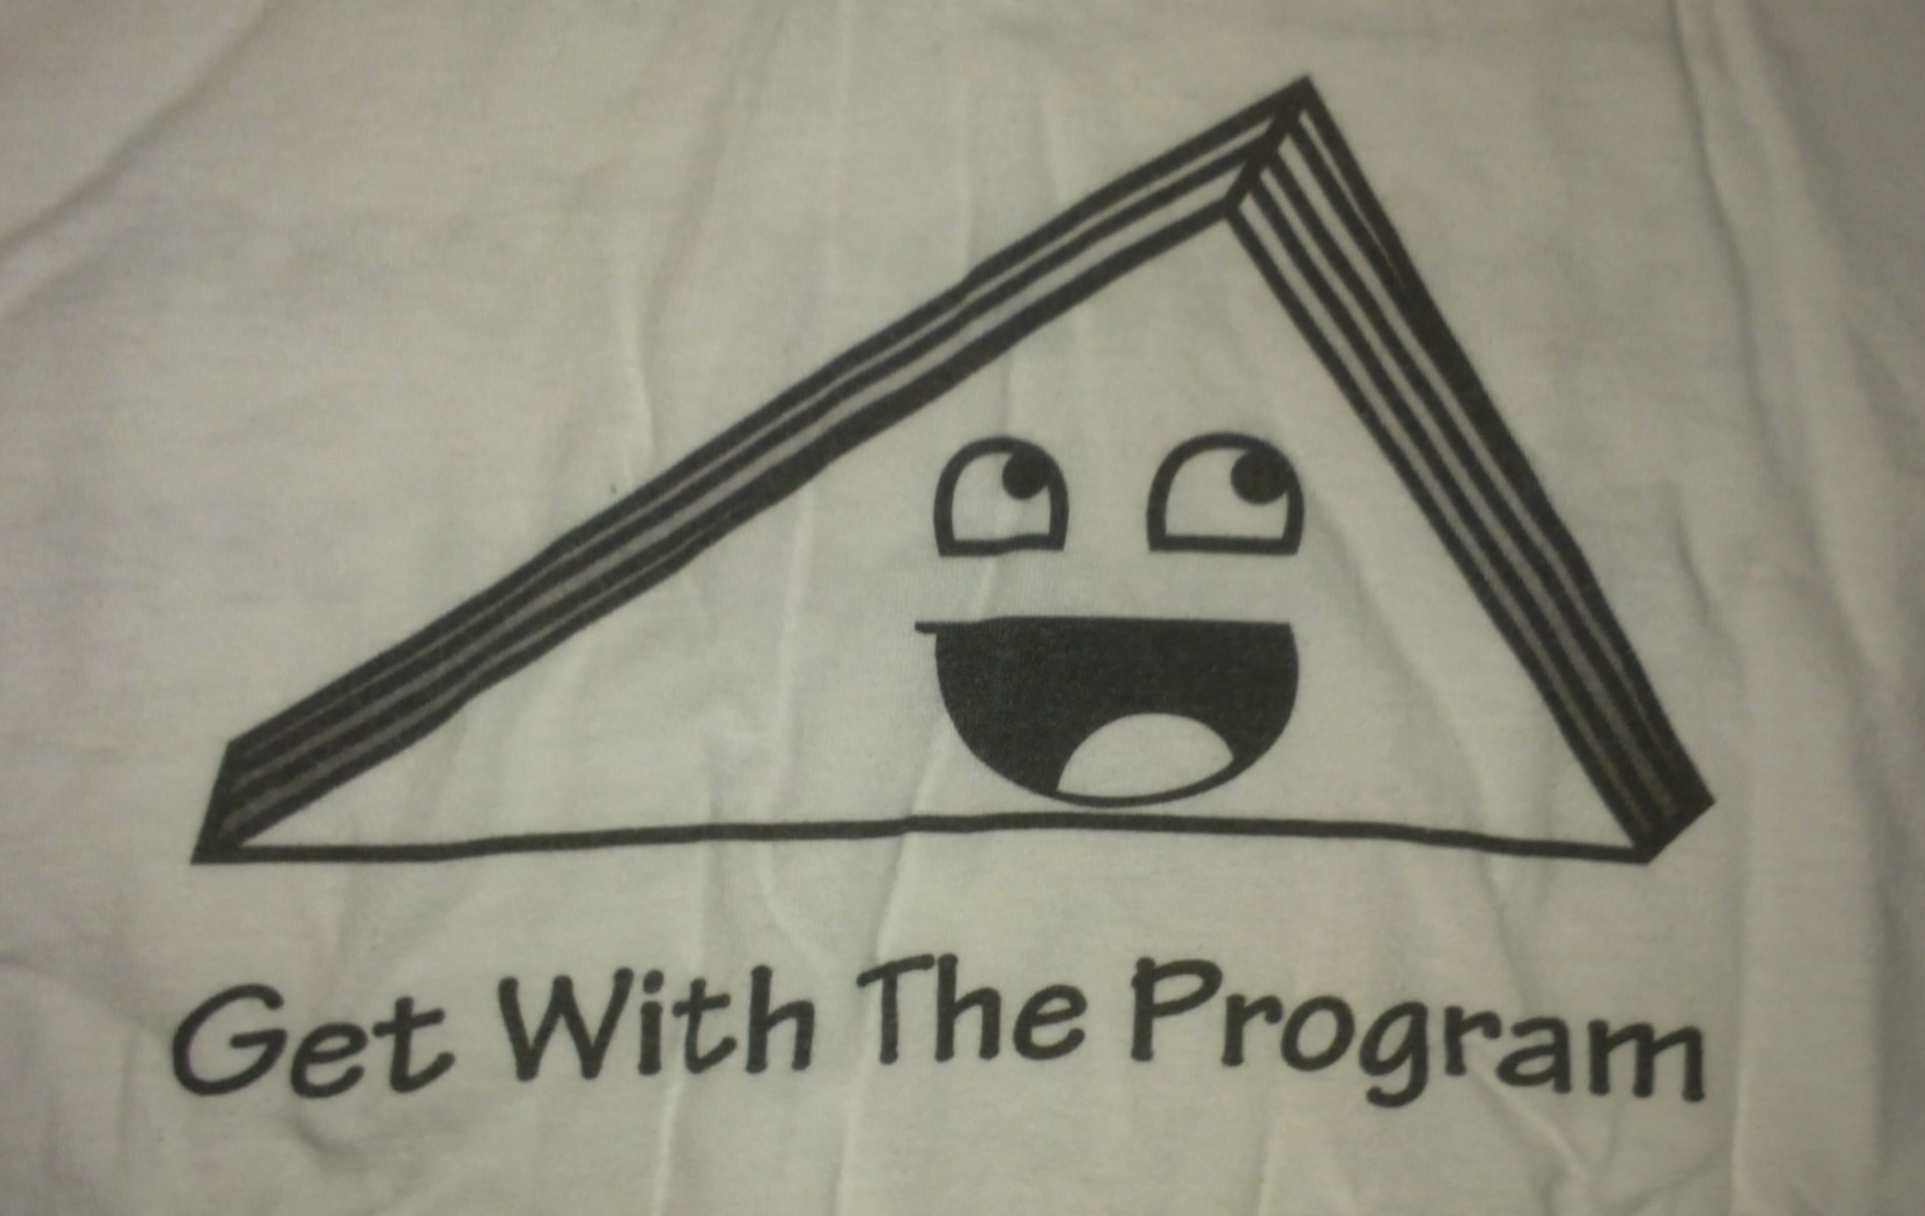
Triangleman
Triangleman is the mascot of the software team
He represents us and our values
  Hard work and dedication
    Writing software can be very challenging and demanding, but also very fun
  Correctness
    Things should be done right, the first time
  Fun
    It's not about the robot, it's about playing with cool stuff
“Get With The Program” T-shirt, Harrison Miller

Slide 5
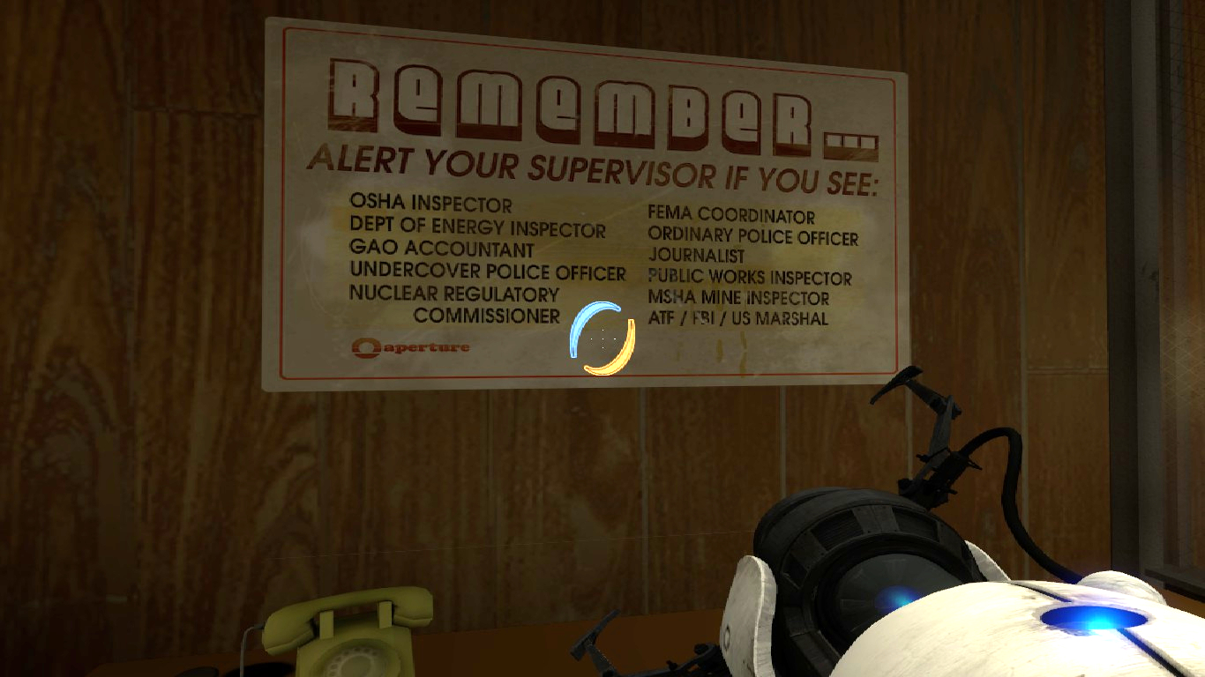
Build Season Timeline
Watch game video release, receive KoP
  Contribute to robot design / prototyping
Get RoboRIO up and running
  Create a complete test setup, get a basic system fully operational
Identify challenges/problems, and begin solving them
Be ready for hardware when it becomes ready
Test the code on the hardware
Make changes as requested
Provide support to other subteams (testing for hardware/electrical)
Go away! We're busy testing.

Slide 6
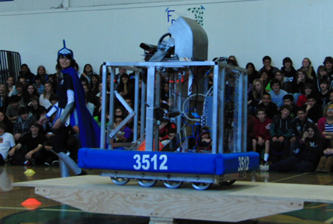
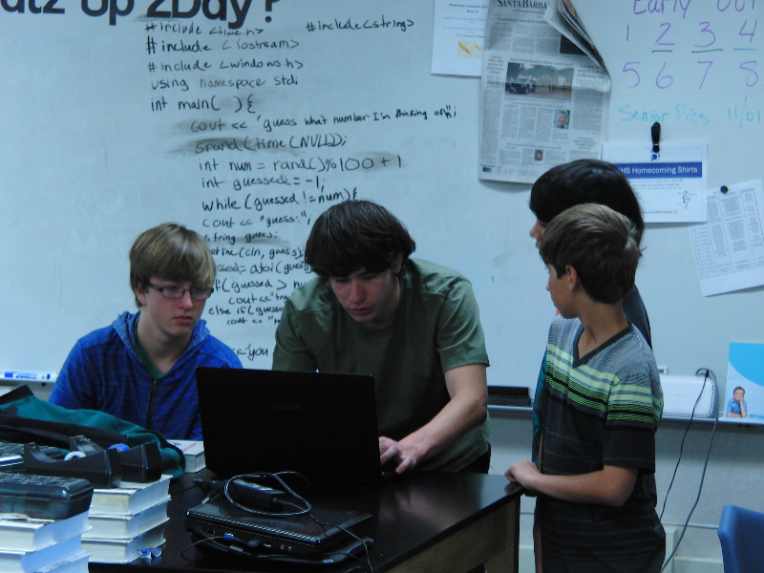
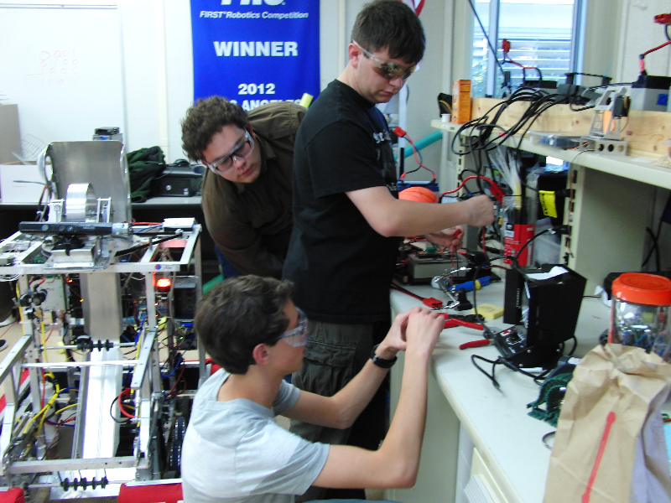
Ribbit!
Harrison working with some new recruits
Electrical monkeys at work

Slide 7
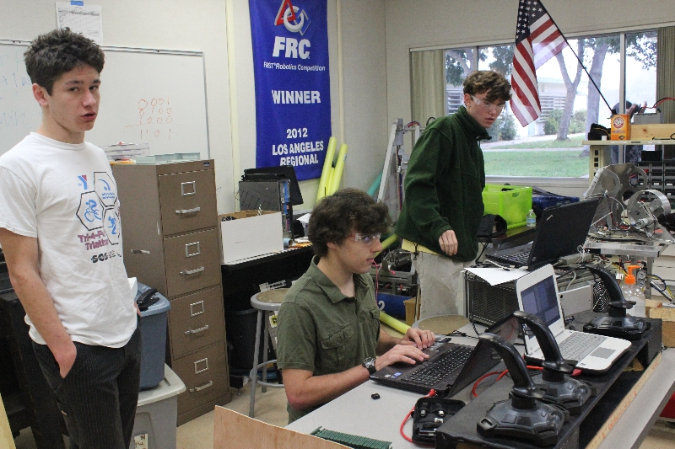
What We Do
We program robots
  Write the code (instructions) that enable the drivers to efficiently control the robot
  Look for ways to improve the drivers' interaction with the robot
  Use algorithms in software to enable the use of more versatile hardware (PID loops, filters, automation of processes)
Test the system
  Ensure that all systems (software, electrical, and mechanical) are fully functional
  Analyze problems, fix them, and prevent them from recurring
A typical day on the software team

Slide 8
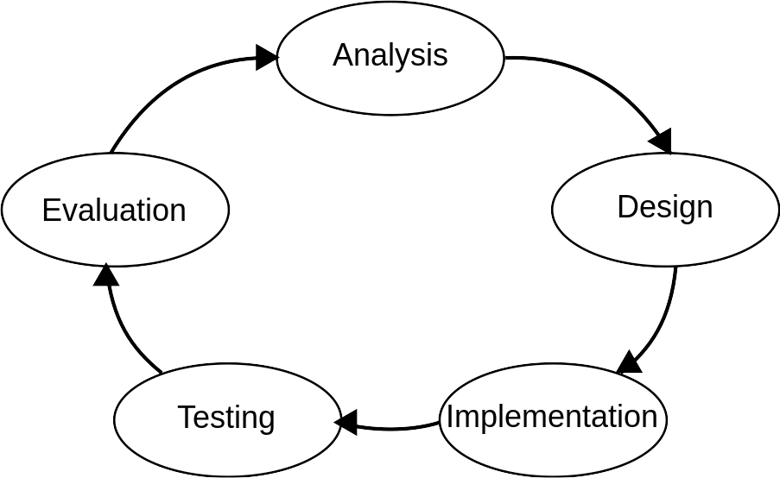
How We Program Robots
Implement functionality
  Write code
Download compiled binary
Test
  Determine if the code functions as expected
Repeat
Software engineering process
(Model of the Systems Development Lifecycle)

Slide 9
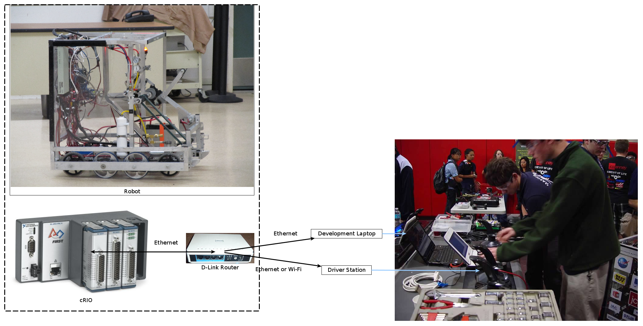
Basic Control System

Slide 10
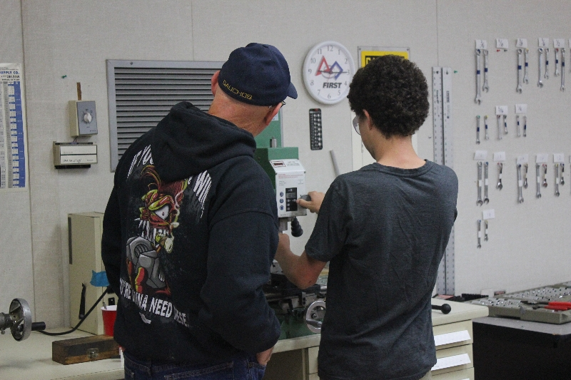
Tools We Use
Toolchain (compiler, linker, etc..)
  Takes symbolic code (source code) and translates it into machine code (computer readable)
  GCC based
IDE
  A special text editor for writing software
  Eclipse
Ethernet cable
  Ethernet is used to download code to the robot
The mechanical guys using their tools

Slide 11
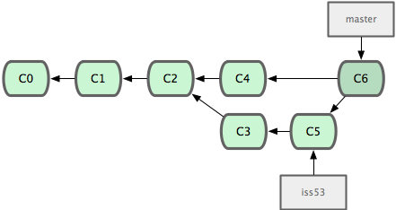
Version Control: Git
It's difficult for multiple people to work on the same code
  Change conflicts
Something broke! We need to roll back!
How do we fix it? Version control!
  Git enables us to efficiently keep track of changes, and merge different people's changes together
A branch “iss53” being merged into master. The boxes represent different versions of the tree.

Slide 12
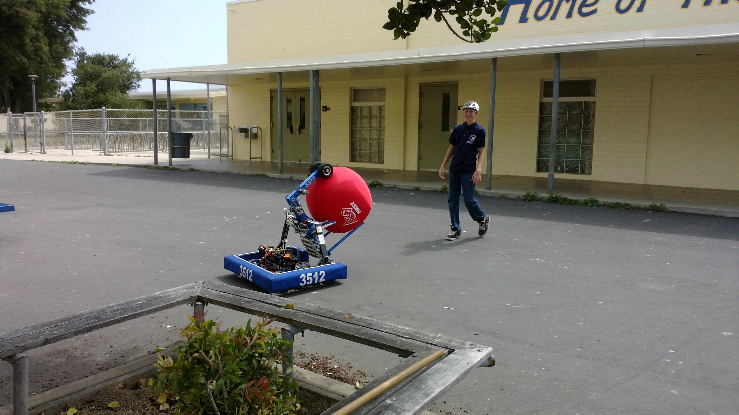
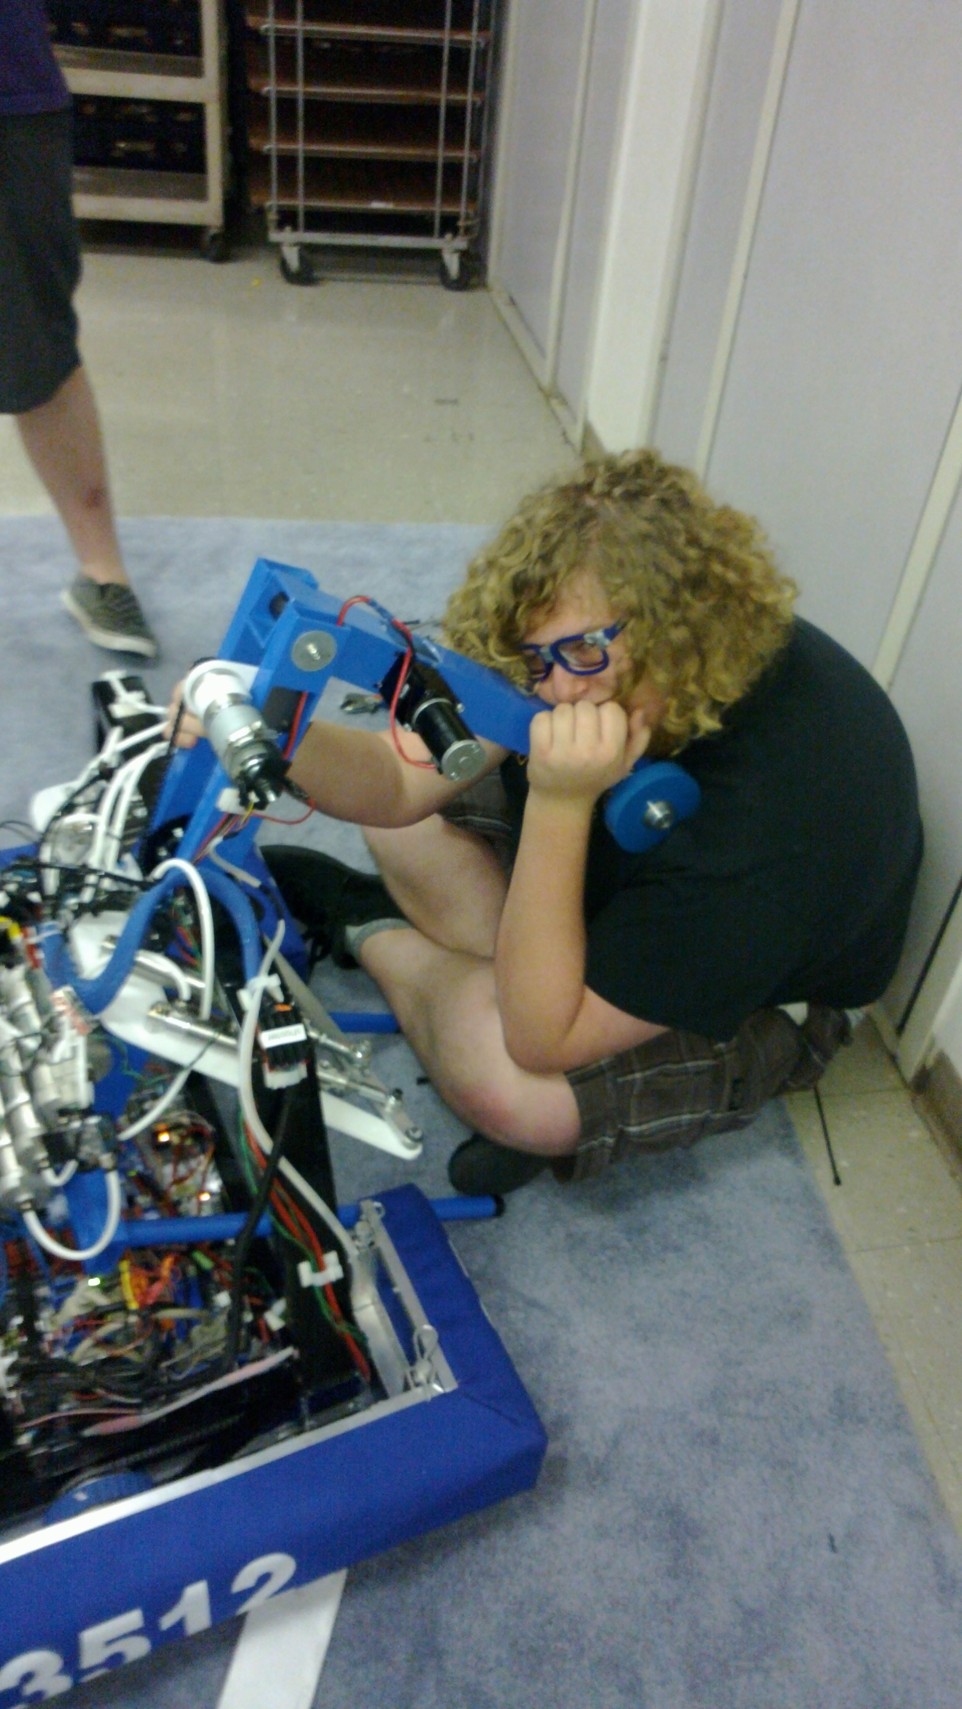
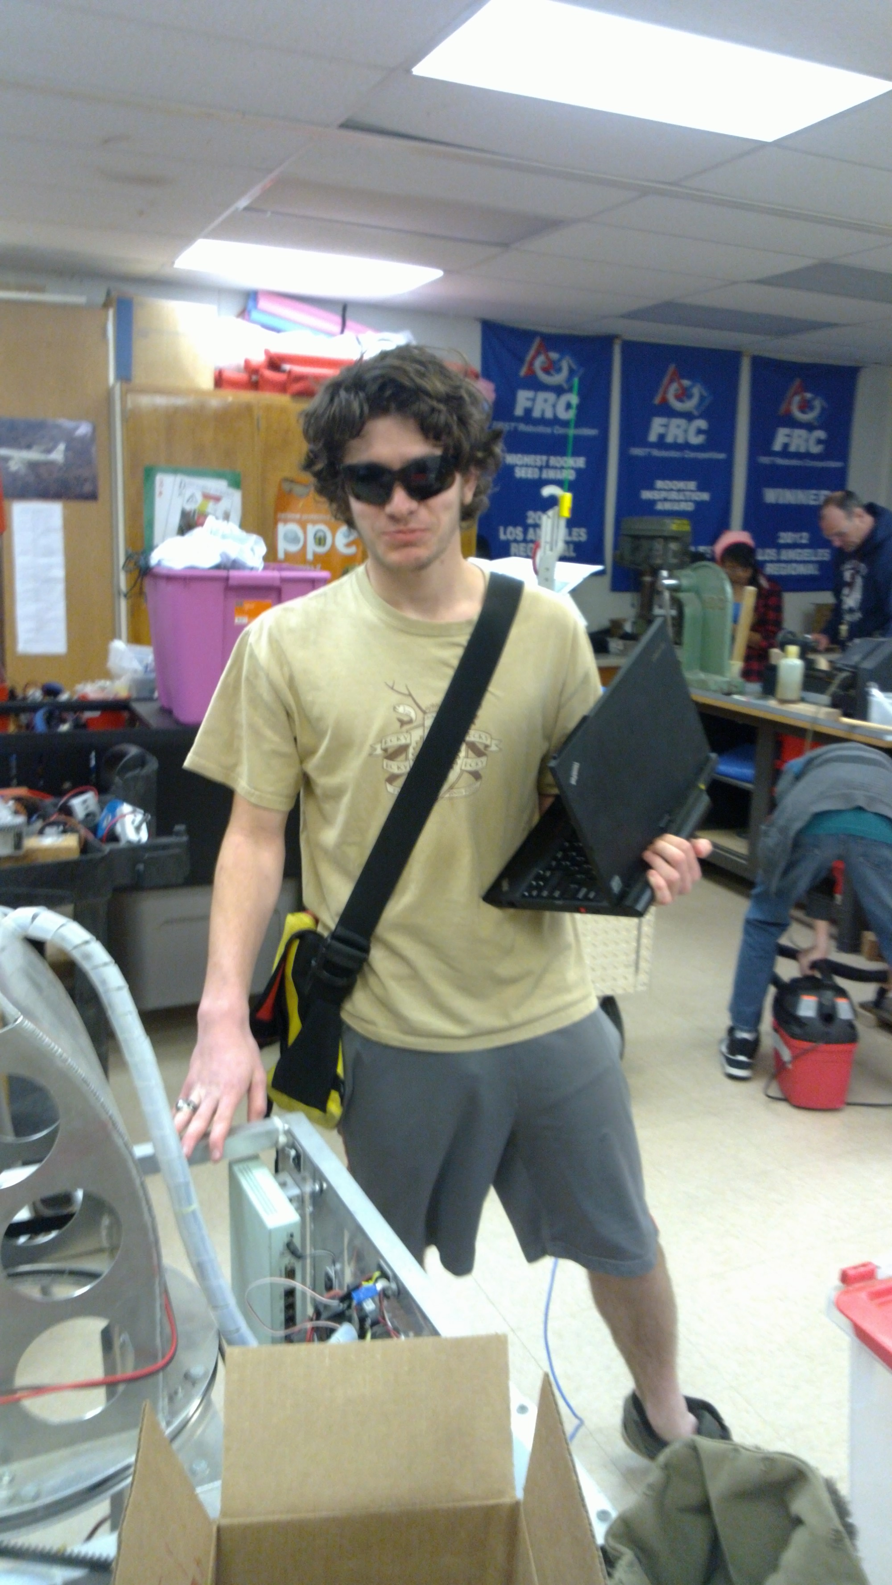
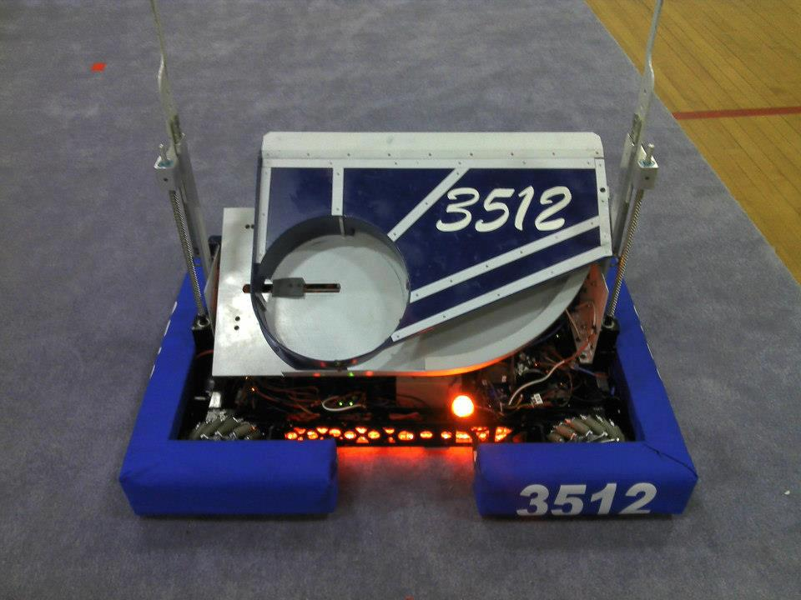
Ballistra in action at an outreach event
Cap'n Kremer and Ballistra (2014)
Testing in the MU during the final days of build season
Harrison Miller (Verra) in sunglasses
Cynisca (2013), my favorite robot

Slide 13
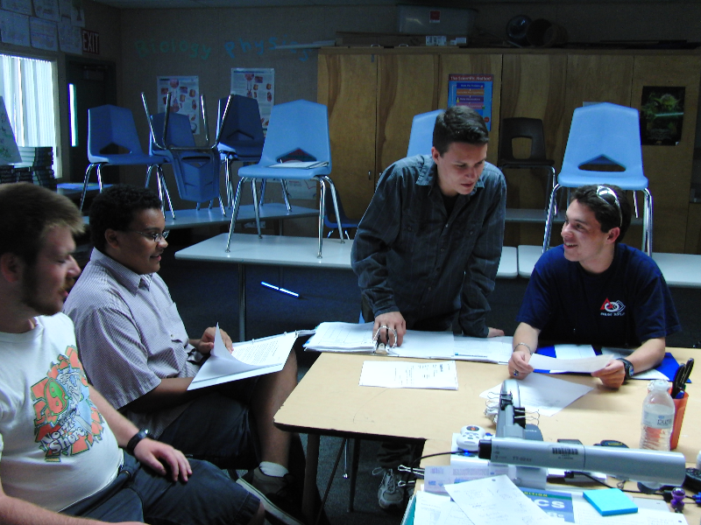
What to do next...?
Take the initiative! Get involved!
Say hi on Slack
  There's a desktop and Android/iPhone app
  https://frc3512.slack.com
Get a compiler and start programming
  https://csweb.frc3512.com/bootstrap/
  If you need help, ask on Slack!
The Business Team getting involved in something

