Slide 1
A Practical Attendance Checking System using Smartphones
Mid-Term Presentation
Team 4
Chorom Hamm, Junghwan Lim, Yoojung Shin, Kwangwook Kwon

Slide 2


Target User
Student
Professor
Automatically attend attendance check
Lower attendance check burden

Slide 3
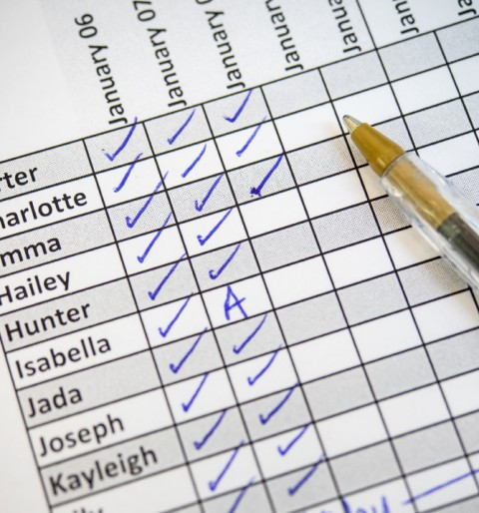
Recall from First presentation
Class attendance is essential to check
Attendance is one of the rating items
Professors are requested to check it at every classes
But, it is sometimes a burden…
Time-consuming tasks
Waste of papers

Slide 4
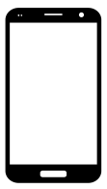
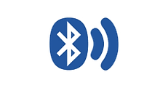

Key Solution Idea (1)
Automatic attendance check system using students’ mobile device
Devices behave like BLE Beacons to periodically detect the presence of each other by sending and receiving messages
Based on the BLE Beacon signal exchanged, clustering is performed and attendance is determined

Slide 5
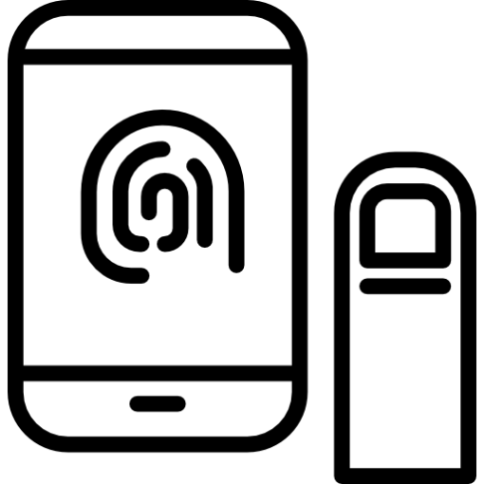

Key Solution Idea (2)
Confirmation of attendance by user authentication
For the reliability, it is necessary to verify that the device user is actually in the place
After clustering, only those who have been authenticated are finally considered to be present

Slide 6
Use Cases
STUDENTS
Login
Automatic signal exchange
Fingerprint Authentication
Attendance confirmation

Slide 7




Key functions
Bluetooth Low Energy (BLE) exchange allows to discover the presence of each device, and enables clustering based on this data
Text Files
Server

Slide 8

Key functions
Clustering is performed based on the BLE signal data
It determines the devices in a class through signal strength
CHALLENGE

Slide 9
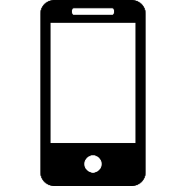
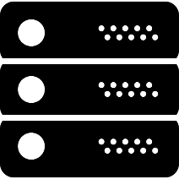
System Overview
※ System requirement
Android OS
BLE support
※ System requirement
Amazon EC2
Transmit and scan signal by Bluetooth Low Energy (BLE)
Communicate with server
Recognize user by fingerprint authentication
Attendance check plan
Check attendance list by clustering algorithm
Communicate with client
Manage attendance history

Slide 10
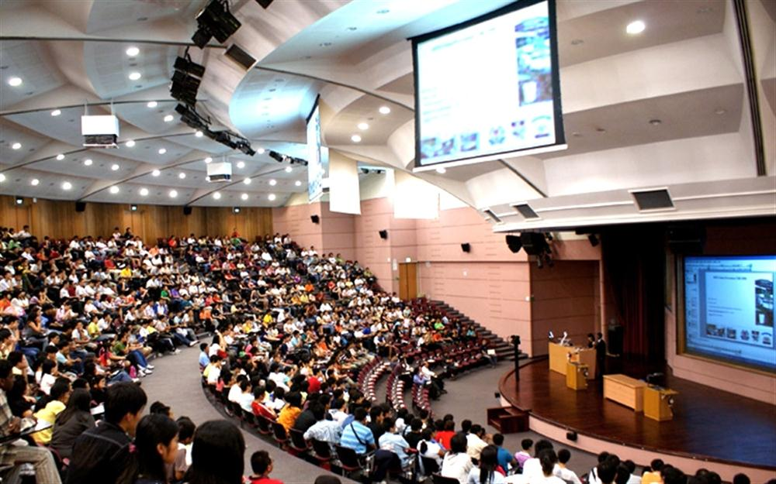
Key Challenges (1): Client-side
Scalability
To get better accuracy, every device works as a beacon to broadcast the BLE signal
So, it should take time to transmit and scan signals: broadcasting time X number of devices
If the number of students are more than 100…?

Slide 11
Key Solutions (1): Client-side
Scalability
Pick representative devices and transmit signals by selected devices
→ Plan to find out the right number of selected devices for better accuracy

Slide 12
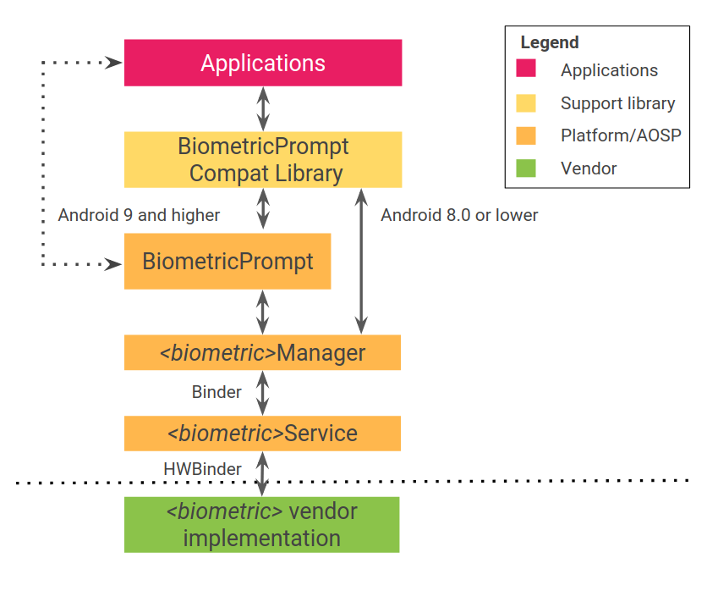
Key Challenge and Solution (2): Client-side
Fingerprint authentication
Support Fingerprint Manager from API level 23
Deprecate it in API level 28
→ Need devices with higher version
→ Use BiometricPrompt API instead of FingerprintManager

Slide 13
Key Challenges (3): Server-side
How to cluster devices with the signal?
1) Naive : include all devices whose signal has been seen
Problems
Students who are in outside can be seen with weak signal
(Bluetooth range is up to 100m dependent on power and obstacles)
Notes:
Key technical challenges & solutions
•Be as detailed as possible.
•Clarify what were already solved and what are still needs to be addressed.
•Encourage to have initial evaluation results (on latency, power, accuracy, etc.).

Slide 14
Key Challenges (3): Server-side
2) Distance-based : include devices whose distance is short
Transform received signal strength indicator (RSSI) to distance between devices
$$RSSI=Ref_RSSI −10 ∗n ∗\log\left(distance\right) (n:range 2−4) \\ distance=10 ^ \frac{\left(Ref_RSSI −RSSI\right)}{10∗n}$$
Notes:
n=2 in free space
식 출처 : https://www.rn.inf.tu-dresden.de/dargie/papers/icwcuca.pdf

Slide 15
Key Challenges (3): Server-side
Device scan data
Bind devices whose distance is shorter than the threshold (How to decide?)
Receiver | Sender | RSS
C | A | -60
C | A | -65
C | A | -70
C | B | -75
C | B | -80
C | B | -77
C | D | -84
C | D | -88
C | D | -83
… | … | …
Receiver | Sender | Distance(m)
C | A | 1
C | B | 2
C | D | 3
... | ... | ...

Slide 16
Project Plan
What were done
Android UI (crhamm)
Server’s student registration & making plan (kwkwon)
BLE Scan/Transmit module (yjshin)
Clustering algorithm (jhlim)
What are to be done
Conduct according to plan & result file transfer (yjshin)
Attendance check (kwkwon)
Authentication processing module (crhamm)
Scalability (jhlim)
Experiment (all)

Slide 17
Success Criteria
Does it work well? (User Experience)
We expect that our lab members participate in beta test
Does it consume a reasonable amount of energy?
We will measure battery usage by profiling tool (e.g., Battery Historian)
Can it discriminate absence from attendance? (accuracy)
We will try to test all abnormal and corner test cases
Can it work well when there are lots of students? (scalability)
We will try to test with as many mobile phones as possible
And we can try with mobile simulator

Slide 18
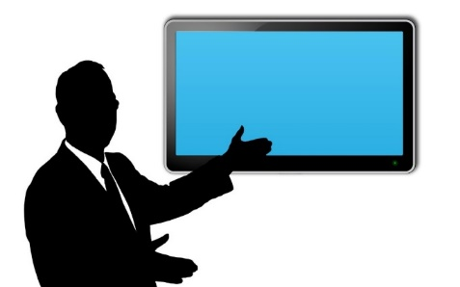
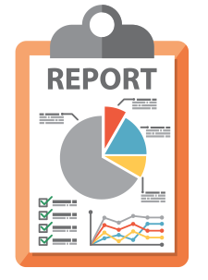
Final Deliverable
GitHub
Final Presentation
Application on Android
Live Demo
Report
Application on Server

Slide 19
Thank you

