Slide 1
A Practical Attendance Checking System using Smartphones
Team 4
Chorom Hamm, Junghwan Lim, Yoojung Shin, Kwangwook Kwon

Slide 2
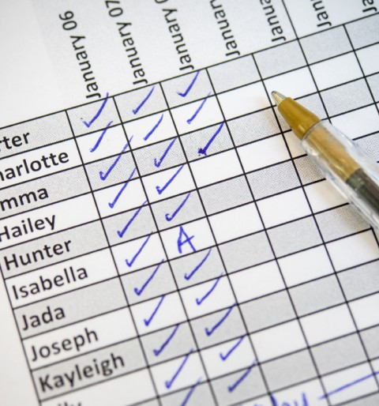
Introduction
Class attendance is essential to check
Attendance is one of the rating items
Professors are requested to check it at every classes
But, it is sometimes a burden…
Time-consuming tasks
Waste of papers

Slide 3
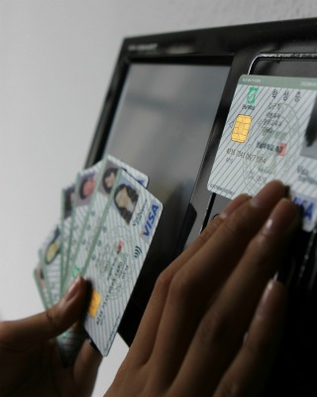
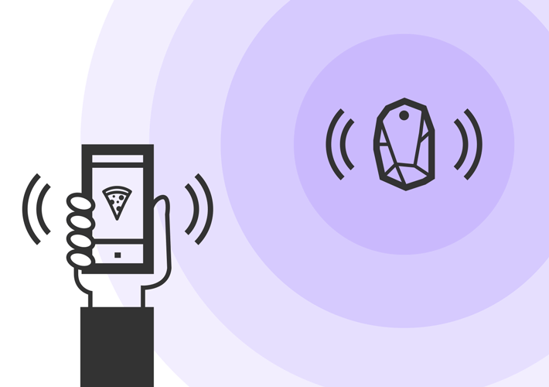
Existing Solution
RFID checking system
Possibility of surrogate attendance
Annoying due to carry ID cards
Central beacon and mobile system
Single point of failure
High cost of maintenance

Slide 4
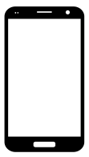


Key Solution Idea
Automatic attendance check system using students’ mobile device
Devices behave like BLE Beacons to periodically detect the presence of each other by sending and receiving messages
Based on the BLE Beacon signal exchanged, clustering is performed and attendance is determined

Slide 5
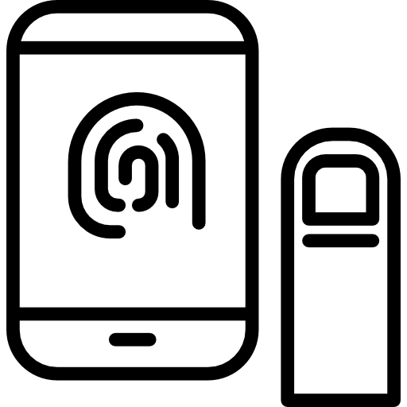

Key Solution Idea
Confirmation of attendance by user authentication
For the reliability, it is necessary to verify that the device user is actually in the place
After clustering, only those who have been authenticated are finally considered to be present

Slide 6


Target User
Student
Professor
Automatically attend attendance check
Lower attendance check burden

Slide 7
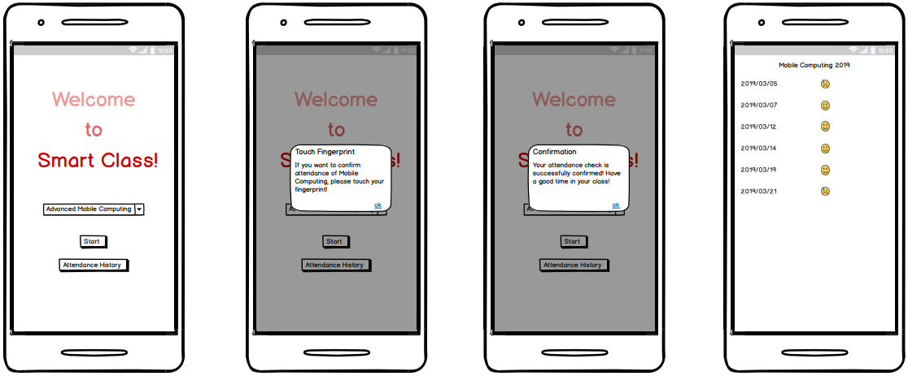
Usage Scenario

Slide 8

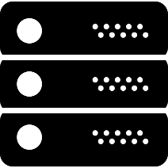
System Overview
※ System requirement
Android OS
BLE support
※ System requirement
Amazon EC2
Transmit and scan signal by Bluetooth Low Energy (BLE)
Communicate with server
Recognize user by fingerprint authentication
Attendance check plan
Check attendance list by clustering algorithm
Communicate with client
Manage attendance history

Slide 9
Expected Challenges
- The automatic attendance check should operate accurately without omitting any present student
Accuracy
→ Perform attendance checking several times to prevent omitting
- If there are lots of students in a class room, it takes a long time and consumes a lot of energy
Scalability
→ Select some students randomly so that only those students transmit the signal.

Slide 10
Project Plan
Task |  | Worker | 3 | 4 |  |  |  |  | 5 |  |  |  | 6
 |  |  | 26 | 2 | 9 | 16 | 23 | 30 | 7 | 14 | 21 | 28 | 4 | 11
 | Proposal | all
 | Setting development environment | jh & kw
 | Define methods between server and client | yj & cr
Application | BLE Scan/Transmit function | yjshin
 | UI development | crhamm
 | Communication module | yjshin
 | Authentication processing module | crhamm
Server | Attendance checking plan | kwkwon
 | Clustering algorithm | jhlim
 | Communication module | jhlim
 | Data processing module | kwkwon
 | Review/prototype demo | all

Slide 11
Final Deliverable & Success Criteria
Final Deliverables
Application on Android
Server
Success criteria
Does it work well?
Does it consume a reasonable amount of energy?
Can it discriminate absence from attendance? (accuracy)
Can it work well when there are lots of students? (scalability)

Slide 12
Thank you

