Slide 1
YASA: Yet another seafood app
Team Four from Table five

Slide 2
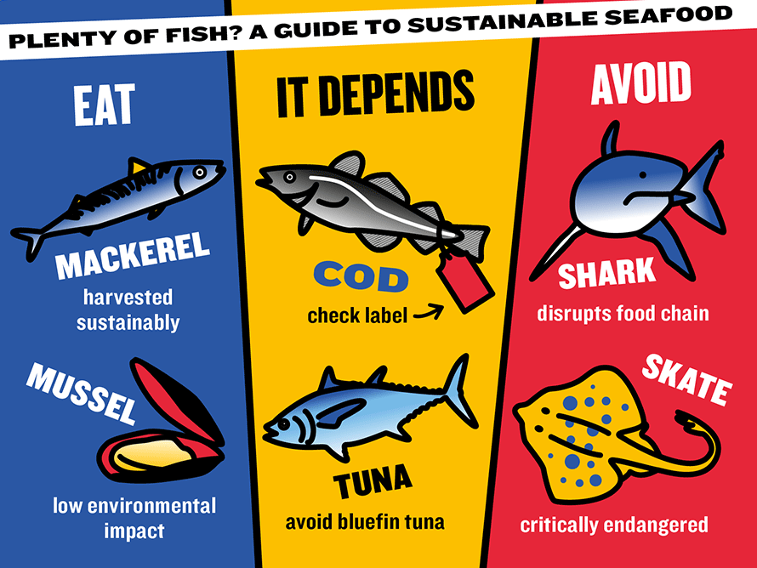
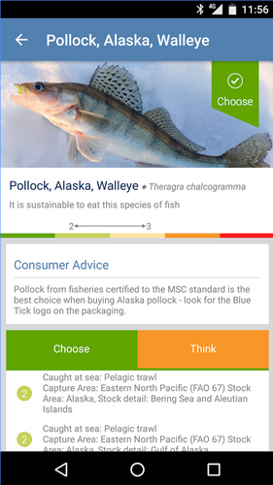

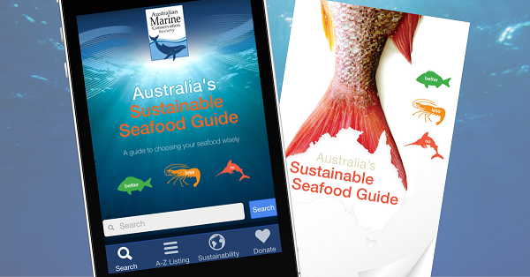
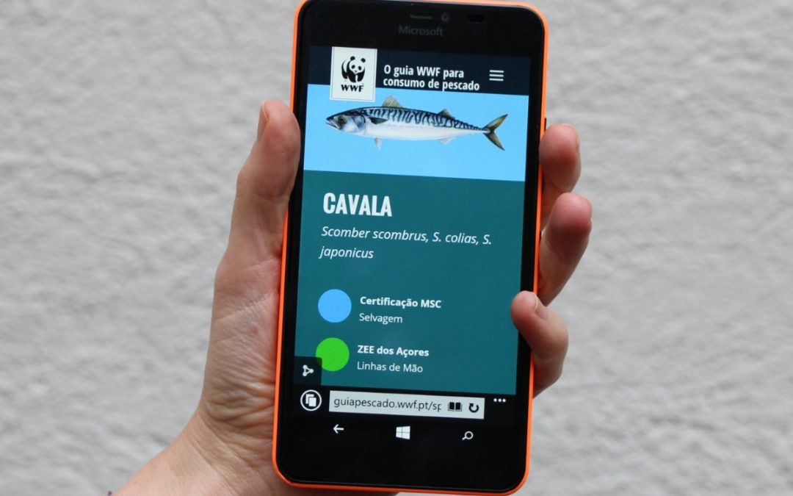
Why does the world need yasa?

Slide 3
YASA is targeted at informed amateurs
The problem:
Seafood is important but Fisheries data is complex and messy
The solution:
YASA presents the best scientific data about species and stocks in an easily accessible format
In a “post-truth” world it is more important than ever to show evidence
YASA also uses a highly advanced algorithm* to predict the future status of stocks
* This is not a guarantee. The value of your investment may go down as well as up. If you do not keep up your repayments your computer may be re-possessed. The future might not be exactly as we predict it.

Slide 4




YASA key features
Open data + OPEn source code
Web services
Fisheries data
Environmental data

Slide 5
Fish + data = success!

