Slide 1
HTML (Hyper Text Markup Language)

Slide 2
What is HTML?
HTML is a markup language for describing web documents (web pages).
HTML stands for Hyper Text Markup Language
A markup language is a set of markup tags
HTML documents are described by HTML tags
Each HTML tag describes different document content

Slide 3
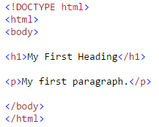
HTML Basic
HTML Documents
All HTML documents must start with a type declaration: <!DOCTYPE html>.
The HTML document itself begins with <html> and ends with </html>.
The visible part of the HTML document is between <body> and </body>.

Slide 4
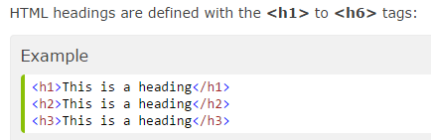
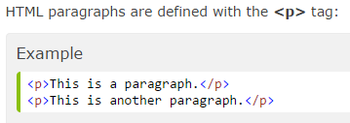
HTML Headings && HTML Paragraphs (HTML basic)

Slide 5
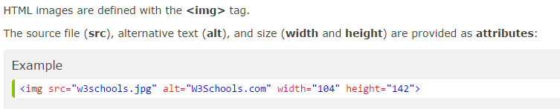
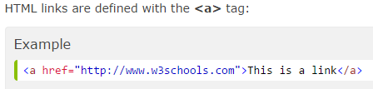
HTML Links && HTML Images (HTML basic)

Slide 6
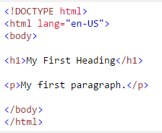
HTML Attributes HTML elements can have attributes Attributes provide additional information about an element Attributes are always specified in the start tag Attributes come in name/value pairs like: name="value"
The lang Attribute
The document language can be declared in the <html> tag.
The language is declared in the lang attribute.
Size Attributes
HTML images are defined with the <img> tag.
The filename of the source (src), and the size of the image (width and height) are all provided as attributes:

Slide 7
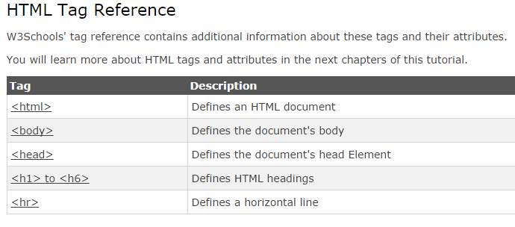
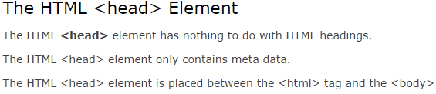

HTML Headings Headings are defined with the <h1> to <h6> tags.
Headings Are Important
Use HTML headings for headings only. Don't use headings to make text BIG or bold.
Search engines use your headings to index the structure and content of your web pages.
Users skim your pages by its headings. It is important to use headings to show the document structure.
h1 headings should be main headings, followed by h2 headings, then the less important h3, and so on.

Slide 8
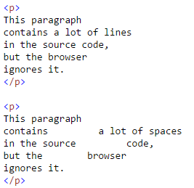
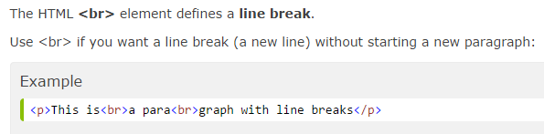
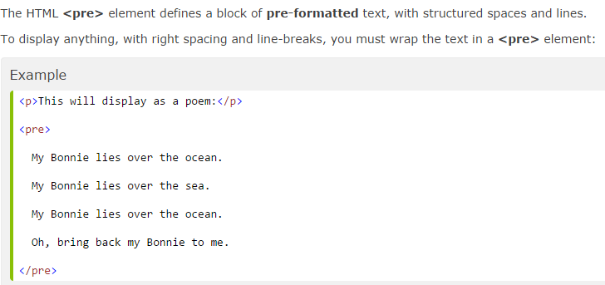
HTML Paragraphs
HTML Display
You cannot be sure how HTML will be displayed.
Large or small screens, and resized windows will create different results.
With HTML, you cannot change the output by adding extra spaces or extra lines in your HTML code.
The browser will remove extra spaces and extra lines when the page is displayed.
Any number of spaces, and any number of new lines, count as only one space.

Slide 9
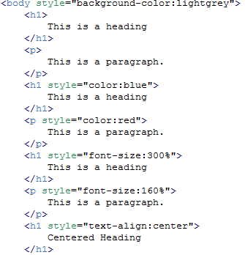
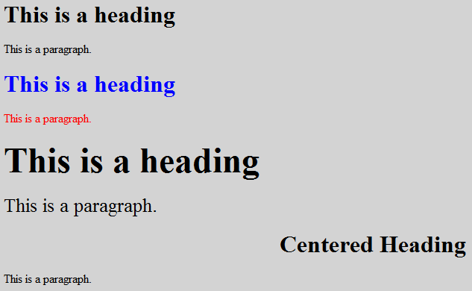
HTML Styles
Use the style attribute for styling HTML elements
Use background-color for background color
Use color for text colors
Use font-family for text fonts
Use font-size for text sizes
Use text-align for text alignment

Slide 10
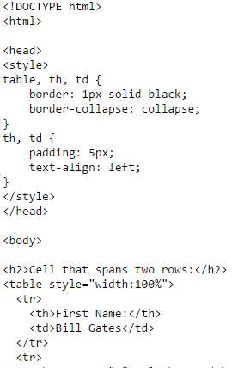
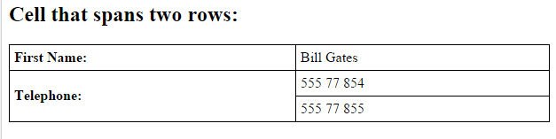
HTML Tables
Use the HTML <table> element to define a table
Use the HTML <tr> element to define a table row
Use the HTML <td> element to define a table data
Use the HTML <th> element to define a table heading
Use the HTML <caption> element to define a table caption
Use the CSS border property to define a border
Use the CSS border-collapse property to collapse cell borders
Use the CSS padding property to add padding to cells
Use the CSS text-align property to align cell text
Use the CSS border-spacing property to set the spacing between cells
Use the colspan attribute to make a cell span many columns
Use the rowspan attribute to make a cell span many rows
Use the id attribute to uniquely define one table

Slide 11

HTML Block Elements
The HTML <div> Element
The HTML <div> element is a block level element that can be used as a container for other HTML elements.
The <div> element has no special meaning. It has no required attributes, but style and class are common.
Because it is a block level element, the browser will display line breaks before and after it.
When used together with CSS, the <div> element can be used to style blocks of content.
The HTML <span> Element
The HTML <span> element is an inline element that can be used as a container for text.
The <span> element has no special meaning. It has no required attributes, but style and class are common.
Unlike <div>, which is formatted with line breaks, the <span> element does not have any automatic formatting.

Slide 12
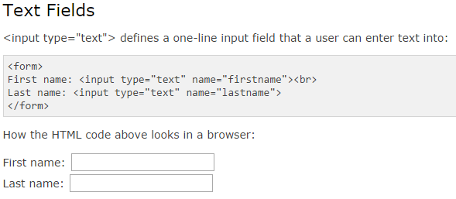
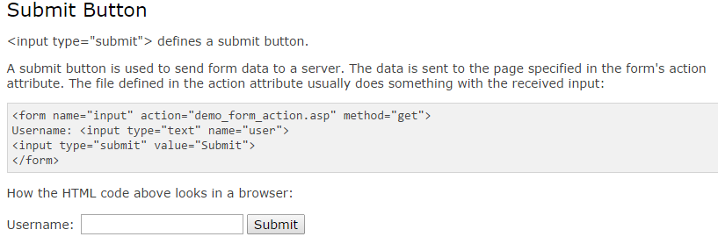
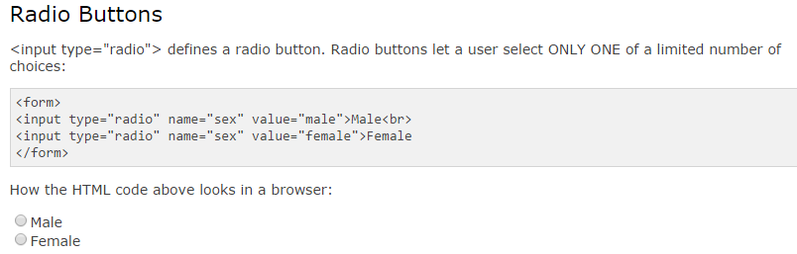
HTML Forms and Input HTML forms are used to pass data to a server. An HTML form can contain input elements like text fields, checkboxes, radio-buttons, submit buttons and more. A form can also contain select lists, textarea, fieldset, legend, and label elements

Slide 13
HTML and XHTML
What Is XHTML?
XHTML stands for EXtensible HyperText Markup Language
XHTML is almost identical to HTML
XHTML is stricter than HTML
XHTML is HTML defined as an XML application
XHTML is supported by all major browsers
<!DOCTYPE ....> Is Mandatory
An XHTML document must have an XHTML DOCTYPE declaration.
A complete list of all the XHTML Doctypes is found in our HTML Tags Reference.
The <html>, <head>, <title>, and <body> elements must also be present, and the xmlns attribute in <html> must specify the xml namespace for the document.

