Slide 1
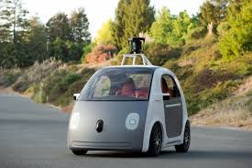
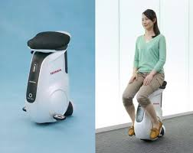
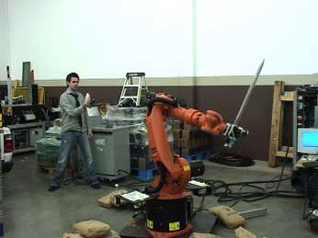
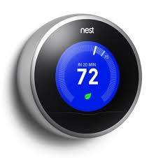
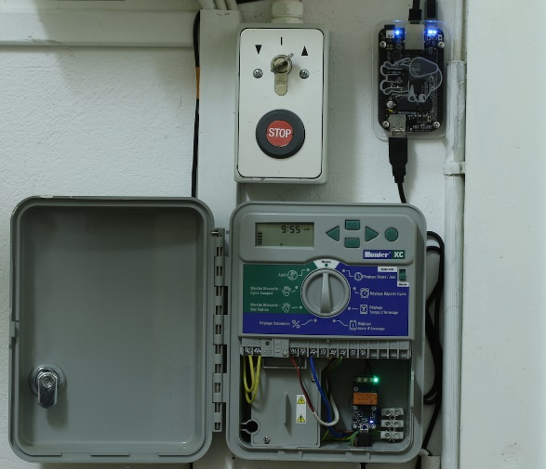
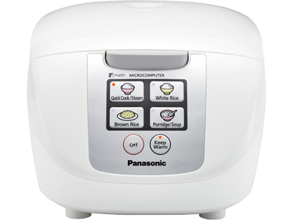
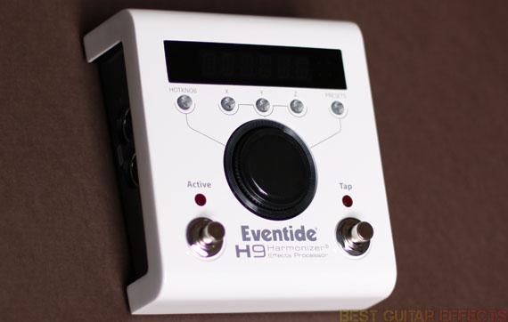
Embedded Computers
Most computers are used to control things that don’t look anything like a laptop or a phone…
… that can actually DO something in the real world

Slide 2
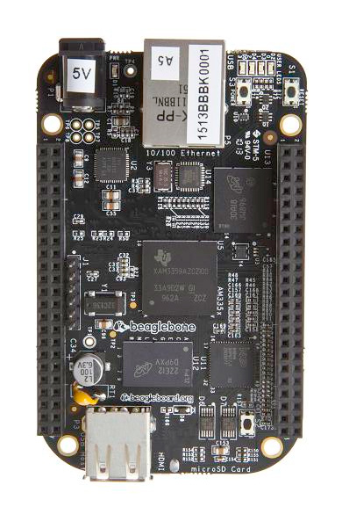
BeagleBone Black
General purpose computer
1.2GHz ARM processor
512M RAM
2GB of flash memory that function like a hard drive
About the size of a credit card
$45 -- cheap enough to use for single purpose homebrew projects
USB, network, and HDMI display connections
Additional connections for sensors and outputs
60 GPIO lines can be used as outputs to turn things on or off under program control, or as program inputs from switches or encoders
Analog to Digital (A/D) input and Digital to Analog (D/A) output allow use of non-digital devices like microphones or speakers

Slide 3
DIY projects possible with BeagleBone
Control lawn watering time using forecast from weather.com
Time lapse photography using a position controlled camera dolly on rails
Christmas lights controlled using Vixen software www.vixenlights.com
Internet radio player with pushbutton station presets
Low power web server

Slide 4
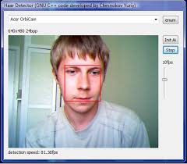
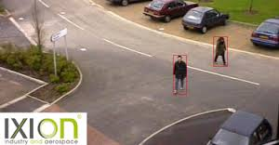
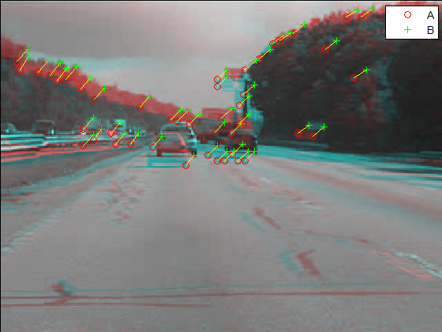
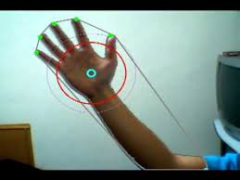
Computer Vision
The camera does not “see”, but we can program computers to find what is interesting in an image

Slide 5
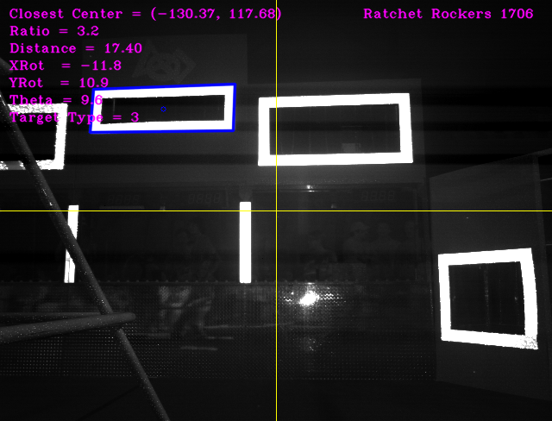
FRC Team 1706 Vision System for 2013 “Ultimate Ascent”

Slide 6
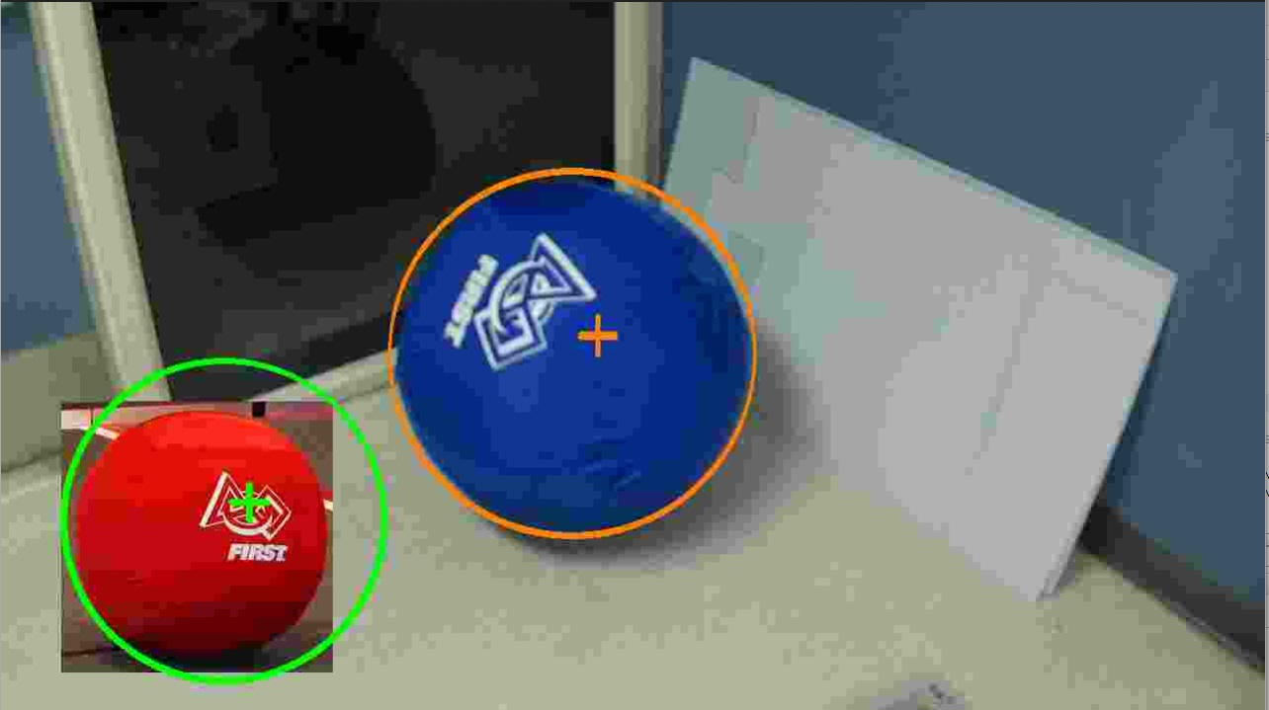
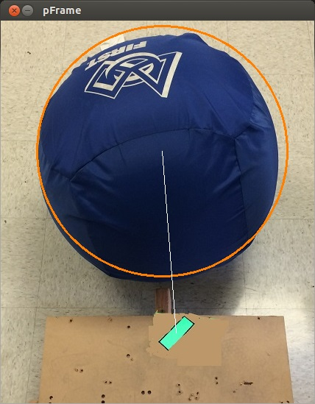
Team 4276 Vision System for 2014 “Aerial Assist”

Slide 7
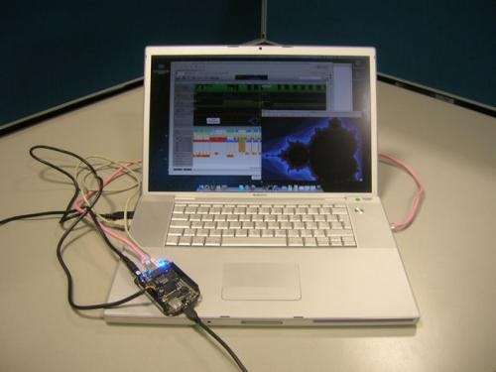
Challenges of programming embedded computers
C++
Similar to Java
Compile for specific processor – does not run on a VM like Java
Linux operating system
Very different from Windows, but you don’t need to learn a lot
NetBeans IDE much the same except used remotely
Nice to have:
Wiring and soldering skills as needed to connect and use sensors and output devices
For the 2014 vision system:
Main sensor (the camera) connected via USB
A few GPIOs used for lighting LEDs, and for switch inputs

Slide 8
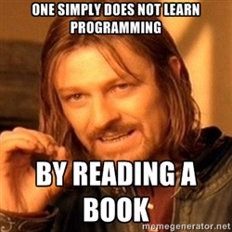
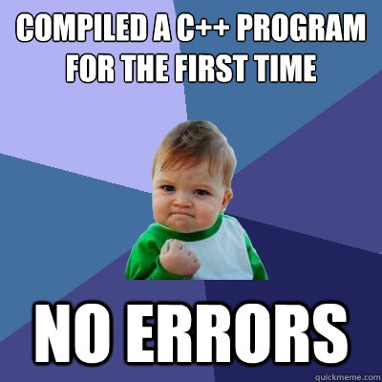

Interested in learning more?
If you:
Have administrator access to a laptop you can bring to training sessions
Have some experience programming in Java
Have time to work on this at home
I can help you with any or all of the following:
Set up NetBeans to write and debug programs remotely on the BeagleBone
Install VirtualBox with an Ubuntu Linux VM on your laptop
(So you can write code and debug when you don’t have a BeagleBone)
C++
OpenCV – an open source library for computer vision
Learn how most of our 2014 code can be reused for 2015
Will need to rewrite the part that uses OpenCV

Slide 9
Questions?

Slide 10
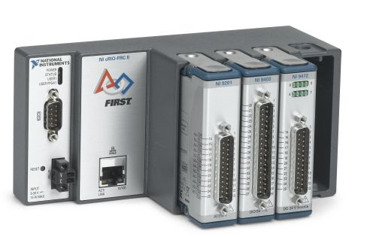
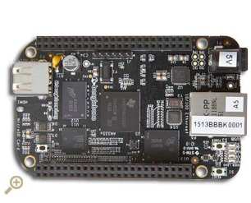
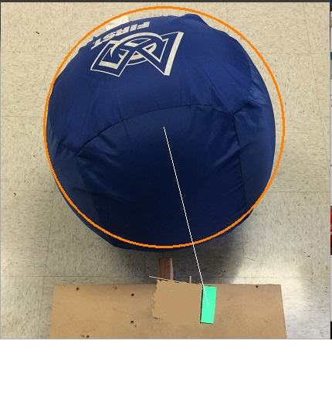
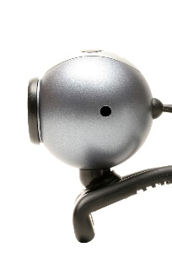
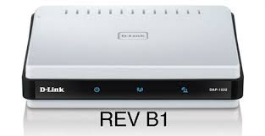

Computer Vision
cRIO
Camera
USB
Ethernet

Slide 11
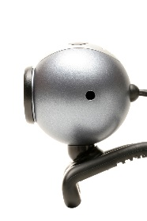
Prototype code on a laptop
Laptop uses the same version of Linux as the BeagleBone → Ubuntu 13.10
NetBeans IDE
“gcc” compiler for C++ from the Linux build tools

