Slide 1
Computer Vision Training
No Experience Necessary

Slide 2
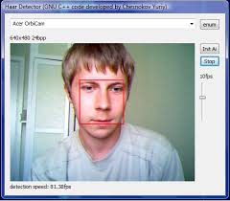
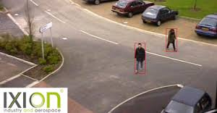
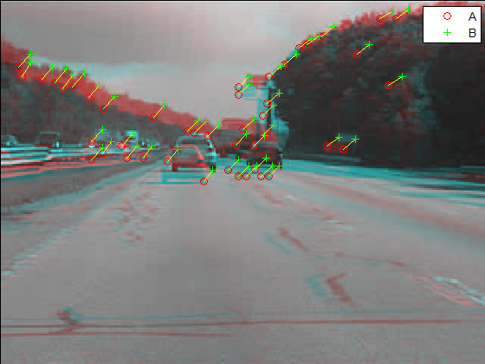
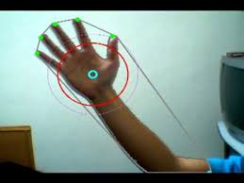
The camera does not “see”, but we can program computers to find what is interesting in an image

Slide 3
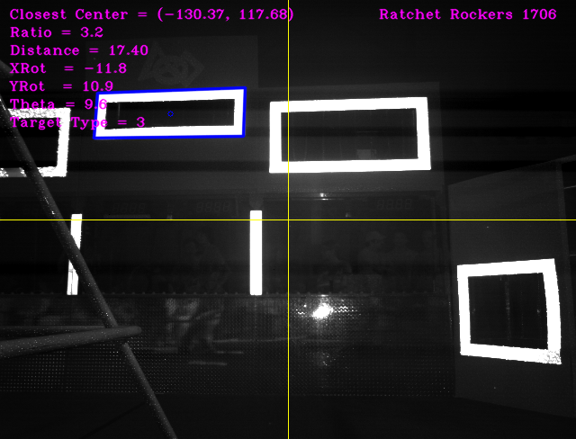
FRC Team 1706 Vision System for 2013 “Ultimate Ascent”

Slide 4
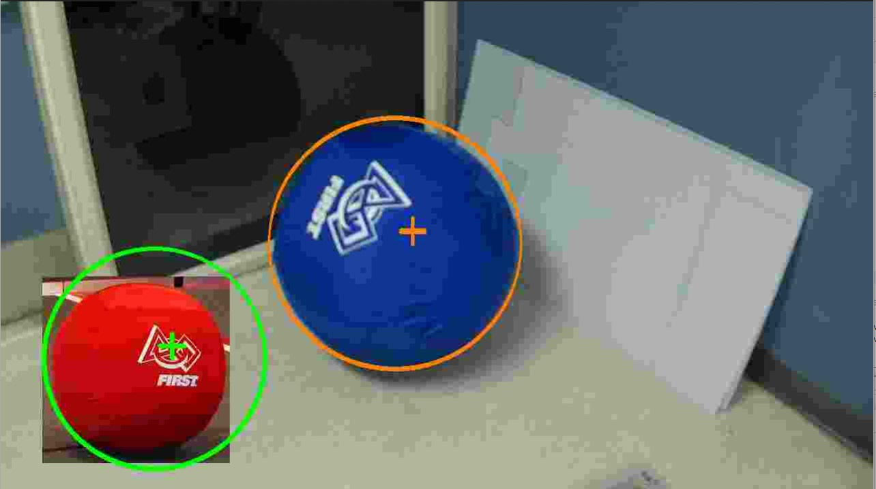
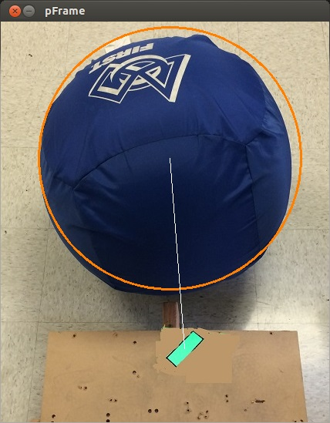
Team 4276 Vision System for 2014 “Aerial Assist”

Slide 5
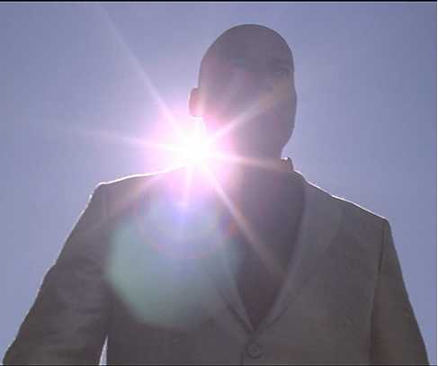
Lighting is a constant challenge
In past years we had to recompile code at the venue in a trial and error series, even after start of qualifications.
GRIP is a tool for developing computer vision algorithms interactively rather than through trial and error.

Slide 6
After you install GRIP on your laptop, plug in the webcam from the robot and go to the venue to adjust for lighting.
When ready you generate Java code based on your adjustments.
Install GRIP 1.5.2
https://github.com/WPIRoboticsProjects/GRIP/releases
Introduction to GRIP
https://wpilib.screenstepslive.com/s/currentCS/m/vision/l/463566-introduction-to-grip

