Slide 1
3: Loops and Arrays

Slide 2
Assignment 2
Foo Corporation needs a program to calculate
how much to pay their employees.
Pay = hours worked x base pay
Hours over 40 get paid 1.5 the base pay
The base pay must be no less than $8.00

Slide 3
Frequent Issues (I)
The signature of the main method cannot be modified.
public
static void
main(String[] arguments) {
...
}

Slide 4
Frequent Issues (II)
Return values: if you declare that the method is not void
then it has to return something!
public static int pay(double basePay, int hours) {
if (basePay < 8.0)
return -1;
return -1;
else else
if (hours > 60)
{
int salary = 0;
...
return salary
}
}

Slide 5
Frequent Issues (III)
Don't create duplicate variables with the same name
public static int pay(double basePay, int hours) {
int salary = 0; | // OK
…
int salary = 0; | // salary already defined!!
…
double salary
…
= 0; //salary
already defined!!
}

Slide 6
HW Solution
class WeeklyPay {
public static void pay(double basePay, int hours) {
if (basePay < 8.0) { System.out.println("You
must be paid at
least $8.00/hour");
than 60 hours a week");
} else if (hours > 60) { System.out.println("You
} else {
int overtimeHours = 0; if (hours > 40) {
can't work more
overtimeHours = hours - 40;
hours = 40;
}
double pay = basePay * hours + overtimeHours * basePay * 1.5;
System.out.println("Pay this employee
$" + pay);
}
}
public static void main(String[] arguments) { pay(7.5, 35);
pay(8.2, 47);
pay(10.0, 73);
}
}

Slide 7
What we have learned so far
Variables & types
Operators
Type conversions & casting
Methods & parameters
If statement

Slide 8
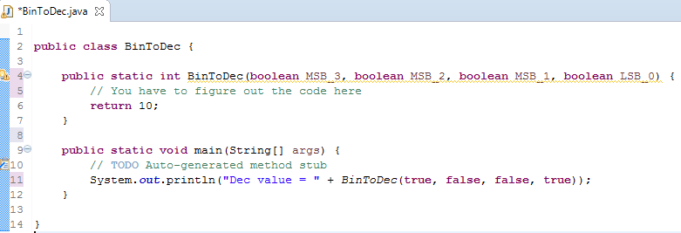
Quiz Time – Problem 1
Create a Method that takes a 4 digit binary number and returns the decimal value
Template:

Slide 9
Problem 1 Solution
public class BinToDec {
public static int BinToDec(boolean MSB_3, boolean Bit_2, boolean Bit_1, boolean LSB_0) {
int value = 0;
if (MSB_3) value += 8;
if (Bit_2) value += 4;
if (Bit_1) value += 2;
if (LSB_0) value += 1;
return value;
}
public static void main(String[] args) {
// TODO Auto-generated method stub
System.out.println("Dec value = " + BinToDec(true, false, false, true));
System.out.println("Dec value = " + BinToDec(true, true, true, true));
}
}

Slide 10
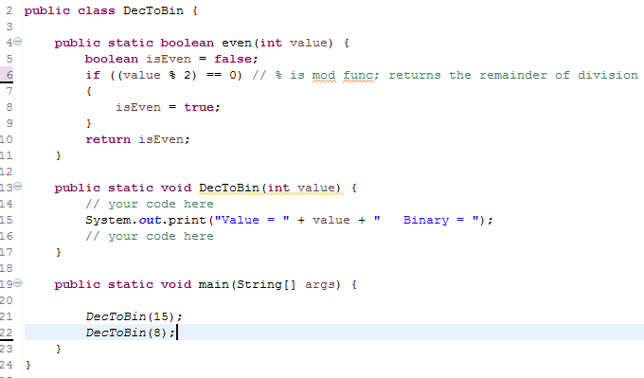
Quiz Time – Problem 2
Create a method that inputs a decimal number between 8 and 15, inclusively, and prints the binary value. If value out of range, print error.
Template:

Slide 11
Problem 2 Solution
public class DecToBin {
public static boolean even(int value) {
boolean isEven = false;
if ((value % 2) == 0) // % is mod func; returns the remainder of division
{
isEven = true;
}
return isEven;
}
public static void DecToBin(int value) {
if (value < 8 || value > 15) {
System.out.println(" Value out of range = " + value);
} else {
// Initialize variable assuming that all are odd
String MSB_3 = "1";
String Bit_2 = "1";
String Bit_1 = "1";
String LSB_0 = "1";
System.out.print("Value = " + value + " Binary = ");
// now fix for the ones that are even
if (even(value)) LSB_0 = "0";
value /= 2;
if (even(value)) Bit_1 = "0";
value /= 2;
if (even(value)) Bit_2 = "0";
value /= 2;
if (even(value)) MSB_3 = "0";
System.out.println(MSB_3 + Bit_2 + Bit_1 + LSB_0);
}
}
public static void main(String[] args) {
DecToBin(20);
DecToBin(15);
DecToBin(8);
}
}

Slide 12
Today’s Topics
Good programming style
Loops
Arrays

Slide 13
Good programming style
The goal of good style is to make your code more readable/understandable by you and by others.

Slide 14
Rule #1: use good (meaningful) names
String a1; int a2;
double b; | // | BAD!!
String firstName; | // | GOOD
String lastName; int temperature; | // // | GOOD GOOD

Slide 15
Rule #2: Use indentation
public
static
void main
(String[]
arguments) {
int
x = 5;
x = x * x;
> 20) {
if (x
System.out.println(x
}
double y = 3.4;
+ “ is greater
than
20.”);
}
Have a demo with no indentation
Ctrl-shift-F to auto-

Slide 16
Rule #3: Use whitespaces
Put whitespaces in complex expressions:
// BAD!!
double cel=fahr*42.0/(13.0-7.0);
// GOOD
double cel
= fahr *
42.0
/ (13.0 -
7.0);

Slide 17
Rule #3: Use whitespaces
Put blank lines to improve readability:
public
static void main (String[] arguments) {
int | x | = | 5;
x = | x | * | x;
if (x > 20) {
System.out.println(x
+ “ is > 20.”);
}
double
y = 3.4;
}

Slide 18
Rule #4: Do not duplicate tests
if (basePay < 8.0) {
60) {
>= 8.0
...
if (hours >
...
if (basePay
...
} else
} else
&& hours
<= 60) {
}

Slide 19
Rule #4: Do not duplicate tests
if (basePay < 8.0) {
...
if (hours >
...
if (basePay
...
} else
60) {
>= 8.0
} else
&& hours
<= 60){
}
BAD

Slide 20
Rule #4: Do not duplicate tests
if (basePay < 8.0) {
...
if (hours > 60) {
...
{
...
} else
} else
}

Slide 21
Good programming style (summary)
Use good names for variables and methods
Use indentation
Add whitespaces Don't duplicate tests

Slide 22
Loops

Slide 23
Loops
static void main (String[] arguments) {
System.out.println(“Rule System.out.println(“Rule System.out.println(“Rule
#1”);
#2”);
#3”);
}
What if you want to do it for 200 Rules?

Slide 24
Loops
Loop operators allow to loop through a block
of code.
There are several loop operators in Java.

Slide 25
The while operator
while
(condition) {
statements
}

Slide 26
The while operator
int i = 0;
while (i < 3) {
System.out.println(“Rule #“
i = i+1;
+ i);
}
Count carefully
Make sure that your loop has a chance to finish.

Slide 27
The for operator
for (initialization;condition;update){
statements
}

Slide 28
The for operator
for (int i = 0; i < 3;
i=i+1) {
System.out.println(“Rule
#“ + i);
}
Note:
i = i+1 may be replaced by i++

Slide 29
Branching Statements
break terminates a for or while loop
for (int i=0; i<100;
if(i == 50)
i++) {
break;
System.out.println(“Rule
}
#” + i);

Slide 30
Branching Statements
Continue proceeds directly to the next iteration
for (int i=0; i<100; if(i == 50)
i++) {
continue;
System.out.println(“Rule
#” + i);
}

Slide 31
Embedded loops
for (int i =
for (int
0; i < 3; i++) {
j = 2; j < 4; j++) {
“
System.out.println (i +
“ + j);
}
}
respective for block

Slide 32
Arrays

Slide 33
Arrays
An array is an indexed list of values.
You can make an array of any type e.g. int, double, String, etc..
All elements of an array mush have the same

Slide 34
Arrays
..
..
0
1 2
3
n-1

Slide 35
Arrays
Example: double [ ]
..
..
5.0 2.44
9.01 1.0
-9.9
0
1 2
3
n-1

Slide 36
Arrays
The index starts at zero and ends at length-1.
Example:
int[]
values
int[5];
= 12; // CORRECT
= 12; // CORRECT
= 12; // WRONG!! compiles but
//
//
= new
values[0] values[4] values[5]
throws an Exception
at run-time

Slide 37
Arrays
An array is defined using TYPE[]. Arrays are just another type.
int[] values; // array of int
int[][] values; // int[] is
a type

Slide 38
Arrays
To create an array of a given size, use the operator new :
int[] values
= new
int[5];
or you may use a variable to specify the size:
int size = 12;
int[] values = new
int[size];

Slide 39
Array Initialization
Curly braces can be used to initialize an array. It can ONLY be used when you declare the
variable.
int[]
values
= { 12, 24, -23, 47 };

Slide 40
Quiz time!
Is there an error in this code?
int[]
values
= {1, 2.5, 3, 3.5, 4};

Slide 41
Accessing Arrays
To access the elements of an array, use the [] operator:
values[index]
Example:
int[]
values
= { 12, 24, -23, 47 };
// {12,24,-23,18}
+ 3; // {12,24,-23,18}
values[3]
= 18;
int x
= values[1]

Slide 42
The length variable
Each array has a length variable built-in that contains the length of the array.
int[]
values
= new int[12]; values.length; // 12
int size =
int[]
values2 =
{1,2,3,4,5}
values2.length; // 5
int size2 =

Slide 43
String arrays
A side note
public static void main (String[] arguments){ System.out.println(arguments.length);
if(arguments.length == 2){
System.out.println(arguments[0]); System.out.println(arguments[1]);
}
}

Slide 44
Combining Loops and Arrays

Slide 45
Looping through an array
Example 1:
int[]
values
= new
int[5];
for (int i=0;
i<values.length; i++) {
= i;
values[i]
int y = values[i] * values[i]; System.out.println(y);
}

Slide 46
Looping through an array
Example 2:
int[] int i while
values
= 0;
= new
int[5];
(i < values.length) {
values[i] = i;
int y = values[i] * values[i];
System.out.println(y);
i++;
}

Slide 47
Summary for today
Programming Style
Loops
Arrays

Slide 48
Assignment 3
A group of friends participate in the Boston Marathon.
Find the best performer.
Find the second-best performer.

Slide 49
MIT OpenCourseWare
http://ocw.mit.edu
6.092 Introduction to Programming in Java
January (IAP) 2010
For information about citing these materials or our Terms of Use, visit: http://ocw.mit.edu/terms.

