Slide 1

SALES PREDICTION
Group 7
Matt Esporrin
Brittany Hayes
Verghese Polukannil
Lisha Shangguan

Slide 2

Table of Contents
Business Situation
Data
Exploration
Cleaning
Modeling
Random Forest
Boosting
GAMs
Results
Alternative Methods
Store Specific
Clustering
Appendix

Slide 3
Business Situation
Rossmann GmbH operates over 3,000 drug stores in Europe
Predicting sales for each store is vital for:
Purchasing Inventory
Creating a staff schedule
General productivity
The goal is to understand what factors drive sales, and accurately predict future daily sales using historical data

Slide 4
Data
From Kaggle competition
Two files that had to be joined
Train (1017209 obs. of 9 variables)
Variables:
Store, Day of Week, Date, Sales, Customers, Open, Promo, State Holiday, School Holiday
Store (1115 obs. of 5 variables)
Variable
Store, Store Type, Assortment, Competition Distance, Competition Since Moth, Competition Since Year

Slide 5
Data Exploration
Before choosing predictors for our models, we did some basic data exploration in Tableau
Some variables that looked like they might have an impact on sales were:
Store Type (see Appendix 1)
School Holiday (see Appendix 2)
Month (see Appendix 3)
Also, we ran a PCA (see Appendix 4)

Slide 6
Data Cleaning & Preprocessing
Change variable type
String —> Date e.g. date
Change labels of factor variables
Separate month and year from the date variable
Add integer month and year variables
Drop the date and customer volume variables

Slide 7
Data Cleaning & Preprocessing
Add a new variable and calculate the time interval in days since the competitor appeared
2015-07-31 minus Competitor Open Date
Exclude closed stores and zero sales observations
Exclude outliers
Competitor Open Date on 1900 and 1961
Sales equal to 46
Minus time interval

Slide 8
Data Cleaning & Preprocessing
Final full dataset
571997 obs. 16 variables
Training and test datasets
Training dataset
439116 obs.
Prior to 2015
Test dataset
132881 obs.
Year 2015

Slide 9

Model Evaluation Metrics
Mean Squared Error (MSE)
$$MSE=\frac{1}{n}\sum_{i=1}^{n}{{\left(yi−yi\right)}^{2}}$$
Root Mean Square Percentage Error (RMSPE)
$$RMSPE=\sqrt{\frac{1}{n}}\sum_{i=1}^{n}{{\left(\frac{yi−yi}{yi}\right)}^{2}}$$
Note: where y_i denotes the sales of a single store on a single day and yhat_i denotes the corresponding prediction. Any day and store with 0 sales is ignored in scoring.

Slide 10
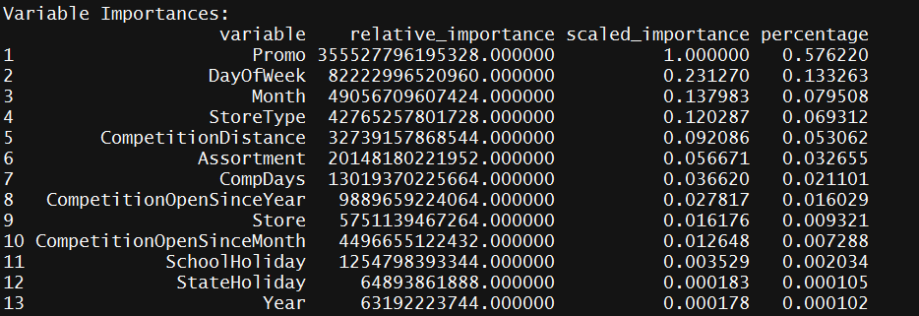
Modeling: Random Forest
Using the h2o package, we constructed several random forest models which used different values of number of trees and max depth. The h2o allows us to process the large scale dataset fast and accurately, using the 100% CPU.
Promotion, DayOfWeek are the most important features.

Slide 11
Modeling: Random Forest
The random forest model (ntrees = 1000)
The random forest model (ntrees = 100)
When the number of trees equals 100, the model performs better. The chosen parameters setting does not lead to overfitting the training data since the test MSE and training MSE are similar.
 | MSE | RMSPE
Training | 7470077 | 53.33%
Test | 7280485 | 48.73%
 | MSE | RMSPE
Training | 7494087 | 53.68%
Test | 7317610 | 49.01%

Slide 12
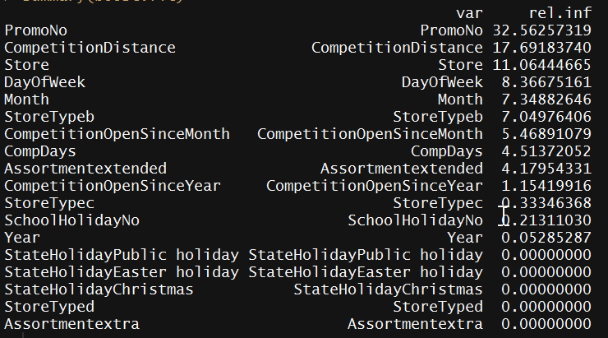
Modeling: Boosting
Using the caret and gbm packages, we constructed boosting models. The caret package can tune the parameters automatically and identify the optimal settings to generate the smallest RMSE.
The optimal settings:
n.trees = 150, interaction.depth = 3, shrinkage = 0.1 and n.minobsinnode = 10
Promotion, competition distance, and store are more important than other features.

Slide 13
Modeling: Boosting
The best boosting model had the following values for our metrics of interest:
The chosen parameters setting does not lead to overfitting the training data since the test MSE and training MSE are similar
 | MSE | RMSPE
Training | 5899619 | 47.90%
Test | 5866356 | 42.66%

Slide 14
Modeling: GAMs
Using the gam package, we constructed several gam models which used smoothing splines with varying degrees of freedom for the numeric predictors and dummy variables for the categorical predictors
The best choice of predictors were chosen by subset selection
CompDays
CompetitionDistance
CompetitionOpenSinceYear
Assortment
StoreType
Month
Promo
DayOfWeek

Slide 15
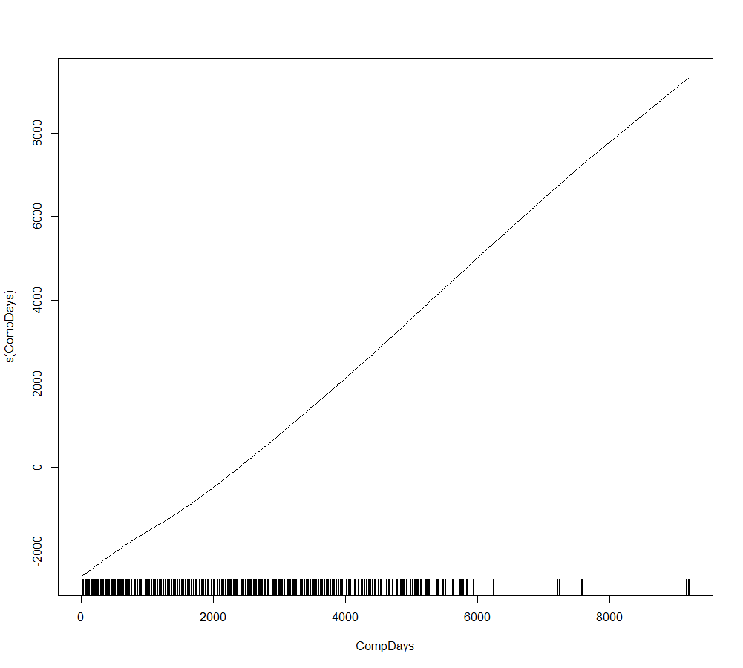
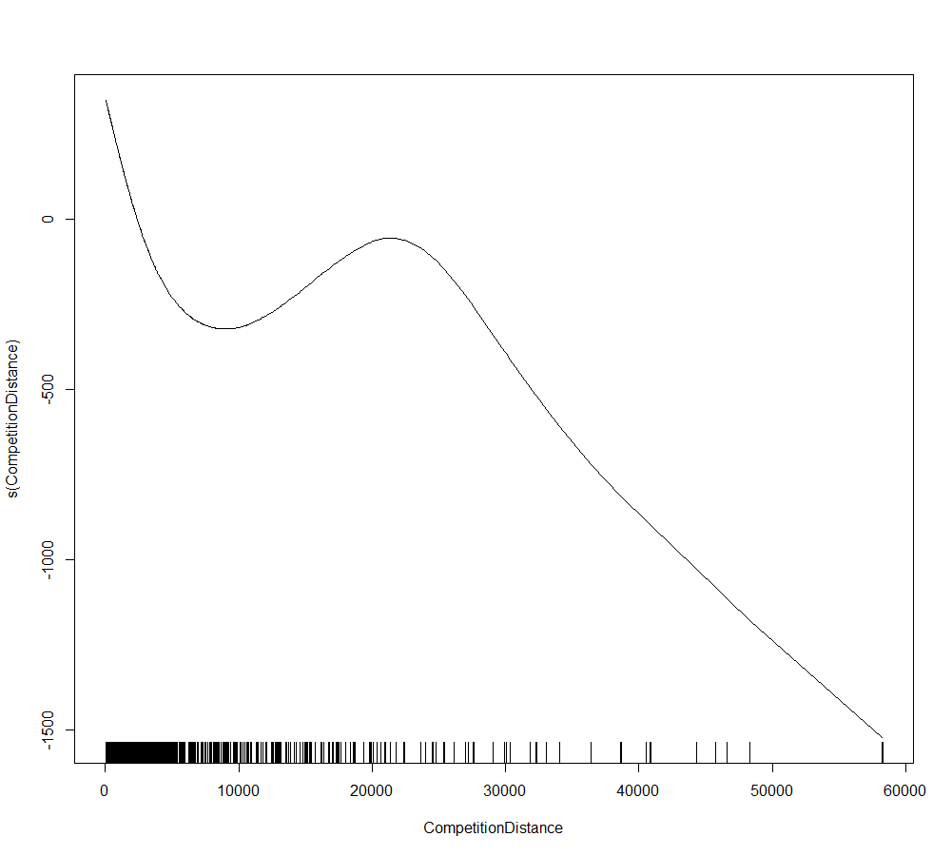
Modeling: GAMs
The best GAM model used smoothing splines for CompDays and CompetitionDistance

Slide 16
Modeling: GAMs
The best GAM model had the following values for our metrics of interest:
It was possible to slightly lower the RMSPE, but at the cost of increasing the MSE.
The flexibility of the splines does run the risk of overfitting the training data, however, as the test MSE and training MSE are similar, this does not seem to be too great a risk in this case.
 | MSE | RMSPE
Training | 7939000 | 34.81%
Test | 7531000 | 31.4%

Slide 17
Accuracy of Results
Results Comparison
 | MSE | RMSPE
GAMs | 7531000 | 31.4%
Boosting | 5866356 | 42.7%
Random Forest | 7280485 | 48.7%

Slide 18
Conclusions and Perspective
GAMs are useful for modeling nonlinear trends, especially with time series data
Important predictors for the data set can be categorized as:
Seasonality
Local competition
Assortment and Type of Store
Rossmann could use a similar model to:
Predict sales for their stores
Build employee schedules
Manage inventory
Understanding what types of stores and merchandise drive sales could be useful in future studies
Clustering stores could prove useful in improving the predictive power of the model
Demographic data for each store could also be useful in finding profitability of a future store

Slide 19
Possible Additions/Alternatives
Store Specific Method:
A function is created that will take a 2015 store ID as a parameter. It will then create a tuned model for this store based on the training data of the same store in the training data then function will output predicted sales
Clustering Method:
Remove sales and customer data from training data
Use hierarchical clustering to cluster all rows of data and cut into 5 clusters
Use a lvq classification model to predict cluster classification of test data
Partition training data by cluster
Use each training partition to train a sales prediction gbm model to predict cluster classified test data

Slide 20
Store Specific Method
Average daily sales for all stores: $5773.82
Results for Store Specific Method:
Mean Absolute Error:
randomForest Model: $551.274
GBM Model: $457.27
GAM Model: $564.02
Modeling for specific stores may be a better method than applying the same model to all stores, especially if more location specific data were available (eg. Distance from highway)

Slide 21
Clustering Method
Clustering Method:
Remove sales and customer data from training data
Use hierarchical clustering to cluster all rows of data cut into 5 clusters
Use a lvq classification model to predict cluster classification of test data
Partition training data by cluster
Use each training partition to train a sales prediction gbm model to predict cluster classified test data
While not fully fleshed out, the clustering method proves promising
Would require fewer models than the store specific method
Would be able to predict profitability of future locations

Slide 22
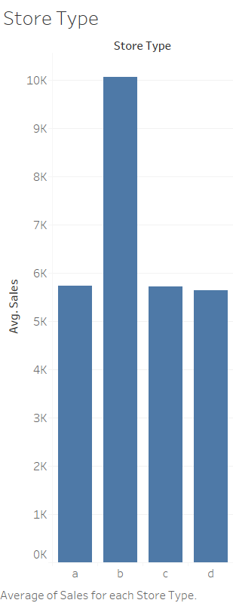
Appendix
1. A simple bar chart of average sales by Store Type. Store Type b generally had larger sales numbers

Slide 23
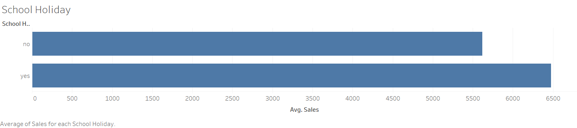
Appendix
2. A bar chart showing average sales on days when there was a school holiday and days when there was not. There might be a slight correlation between higher sales and days when there was a school holiday.

Slide 24
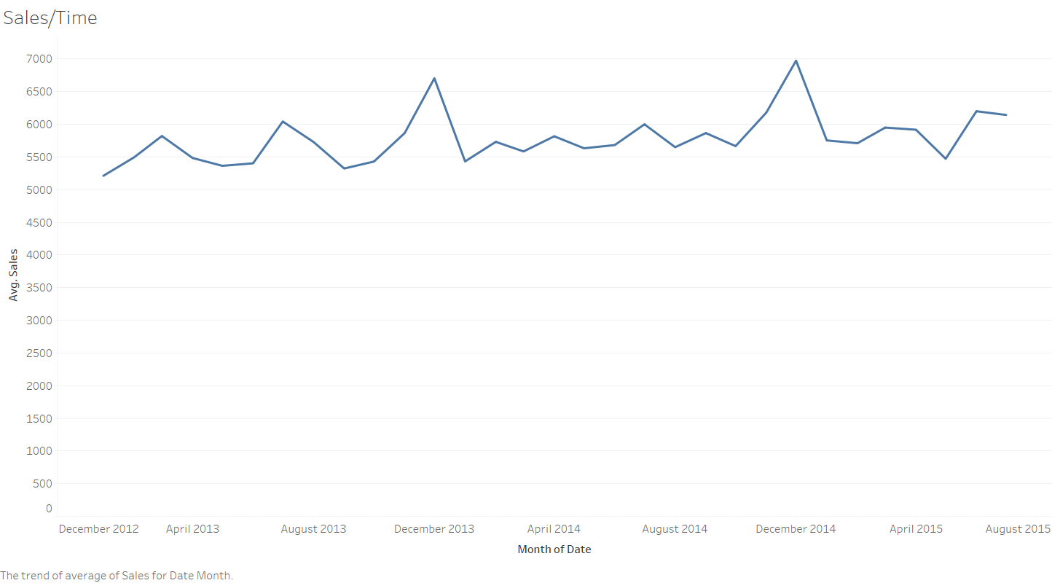
Appendix
3. A line graph of average sales by month. December seems to be a peak month.

Slide 25
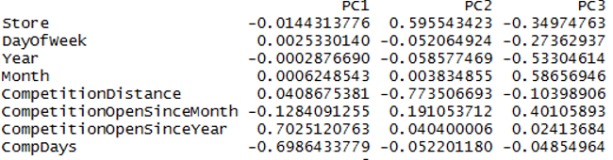
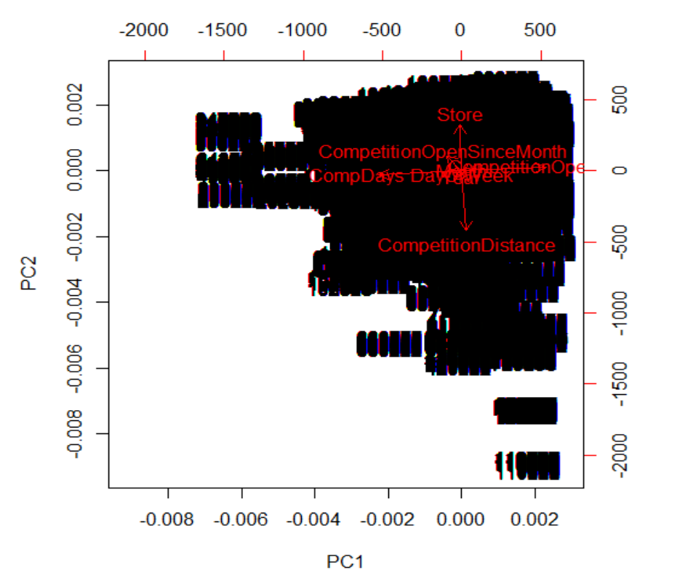

Appendix
4. Results of PCA and Plot PC1 and PC 2

