Slide 1

Group 7
Matt Esporrin, Brittany Hayes, Verghese Polukannil & Lisha Shangguan

Slide 2

Business Reasoning
Rossmann GmbH operates over 3,000 drug stores in Europe
Predicting sales for each store is vital for:
Purchasing Inventory
Creating a staff schedule
General productivity
The goal is to understand what factors drive sales, and accurately predict future daily sales using historical data

Slide 3
Data
From Kaggle competition
Two files that had to be joined
Train (1017209 obs. of 9 variables)
Variables:
Store, Day of Week, Date, Sales, Customers, Open, Promo, State Holiday, School Holiday
Store (1115 obs. of 10 variables)
Variable
Store, Store Type, Assortment, Assortment, Competition Distance, Competition Since Moth, Competition Since Year, Promo2, Promo2 Since Week, Promo2 Since Year, Promo Interval

Slide 4
Data Cleansing

Slide 5
Modeling
• A summary of your modeling steps, with reference to your script where appropriate to allow me to relate it to your description. • In particular, if in a predictive setting, overtraining avoidance, bias variance tradeoff, etc. should be discussed.

Slide 6
Modeling
A summary of your modeling steps, with reference to your script where appropriate to allow me to relate it to your description. • In particular, if in a predictive setting, overtraining avoidance, bias variance tradeoff, etc. should be discussed.

Slide 7
Modeling: GAM
Using the gam package, we constructed several gam models which used smoothing splines with varying degrees of freedom for the numeric predictors and dummy variables for the categorical predictors
The best choice of predictors were chosen by subset selection
CompDays
CompetitionDistance
CompetitionOpenSinceYear
Assortment
StoreType
Month
Promo
DayOfWeek

Slide 8
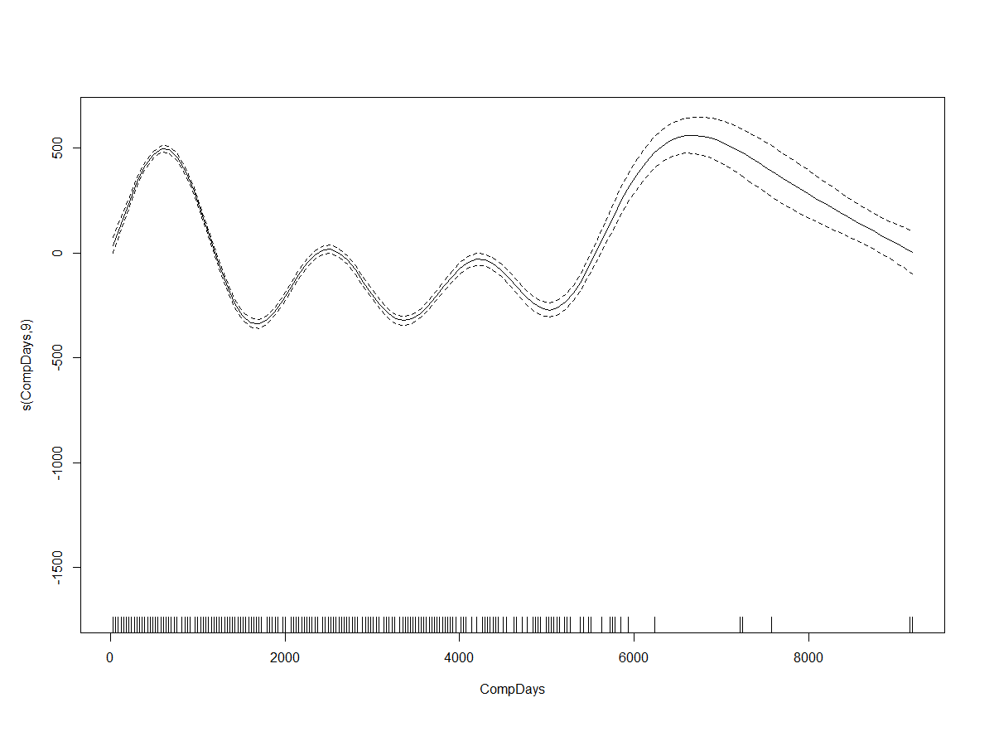
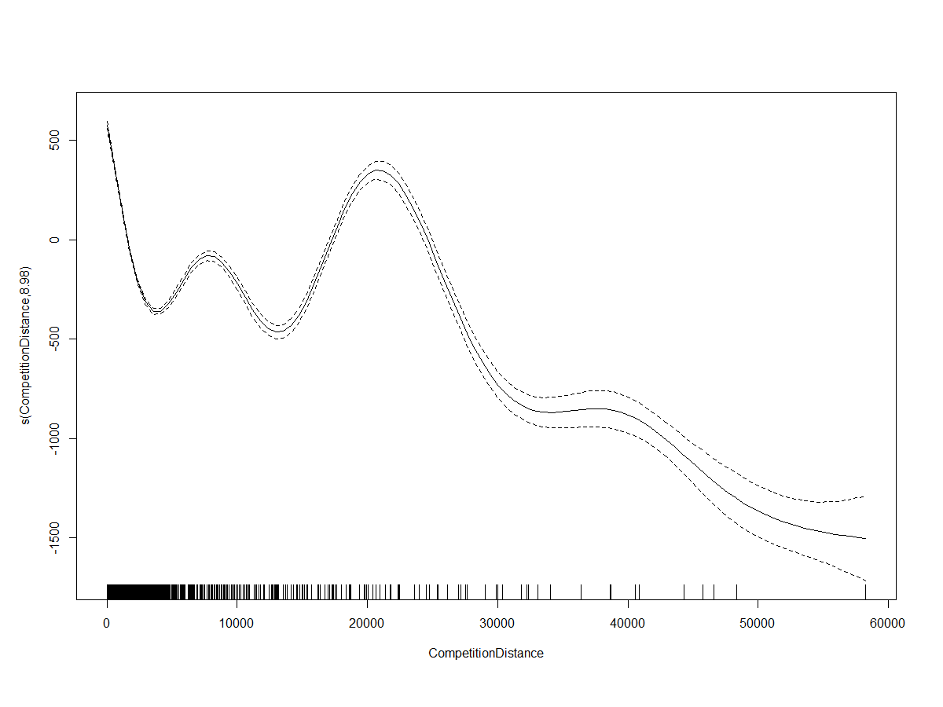
Modeling: GAM
The best GAM model used smoothing splines for CompDays and CompetitionDistance

Slide 9
Modeling: GAM
The best GAM model had the following values for our metrics of interest:
Test MSE: 7501000
RPSPE for the test set: 0.3141 or 31.41%
It was possible to slightly lower the RPSPE, but at the cost of increasing the MSE.
The flexibility of the splines does run the risk of overfitting the training data, however, as the test MSE and training MSE are similar, this does not seem to be too great a risk in this case.

Slide 10
Accuracy of Results
Your assessment of the accuracy of your model(s), again with reference to your script where appropriate
• Error types should be identified and discussed

Slide 11
Accuracy of Results
Your assessment of the accuracy of your model(s), again with reference to your script where appropriate
• Error types should be identified and discussed

Slide 12
Interpretation
Your interpretation of the results of your analysis
• What you learned, how it might inform the business situation that you chose to analyze, how your findings might be deployed in the organization.

