Slide 1

Github
Team 708 – Hardwired Fusion
Created by Nam Tran 2014

Slide 2

What is Git and Github?
Git
Fast and lightweight revision control system
Developed in 2005 by Linus Torvalds for Linux
Originally used in command line but now has a GUI
Github
Web-based hosting for Git repositories
Pretty much a social network for programmers

Slide 3
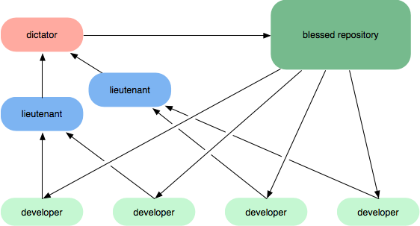
What is Revision Control?
The ability to manage changes done to files
Terms:
Repository – where files and change history is stored (often shortened to “repo”)
Commit – a saved point in the repository history where files were changed somehow

Slide 4

So How Github Beneficial to a FIRST Team?
Easy storage and distribution of the code in a public domain
Can revert to a former version of the code any time without archiving files as .zip
Can look at how the code has changed
Multiple people can collaborate on the code (I’ll talk about this more later)

Slide 5
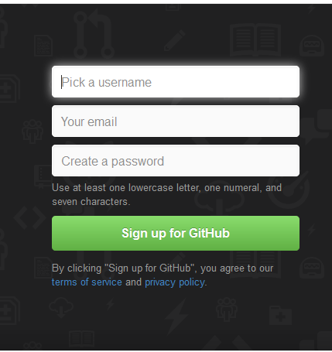
Signing Up For Github
Go to http://github.com/ and fill out the sign-up information and follow the steps
Let me know your username so I can add you to the Hardwired Fusion organisation

Slide 6
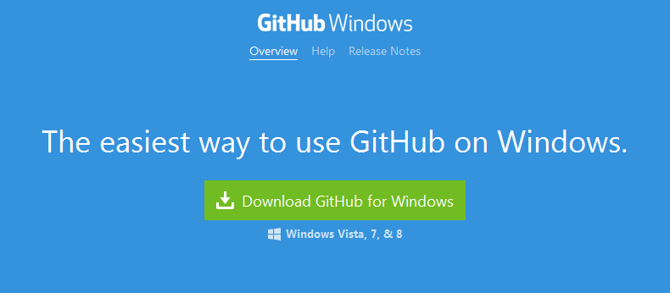
Setting Up Github
Go to http://windows.github.com/ and click “Download”
This gives you a GUI for using Git as well as a shell

Slide 7
GUI vs Shell
GUI
Graphical User Interface
Looks nice and comes with buttons, boxes, and other components
Shell
Runs from command line
Looks like a lot of text, and it can be easy to get lost or confused for beginners
Essentially, a GUI is like typing in Microsoft Word, while a shell is like typing in Notepad
Both are useful, so it is good to know how to use both

Slide 8
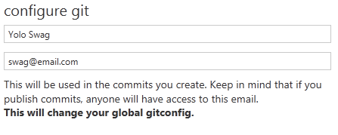
Configuring User Information
Username
git config --global user.name “[name]”
Email
git config –-global user.email “[email]”

Slide 9
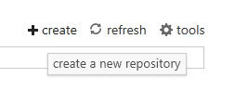
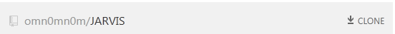
Setting Up A Repository
Create a new repository
First, create the repository folder somewhere
cd [repository\directory\path]
git init
Clone an existing repository
git clone [url]

Slide 10
Staging and Snapshots (Shell)
git status
Shows modified files in the stage for the commit
git add [file]
Adds new files to the stage
git reset [file]
Unstages a file
git diff --staged
Shows staged changes (can remove “--staged” to show unstaged changes)
git commit –m “[commit-message]”
Commits the stage and adds a message about the commit

Slide 11
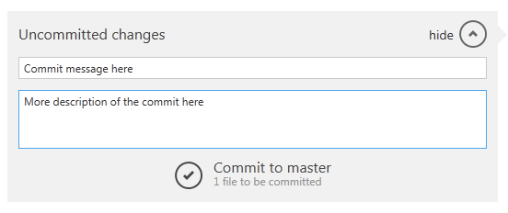
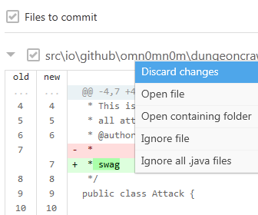
Staging and Snapshots (GUI)
In the GUI, status and diff are shown when checking out the repository
Right clicking gives the option to do “reset”
New files are automatically “added”

Slide 12
Branching and Merging
Branching is done to create multiple versions of the code
Merging is done to bring all the different versions together into one code version
REMEMBER to merge branches back together to keep the version control easier to manage
When to Branch:
Adding a new and experimental feature while wanting a working version of the code
Having multiple features being worked on by multiple people at once

Slide 13
Branching and Merging (Shell)
git branch [branch-name]
Creates a new branch (Without branch-name, it lists all the existing branches)
git checkout [branch-name]
Switches to branch-name for editing
git merge [branch]
Merges branch into the current branch
git log
Shows the current branch’s commit history

Slide 14
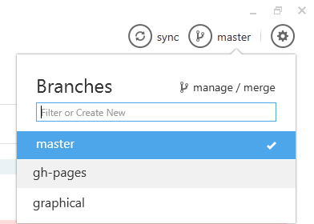
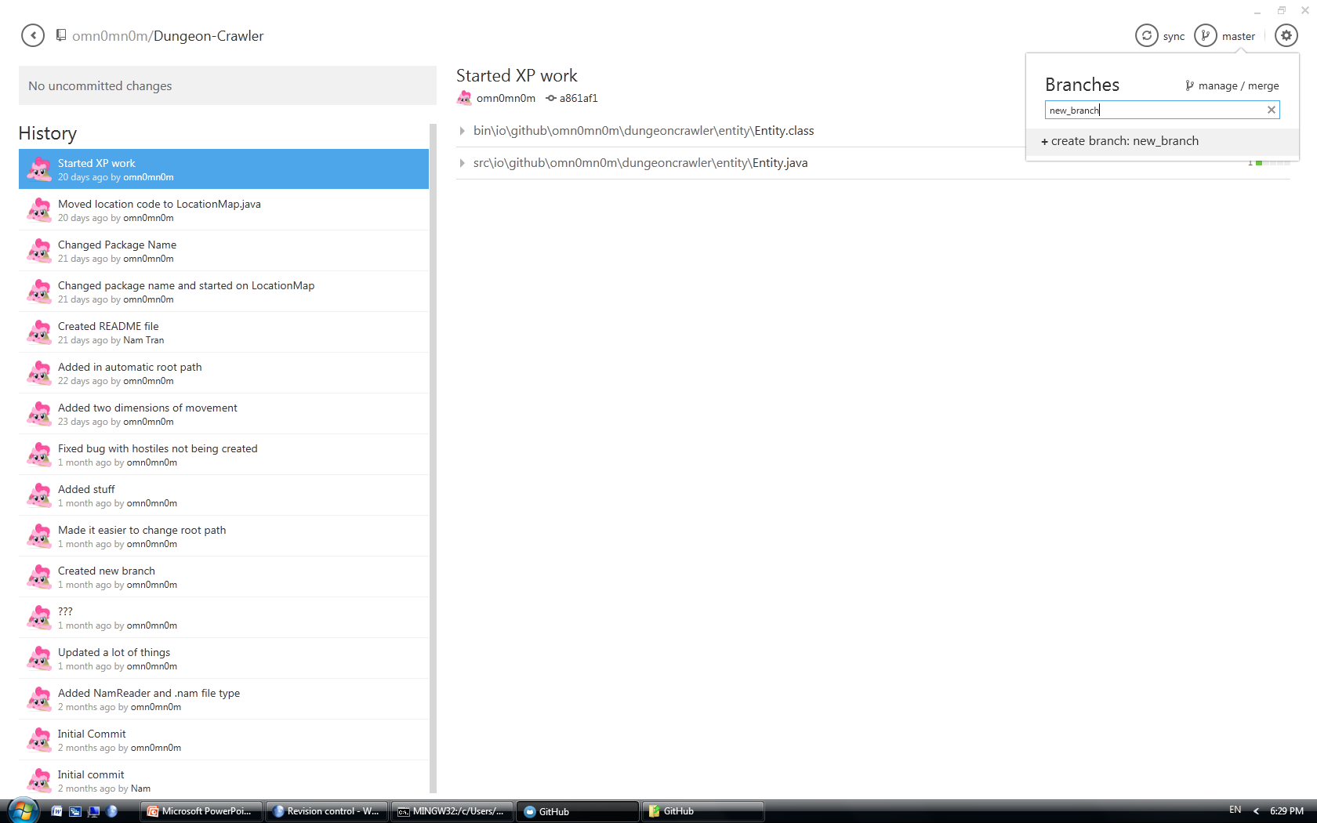
Branching and Merging (GUI)
Clicking the branch icon displays the existing branches for selection, highlighting the current one
Typing in a new branch name gives the option to create it

Slide 15
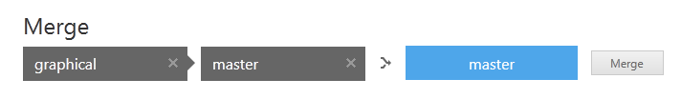
Branching and Merging (GUI)
Drag the target branch to the right
Drag the branch that is getting added to the left
The GUI will display the resulting branch
Clicking the arrow swaps which branch is the resulting branch

Slide 16
Detached Heads
What are they?
When merge conflicts exist, Git will created detached heads with both versions of the code in the head to select one version while deleting the other
Detached heads are also created to edit code without it being associated with the branch it is from
Use a merging tool to deal with the heads, or open the code in an IDE and manually handle the conflicts:
Delete the unwanted version
Remove the detached head tags
Commit to the branch after all detached heads are resolved

Slide 17
Tags
Tags are used to mark important commits in a branch’s history
We often use it to mark stable versions of the code for competitions and tested features
i.e. “vision_v1.0” or “world_champs_v3.0”
git tag “[tag-name]”
Creates a tag at the currently checked out commit
git checkout “[tag-name]”
Checks out the commit at the tag (reverting the code to the tag)

Slide 18
Temporary Commits
Sometimes you want to save changes but are not ready to commit them yet
Git has the ability to “stash” the changes
git stash
Stashes any changes
git stash list
Lists the stashed file changes in a stack
git stash pop
Write working from top of stash stack
git stash drop
Discards the changes from top of stash stack

Slide 19
Pushing Commits to Github
Commits are stored locally on a computer
They have to be “pushed” to Github to be viewed online
git push --all
For simplicity, just push everything. There are many other modifiers if you want to look them up

Slide 20
Getting Commits from Github
Likewise, sometimes you need to get new code that someone loaded to Github
They have to be “fetched” or “pulled” from Github
git fetch [alias]
Fetches all the commits from Github (alias is repository name on Github)
git pull
Does “git fetch” as well as “git merge” with only one command typed

Slide 21
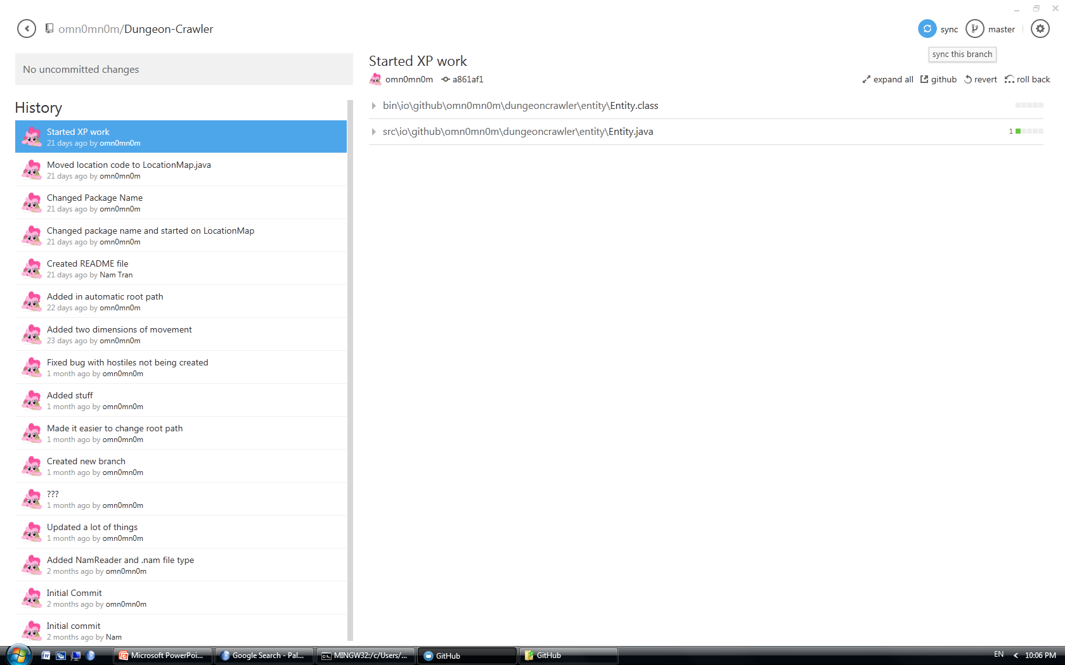
The “Sync” Button (GUI)
The GUI fetches, merges, and pushes all with one button
Shows how many commits ahead or behind your local repository is with numbers next to the button

Slide 22
There Are MANY More Features!
Git has a huge amount of commands and features in it
Not all of them are as commonly used during the FIRST season
Main Features (all of them covered in slideshow)
Creating commits and an edit history
Branching and merging repositories
Tagging different commits
Stashing temporary changes for later use
Storing everything on Github
Google “git” or “github” some time, there are a lot of other things possible

