Slide 1
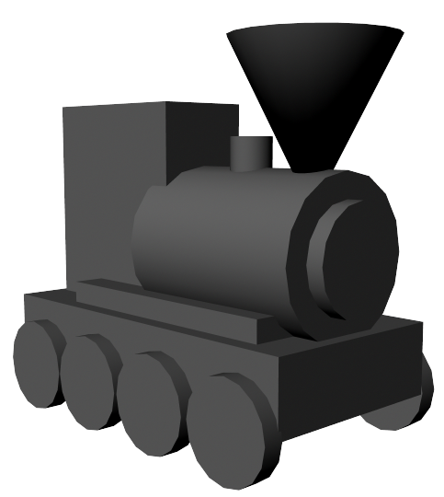
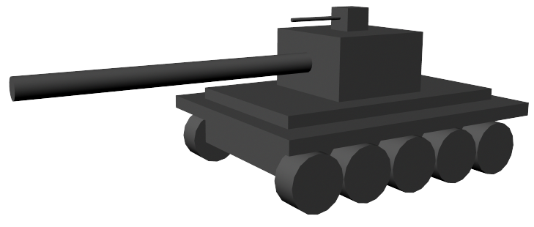
Animation Workshop
Week 2

Slide 2
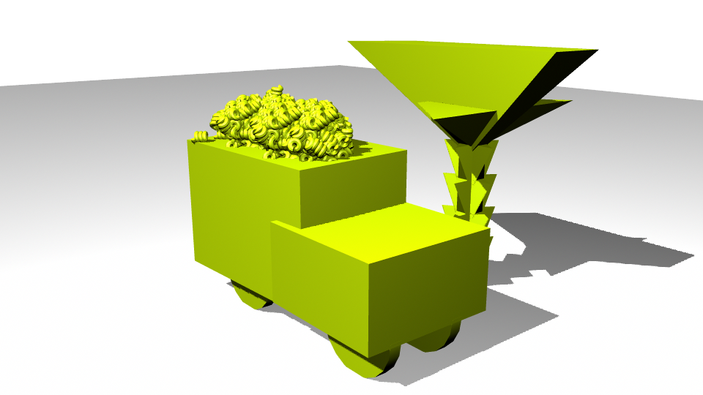
Richard’s macaroni truck

Slide 3
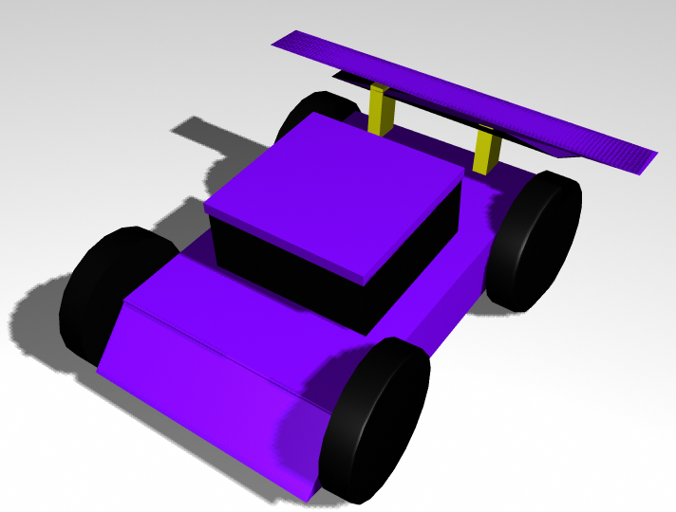
Pranav’s race car

Slide 4
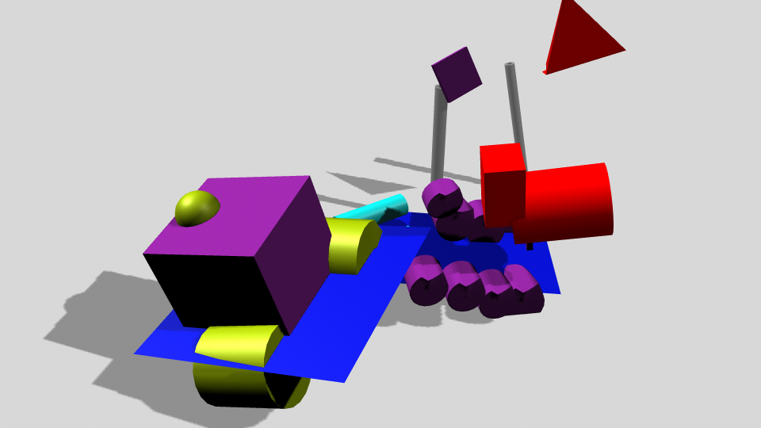
Ye Sol’s steam roller crashing through construction equipment

Slide 5
Basic Workflow of Animation
Modeling
create 3D models of objects to animate
Coloring/Texturing
color the models
Lighting
add virtual lights to the scene
Rendering
exporting the animation
Editing
combine many animations into 1 video
add sound

Slide 6
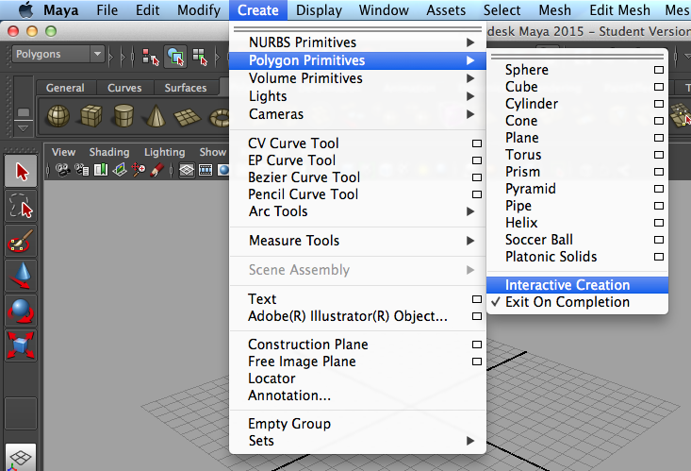
Modeling
Turn off Interactive Creations mode:
Create - Polygon Primitives - Interactive Creations
(uncheck Interactive Creations)
Always turn off Interactive Creation mode when modeling. This creation mode allows you to create objects by clicking and dragging on the screen. Nobody uses this, because it’s a very inaccurate way of modeling.

Slide 7
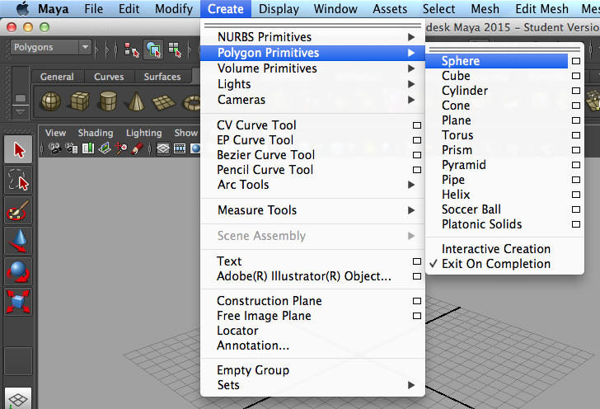
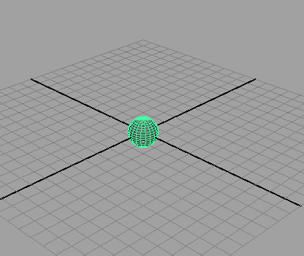
to create a primitive object:
Create - Polygon Primitives - Sphere, Cube, Cylinder . . .
(the selected primitive object will appear at the center of the virtual world

Slide 8
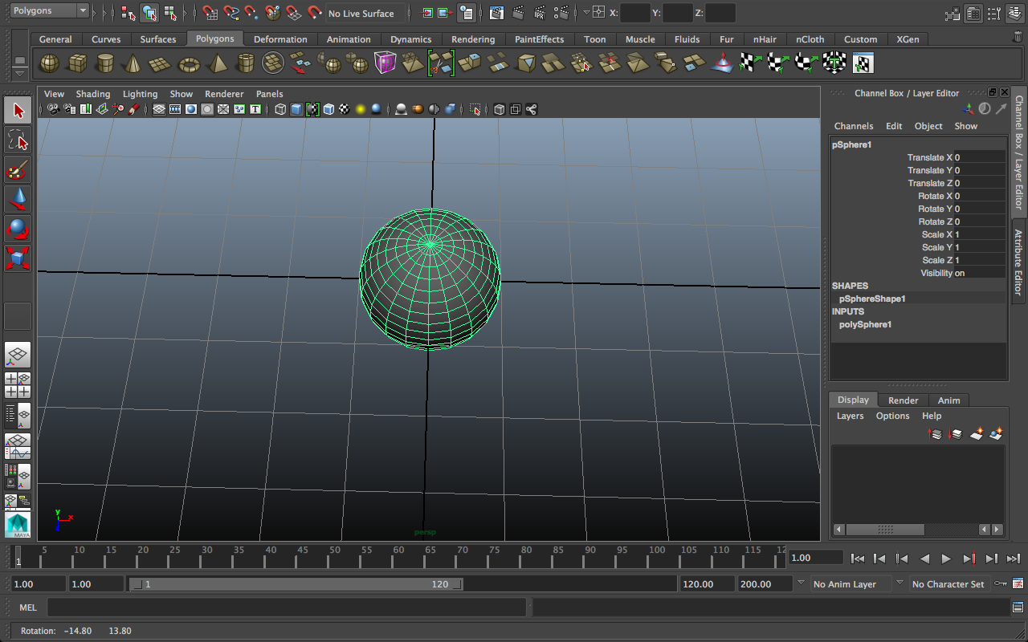
Navigating the Virtual World
to rotate around your current view:
Alt + Left mouse button drag
to move sideways:
Alt + Middle mouse button drag
to zoom in:
Scroll (with the middle mouse button)
to focus on the selected object:
press “F”

Slide 9
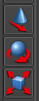
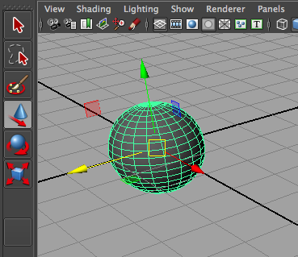
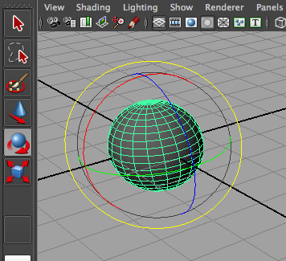
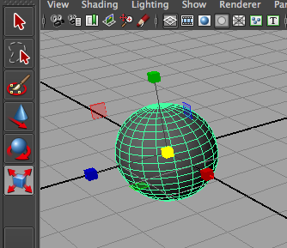
The 3 Basic Manipulator Tools
Translate
Rotate
Scale
to use:
select object to manipulate (click on it)
click on a manip tool (in the sidebar)
drag manip handles that appear

Slide 10
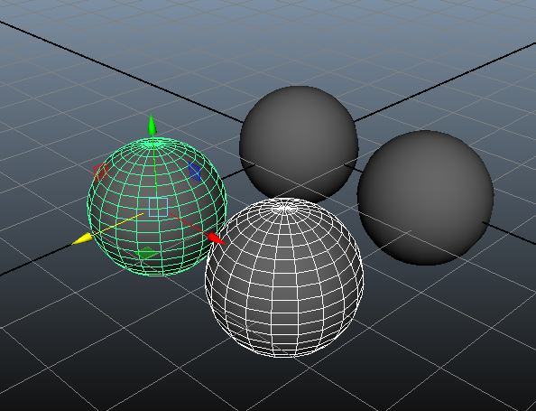
To duplicate an object:
select the object
Windows: Ctrl + D
Mac: Command + D
To select multiple objects at a time:
Shift-click them
(you can now manipulate/duplicate them at the same time)

Slide 11
Make a simple model!
For now, try using primitive objects like building blocks.

Slide 12
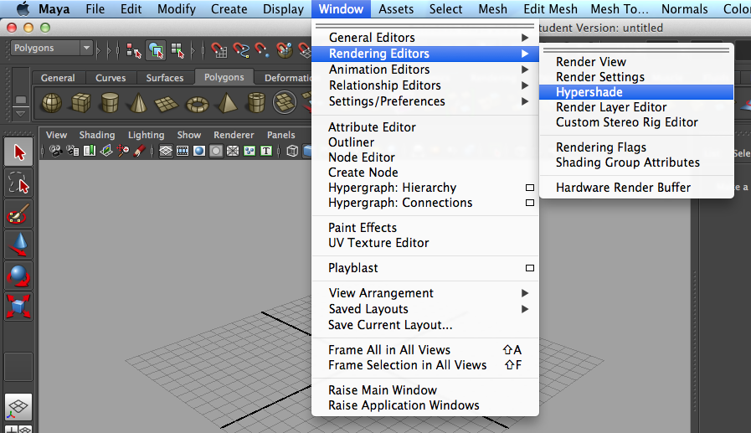
Coloring
To create a color:
open the Hypershade window:
Window - Rendering Editors - Hypershade

Slide 13
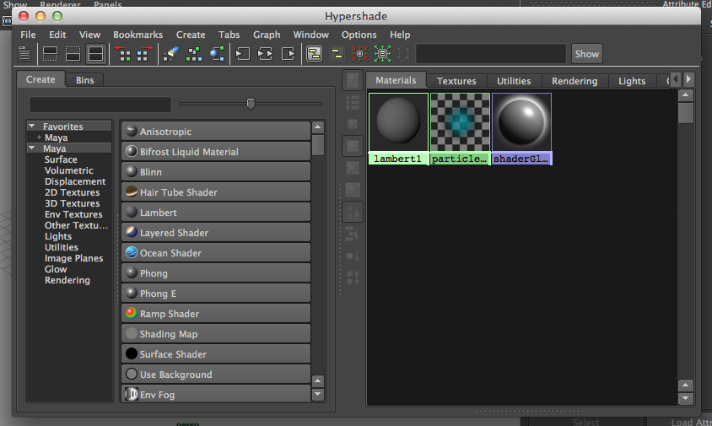
in the Hypershade Window . . .
click on a color type
(your created color will appear on the right)
popular types:
Blinn
for shiny objects
ex: metal, glass . . .
Lambert
for nonreflective objects
ex: paper, wood . . .

Slide 14
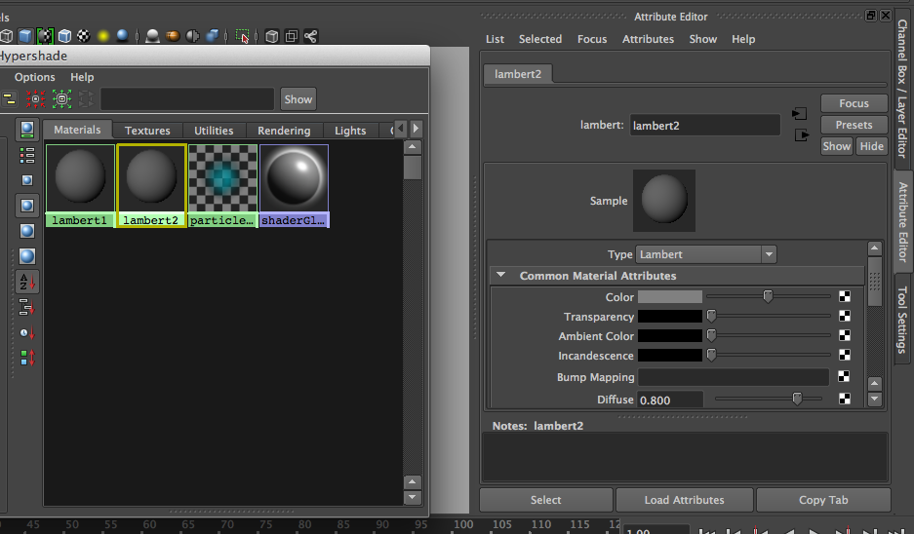
to edit your created color:
double click on it
its attributes will appear on the side

Slide 15
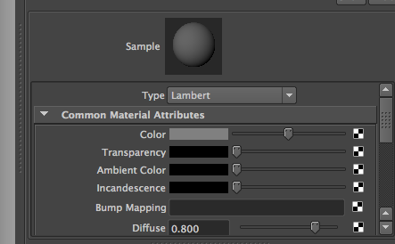
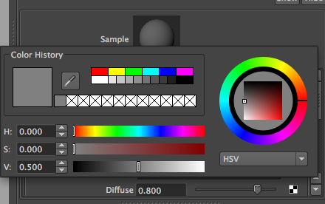
to change the Color attribute of the color:
click on the gray box next to “Color”
create a desired color

Slide 16
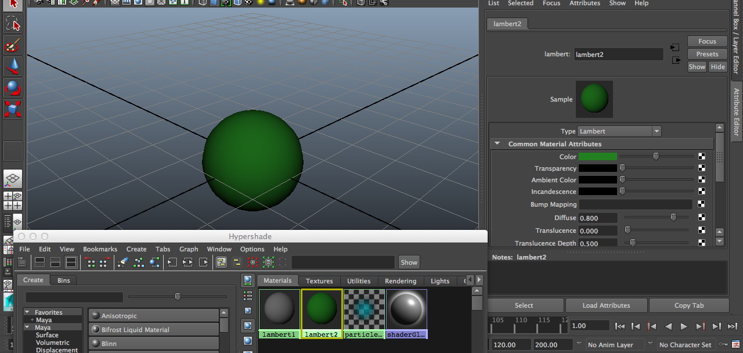
to apply the color to an object
middle mouse button drag the color
from Hypershade to the object

Slide 17
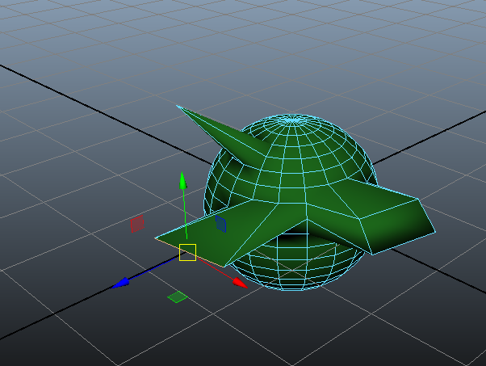
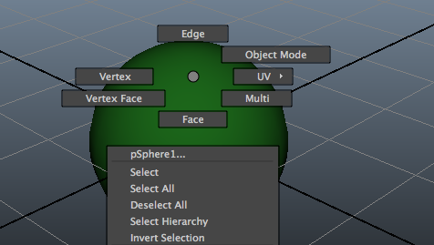
Manipulating Components of Objects
manipulatable object components:
faces
edges
vertices
to select and manipulate object parts
hold down the right mouse button
choose the desired selection mode
you can now select/manipulate the desired component types

Slide 18
Saving Scenes
File - Save Scene - (Select Destination)
e-mail your scenes to brianlo1202@gmail.com

