Slide 1

Animation Workshop
Week 3

Slide 2
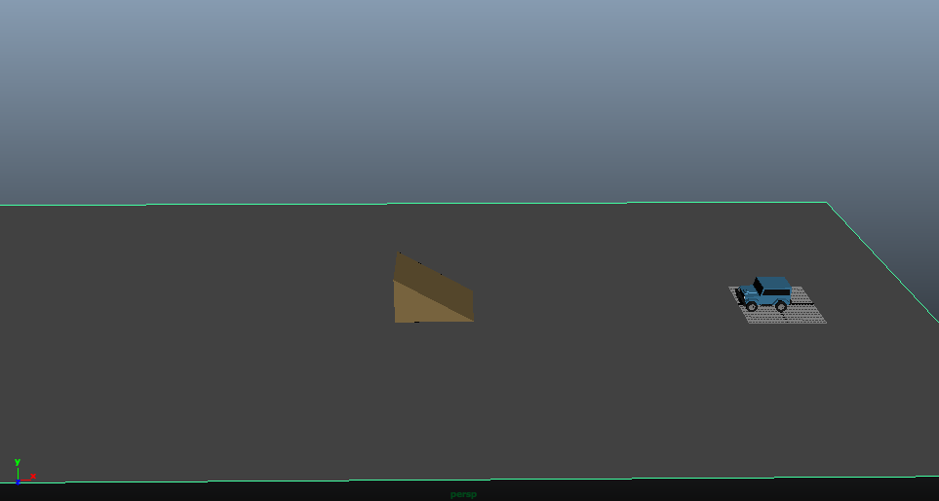
Setting up the animation
Place the back wheels of the car at the origin of the virtual world
make a ramp
make a ground from a plane

Slide 3
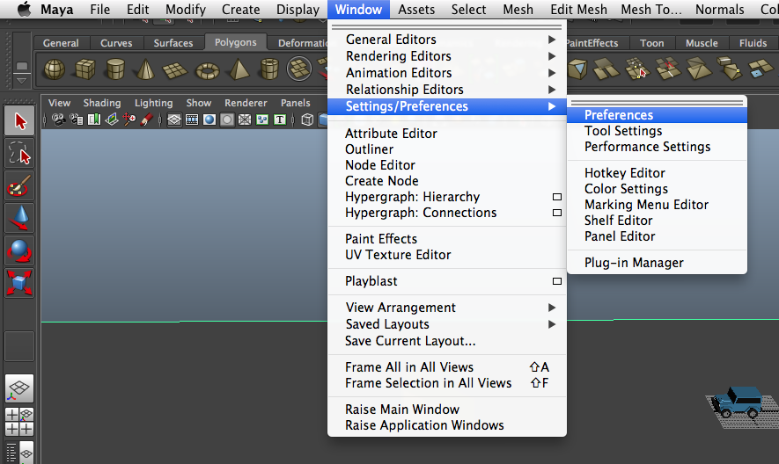
Setting the frames per second
Window - Settings/Preferences - Preferences

Slide 4
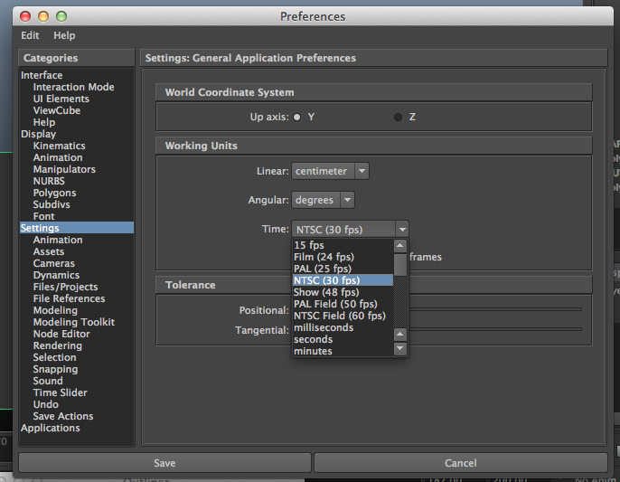
The Preferences Window should open
Settings - Time - (choose desired fps)

Slide 5
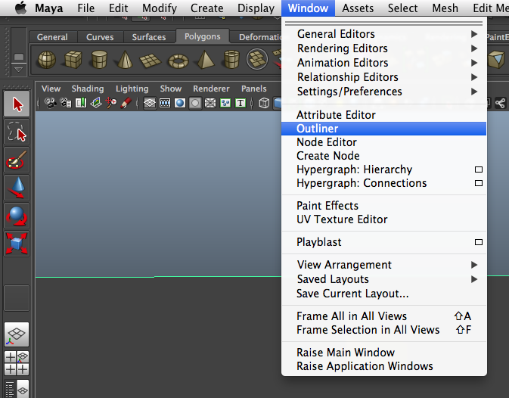
Making your vehicle one object
open the outliner window:
Window - Outliner

Slide 6
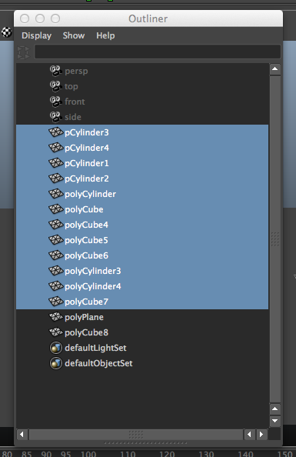
The Outliner window should open
click on objects to select them
shift - click all objects that make up the vehicle

Slide 7
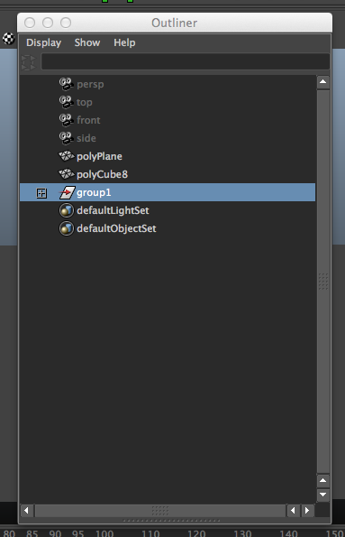
To group the selected objects into 1 object:
press Ctrl-G (or Command-G for macs)

Slide 8
Accessing specific frames
drag in ticked, black box to control which frame you are currently looking at
drag on the end squares of the gray rectangle to adjust the range of frames displayed by the ticked, black box
go to frame 1

Slide 9
Creating Animation
Select the car as 1 object
press: Shift W, Shift E, Shift R
Shift W
record object’s current position at current frame
Shift E
record object’s current rotation at current frame
Shift R
record object’s current scale at current frame

Slide 10
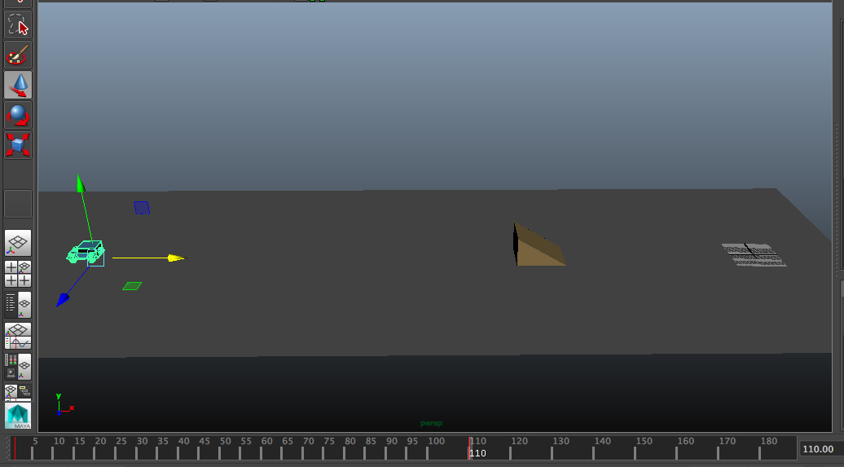
go to the desired last frame of the animation
(make it at least 100)
move the vehicle forward
Shift W,E,R

Slide 11
To playback your current animation
use the pause/play controls next to the ticked black box

Slide 12
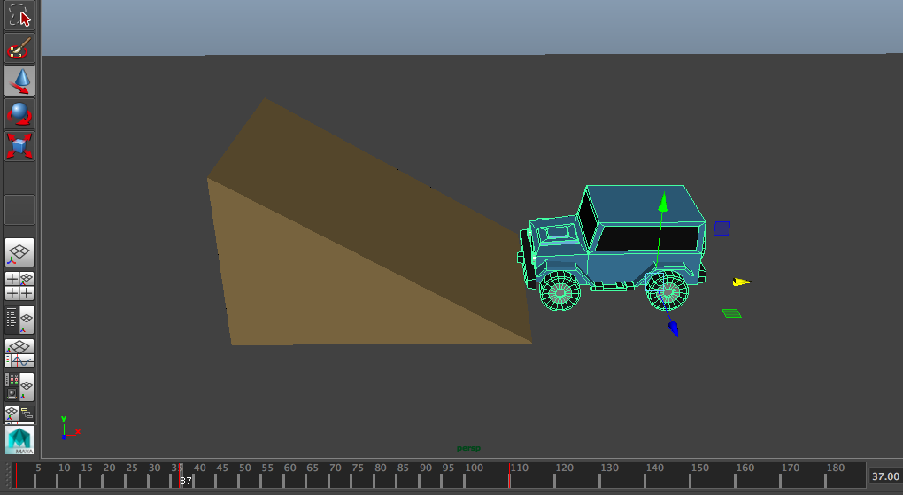
Let’s make the vehicle jump the ramp!
go to the frame where the vehicle is about to drive up the ramp
Shift WER

Slide 13
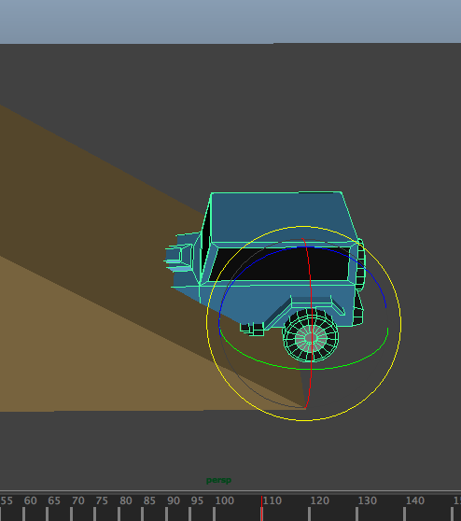
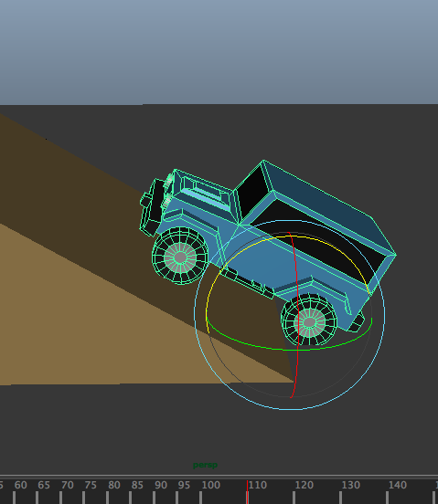
now go to the frame where the back wheel should be about to drive up the ramp
rotate the car so that it is parallel to the ramp
Shift WER

Slide 14
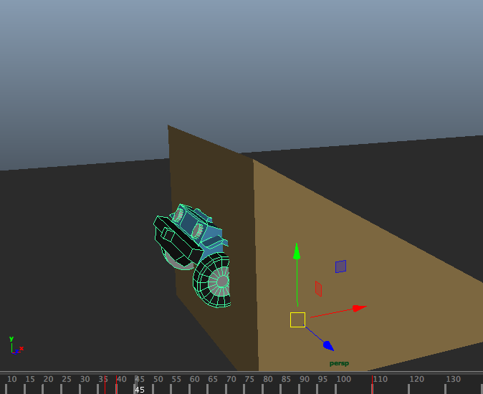
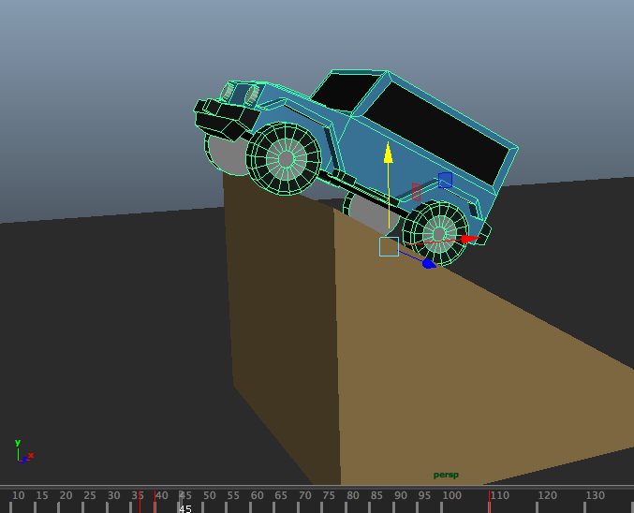
go to the frame where the front tire should be at the tip of the ramp
move the car on top of the ramp
Shift WER

Slide 15
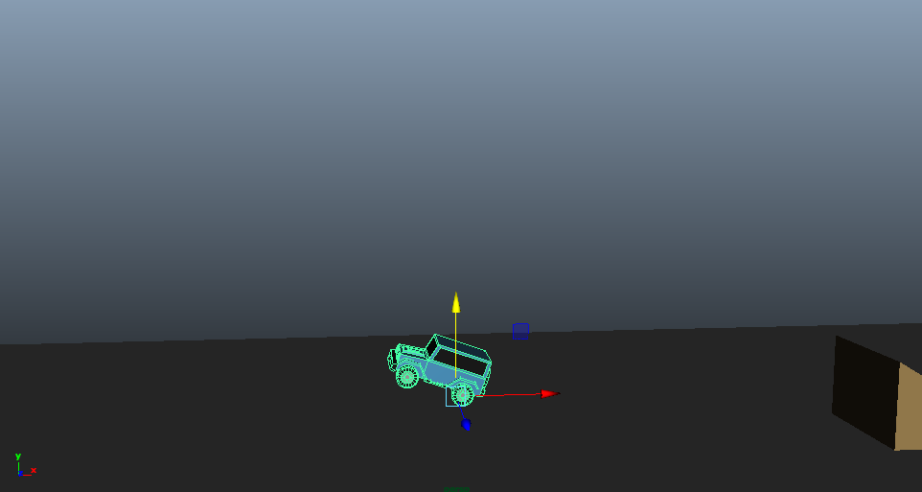
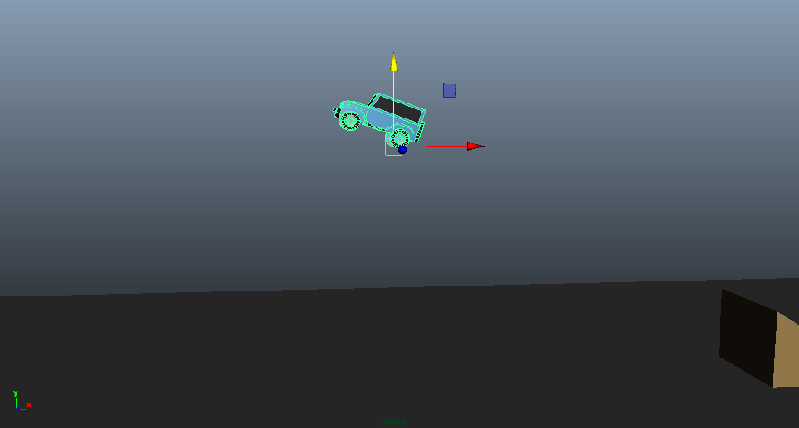
go to the frame where the car should be at the peak of its jump
move the car to the proper height
Shift WER

Slide 16
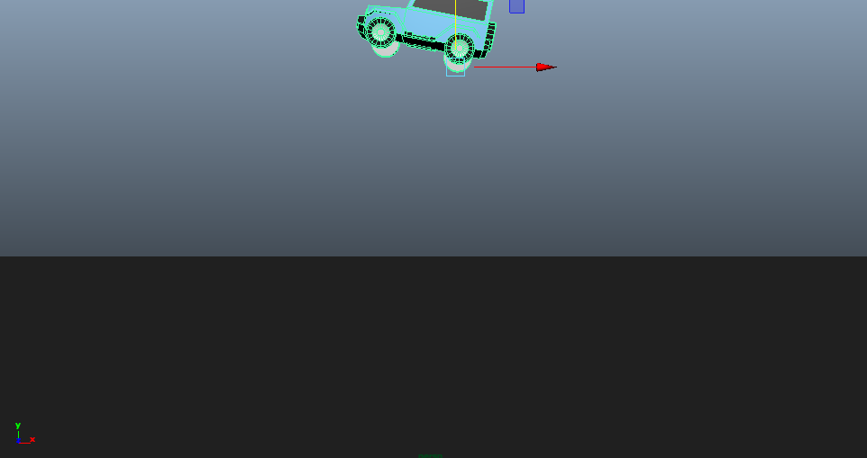
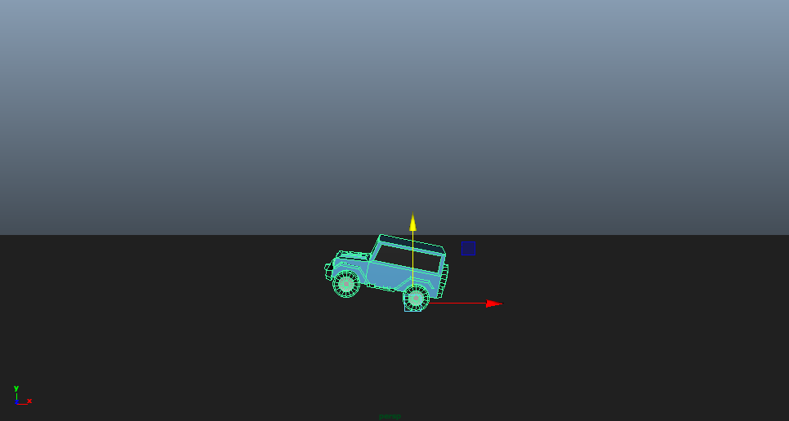
go to the frame where the vehicle should land
move the back wheel of the car to the ground
Shift WER

Slide 17
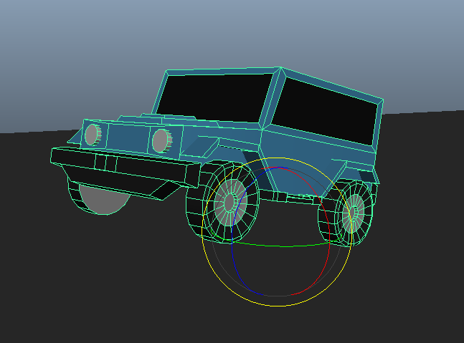
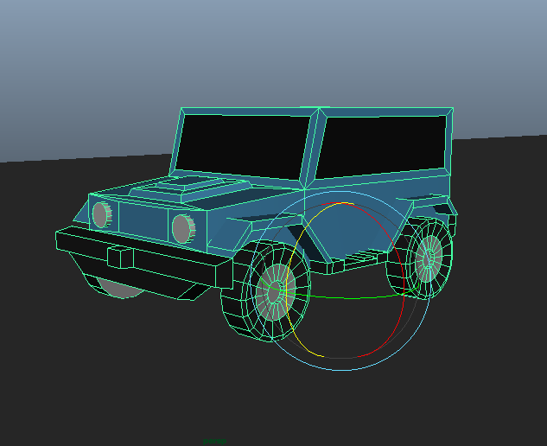
go several frames forward
rotate the vehicle back to the ground
Shift WER

Slide 18
Try this:
make the vehicle bounce 1 or 2 times before coming to a complete stop
We have created only the general motion of the animation, so some movements will look awkward. We will work on timing soon.

Slide 19
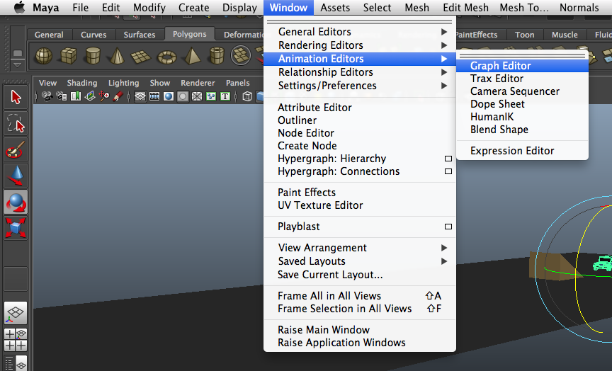
Adjusting Timing
Open the Graph Editor window:
Window - Animation Editors - Graph Editor

Slide 20
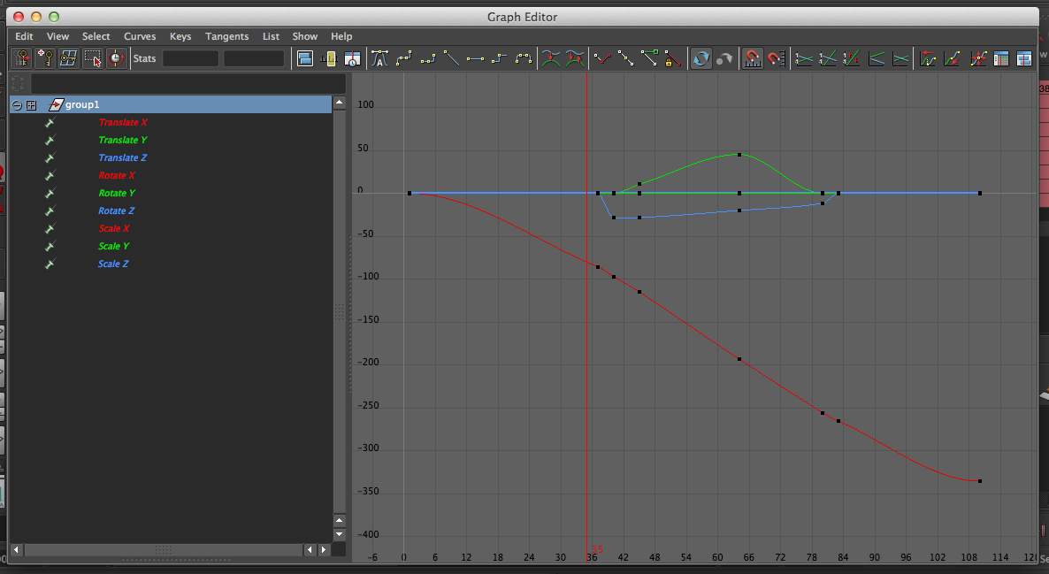
the Graph Editor should open
shows all changes to the vehicle
press F to view all graphs
you can click on a single attribute and press “F” to view only its graph

Slide 21
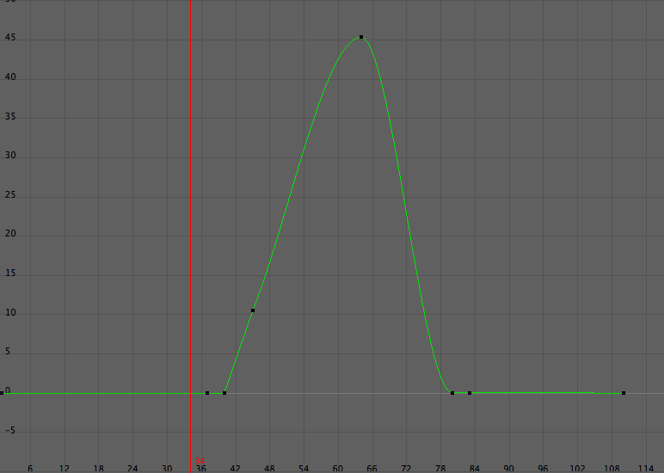
the car’s jump isn’t obeying the laws of gravity
it should be decelerating as it goes up, and accelerating as it goes down
add more recording points on the y graph and drag the points around to make

Slide 22

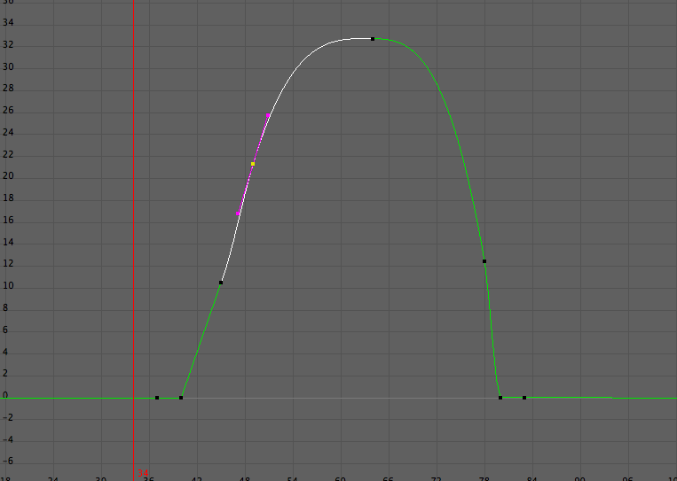
to add another recording point:
select the graph
press (Insert Keys Tool)
middle mouse button drag on the graph where you want the new point to be
to move a point:
select the translate tool in the side bar
middle mouse button drag it the point
brianlo1202@gmail.com

