Slide 1
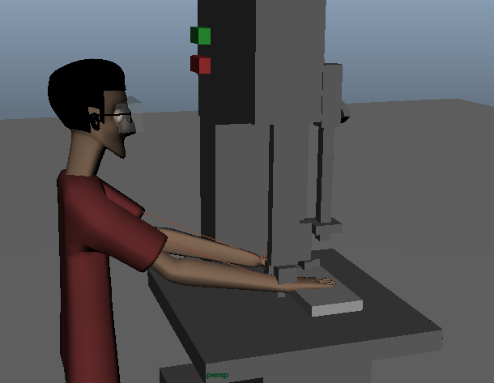
Animation Workshop
Week 4

Slide 2
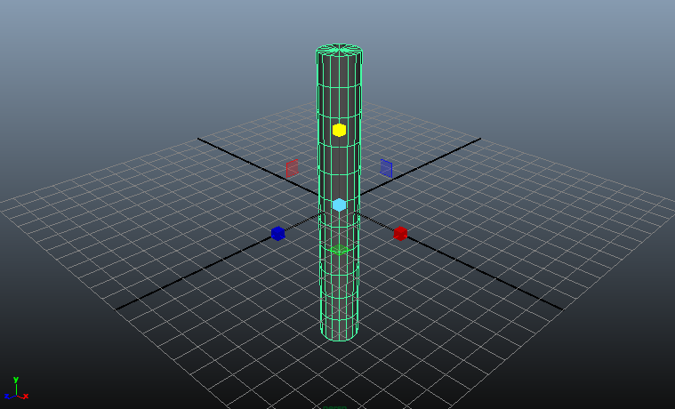
make a cylinder.
scale it so that it’s very long

Slide 3
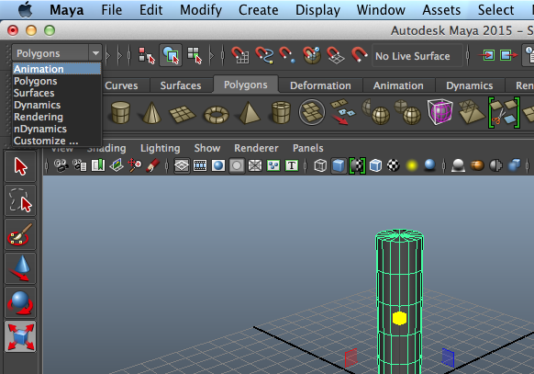
you are currently in the Polygons (modeling) menu
go to the Animation menu
change the menu set with the drop-down menu on the top left corner

Slide 4
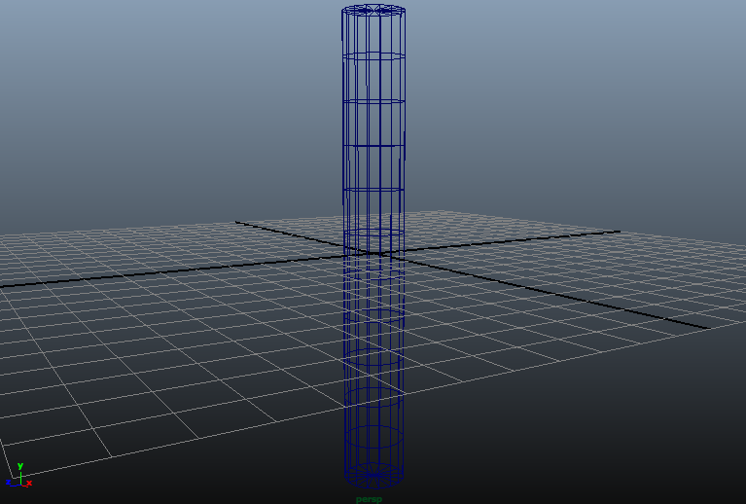
press “4” to make objects in the scene transparent
it’s sometimes easier to see what you’re doing this way
press “5” to make objects solid again

Slide 5
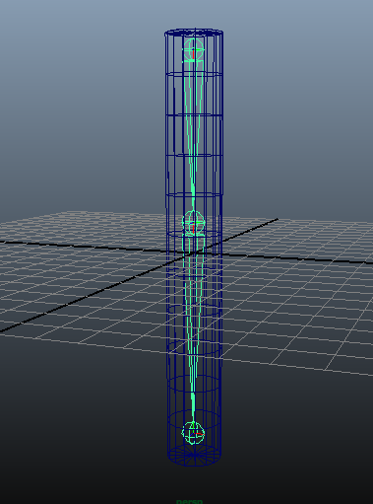
make “joints” for the cylinder
go to the Joints Tool:
Skeleton - Joints Tool
click in the desired locations to create a joints
create joints at the top, middle, and bottom of the cylinder

Slide 6
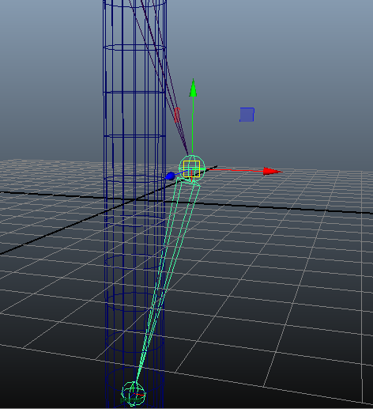
to adjust the positions of the joints:
click on the joint(s) to move
select the move tool
hold down “d” and drag the joint

Slide 7
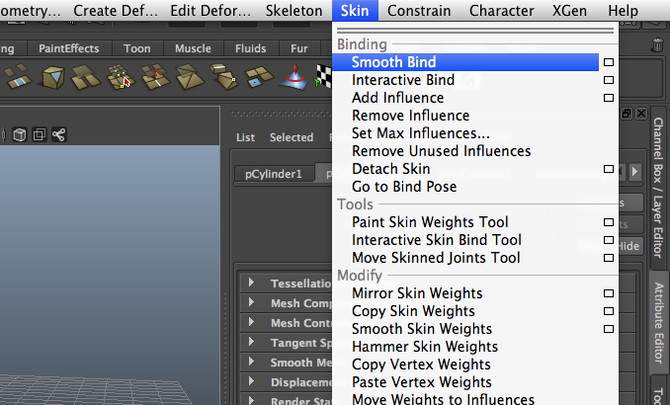
to attach the joints to the cylinder:
select the cylinder and the joints
Skin - Smooth Bind

Slide 8
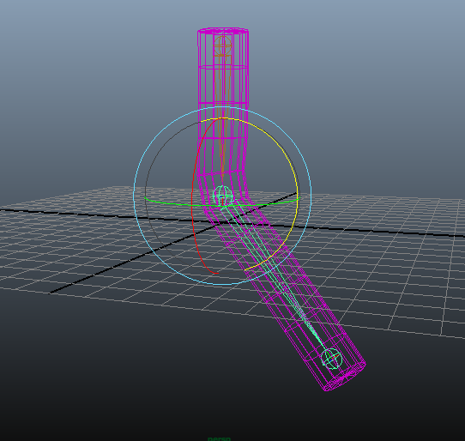
you can now rotate the joints to deform the cylinder

Slide 9
you can add “handles” to make bending the cylinder easier:
Skeleton - IK Handle Tool
click on 2 joints to make a handle between them
you can drag the handle to manipulate the cylinder now

Slide 10
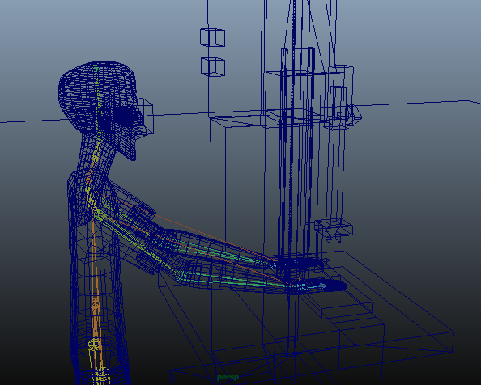
Let’s animate a human operating a bandsaw
Record the changes of the handles on his arms to animate him

