Slide 1

CAD Parts
10.28.15

Slide 2
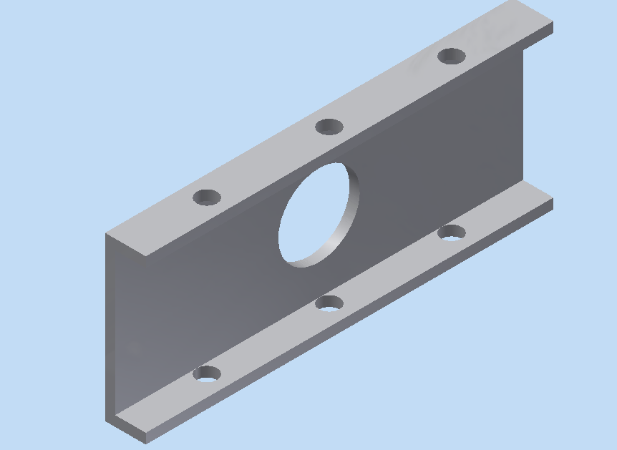
A C-Channel Part

Slide 3
Make a Part File
Click on the “I” in the top left
Select the arrow next to “New”
Select “Part”
Save the File as “C_Channel_(your name).ipt”

Slide 4
Sketches
The most basic design is a sketch
3D models are derived from basic sketches using features like:
Extrude
Revolve
Hole

Slide 5
Create a 2D Sketch
Click “Create 2D Sketch” in the top left corner
Click the (+) next to “Origin” on the sidebar and select “XY Plane”
A set of three planes will pop up after clicking “Create 2D Sketch” -- you can select the XY plane from there as well

Slide 6
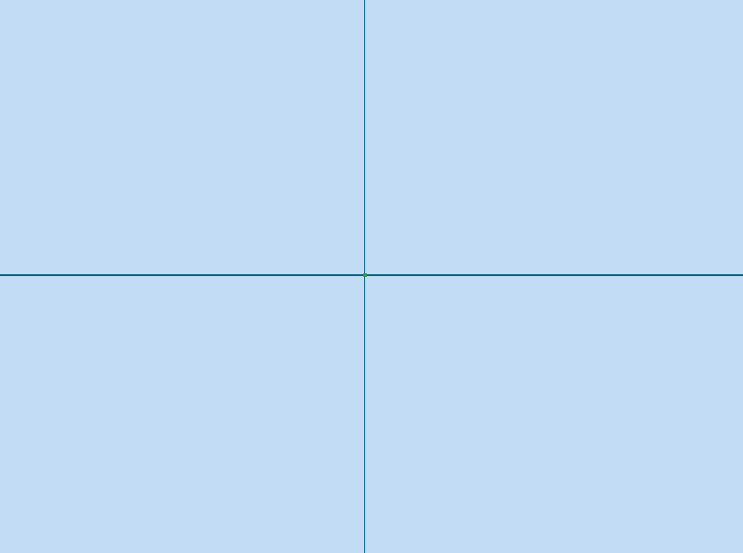
Sketch Mode
You will enter sketch mode now in Inventor
The two lines that you see are the X and Y axes

Slide 7
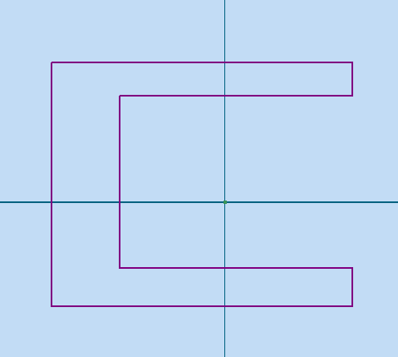
Make the “C”
Start by Making Lines:
Use the line tool in the top left to drag out perpendicular lines in the form of a general “C”
coincident constraint: if two parts of your line aren’t joined, you can use the coincident constraint to make the ends of those lines (the points) essentially the same point
collinear constraint:
(refer to next slide)
perpendicular constraint: make two lines perpendicular to each other

Slide 8
Constraints!
Add Sketch Constraints to fix the locations of the lines in the sketch
Use collinear constraint to make the outside lines of the flanges lie on the same line...click collinear, then the two lines

Slide 9

Dimensioning
Add dimensions (measurements) to the drawing!
Click the “Dimension” Tool
Create Dimensions

Slide 10
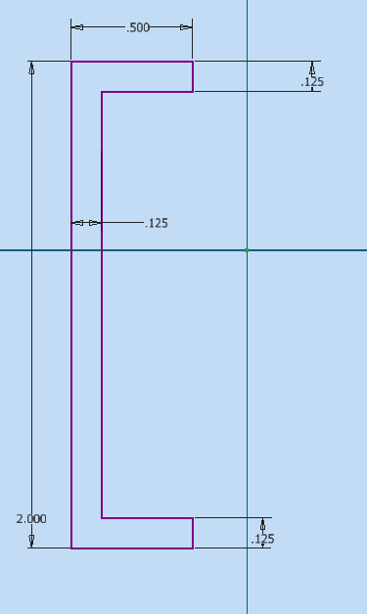
Sketch Dimensions

Slide 11
More Constraints!
Project the x and y-axes onto sketch with Project Geometry
Make top and bottom lines symmetrical on x-axis...click top, bottom, then x-axis

Slide 12
Constrain!
Use symmetry constraint again to make left and right sides symmetrical on the y-axis

Slide 13
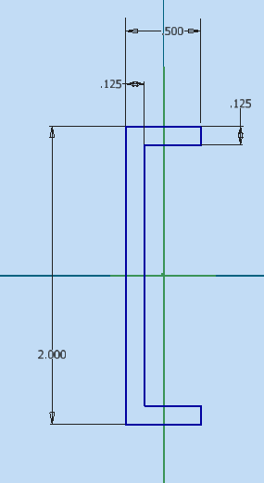
What it Should Be

Slide 14


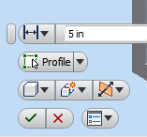
Make it 3D!
Click “Finish Sketch” on the top bar
We will now extrude the 2D sketch into a 3D part…
Click “Extrude” on the top bar
Enter “5” in the dimension field and select the two directional extrusion option

Slide 15
A Second Sketch
Make a hole on the side of the part.
Rotate view to see side of channel and click face.
Select “Create 2D Sketch”
Make a circle on the center dot on this face using the circle tool
Dimension the Circle as “1 inch”

Slide 16
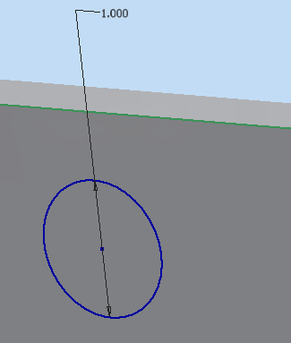
The Sketch

Slide 17

Make a Hole
Click “Hole” in the top bar
Click the center point on the sketch and dimension to hole to be 1 inch
Select Termination “Through All”
Rename the Hole in the sidebar

Slide 18
More Holes
Create a 2D sketch on the upper flange face
Draw a vertical centerline
You’ll know it’s a centerline by drawing the line between the green midpoints on the top and bottom of the c-channel
Remember to project the c-channel face in order to constrain things to the face itself!
Draw 1 circle on the vertical centerline, and dimension it as 0.25 inches
The distance from the circle to the bottom of the face is 1”

Slide 19
More Holes (Cont.)
Finish the sketch and extrude that hole through both faces of the c-channel (through “All” under “Extents”)
To create the other two holes, we’ll make a rectangular pattern
Click on the rectangular pattern symbol in the top bar
The defining edge is the long edge of the c-channel → make sure the arrow is pointing in the right direction
Define the numbers as “3” holes each “1.5 inches” apart

Slide 20
The Final Part

Slide 21
You’re Done!
Congratulations!
For homework, go into the “Parts” folder in the “training16” folder and click on the bracket pdf. Your job is to make this part based on the given machinist drawing.

