Slide 1
Electrical subsystem
Notes:
Manual vs Automation

Slide 2
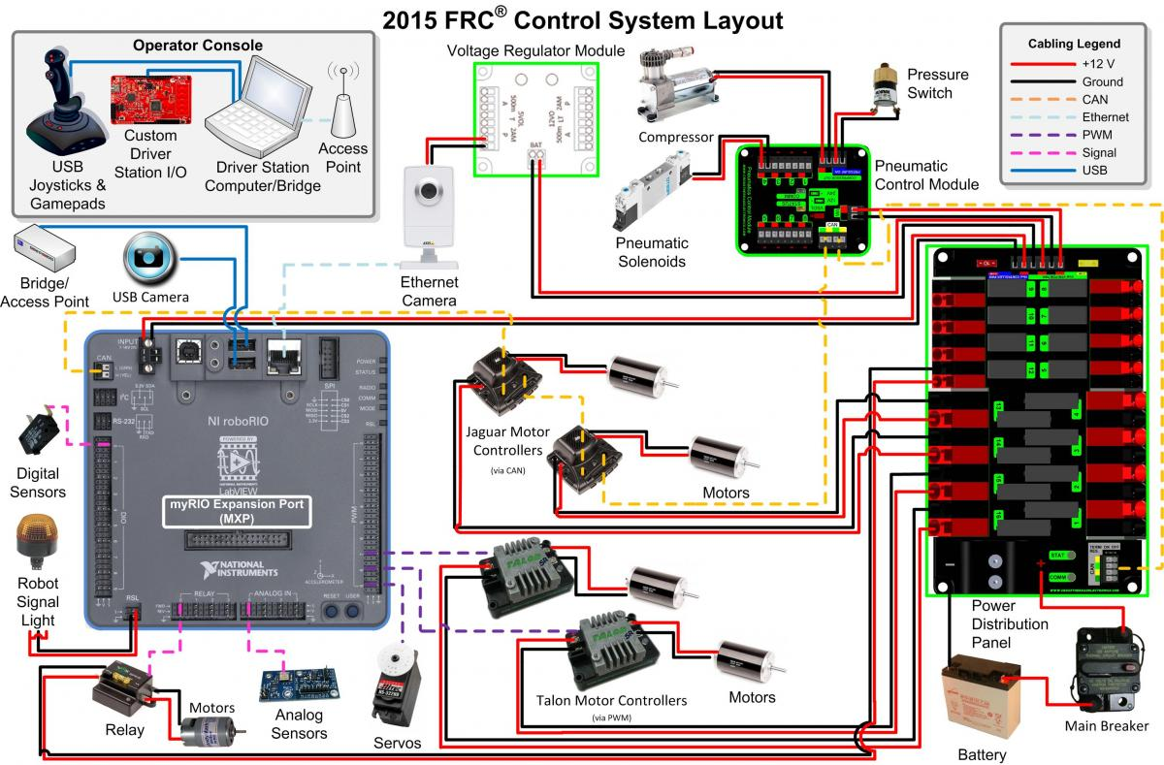
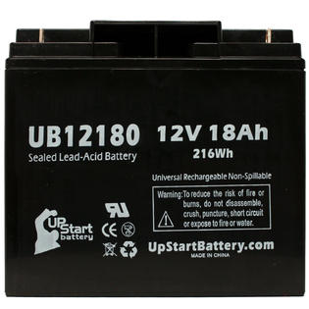
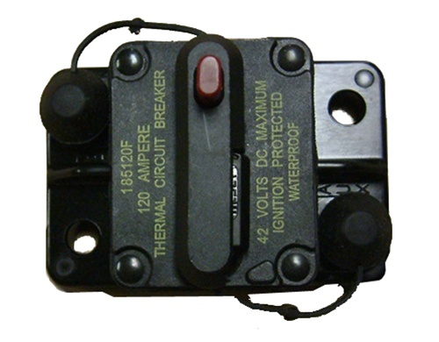
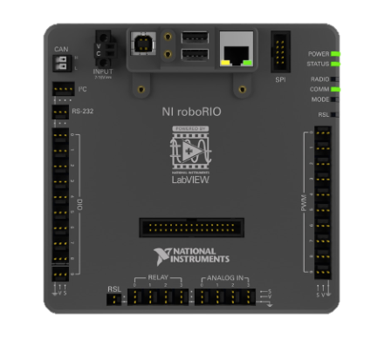
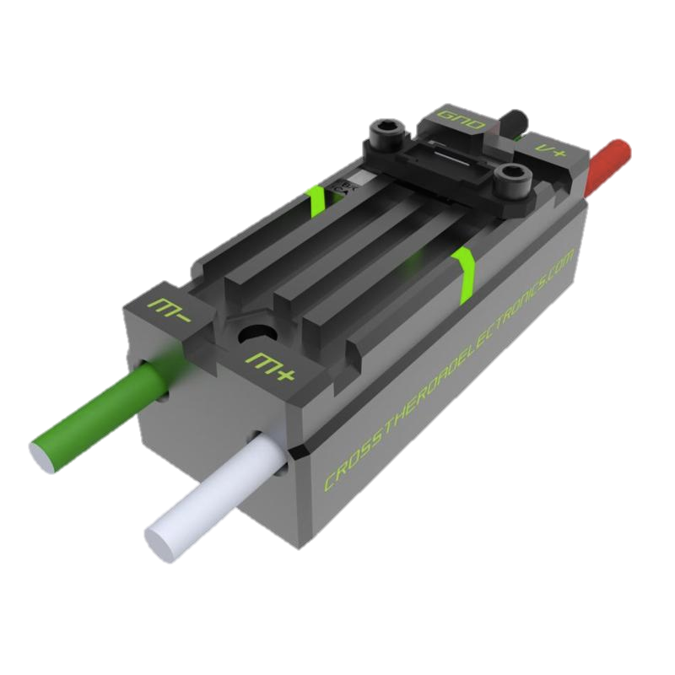
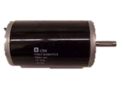
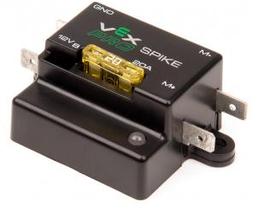
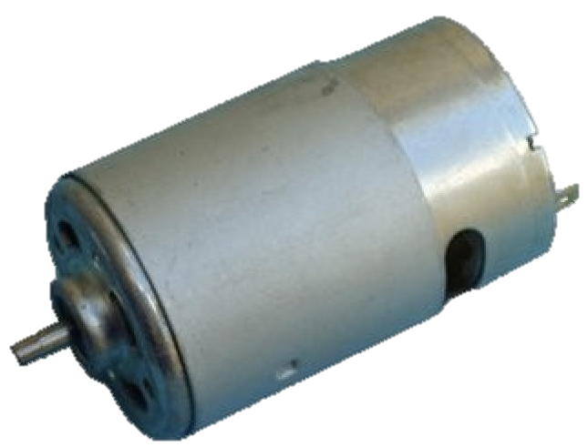
Power Distribution Diagram
Notes:
Make motor in the corner smaller to resemble scaling
Make CPU darker
Put red/black lines closer together
Put currents for the branches – CPU = 20 A, Spike = 20 A, Speed Controller = 40 A,

Slide 3
FIRST Power Distribution Diagram

Slide 4
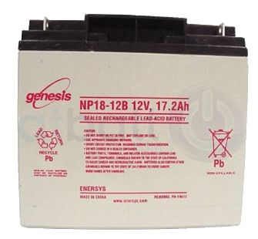
Battery
Voltage: 12 Volts Nominal​ Weight: 13 Pound​ Chemistry: Lead-Acid (Gel)​ Capacity: 18 Ah​ 10.2 Ah when rated for 1 hour​
​
Current: Nominal 150 A​ ⇨Power: ~1600 Watts at 150 A​ ​
Can supply over 700 amperes of current when terminals are shorted.
Notes:
Explain battery safety
Two hands because it is heavy
Nylon stop nut is a tip
Remove #10 screw - done
Smaller than a car battery
Fix spacing
Remove bullet point for take precautions
Change text
NEED TO SAY
Terminals are separate
Wrench
Welded together

Slide 5
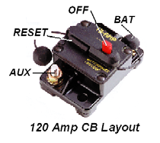
Robot Power Switch
Used to turn robot on and off, including emergency shut off
Also a 120 amp circuit breaker
Must be placed in an accessible location
Notes:
Not located accessibly
Should be in an easy-to-access area
On/Off switch
Fire hazard
Retitle to robot power switch
120 amp circuit breaker
Control should be changed to limit
Exceed 120 amps and it will break
Remove bullet points when not necessary
High current switch
Handles high enough current
Primary importance
Doubles as a circuit breaker

Slide 6
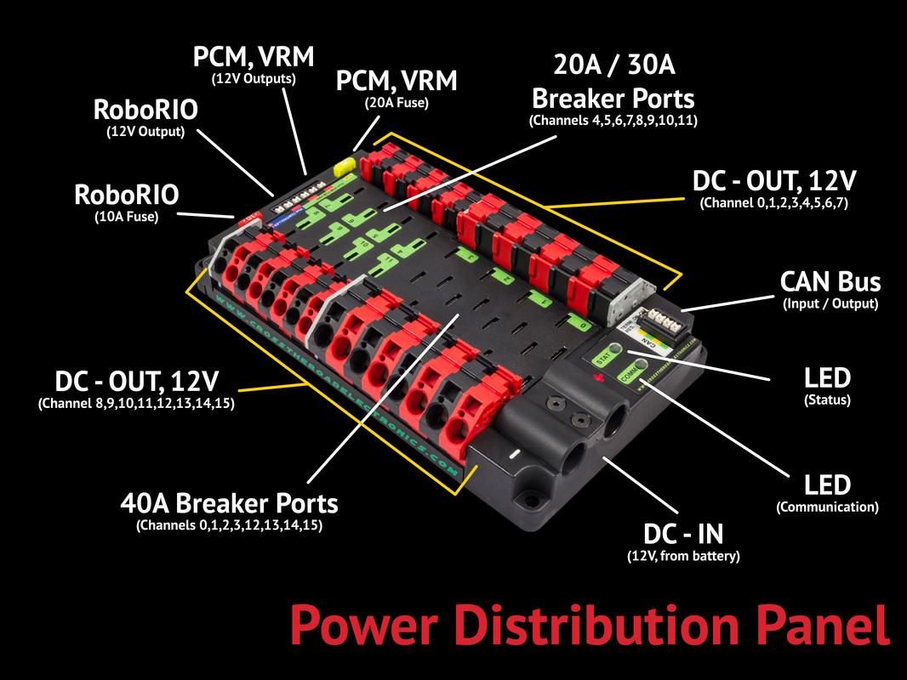
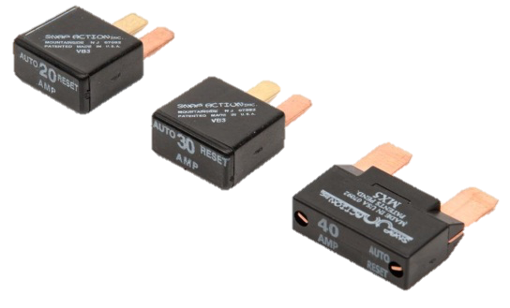

Slide 7
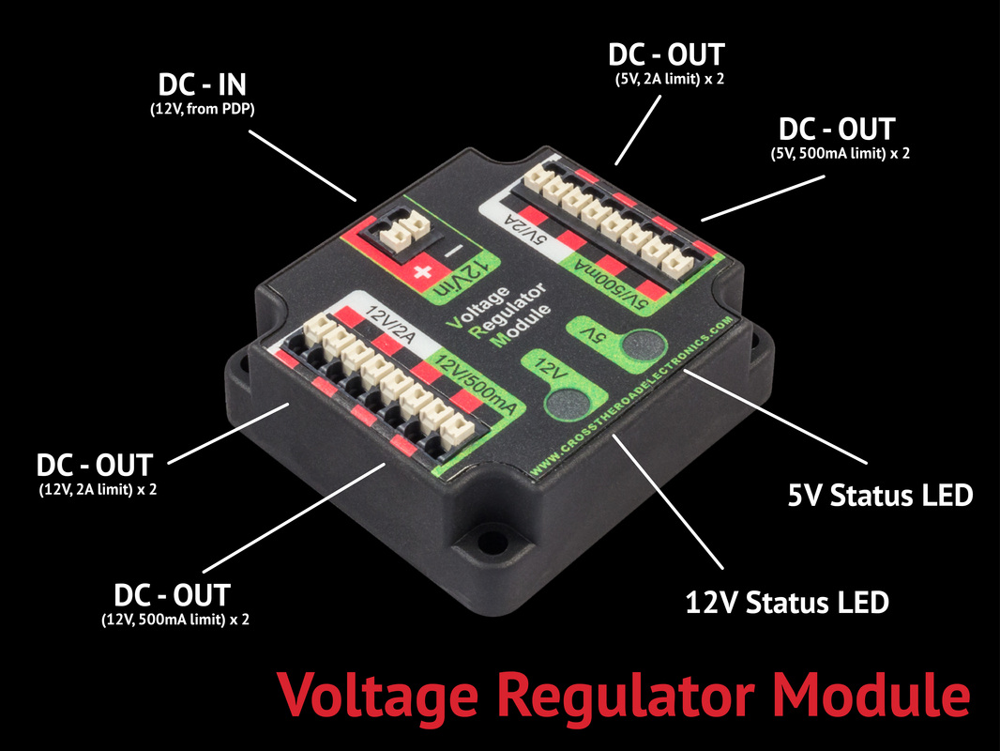

Slide 8
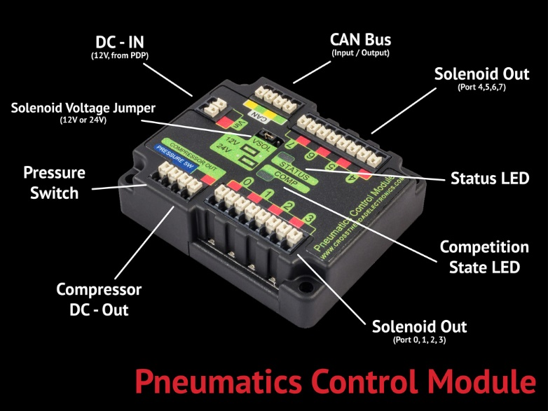

Slide 9
Power Distribution Diagram
18AWG
100A
6AWG
40A
20A
12AWG
18AWG
Notes:
Make motor in the corner smaller to resemble scaling
Make CPU darker
Put red/black lines closer together
Put currents for the branches – CPU = 20 A, Spike = 20 A, Speed Controller = 40 A,

Slide 10
American Wire Gauge
Wire thicknesses are based on the AWG (American Wire Gauge) System
AWG wire thicknesses are based on number of wire draws: Higher gauge = thinner wire
Notes:
Explain safety concerns when using smaller diameter wires

Slide 11
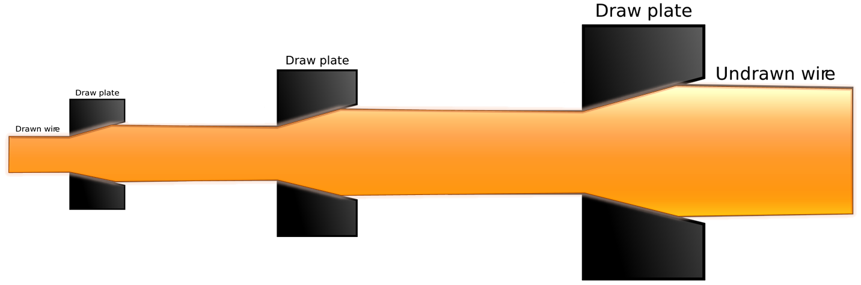
American Gauge System
Draw Plate 1
Draw Plate 2
Draw Plate 3
Undrawn Wire
Gauge 1
Gauge 2
Notes:
oAll wire from battery to PD have min #6 AWG (4.11mm) wire <R39 & Fig.4-8>
o40 amp breakers have min #12 AWG (2.052mm) wire <R44>
o30 amp breakers have min #14 AWG 1.628mm) wire <R44>
o20 amp breakers have min #18 AWG (1.024mm) wire <R44>

Slide 12
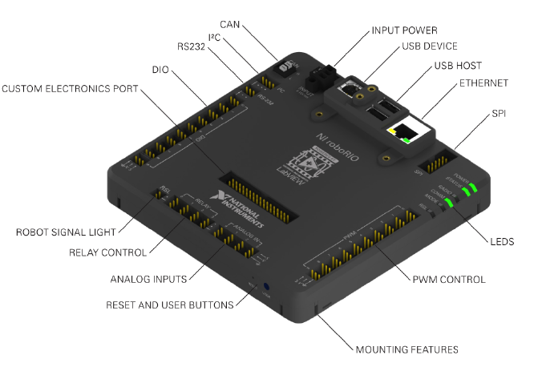
RoboRIO

Slide 13
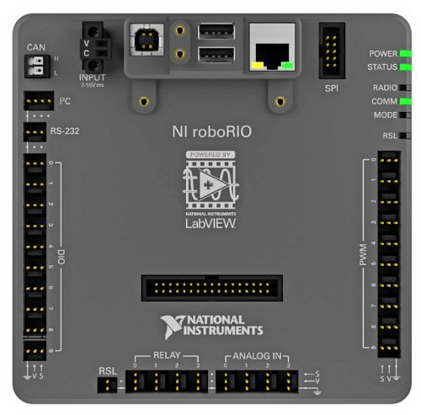
RoboRIO
2014 RoboRIO
Power
6.8-16V via PDP
Processor
Dual-Core ARM Cortex™-A9 at 667 MHz .
Memory
256MB System.
256MB Storage.
PWM
10 Ports
USB
2 USB Host and

Slide 14
Problem!
The roboRIO cannot directly control the motors.
Cannot provide enough power
Solution:
Motor Controllers
Relays
Electronic Speed Controllers

Slide 15
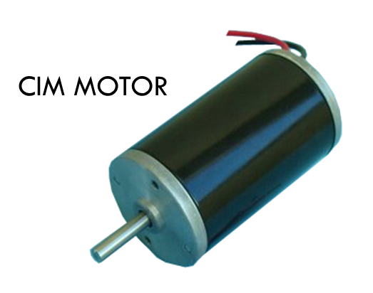

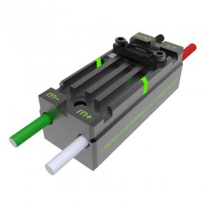
Connections
Motor
roboRIO
Motor Controller
Copper Wire

Slide 16
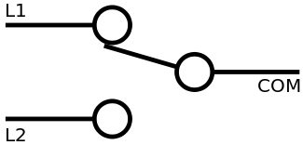
Spike Relays
Relays close or open the circuit based on signals from the cRIO.
Contains two independently controlled SPDT* relays arranged in an H-Bridge
*SPDT = Single Pole Double Throw switch

Slide 17
How an H-Bridge Works `
+12V
S1+S4
FULL FORWARD
S1+S3
BRAKE
S3+S2
FULL REVERSE
S1
S3
S2
MOTOR
S4
Ground

Slide 18
Electronic Speed Controller (ESC)
Control the amount of power sent to the motors in addition to direction that motor turns.
Two types of ESC’s:
Talon SRX
Victor SP
Notes:
2004+ Victor
2009+ Jaguar

Slide 19
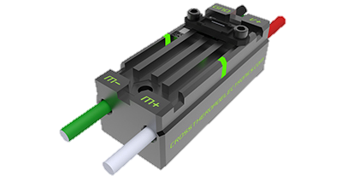
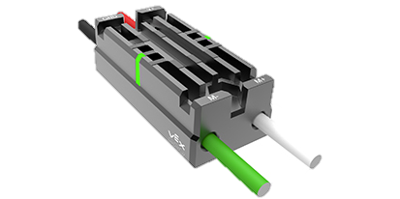
Comparison
Talon SRX | Victor SP
$79.99 | $59.99
Features | Similar Features | Features
CAN & PWM communication 6-28V | Small & light Embedded power and output Completely Sealed 12V Nominal | PWM communication 6-16V

Slide 20
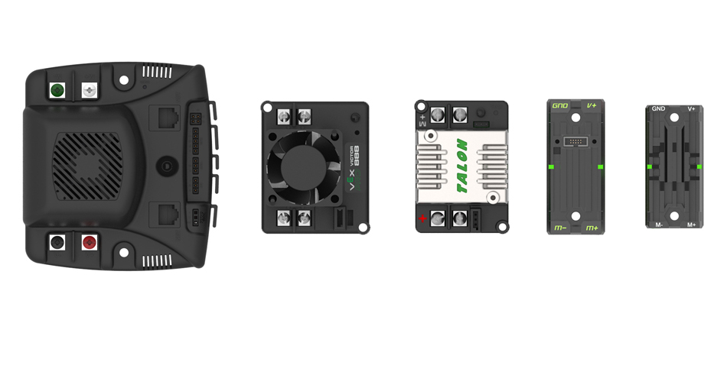
Size Comparison

Slide 21
Speed Controller Communications
There are two ways to communicate with the Jaguar ESC
Servo Wire
Uses Pulse Width Modulation
CAN-bus
Uses “Message based protocol” (like Ethernet)

Slide 22
Difference between CAN and PWM Wiring
roboRIO
cRIO
(Daisy Chaining)
ESC
ESC
ESC
ESC
ESC
ESC
ESC
ESC
ESC
ESC
ESC
ESC
ESC
ESC
ESC
ESC

