Slide 1
Control System Miniseries - Lecture 2
05/22/2012

Slide 2
Lecture 2 – What Will a Controller Do?
What we expect from a control system?
How to evaluate performance of a system
Typical performance requirements
Standard test approach
Typical system performance – demo
Control system design procedure

Slide 3
What do we expect from adding a controller to a system?
Control Variable
+
Error
Input
Controller
Plant
Output
-
Feedback
Sensor
System
With a control system, overall system should be
Stable
Quick response
Accurate
Resist disturbance
Notes:
Originally a system is plant with input and output.
Add on controller, sensor and control loop, we have a new system
We expect the new system will have better performance.

Slide 4
Standard System Performance Tests
One of standard system performance tests
Drive a system with step input
Observe output – system response
+
Error
Control Variable
Input
Controller
Plant
Output
?
-
Feedback
Sensor
System
Notes:
How do we know one control system design is better than another?
We evaluate a control system with observing overall system response to a step input

Slide 5
Demo of Pendulum w/wo Damping
Step Move
Make a pendulum
Get a bar with length ~ 2 – 3 feet long
Drill a hole at its top and insert rod (shaft) into the hole.
Note: The diameter of the rod should be much smaller than the hole diameter.
Hang the bar with the rod. Then, try to move top of pendulum a distance. You will see the pendulum oscillate less than 1 Hz.
You will find same length of bars, no matter of their cross section shape and weight, will have same oscillation frequency.
Make a damper
Find a container and fill with water
Dip lower end of pendulum into water.
Run the test
At different dipping depth, move top of pendulum a distance (step input)
Observe pendulum response.
Notes:
Let’s see a pendulum system
When we move top point of the pendulum a unit distance, this pendulum will take long time to settle down to new position because there is insufficient damping in the system.
This system is called underdamping system.

Slide 6
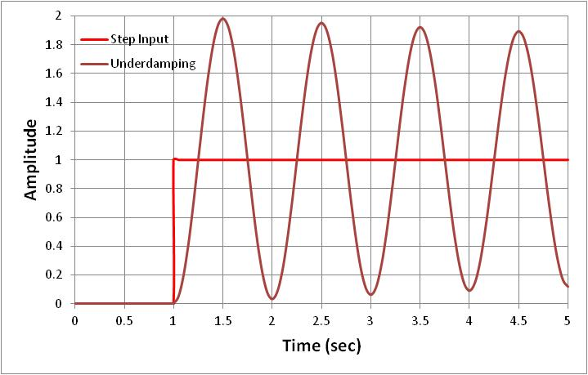
Under-damping Pendulum
Pendulum above water (no damping)
Under-damping system
Notes:
Let’s hang the pendulum above water, and move top a distance – step input
The pendulum will take forever to settle down at new position.
We do not want a robot, such as aiming a target, has this type behavior.

Slide 7
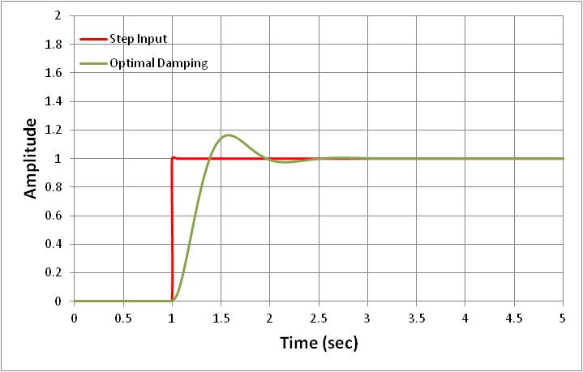
Optimal-damping Pendulum
Dip pendulum into water to a proper depth
optimal-damping system
Notes:
Let’s dip the pendulum into water and move tip a unit distance. The system settle down to new position much faster.
Let’s dip the pendulum into water dipper, means more damping, this system settle down even faster. The system damping is approaching critical damping.
We would like to this type of behavior (performance).

Slide 8
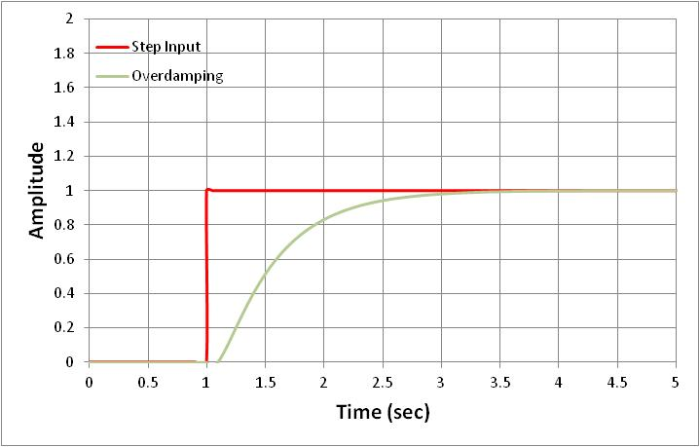
Over-damping Pendulum
Dip pendulum into water to deeper
over-damping system
Notes:
Let’s dip the pendulum into water deeper. Or you can imagine that we can replace water with thicker paste.
Then, the pendulum will take long time to reach new position though it does not oscillates.
We do not want our robot to have this behavior either.

Slide 9
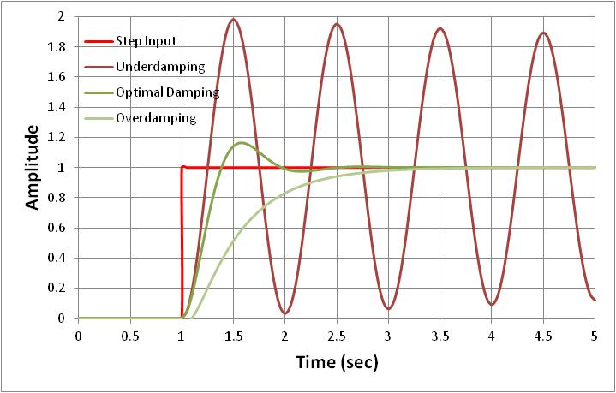
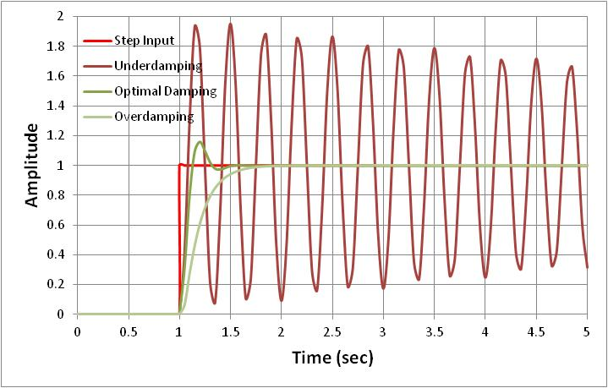
Pendulum with Short Length
Step Move
Lower oscillation frequency.
Similar step response
Step Move
Higher oscillation frequency.
Notes:
Let’s take quick look at a short pendulum which oscillates at high frequency.
But, with proper damping tuning, both long and short pendulum have same step response relative to cycle period.
Actually, the short pendulum will settle mach faster relative to time.

Slide 10
Goal of Control System Design
There are varieties of plants (devices, systems)
Mechanical/Pneumatic/Electrical/ Hybrid
These plants have their own characteristics
Different mathematical expression
But, after add proper controllers and control loop, overall systems should have same response to step input as optimal-damped pendulum
Pendulum with damping can be mathematically modeled as 2nd order differential equation.
Control system design will make any system have same mathematically expression (behavior) as the pendulum.
So, overall system will have quick and accurate response.
Where ζ – damping ratio
ω_{b}(= 2πf_{b}) – control system bandwidth

Slide 11
Control System Design Procedure
Define system spec
Stability, response time, accuracy, robustness, reliability, etc.
Analyze plant
Modeling based on physics and math
Design controller and control loop
Example PID controller
Modeling
Run simulation
Make system meet spec
Mathematically, overall system can be expressed as 2nd order differential equation with optimal damping ratio (ζ = 0.5 ~ 1, ω_{b} = 5 - 10 Hz for 50 Hz system sample rate)
Experimentally, run step input response.
Input
Plant
Output
P
Control Variable
Input
+
Error
Plant
I
Output
-
D
Controller
Feedback
Sensor
Notes:
Starting from next lecture, we will analyze shooter (plant) response, mathematically and experimentally, to step input.
Then, we will try to add P controller, PI controller, and PID controller to see how overall system behavior changes.

Slide 12
Example
Motor Output Torque
Gearbox Output Torque
Calculated Wheel Speed
Speed Error
Control Voltage
Motor Voltage
Wheel
Speed
Δω
(rpm)
V_{ctrl} (volt)
V_{m}
(volt)
T_{m}
(N-m)
T_{gb}
(N-m)
ω_{whl}
(rpm)
ω₀
(rpm)
+
Control Software
Jaguar
Speed Controller
Motor
Gearbox
Shooter Wheel
-
Controller
Plant
Sensor
Voltage to Speed Converter
Pulse Counter
Hall Effect Sensor
(Voltage Pulse Generator
ω_{fbk}
(rpm)
V_{pls}
(volt)
P_{whl}
(# of pulse)
Measured Wheel Speed
Voltage of Pulse Rate
Sensor Pulse
Present every major component
Label variables and physical unit
Label conversion factor

