Slide 1
Control System Miniseries - Summary of Lecture 1 - 3
06/03/2012

Slide 2
Core Contents of Lecture 1
Drawing a system block diagram is starting point of any control system design.
Example, ball shooter of 2012 robot
Speed Error
Control Voltage
Motor Voltage
Motor Output Torque
Gearbox Output Torque
Wheel
Speed
Δω
(rpm)
V_{ctrl} (volt)
V_{m}
(volt)
T_{m}
(N-m)
T_{gb}
(N-m)
ω_{whl}
(rpm)
ω₀
(rpm)
+
Control Software
Jaguar
Speed Controller
Motor
Gearbox
Shooter Wheel
-
Controller
Plant
Sensor
Voltage to Speed Converter
Pulse Counter
Hall Effect Sensor
(Voltage Pulse Generator
ω_{fbk}
(rpm)
V_{pls}
(volt)
P_{whl}
(# of pulse)
Measured Wheel Speed
Voltage of Pulse Rate
Sensor Pulse
Tip: Draw a system block diagram
On our robot, starting from shooter wheel, you can find a component connecting to another component. For example, wheel is driven by gearbox, gearbox is driven by a motor, motor is driven by speed controller, …. Physically you can see and touch most of them on our robot.
For each component, draw a block in system diagram.
Name input and output of each block, present them in symbols. Later, you will use these symbols to present mathematic relation of each block and entire system.
Define unit of each variable (symbol)
Notes:
Lecture 1 briefly tell us what is control system. But, the core content is how to present a system in block diagram.
After you have completed the diagram, you are ready to analyze individual blocks, then the whole system

Slide 3
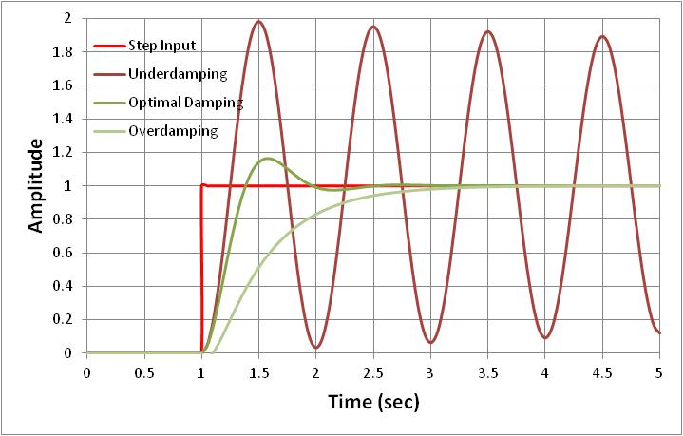
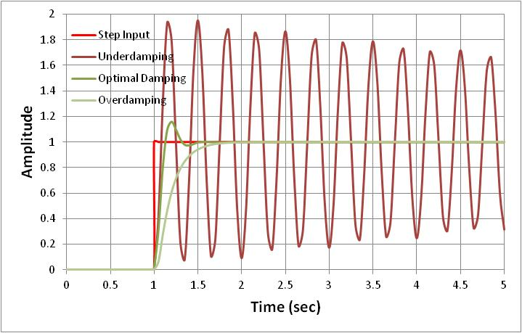
Core Contents of Lecture 2
To a step input (the red curve in following plots), responses of system with a well designed controller should have performance as the green curves.
Green curves in both plots have optimal damping ratio (0.5 ~ 1)
But, the green curve in right figure is preferred because it has faster response (higher bandwidth)
Systems with behavior as shown in above figures can be represented by 2nd order differential equation.
Tip: We take an approach to design our control system without solving this differential equation.
Model robot system based on physics and mathematics.
Typically we will get the 2nd order differential equation as above. Then we optimize
Damping ratio: ζ = 0.5 ~ 1.
System bandwidth(close loop): ω_{b} = 5 - 10 Hz for 50 Hz control system sampling rate
Notes:
Before getting on road, you should know your destination, meaning what is targeted system performance.
Optimal-damping and higher close loop bandwidth is destination of control system design.
Optimizing ζ and ω_{b} will be much easier job because you will just solve simple algebra or trigonometry.
We will show you, through rest of lecture, how generate 2nd order differential equation and extract ζ and ω_{b} .

Slide 4
Core Contents of Lecture 3
The characteristics of 2nd order differential equation (or a system which can be presented by the same equation)
can be examined by solving special cases such as F(t) = 0 or F(t) = 1 and given initial conditions.
At this point, you can use solutions from Mr. G’s presentation for our robot control system analysis and design.
Tip: use published solutions listed in table below for your simulation.
Notes:
Solutions for a 2nd order differential equation depend on input function of F(t) and system initial conditions.
Complete solution is out of scope of mini lecture. You will have opportunities to understand how to solve differential equations in college.

Slide 5
Heads-up
In rest of lectures we will get on real stuff of our robot.
First, we will model ball shooter wheel, its gearbox and motor, etc.
Second, analyze a proportional controller.
Proportion controller (P)with speed feedback is used on our shooter.
Answer why the system is always stable (thinking about damping). Can step response be faster?
Run step response test.
Answer why this system can not keep constant speed in SVR. We will introduce disturbance input in block diagram.
Third, we will change the controller to proportion – integration controller (PI)
Analyze that under which condition this system will be stable or not stable.
Program the controller on robot and see step response.
Add load to shooter and see if speed can be constant.
Fourth, we will change the controller to proportion-integration-derivative (PID) controller if we can not achieve stable operation from above design.
Modeling and analysis could be more complicated for students. But we will give a try.
We will finalize the design and tune the system for CalGames.
Then, we will get on aiming position control system design for CalGames.

