Slide 1
Basic Feedback Control
David Giandomenico
Team mentor for
Lynbrook Robotics – Team #846
<DGiandomenico@LynbrookRobotics.com>
Feedback – noun; 1919 \`fēd-bak\ from Merriam-Webster
1: the return to the input of a part of the output of a machine, system, or process (as for producing changes in an electronic circuit that improve performance or in an automatic control device that provide self-corrective action)
Notes:
My intended audience is high school students involved actively in FIRST Robotics.
This talk covers basics of feedback control, together with discussions of practical techniques of measuring position and speed, dealing with changing loads, nonlinearities etc.

Slide 2
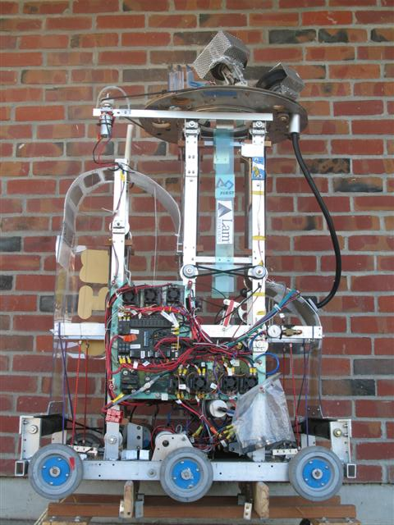
FRC2006 “Aim High”
Speed & Position Control
Team #846, The Funky Monkeys’
Triple Feedback System!
AutoTargeting Ball Launching Turret
Turret sensor: CMU2 Camera. Tracks horizontal position of green target light.
Ball Launcher System Sensor: CMU2 Camera. Based on vertical position of green target light, sets wheel speed to ‘make shot.’ based on vertical position of green target light
Ball Launch Wheel Sensor (x2): Hall Effect Used to measure wheel speed.

Slide 3

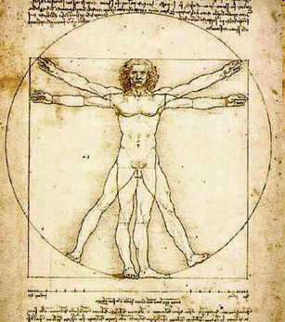
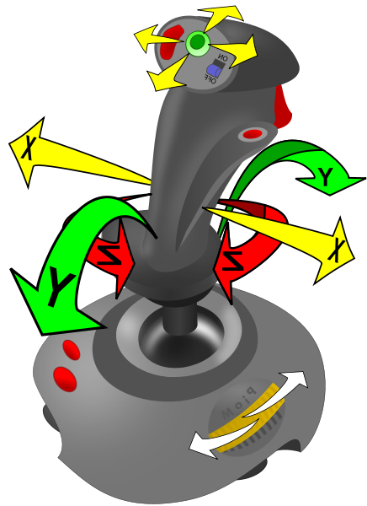
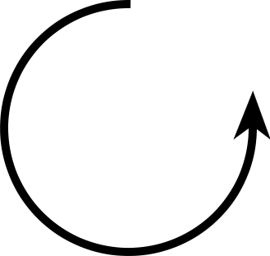
Human Robot Feedback Demo
Notes:
Placeholder for feedback / no feedback
2 volunteers
Ask one volunteer to act as robot, another to act as driver.
Objective: see how the <human driver – robot> loop responds
Instruct human robot to move arm up or down at constant fast speed.
Instruct human driver to command blind human robots arm up/down (only!) to point to target position.
[Expect overshoot and difficulty getting human robot to point to target]
Repeat with human going ‘slow’
Repeat giving human robot “points on clock” directives. [human robot now using ‘closed loop control’]

Slide 4
Expected Human Demo Results Recap
Open Loop
Fast up/down commands → Overshoot
Slow up/down commands → Controllable, but Not Fast
Closed Loop
+ Human robot responds quickly to clock commands
− Limited to resolution of robot’s sensors

Slide 5
Bang-Bang Control
Two state controller (On - Off). Examples:
House temperature control
Pneumatic pump on FIRST robot
Often, we don’t need a proportional controller!
We can use a three state version (up-down-off) on robotic arms or lifts.
Don’t overlook this simple method!
(with more time today we would be talking hysteresis)
Notes:
Good for cmd moves
Stable

Slide 6

Simple System
No Feedback – “Open Loop”
In
A
Out
Notes:
Got to show the basics; Introduce the symbols.

Slide 7
Feedback System
“Closed Loop”
In
+
G
Out
−
H

Slide 8


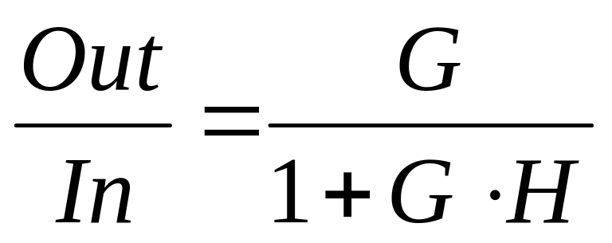
Feedback System
“Closed Loop”
In
+
G
Out
−
H

Slide 9


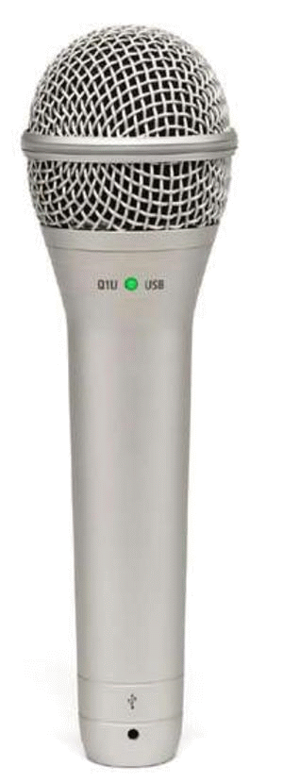

Undesired Feedback Path
Notes:
Pacman singing creates sound pressure at microphone and corresponding electrical signal.
PA amplifier output = gain x input
Speaker turns electrical signal back to sound
Sound is conveyed back to mic. If new sound is greater then original sound then oscillations occur.
In general, oscillations will occur if there exists a frequency such that the “loop gain” is > 1.

Slide 10
Build Schedule
BrainStorm
Not much time!
Need to develop software without robot hardware completed.
On competition field – we must change parameters quickly.
Week 1
BrainStorm
Design
Week 2
Design
Week 3
Design
Build
Week 4
Build
Electronics
Week 5
Build &
Test Software!
Build &
Test Software!
Week 6

Slide 11
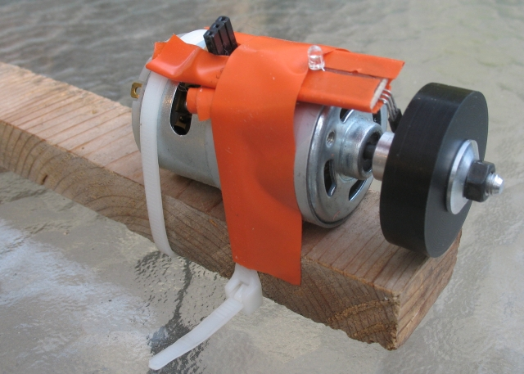
Simple Speed and Position Test Setup
Crude, cheap, but invaluable for testing speed and position control loops!

Slide 12
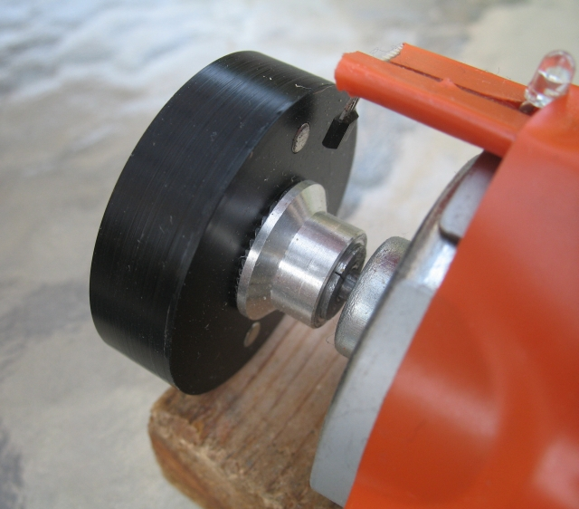
Simple Speed and Position Test Setup
Neodymium Magnet
Qty 2, for balance.
(see the web, eBay!)
Custom disk with holes for shaft and magnets
Hall effect magnetic sensor
<$2 at digikey or mouser
R/C Hobby Prop Adapter, 1/8”

Slide 13
Tip: Setting Gain Fast
Option 1: Recompile and upload. Bleah!
Option 2: Attach a potentiometer to an analog input (once adjusted, hardwire in code). Not Bad!
Option 3: Use cRio’s File System to save values. Access values through Operator Interface buttons. Display values on robot or OI. Way Cool!

Slide 14
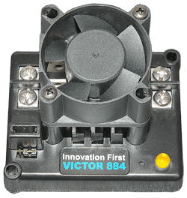
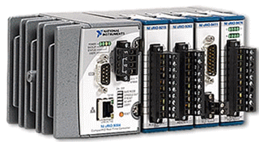
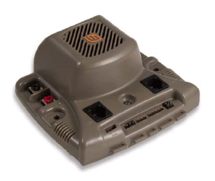

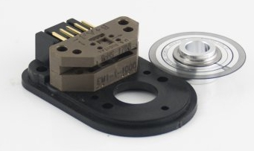
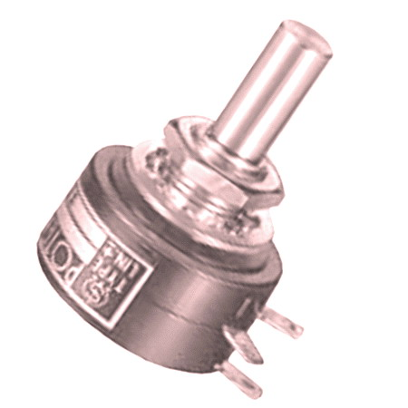
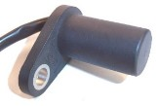
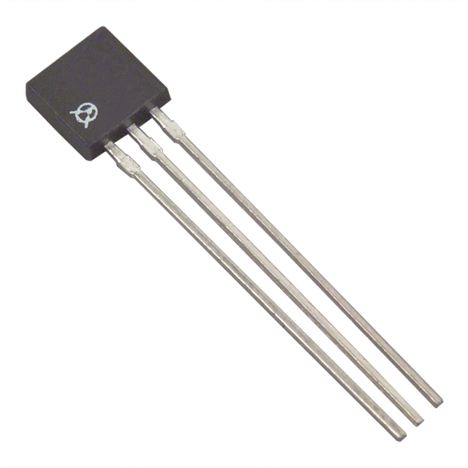
Let’s Build Our FIRST
Closed-Loop Control System
Input Speed
or Position
(joystick,
preset button,
autonomous, etc.)
+
+
G
Out
E.S.C.
−
−
Sensor
Potentiometer, Encoder,
Gear Tooth Sensor,
Hall effect Sensor, …
Yet more sensors:
  Accelerometers & Gyros
  Optical Distance Meas.
  Cameras,
  Ultrasonic
  :
Notes:
Optical encoders, Hall effect (magnetic) sensors, Gear tooth sensors, potentiometers, gyros, …

Slide 15
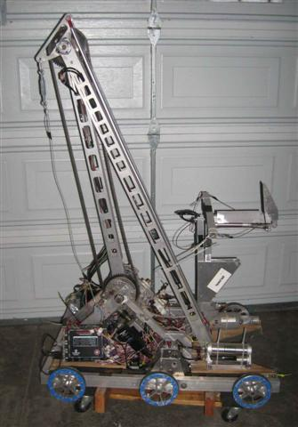
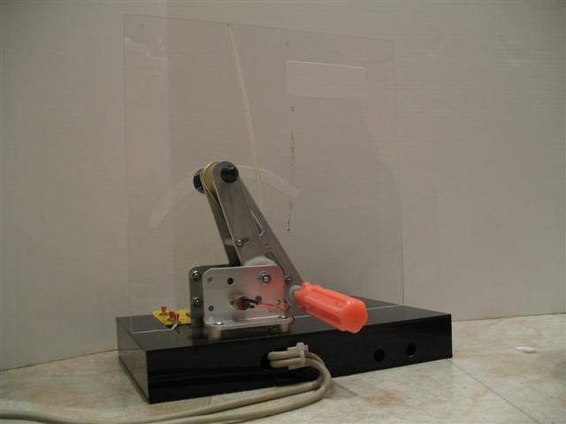
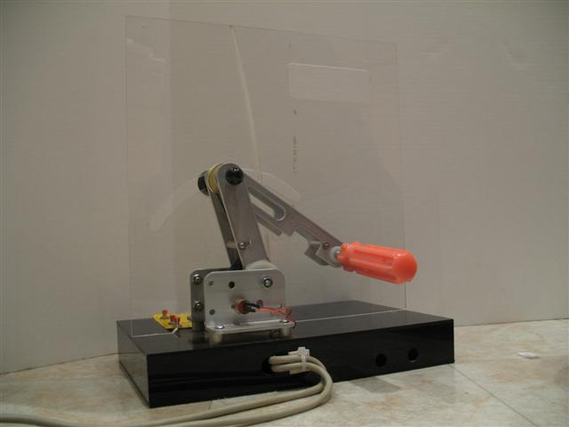
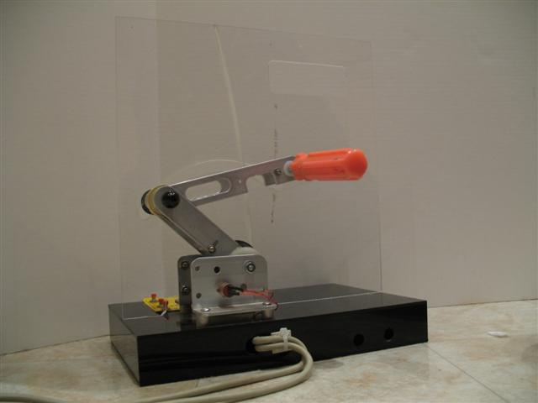
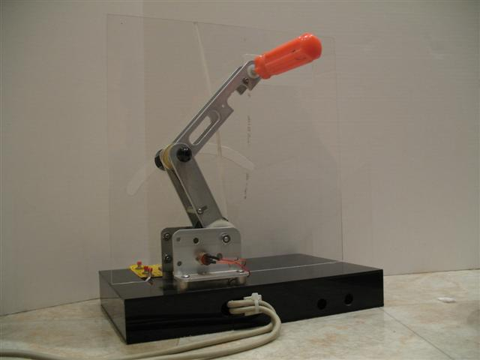
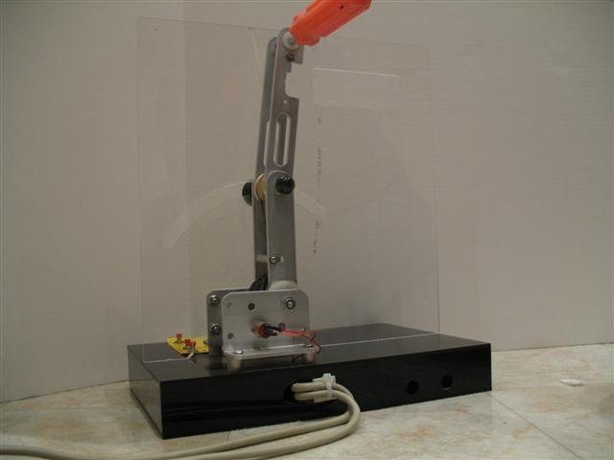
Mirroring Controls
Cool !

Slide 16
Closed-Loop Position Control System
+
Input
Position
(joystick,
preset button,
autonomous)
+
Position
Error
Gain
E.S.C.
Out
−
−
Position Sensor
Potentiometer, Encoder Count, Gear Tooth Count, Camera, …
Notes:
Generally the basic Closed-Loop Position System works well for our applications.

Slide 17
Detour: RealTime Data Processing
Psuedo Code:
int myRobotsMainLoop(void)
{
do forever {
WaitForNewDataFromHuman();
newData = GetDataFromMuman();
UpdateMyRobot( newData );
}
}
How does this compare to other programming?
Compare to how you would program factorial(N){}.
What if you could only do five multiplications every cycle?
Notes:
Since FRC2009, we can Update the robot 200/sec, but ~40x is an acceptable rate.
There is no point in updating the robot faster than new data arrives (excepting onboard info).

Slide 18
How Fast Should We Run the Code?
Data from sensors onboard the robot arrive continuously
But: Data from driver station arrives ~40-100x /sec
But: Human Reaction Time: ~ 0.1 seconds
Yet: Video Games: ~40+ frames/sec
Also: cRio may not be able to process fast enough
What to do?
Processing at 50-100x/sec allows the robot to respond quickly without overtaxing the cRio CPU
Notes:
Audience may have no familiarity with programming a FIRST Robot.
Allows us to process periodic input data. As a bonus, we can perform multiple motions simultaneously.

Slide 19
Position Controller
Psuedo Code
#define kTheGain 1.46 //Set empirically
double MoveToPosition(int targetPosition)
{
double gain, error, toESC;
gain = kTheGain;
error = targetPosition - ReadPosition();
toESC = gain * error;
return limitONE(toESC); //limit value to {-1.0, 1.0}
}
double MoveToPosition(int targetPosition)
{
double gain, error, toESC;
gain = ReadGainSetting(); //Read from pot or file
error = targetPosition - ReadPosition();
toESC = gain * error;
return limitONE(toESC); //limit value to {-1.0, 1.0}
}
double MoveToPosition(int targetPosition)
{
const double kDeadband = 10; //acceptable error
double gain, error, toESC;
gain = ReadGainSetting(); //Read from pot or file
error = targetPosition - ReadPosition();
if (absolute(error)<= kDeadBand)
error=0; //We are close enough.
toESC = gain * error;
return limitONE(toESC); //limit value to {-1.0, 1.0}
}
Comments: with a fairly constant load, and enough friction (damping) this simple algorithm may be all you need.
Notes:
Supporting code in or outside this snippet may further limit the minimum value of ESC to prevent motor ‘stewing’
As long as there is enough friction in the system, and the load is constant, this basic loop will work fairly well.
Click to see addition of Deadband Code.

Slide 20
Closed-Loop Position Control System
Potential Issues:
What happens if we pick up a heavy game piece with our robotic arm?
For a lift, what happens if we are going up versus going down?
For a robotic arm, what happens when we lift from horizontal to vertical?
Notes:
Generally the basic Closed-Loop Position System works well for our applications.

Slide 21
Closed-Loop Position Control System
Load Sensor
Holding game target?
Adjust gain based
on target position
+
Input
Position
(joystick,
preset button,
autonomous)
+
Gain
E.S.C.
Out
Position
Error
−
−
Position Sensor
Potentiometer, Encoder Count, Gear Tooth Count, Camera, …
Notes:
Add Load Detector for gain
Add gain based on arm position

Slide 22
Position Controller
Psuedo Code
int MoveToPosition(int targetPosition)
{
long gain = ReadGainSetting();
long error = targetPosition - ReadPosition();
long toESC = gain * error;
return limit127(toESC); //limit toESC to {-127,127}
}
double MoveToPosition(int targetPosition)
{
double gainUp = ReadGainUpSetting();
double gainDown = ReadGainDownSetting();
int error = targetPosition - ReadPosition();
double gain = error > 0? gainUp : gainDown;
long toESC = gain * error;
return limit127(toESC); //limit to {-1.0, +1,0}
}
double MoveToPosition(int targetPosition)
{
double gainPosTop = ReadGainTopSetting();
double gainPosBottom = ReadGainBottomSetting();
int error = targetPosition - ReadPosition();
double gain = interpolate(targetPosition,
gainPosBottom,gainPosTop)
double toESC = gain * error;
return limitOne(toESC); //limit to {-1,0, +1,0}
}
Notes:
Supporting code in or outside this snippet may further limit the minimum value of ESC to prevent motor ‘stewing’
As long as there is enough friction in the system, and the load is constant, this basic loop will work fairly well.

Slide 23
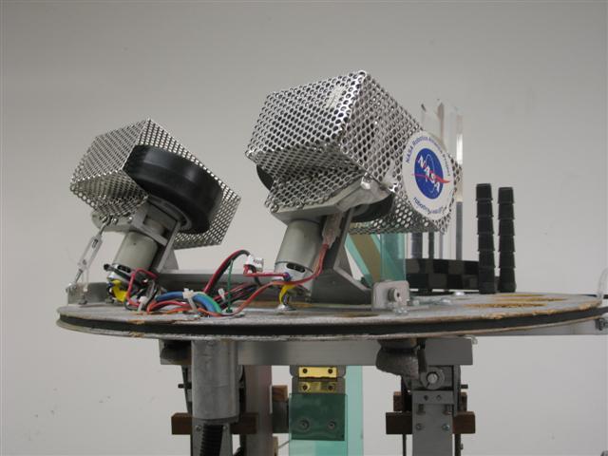
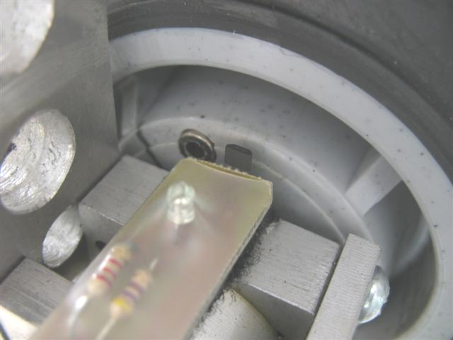
FRC2006 “Aim High”
Need for Speed Control
¼” Neodymium Magnet
Rather than determine Launch Speed vs Distance, we determined the best Launch Speed vs Vertical-Position-of-the-Target-Light-on-the-Camera.
Then we interpolated the data for all camera values in between.
Hall effect “Magnet Detector”

Slide 24
Detour: Measuring Speed
5 pulses
4 pulses
How’s our resolution?
Notes:
Counting pulses in a small time interval results in poor resolution. Here, the difference between 4 and 5 is 20%-25%, with no possible values in between.
Higher count puts a burden on the processor, and encoders are often limited to a few KHz.
Schemes like rolling averages of counts over several cycles result in phase delays and cause instability in the control loop.
What can we do?

Slide 25
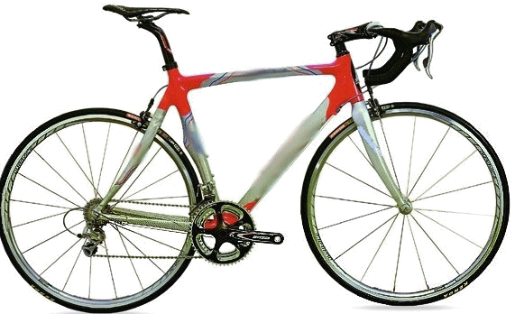
Measuring Speed
Magnet
Counting: in 10 revolutions we can tell the speed within ?? %
Measuring Time in one revolution: we call tell speed within ?.???%
Notes:
Counting: in 10 revs, we only know speed within 1 part in 10, or 10%.
But by measuring time in one revolution, we have time to the accuracy of our clock, updated every revolution!

Slide 26
Measuring Speed –A Better Way!
n.nnn milliseconds
p.ppp milliseconds
We can read time with microsecond resolution during the
same CPU Interrupt that is used to count encoder pulses.
Resolution is now easily better than 1 part per 1000.
Count over last 2 (or more) pulses to reduce inaccuracy due to encoder pulse variations and interrupt service delays.
Notes:
Consider how we might measure speed of a bicycle with a magnet on one spoke. If we measure speed by counting, we will have to go 10 revolutions to have 10% resolution. Instead, measure the time of each revolution with millisec resolution.

Slide 27
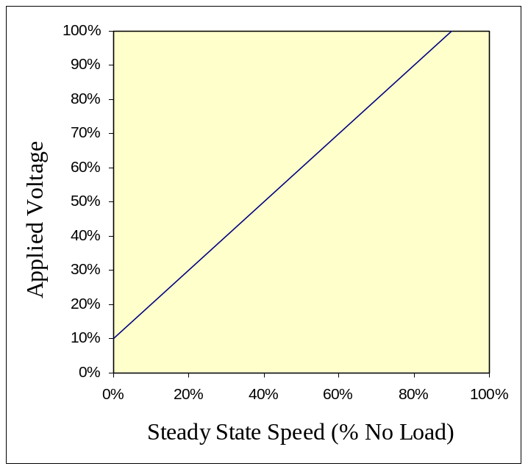
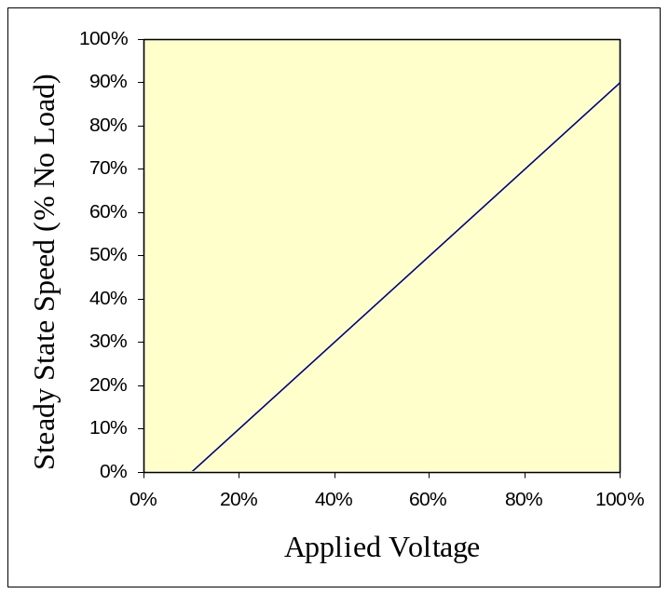
Speed Control
Make the system work Open Loop for Steady State!
+
Out
Input
Speed
Inverse E.S.C.
Transfer function
E.S.C.
−
Ideal Linear System

Slide 28
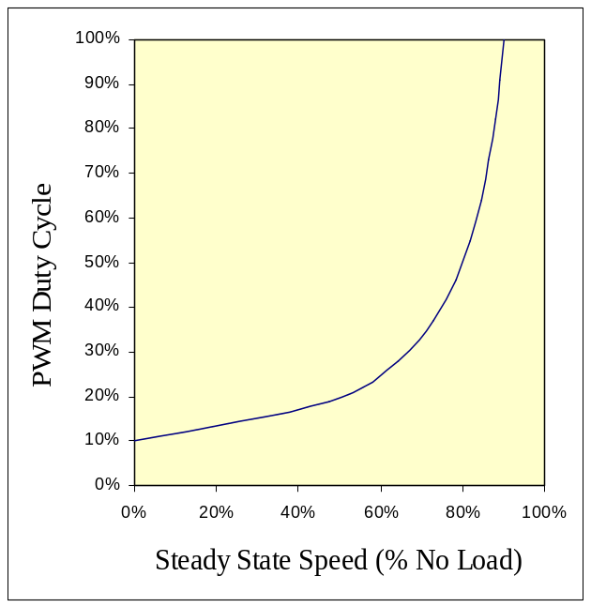
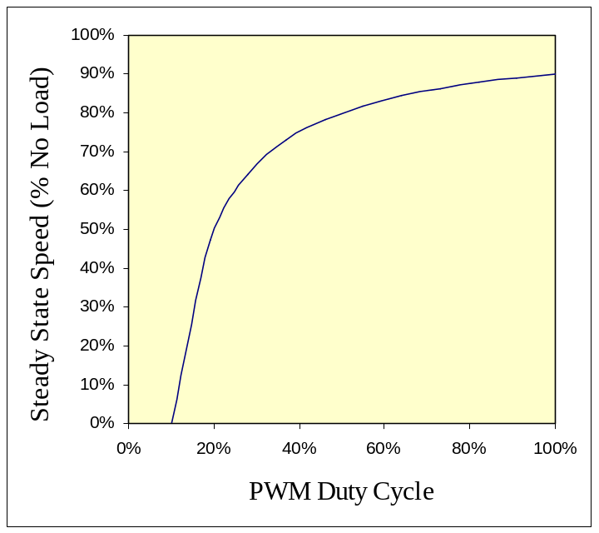
Speed Control
Make the system work Open Loop for Steady State!
+
Out
Input
Speed
Inverse E.S.C.
Transfer function
E.S.C.
−
Transfer function
For IFI’s
Victor884 E.S.C.
! !

Slide 29
Textbook Speed Control
+
Input
Speed
+
Speed
Error
Gain
Out
E.S.C.
−
−
Speed Sensor
Gear Tooth Detector,
Encoder, etc.
Doesn’t work well for our application.
At high speeds, the ESC needs a large input signal to drive the motor, we can’t minimize the Speed Error!

Slide 30
Revised Speed Controller
+
Controller
Out
Input
Speed
+
E.S.C.
+
−
G
Error
Speed Sensor
+
−

Slide 31
Revised Speed Controller
+
Controller
Out
Input
Speed
+
Inverse E.S.C.
Transfer function
E.S.C.
+
−
G
Error
Speed Sensor
+
−

Slide 32
Speed Controller
Psuedo Code
int RunAtSpeed(int targetSpeed, int load)
{
long gain = ReadGainSetting();
long error = targetSpeed - GetActualSpeed();
long openLoopPWM = ComputeNeededPWM(speed,load);
int outputPWM = openLoopPWM + error * gain;
return outputPWM;
}
int RunAtSpeed(int targetSpeed, int load)
{
long gain = ReadGainSetting();
long error = targetSpeed - GetActualSpeed();
long openLoopPWM = ComputeNeededPWM(speed,load);
long AdjustedGain =
gain * pwmGainAdjust(speed,load);
int outputPWM = openLoopPWM + error * AdjustedGain;
return outputPWM;
}
Conceptualized Code. Limits on values required. Will not work on your robot “As Is”. If problems persist, you should consult your mentor.
Conceptualized Code. Limits on values required. Will not work on your robot “As Is”. Consult your mentor if problems persist .

Slide 33
Turning in Autonomous
(Applying closed loop control)
Method to detect turning:
  Electronic Gyro (really an angular accelerometer)
  Independent of robot’s contact with environment.
  Wheel Encoders (optical, or gear tooth detectors)
  Encoders provides distance as well.

Slide 34
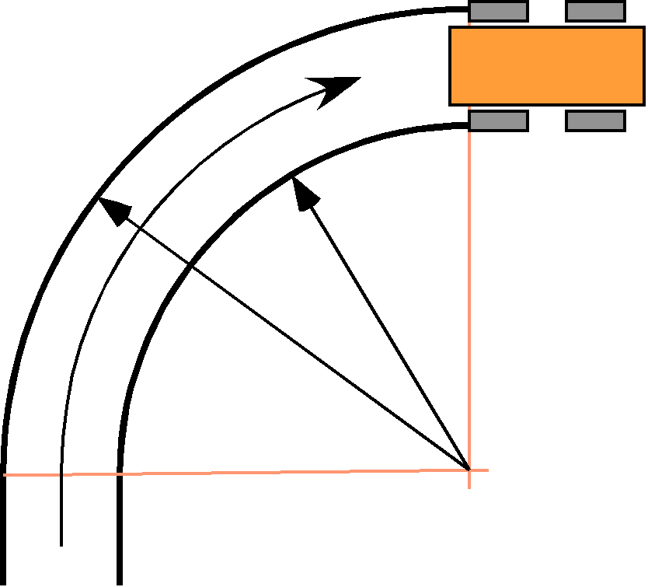

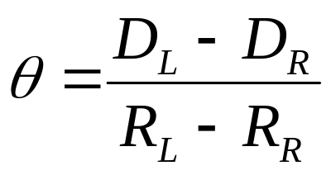
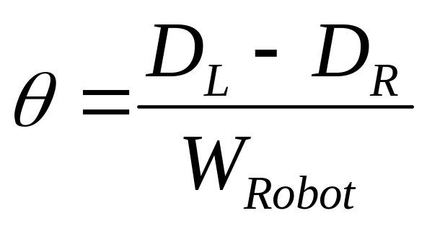
Calculating Change of Bearing
R_{R}
R_{L}
Independent of path!

Slide 35
Calculating Distance and Angle
long encoder_sum(void)
{
return gEncoders[LEFT].position + gEncoders[RIGHT].position;
}
long encoder_diff_absolute(void)
{
return gEncoders[LEFT].position - gEncoders[RIGHT].position;
}

Slide 36
Turning in Autonomous
Two methods to turn angle Ө:
Method A.
1. Turn angle Ө.
2. Wait until turn completed.
3. Proceed with next command.
Method B.
1.Add angle Ө to target bearing.
2. Start Turn to target bearing
3. Don’t wait to complete turn!
4. Proceed with next command, still driving to target bearing.

Slide 37
Turning in Autonomous
typedef struct {
int turn;
int fwd;
} Drive;
boolean HeadingDistanceRun(Drive *drive,
long targetAbsDistanceLRSum, long bearingTicks, char power)
{
long currentSum = encoder_sum();
drive->turn = computeTurn(bearingTicks);
drive->fwd = power;
if (power >= 0) {
return (currentSum >= targetAbsDistanceLRSum);
} else {
return (currentSum <= targetAbsDistanceLRSum);
}
}

Slide 38
typedef struct {
int turn;
int fwd;
} Drive;
extern Drive drive;
//From main routine, call Autonomous()every 25ms;
static var currentbearing, targetbearing, targetDistance, phase;
void Autonomous() {
switch (phase){
case 1: //Setup the turn+move; Turn 90 & move 15ft
targetbearing = currentBearing + 90*kTicksPerDegree;
targetDistance = encoder_sum();
targetDistance += 15 * kTicksPerFoot;
phase++; //fall thru
case 2: //Execute the turn+move every loop until done.
if (true == HeadingDistance(drive,
targetbearing, targetDistance, kPower))
phase++;
break;
case kDoNextThing:
: //etc. etc.
} //end of switch
}
Notes:
As we repeatedly call HeadingDistance(), the robot seeks the targetbearing, and moves until the targetDistance is passed.

Slide 39
Turning in Autonomous – Recap
Maintain a TargetBearing variable for the robot.
When initiating a turn, add the desired turn amount to the TargetBearing variable.
Using a closed loop feedback system, make the robot seek the input TargetBearing.

Slide 40
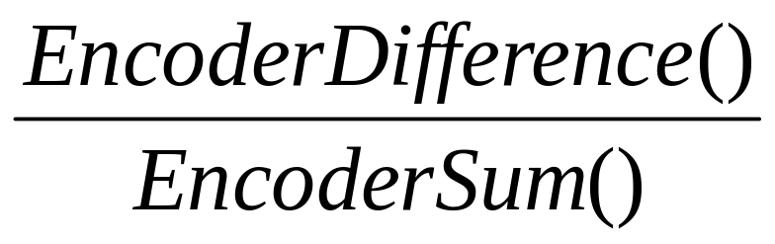
My Robot Drifts Left!
How To Drive Straight in Autonomous
Determine the required Trim:
  Clear encoder counts.
  Push robot straight as far as practical.
  Required Trim is:
Make the robot turn at rate Trim.

Slide 41
Implementing Trim
Modifying Angle Measurement
long encoder_sum(void)
{
return gEncoders[LEFT].position + gEncoders[RIGHT].position;
}
long encoder_diff_absolute(void)
{
return gEncoders[LEFT].position - gEncoders[RIGHT].position;
}
// Measure by reading the encoder difference after pushing robot
// in a straight line. e.g. bearing = -24, dist = 1106+1130, so
// ENC_TRIM = -24, ENC_TRIM_DIST = 1106+1130
#define ENC_TRIM (-24L)
#define ENC_TRIM_DIST (1106L + 1130L)
long encoder_diff_corrected(void)
{
long trim = encoder_sum() * ENC_TRIM / ENC_TRIM_DIST;
return encoder_diff_absolute() - trim;
}

Slide 42
Basic Feedback Control
Presentation available at:
<lynbrookrobotics.com>
Tech:Resources:WRRF Presentations

Slide 43
Basic Feedback Control
David Giandomenico
Team mentor for
Lynbrook Robotics – Team #846
<DGiandomenico@LynbrookRobotics.com>
Notes:
My intended audience is high school students involved actively in FIRST Robotics.
This talk covers basics of feedback control, together with discussions of practical techniques of measuring position and speed, dealing with changing loads, nonlinearities etc.

Slide 44
Understand your
Electronic Speed Controller
Determine the input /output. I.e. what numeric input creates what % duty cycle on the output.
How? Connect oscilloscope and measure duty cycle at different numeric inputs.
Look for other peoples data especially on forums.
Remap In↔Out to remove/insert deadband as desired.

Slide 45
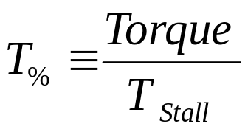
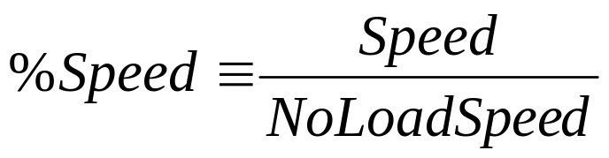
Definitions & Notes
E.S.C. – “Electronic Speed Controller”.
Victor884, Jaguar, etc.
All ‘%’ quantities are on range {0,100%}
DutyCycle_{E.S.C.} is the % time the E.S.C. is ‘on’

Slide 46
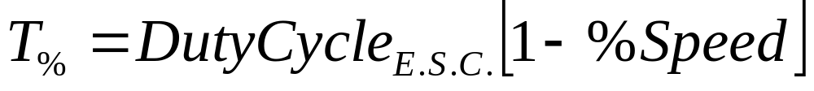

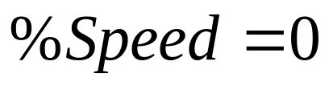

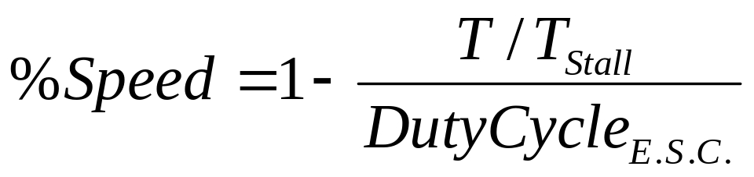
E.S.C. ↔ Motor Characteristics
Notes:
These are the basic steady-state characteristics for a low frequency PWM E.S.C. (such as the Victor884)

Slide 47
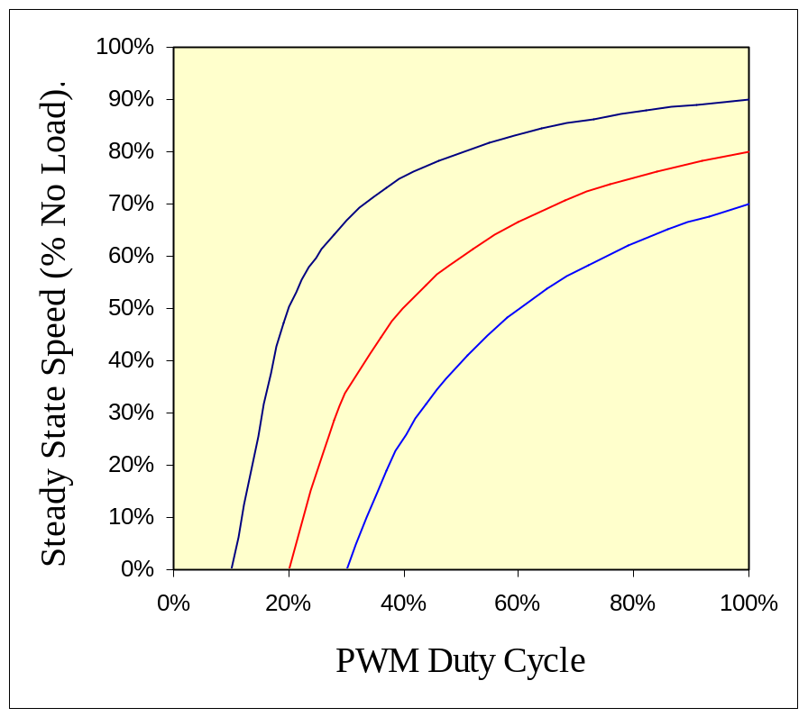
Victor884 Motor Speed vs DutyCycle

Slide 48
Basic Feedback Control
David Giandomenico
Team mentor for
Lynbrook Robotics – Team #846
<DGiandomenico@LynbrookRobotics.com>
Notes:
My intended audience is high school students involved actively in FIRST Robotics.
This talk covers basics of feedback control, together with discussions of practical techniques of measuring position and speed, dealing with changing loads, nonlinearities etc.

