Slide 1
Steady State Error in
Feedback Control
David Giandomenico
Team mentor for
Lynbrook Robotics – FIRST #846
<DGiandomenico@LynbrookRobotics.com>
Notes:
My intended audience is high school students involved actively in FIRST Robotics.
This is an introductory analysis of the error in a feedback loop at steady state.

Slide 2
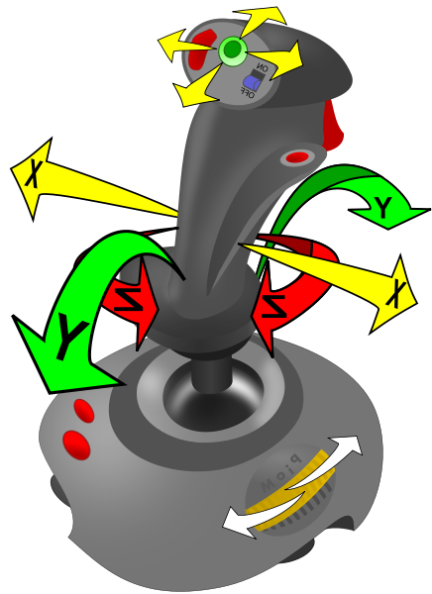
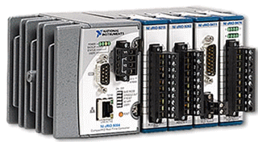
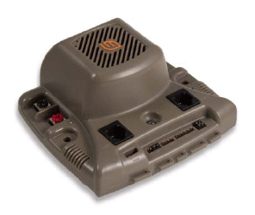

Open-Loop Control System
Input Speed
or Position
(joystick,
preset button,
autonomous, etc.)
+
Out
+
G
E.S.C.
−
−

Slide 3
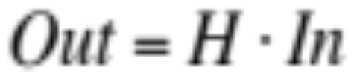
Simple System
No Feedback – “Open Loop”
H
In
H
Out
CPU+ESC+Motor+Robot
Notes:
Got to show the basics; Introduce the symbols.

Slide 4

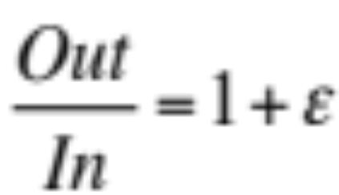
System Error
In
Out
Notes:
Got to show the basics; Introduce the symbols.

Slide 5
Feedback System
“Closed Loop”
+
H
A
Out
In
Σ
Error
= ( In – Out)
−
CPU
ESC + Motor + Robot

Slide 6
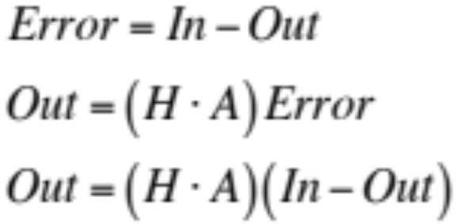
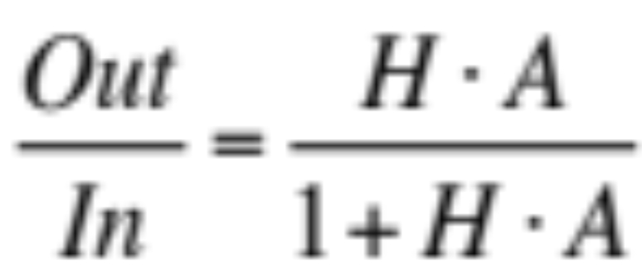
Feedback System
“Closed Loop”
+
A
H
In
Σ
Out
−
Error
= ( In-Out)
CPU
ESC + Motor + Robot

Slide 7
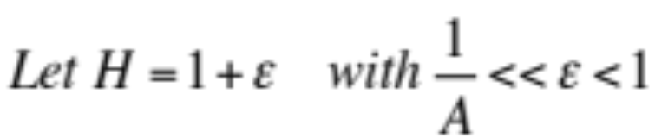
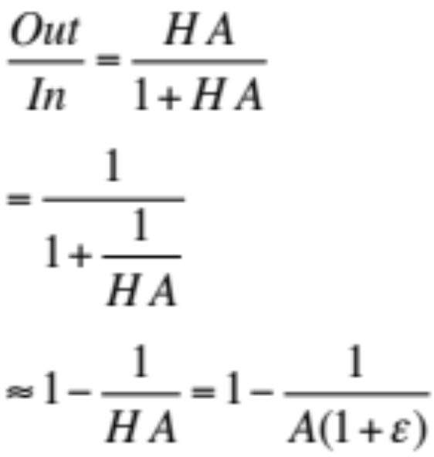
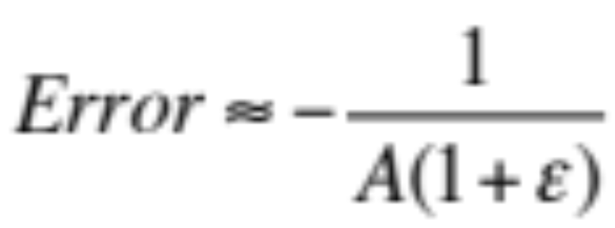
Error in Feedback System
+
A
In
Σ
Out
−
Error
= ( In-Out)
CPU
ESC + Motor + Robot

Slide 8
Feedback System w/Feed Forward
ESC + Motor + Robot
H
+
In
Σ
Out
(Velocity)
−
A
CPU
Error = (Out – In)
Σ
−
+

Slide 9
Feedback System w/Feed Forward
+
H
−
A
Σ
Σ
Out
In
Error
= ( Out-In)
−
+
CPU
ESC + Motor + Robot

Slide 10
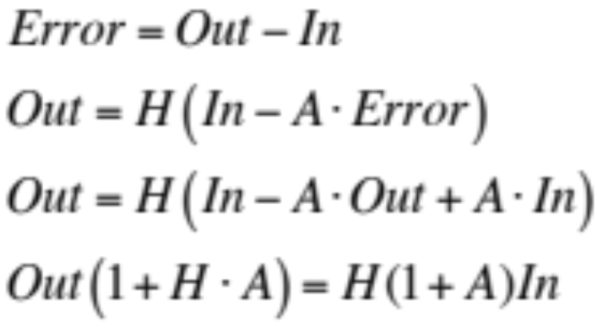
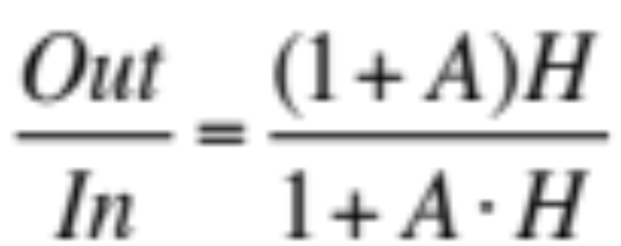
Feedback System w/Feed Forward
In
−
+
H
Σ
A
Σ
Out
+
Error
= (Out-In)
−
CPU
ESC + Motor + Robot

Slide 11

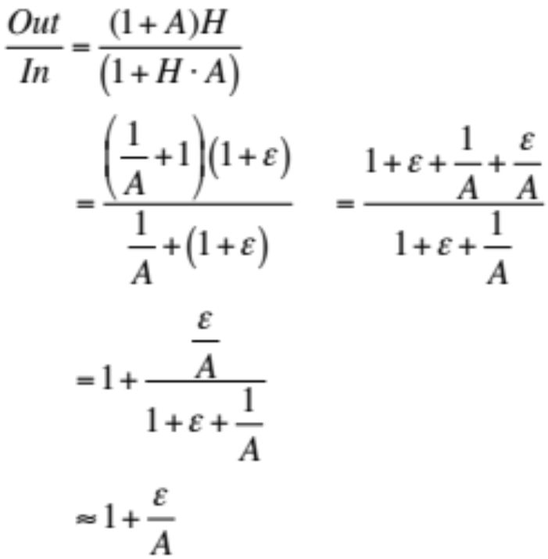
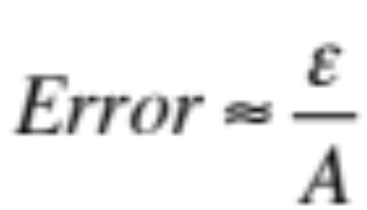
Static Error in Feedback System w/Feed Forward
In
−
+
H
Σ
A
Σ
Out
+
Error
= (Out-In)
−
CPU
ESC + Motor + Robot

Slide 12
Comparison: Steady State Error
Open Loop
 | ε | 0.1
 | Out/In | 0.90
 | Error | 0.10 | 10.00%
Basic Closed Loop
 | A | 15
 | ε | 0.1
 | H(s) = 1+ε | 1.1
 | AH(s) | 16.5
 | System Gain (Target=1.00)
 | Out/In | 0.94286
 | Error | -0.05714 | -5.71%
 | Estimate of Error:
 | =[A(1+ε)]⁻¹ | -0.06061 | -6.06%
With Feed-Forward
 | A | 15
 | ε | 0.1
 | H(s) = 1+e | 1.1
 | AH(s) | 16.5
 | System Gain (Target=1.00)
 | Out/In | 1.0057
 | Error | 0.00571 | 0.57%
 | Estimate of Error:
 | =ε/A | 0.007 | 0.67%
Notes:
Got to show the basics; Introduce the symbols.

Slide 13
Steady State Error in
Feedback Control
David Giandomenico
Team mentor for
Lynbrook Robotics – FIRST #846
<DGiandomenico@LynbrookRobotics.com>
Notes:
My intended audience is high school students involved actively in FIRST Robotics.
This is an introductory analysis of the error in a feedback loop at steady state.

Slide 14
Error in System
In
H
Out
Notes:
Got to show the basics; Introduce the symbols.

Slide 15


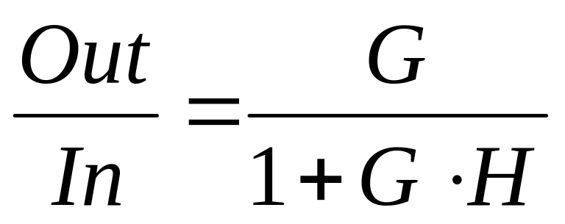
Feedback System
“Closed Loop”
In
+
G
Out
−
H

Slide 16


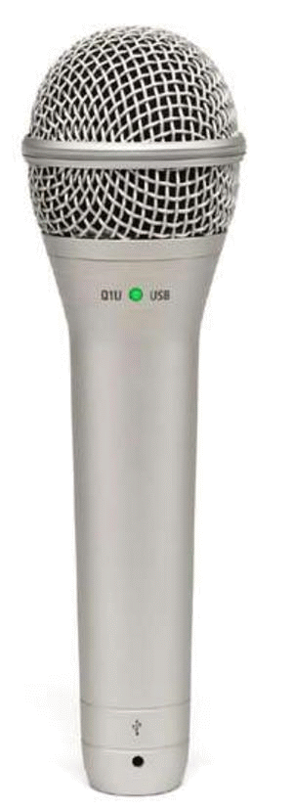


Undesired Feedback Path
Notes:
Pacman singing creates sound pressure at microphone and corresponding electrical signal.
PA amplifier output = gain x input
Speaker turns electrical signal back to sound
Sound is conveyed back to mic. If new sound is greater then original sound then oscillations occur.
In general, oscillations will occur if there exists a frequency such that the “loop gain” is > 1.

Slide 17
Tip: Setting Gain Fast
Option 1: Recompile and upload. Bleah!
Option 2: Attach a potentiometer to an analog input (once adjusted, hardwire in code). Not Bad!
Option 3: Use EEPROM/Flash Memory to save values. Access values through Operator Interface buttons. Display values on robot or OI. Way Cool!

Slide 18
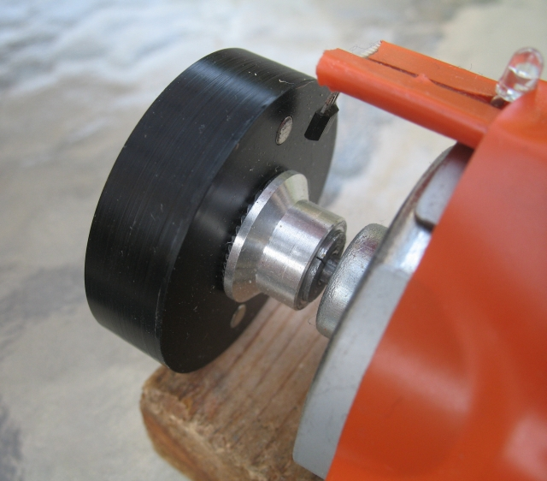
Simple Speed and Position Test Setup
Neodymium Magnet
Qty 2, for balance.
(see the web, eBay!)
Custom disk with holes for shaft and magnets
Hall effect magnetic sensor
<$2 at digikey or mouser
R/C Hobby Prop Adapter, 1/8”

Slide 19
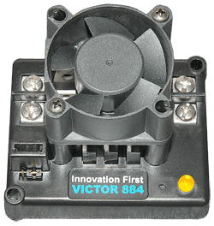
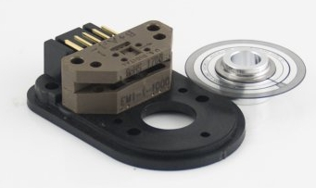
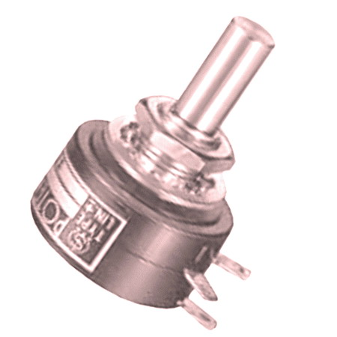
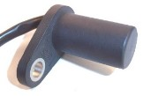
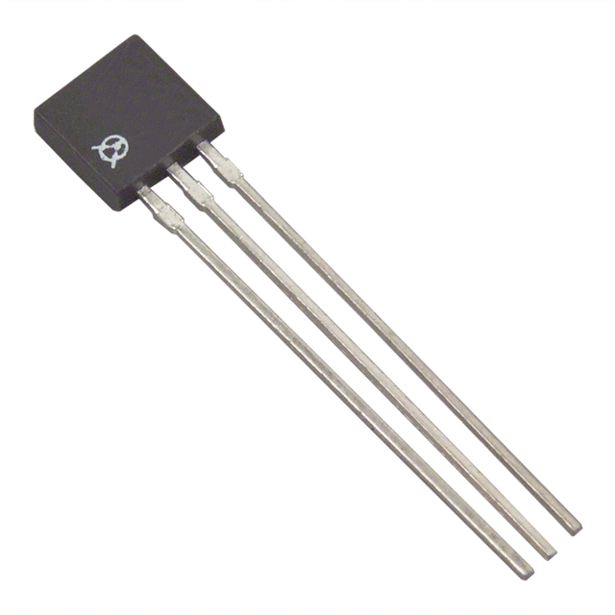
Closed-Loop Control System
Input Speed
or Position
(joystick,
preset button,
autonomous, etc.)
+
+
G
Out
E.S.C.
−
−
Sensor
Potentiometer, Encoder,
Gear Tooth Sensor,
Hall effect Sensor, …
Yet more sensors:
  Accelerometers & Gyros
  Optical Distance Meas.
  Cameras,
  Ultrasonic
  :
Notes:
Optical encoders, Hall effect (magnetic) sensors, Gear tooth sensors, potentiometers, gyros, …

