Slide 1
“Octo-Robot”

Slide 2
Presentation Outline
Intro – what were we trying to accomplish
Robot Hardware & “Firmware”
Low Level Robot Command Speed Run
First Robotics Java Emulation Code
First Robotics Example Code

Slide 3
Goals

Slide 4
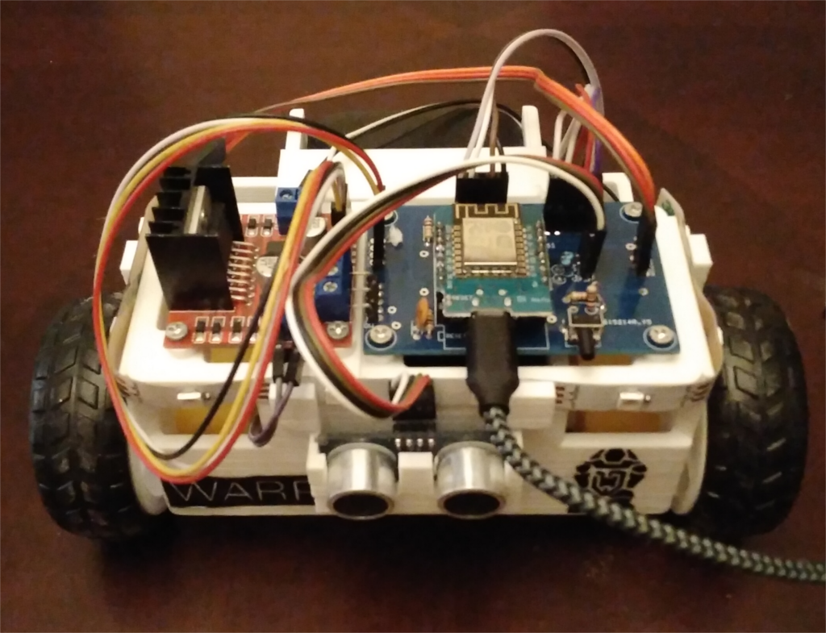
What is it
Inexpensive Trainer for First Robotics Programming
Hardware Features
  Two motors
  Two encoders
  Sonar Range Finder
  Status Lights
“Driven” from a PC
  Like a remote controlled car,
  But student robot code is doing the driving

Slide 5
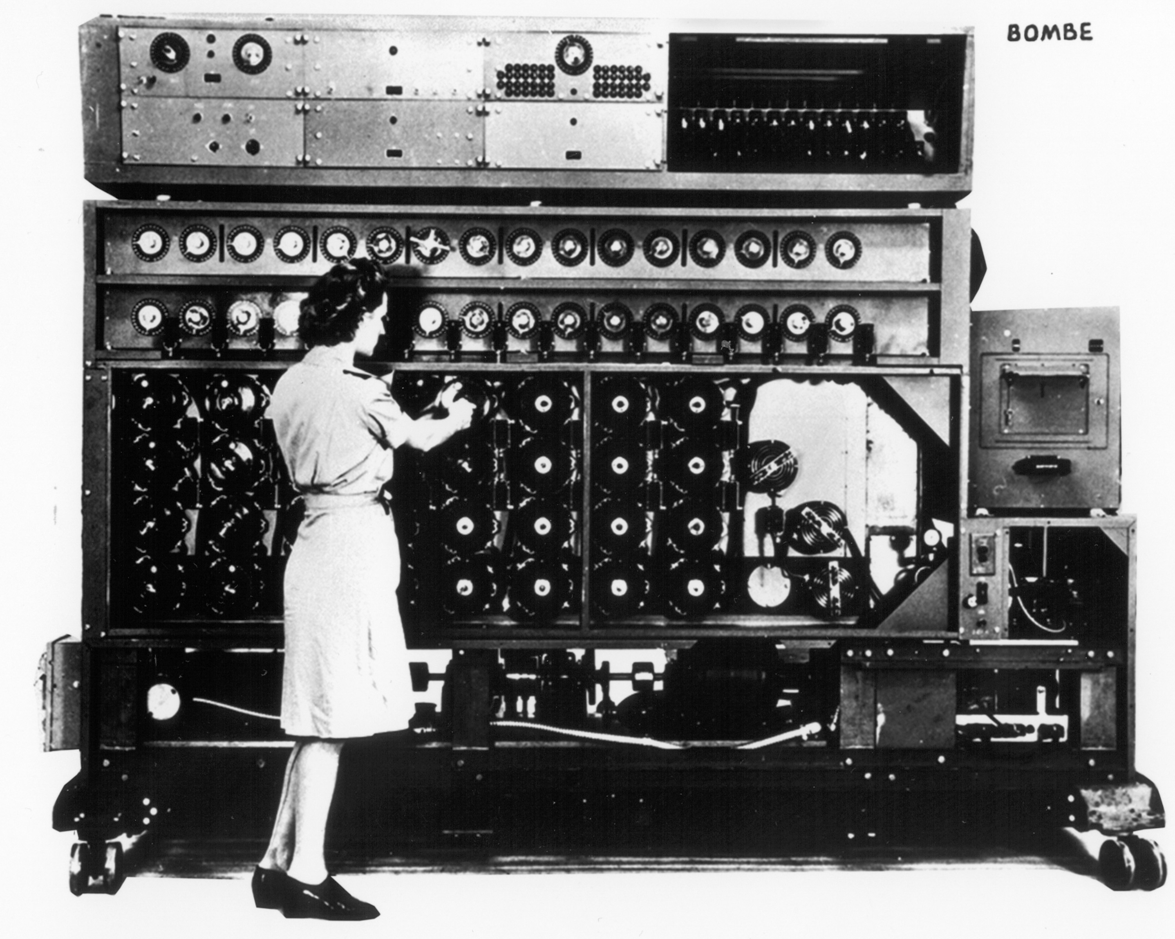
Goals
“Make it easy to start First Robotics programming”

Slide 6
Goals
Inexpensive and friendly (parts cost <$50)
Programmed like a competition robot
  Visual Studio Code Java Environemnt
  First Robotics Smart Dash Board
  First Robotics like hardware interfaces
Enough hardware for basic Robot tasks
  Encoders for PID Controllers + Sonar Range Finder

Slide 7
Robot Hardware & “Firmware”

Slide 8
Robot Hardware
Battery Pack
Motor Controller
I.O.T. Microcontroller
Status Lights
Sonic Range Finder

Slide 9
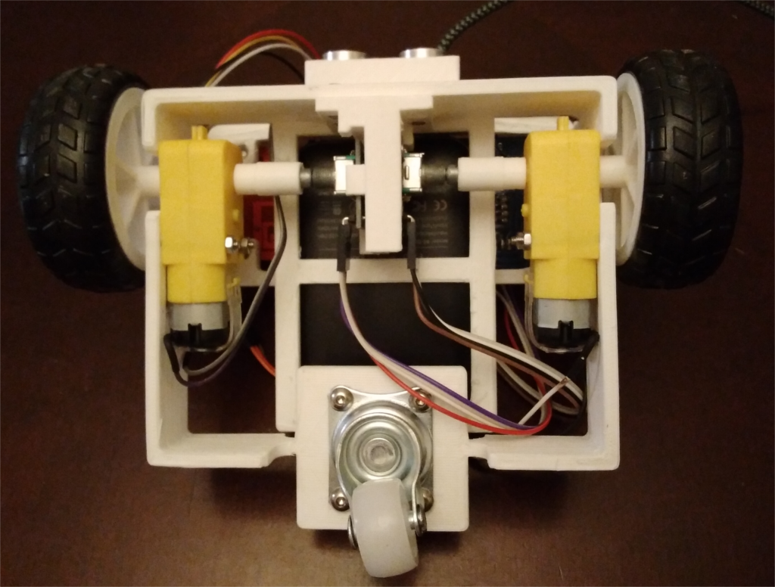
Robot Hardware
Right Motor
Right Encoder
Left Motor
Left Encoder
Rear Wheel

Slide 10

How it Works
The Robot Creates a WiFi Access Point
Robots have unique SSIDs. Password is graciousp

Slide 11

How it Works
Computer Connects to WiFi access point
The computer & robot form a private “intranet”

Slide 12
How it Works
Listening to 192.168.4.1
Port 4999
The Robot Listens to a TCP/IP Socket
Web Servers work in a similar way

Slide 13
How it Works
Connect to 192.168.4.1
Port 4999
Listening to 192.168.4.1
Port 4999
The Java Code on the laptop connects to the robot
Like a browser connecting to a web server

Slide 14
The Physical Robot is Pretty Basic
First Robitics Competition Robot
  Robo Rio is the brains of the robot
  Robo Rio talks to devices like motors through a bus
  Libraries for talking to the devices are provided
Trainer “Oct-Robot”
  Your PC is the true brains of the robot
  PC talks to devices like motors through the WIFI
  Libraries for talking to the devices are provided

Slide 15
Low Level Robot Command
Speed Run

Slide 16
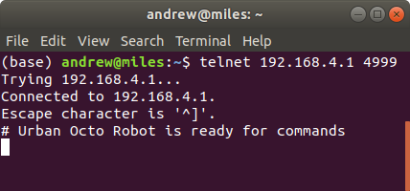
Low Level Commands - Connecting
Command that connects to robot
Robot’s Address and port
Robot saying “I’m listening & ready”

Slide 17
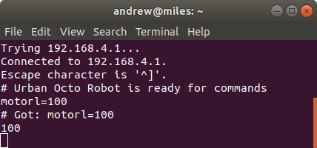
Low Level Commands - Motor
Tell Left Motor to go at 100%. This is something I typed in by hand
Robot saying “I got the command”

Slide 18
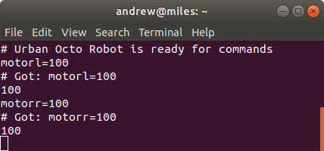
Low Level Commands - Motor
Tell Right Motor to go at 100%.
Robot saying “I got the command”

Slide 19
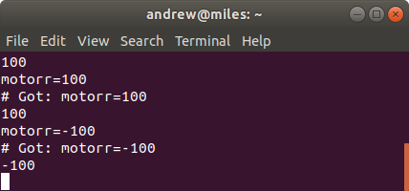
Low Level Commands - Motor
Tell Right Motor to go at -100%.
“Go counter clockwise instead of clockwise”

Slide 20
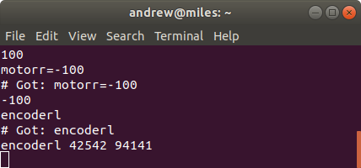
Low Level Commands - Encoder
Read the Left Encoder
Left Encoder Position
Left Encoder Rotation Speed
(94141 = ~1.44 rotations / sec)

Slide 21
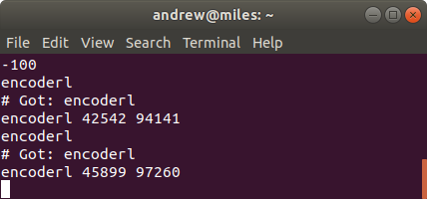
Low Level Commands - Encoder
Encoder Position Changes while the wheel runs at 100%
Encoder Speed is about the same
94141 = 1.44 rot/s
97260 = 1.48 rot/s

Slide 22
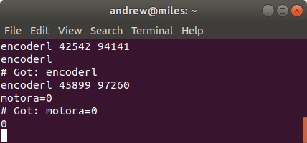
Raw Commands - “motora”
“motora” sets all motors. Setting all motors to 0 stops the robot

Slide 23
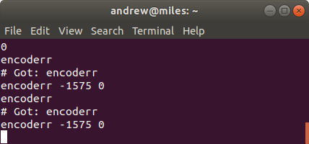
Low Level Commands - “encoderr”
“encoderr” gets the right encoder
If the motors are off, position doesn’t change
And rotation speed is 0

Slide 24
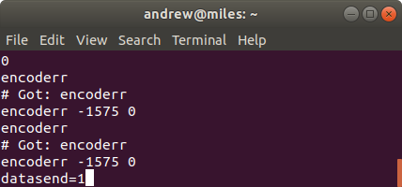
L.L. Command - Spam Sensor Data
datasend=1 tells the robot to send encoder and sonar range finder data every 1/10th of a second
datasend=0 turns this off.

Slide 25
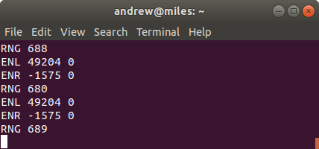
L.L. Command - Spam Sensor Data
Left Encoder
Position
Left Encoder Rotation Speed
Right Encoder Position
Right Encoder Rotation Speed
Sonar Sensor Distance in mm

Slide 26
First Robotics Java Emulation Code

Slide 27
TODO
TODO
  TODO

Slide 28
First Robotics Example Code

Slide 29
TODO
TODO
  TODO

