Slide 1
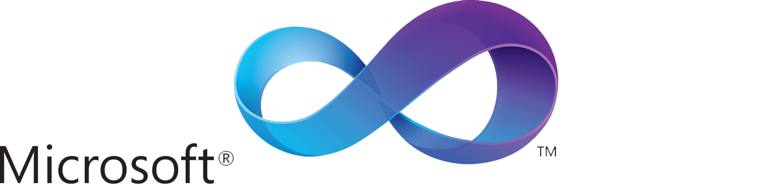
What is Visual Basic?
An Introductory Presentation

Slide 2
Visual Basic is an IDE and a Language
Visual Basic is an IDE, an Integraded Development Environment, basically a program to make programs, all in one package.
Visual Basic is ALSO a programming language, a set of words and numbers that the computer translates to program binary (so you don't have to, even though you could)
There are many elements in the Visual Basic programming language, many of which we will introduce today.

Slide 3
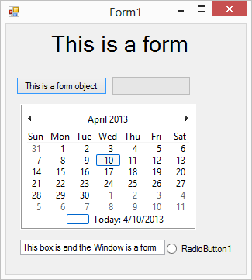
First Concept: Forms
A form is something which Visual Basic code can interact with or contains.
Code is a form.
A button is a form object
A window is a Form
And the Program is the Main form

Slide 4
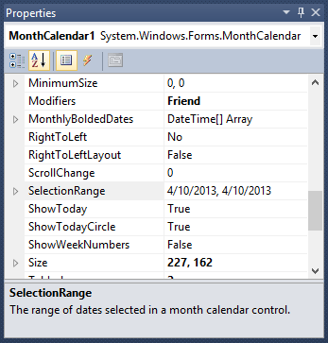
Almost all forms have properties
A property is something that can be changed in a form. (Think of it like in alice, a Form is a character and a property is a setting, like a color)
Most forms have properties, and all the properties can be changed from the GUI (seen on the right) OR changed in code.
For many forms, changing properties is important. For example, changing the location of a picture.

Slide 5
Demo

Slide 6
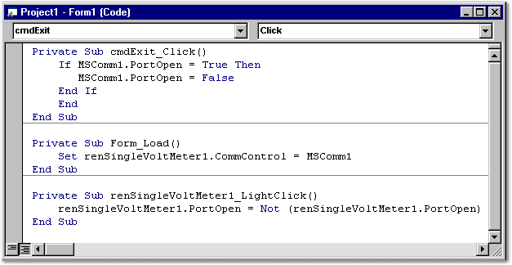
All Forms can be controlled by code
Visual Basic can be coded in both a visual and written way.
Many aspects of a program can only be controlled by code, such as Form classes and inputs.
All forms with properties can have their properties changed by code, including during the execution of a program.
Many other programming languages have the same behavior.

Slide 7
All of VB is based on code.

Slide 8
Forms that we will use today

Slide 9
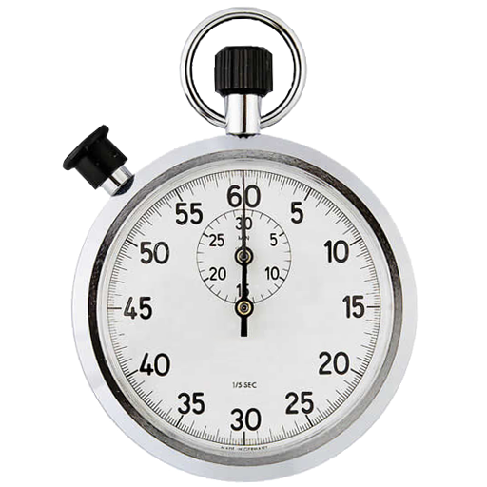
Timers
A timer is a form that measures time and runs code in intervals.
An interval is the time that the code pauses for in milliseconds.
The higher the interval, the longer the pauses between code runs.

Slide 10
Demo

