Slide 1
ADVERSARIAL VISION LAB
Why Securing Vision AI Matters
Computer-vision models are being trusted with decisions that matter — content moderation, document verification, autonomous perception. But small, often invisible changes to an image can flip a model's prediction entirely.
100%
60%
0%
of pixel-shifted images fooled our
baseline classifier in testing
attack success rate from Gaussian
noise alone — imperceptible to the eye
of teams can assume their vision
pipeline is safe by default
Adversarial Vision Lab tests exactly how fragile these pipelines are — and how much a defense layer can win back.
01 / Problem Statement

Slide 2
System Architecture
How an image moves from upload to a verdict on model robustness
👤
🧨
🛡️
🤖
→
→
→
User
Attack
Defense
AI Model
Uploads a PNG/JPEG
(validated & resized)
Noise or steganography
injected on demand
Optional EXIF strip +
Gaussian blur filter
ViT or LLaVA classifies
every stage
Every stage is compared side-by-side
Baseline → Attacked → Defended predictions and confidence scores are logged for each run, so an attack's success and a defense's recovery are both measurable, not anecdotal.
02 / System Architecture

Slide 3
LIVE DEMO
1
Upload a clean image
See the attack –
defense loop
in real time
Drop in an everyday photo — the ViT baseline gets it right.
2
Apply an attack
Turn on Gaussian noise or pixel shift and watch the label flip.
3
Enable the defense filter
Toggle EXIF stripping + blur back on.
4
Show the recovery
Run on the live Streamlit dashboard — no slides, no simulation.
Compare baseline → attacked → defended, side by side, live.
03 / Live Demo

Slide 4
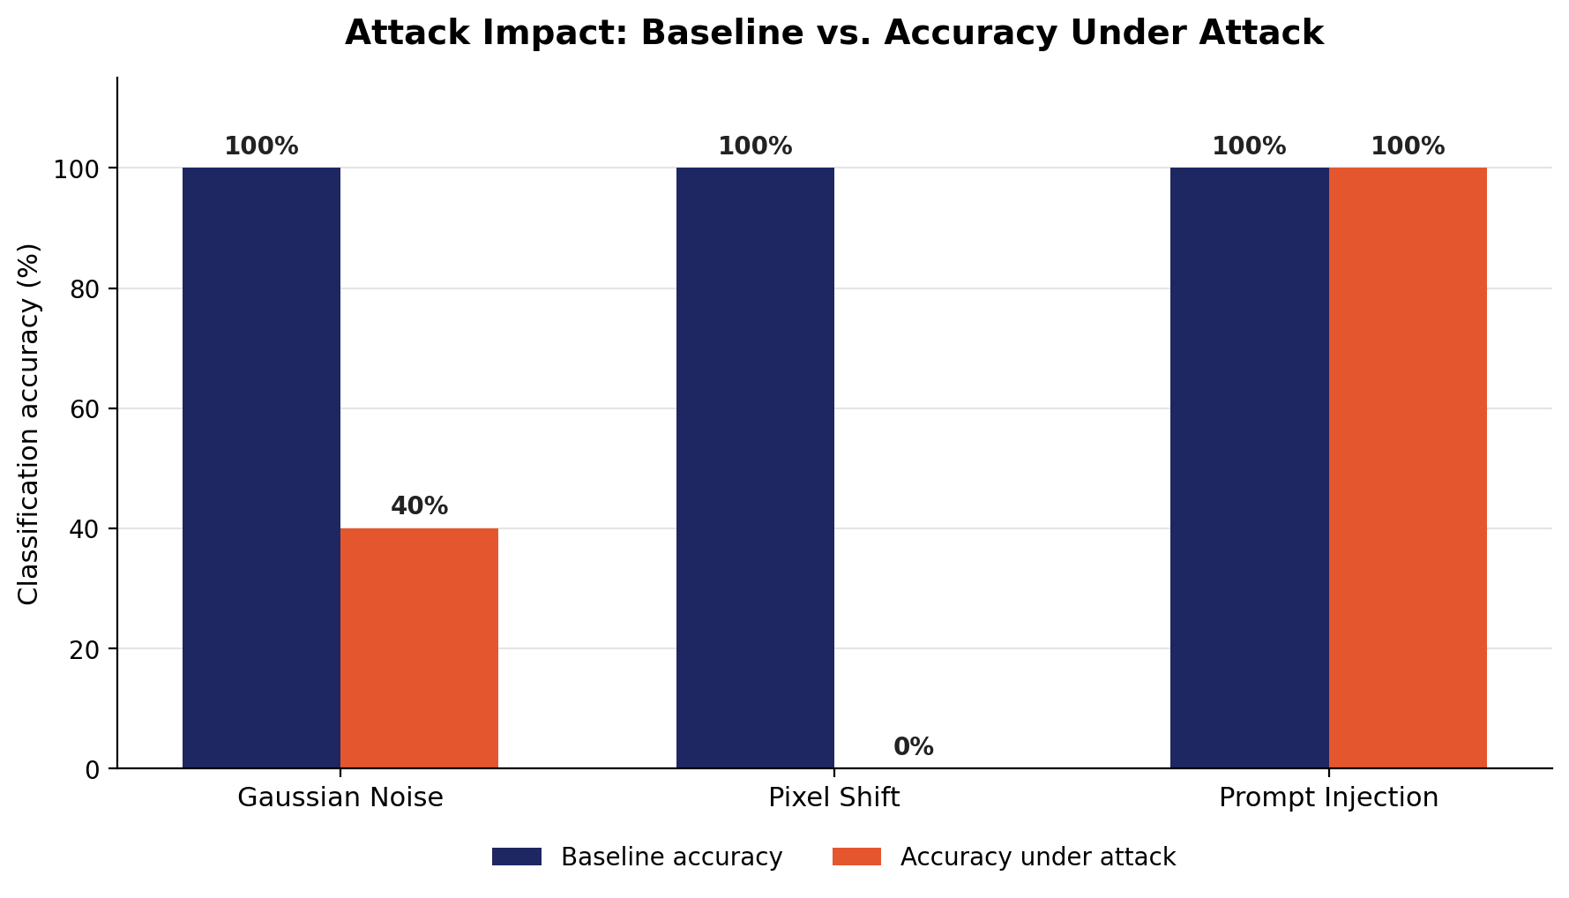
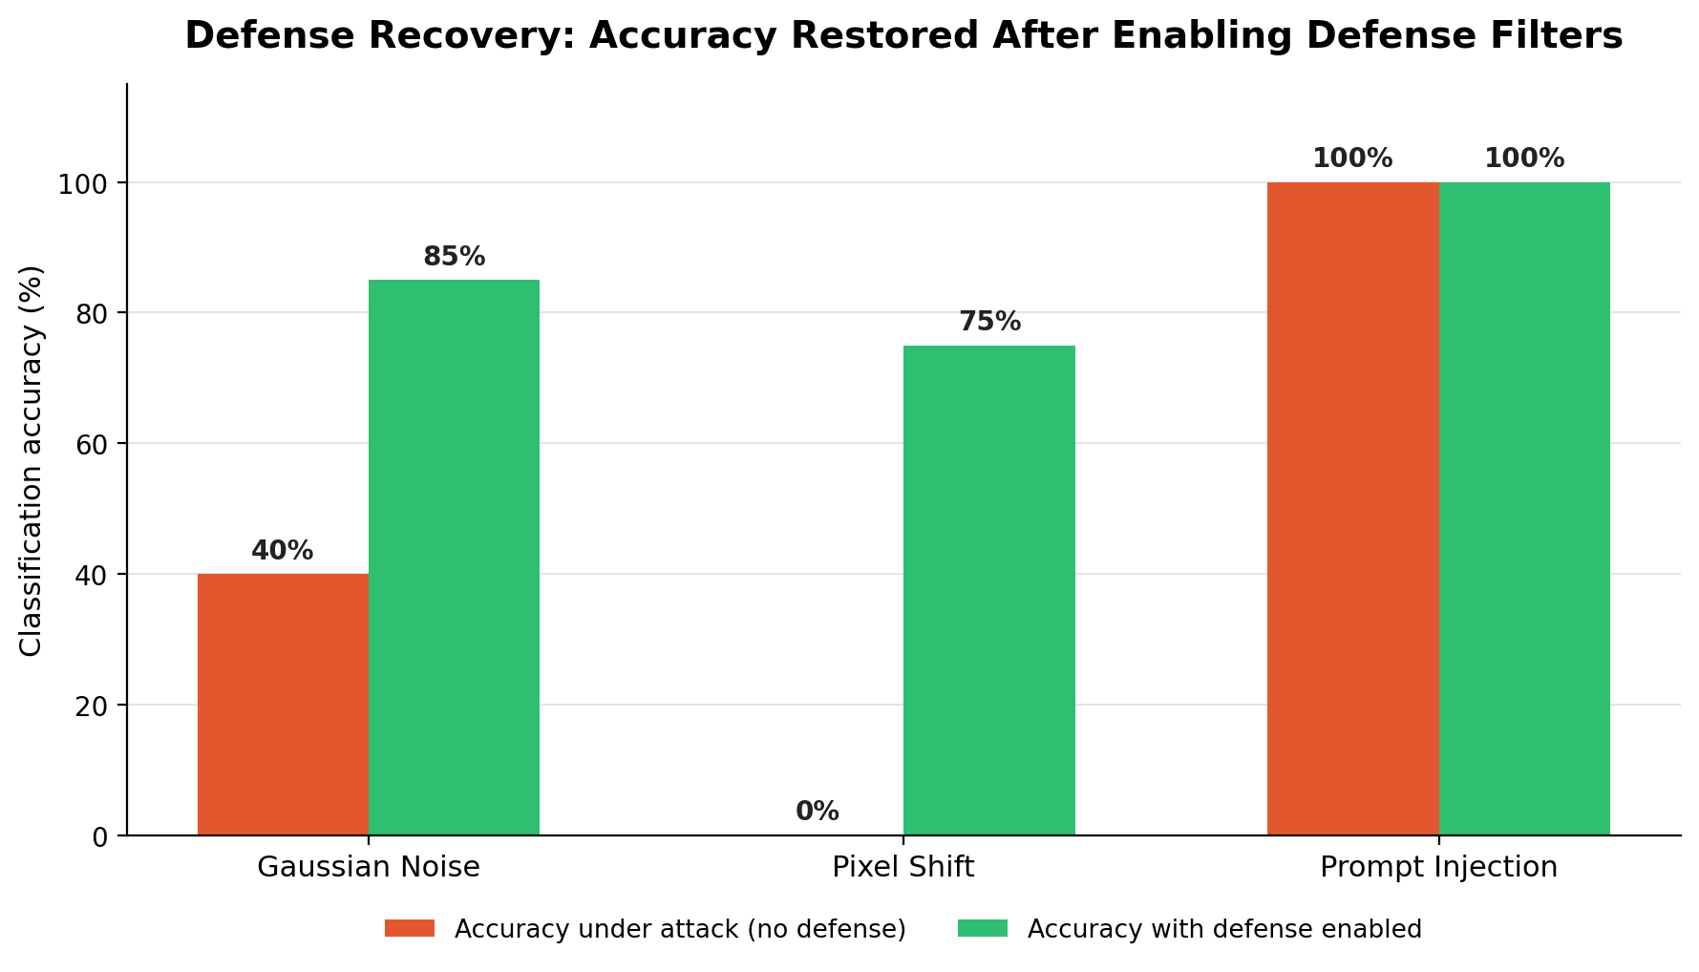
Benchmark Charts & Findings
Week 4 test set — 20 images per attack type
Pixel shift is the most dangerous attack
The defense filter reliably recovers accuracy
Prompt injection alone doesn't fool the vision model
100% success rate — every single test image was misclassified.
75% of successful attacks were undone by EXIF-strip + blur.
0% success — hidden EXIF/LSB payloads don't reach the classifier.
04 / Benchmark Charts & Findings

Slide 5
Key Learnings & Future Enhancements
WHAT WE LEARNED
WHAT'S NEXT
Pixel-level attacks are cheap to run and devastating — no gradient access needed.
A lightweight defense filter (EXIF strip + blur) recovers most of what noise attacks break.
Confidence scores drop even when the label survives — worth tracking separately from label flips.
Expand the benchmark set beyond 20 images per attack for tighter confidence intervals.
Add adaptive/gradient-based attacks to stress-test beyond the current black-box methods.
Explore ensemble defenses (denoising + blur) to close the gap on pixel-shift recovery.
Thank you — questions welcome.
05 / Key Learnings & Future Enhancements

