Slide 1
ADVERSARIAL VISION LAB
Why Securing Vision AI Matters
Vision AI is increasingly used in autonomous vehicles, healthcare, surveillance, and document verification. Small image modifications or hidden adversarial content can mislead AI models, making security an essential part of reliable Vision AI systems.
Attack Simulation
Defense
AI Models
Gaussian Noise
Pixel Shift
EXIF Injection
LSB Steganography
EXIF Removal
Gaussian Blur
ViT
LLaVA
Evaluating the robustness of Vision AI against adversarial attacks and measuring the effectiveness of defense techniques.
01 / Problem Statement
Hiba Fathima K

Slide 2
System Architecture
How an image moves from upload to a verdict on model robustness
👤
🧨
🛡️
🤖
→
→
→
User
Attack
Defense
AI Model
Uploads a PNG/JPEG
(validated & resized)
Noise or steganography
injected on demand
Optional EXIF strip +
Gaussian blur filter
ViT or LLaVA classifies
every stage
Every stage is compared side-by-side
Baseline → Attacked → Defended predictions and confidence scores are logged for each run, so an attack's success and a defense's recovery are both measurable, not anecdotal.
Hiba Fathima K
02 / System Architecture

Slide 3
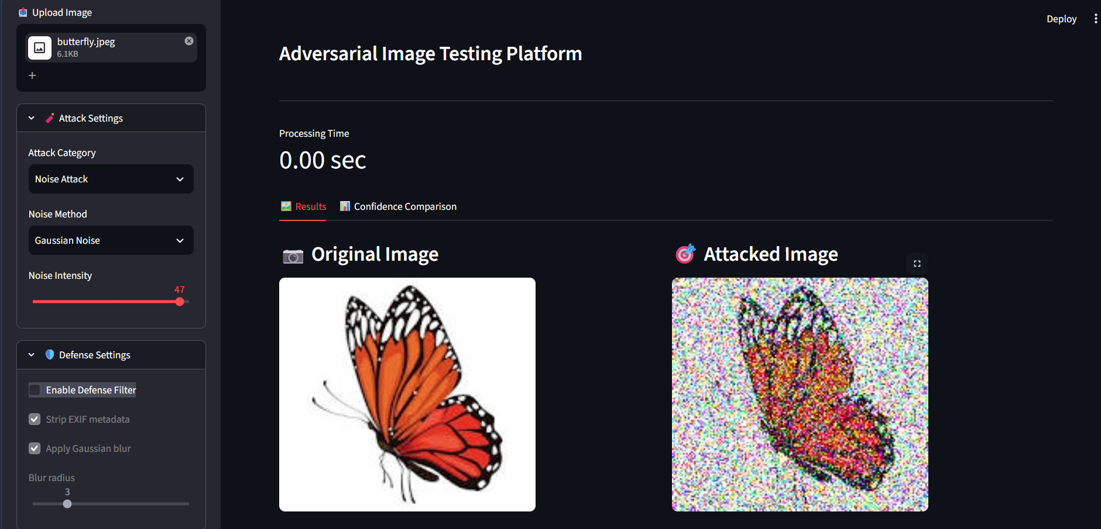
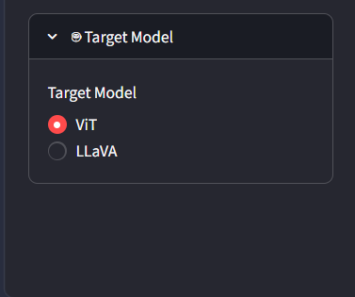
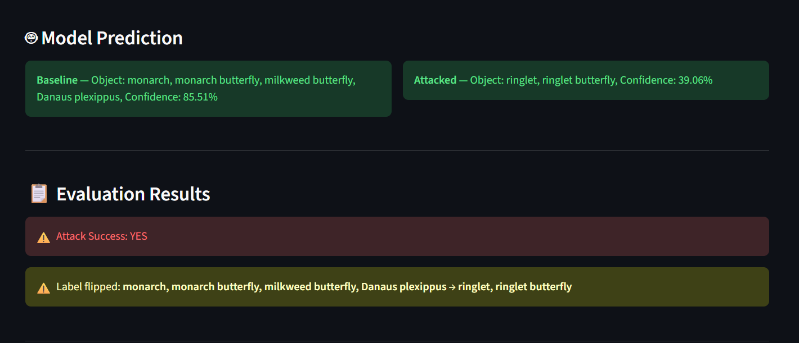
Live demo
Uploading image
and
applying attack
03 / Live Demo
Hiba Fathima K

Slide 4
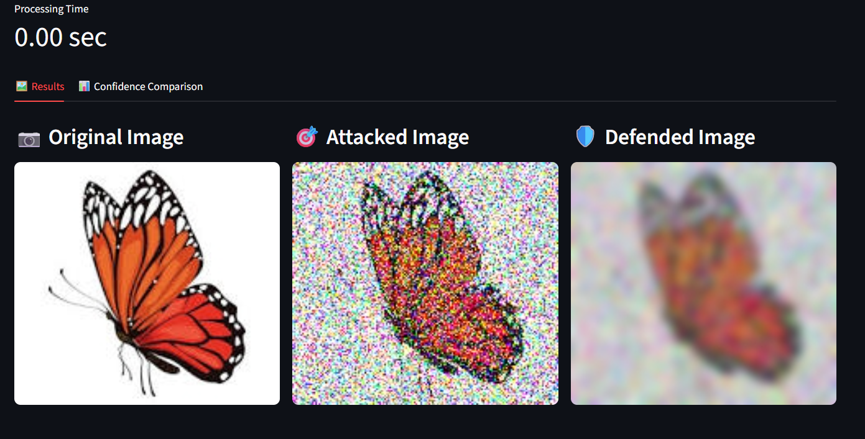
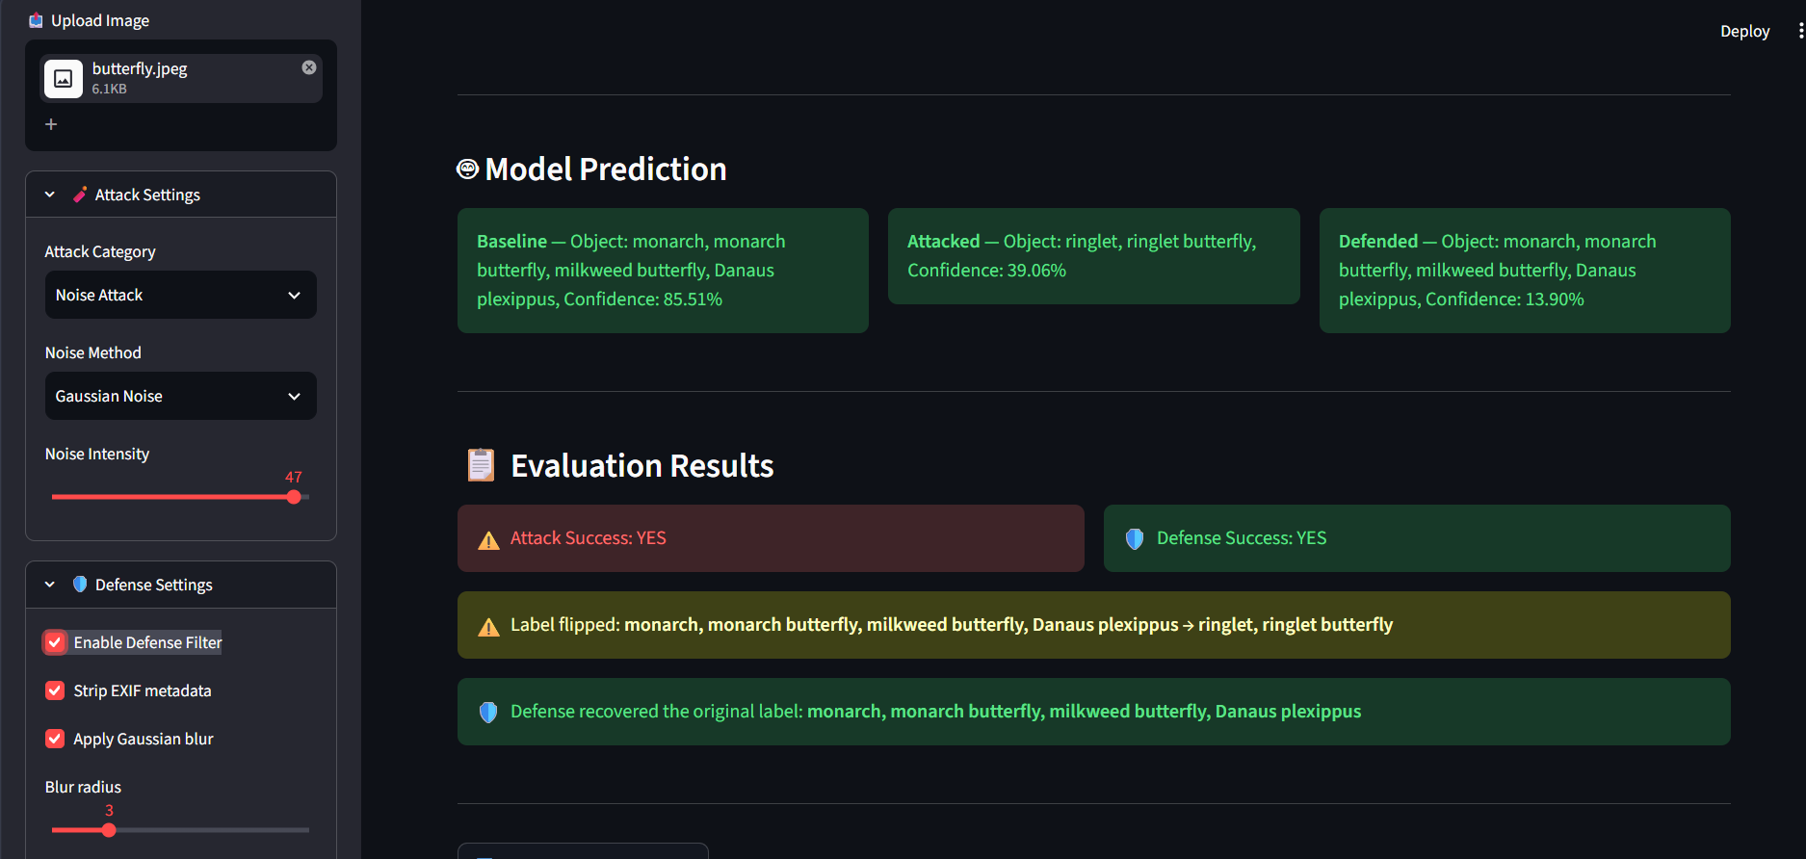
Live demo
Enable Defense
Filter
Hiba Fathima K

Slide 5
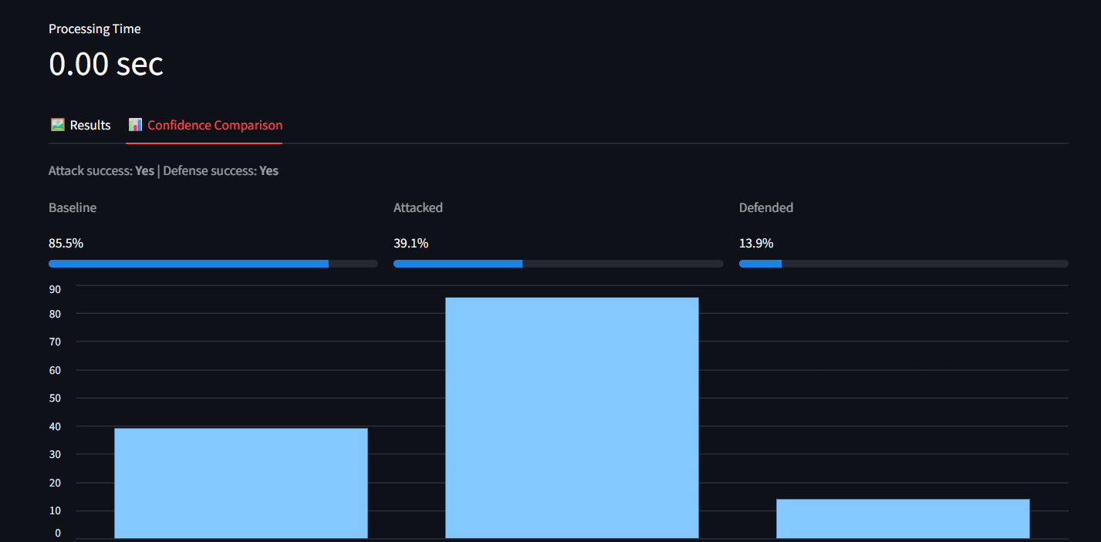
Live demo
Confidence
Comparison
Chart
03 / Live Demo
Hiba Fathima K

Slide 6
Performance Evaluation & Benchmark Results
20 images tested for each attack type
Pixel Shift produced the highest attack success rate
Defense pipeline improved model robustness
Prompt injection showed no impact on image classification
Achieved a 100% attack success rate, causing misclassification on all benchmark images.
EXIF metadata removal combined with Gaussian blur successfully recovered predictions in 75% of successful attacks.
Hidden EXIF and LSB payloads did not affect ViT image classification because these models rely primarily on pixel information rather than metadata.
04 / Benchmark Charts & Findings
Hiba Fathima K

Slide 7
Key Learnings & Future Enhancements
WHAT WE LEARNED
WHAT'S NEXT
Gained practical experience with adversarial attacks on Vision AI systems.
Implemented multiple attack techniques, including Gaussian Noise, Pixel Shift, Prompt Injection.
Evaluated the robustness of ViT and LLaVA models under different attack scenarios.
Developed a defense pipeline using EXIF metadata removal and Gaussian blur.
Built an interactive Streamlit dashboard for attack simulation, defense, and performance evaluation.
Integrate advanced adversarial attacks such as FGSM, PGD, and DeepFool.
Implement stronger defense mechanisms for improved robustness.
Evaluate the system using larger and more diverse image datasets.
Add automated benchmarking reports and performance analytics.
Deploy the dashboard as a cloud-based web application.
This project demonstrates how adversarial attacks can affect Vision AI systems and shows that appropriate defense techniques can improve the reliability and robustness of AI predictions.
05 / Key Learnings & Future Enhancements
Hiba Fathima K

