Slide 1
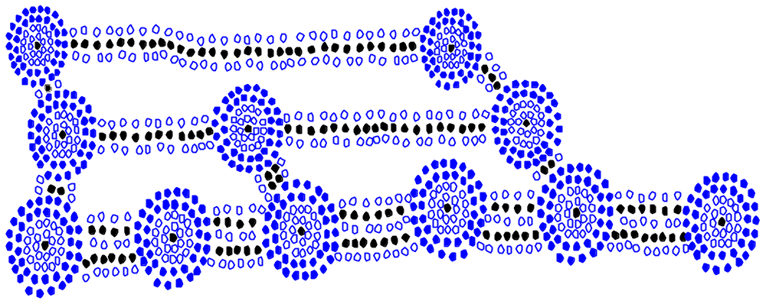
AVL Trees

Slide 2
Why do we want binary search trees?
What property do we want to maintain?
how can we do that?
Look at emailOfDoom.txt data set

Slide 3


Slide 4
AVL Trees
G. Adelson-Velskii and E.M. Landis, "An algorithm for the organization of information." Doklady Akademii Nauk SSSR, 146:263–266, 1962 (Russian). English translation by Myron J. Ricci in Soviet Math. Doklady, 3:1259–1263, 1962.
Donald Knuth. The Art of Computer Programming, Volume 3: Sorting and Searching, Third Edition. Addison-Wesley, 1997. ISBN 0-201-89685-0. Pages 458–475 of section 6.2.3: Balanced Trees. Note that Knuth calls AVL trees simply "balanced trees".

Slide 5
AVL Trees
Proposed in 1962, Adelson-Velskii and Landis
  Trying to devise a better data structure for a chess engine!
Depth ensured to be O(log n)
  But not always perfectly balanced
Recursive definition:
  The sub-trees of every node differ in height by at most one.
  Every sub-tree is an AVL tree.
Height of an empty tree is -1
Height of a leaf node is 0

Slide 6
Operations on AVL trees
Search, as for BSTs
Insert is the same as for BST but
  May have to fix the tree after insertion to restore the balance condition
  Can always do this via a modification known as a rotation
    Single rotation or double rotation
Similarly for deletion
Note that the balance condition ensures that search,insert and delete operations are all O(log n), where n is the number of nodes
balancing is O(1)
ADS2 Lecture 96
<number>3425.61

Slide 7
What do we mean by imbalance?
x
The imbalance of x is abs(height(left.x) – height(right.x))
If imbalance(x) > 1 we need to restore balance by a restructuring
of the tree. This is called a “rotation”. There are 4 kinds of rotation

Slide 8
There are 4 cases to consider (after an insertion)
Case 1
Case 2
Case 3
Case 4

Slide 9
There are 4 cases to consider (after an insertion)
Case 1
Case 2
Case 3
Case 4
Symmetry

Slide 10
Single Rotations
Case 1
Case 4
Symmetry

Slide 11
LL Rotation
k2
k1
k1
k2
Z
X
Y
X
Y
Z

Slide 12
LL Rotation
k2
k1
k1
k2
Z
X
Y
X
Y
Z
NOTE:
X < k1 & X < Y & X < k2 & X < Z
Y > X && Y > k1 & Y < k2 & Y < Z
k1 > X && k1 < Y & k1 < k2 & k1 < Z
k2 > X & k2 > k1 & k2 > Y & k2 < Z
Z > X & Z > k1 & Z > Y & Z > k2

Slide 13
LL Rotation
k2
k1
k1
k2
Z
X
Y
X
Y
Z
NOTE:
X < k1 & X < Y & X < k2 & X < Z
Y > X && Y > k1 & Y < k2 & Y < Z
k1 > X && k1 < Y & k1 < k2 & k1 < Z
k2 > X & k2 > k1 & k2 > Y & k2 < Z
Z > X & Z > k1 & Z > Y & Z > k2
NOTE:
X < k1 & X < Y & X < k2 & X < Z
Y > X && Y > k1 & Y < k2 & Y < Z
k1 > X && k1 < Y & k1 < k2 & k1 < Z
k2 > X & k2 > k1 & k2 > Y & k2 < Z
Z > X & Z > k1 & Z > Y & Z > k2

Slide 14
Single Rotation
LL Rotation
Case 1
x
Identifying Case 1:
imbalance(x) = 2
height(left.x) > height(right.x)
height(left.left.x) > height(right.left.x)

Slide 15
Single Rotation
LL Rotation
Case 1
x
Identifying Case 1:
imbalance(x) = 2
height(left.x) > height(right.x)
height(left.left.x) > height(right.left.x)

Slide 16
Single Rotation
LL Rotation
Case 1
x
Identifying Case 1:
imbalance(x) = 2
height(left.x) > height(right.x)
height(left.left.x) > height(right.left.x)

Slide 17
Single Rotation
LL Rotation
Case 1
x
Identifying Case 1:
imbalance(x) = 2
height(left.x) > height(right.x)
height(left.left.x) > height(right.left.x)
Restore balance by a LL Rotation

Slide 18
Single Rotation
LL Rotation
Case 1
x
Identifying Case 1:
imbalance(x) = 2
height(left.x) > height(right.x)
height(left.left.x) > height(right.left.x)
Restore balance by a LL Rotation
k2
k1
Z
X
Y

Slide 19
Single Rotation
LL Rotation
Case 1
x
Identifying Case 1:
imbalance(x) = 2
height(left.x) > height(right.x)
height(left.left.x) > height(right.left.x)
Restore balance by a LL Rotation
k2
k1
k1
k2
Z
X
Y
X
Y
Z

Slide 20
Single Rotation
LL Rotation
Case 1
x
Identifying Case 1:
imbalance(x) = 2
height(left.x) > height(right.x)
height(left.left.x) > height(right.left.x)
Restore balance by a LL Rotation
k2
k1
k1
k2
Z
X
Y
X
Y
Z
NOTE:
EI(X) < k1 < EI(Y) < k2 < EI(Z)
where EI(T) means “Everything In tree T”

Slide 21
Single Rotation
LL Rotation
Case 1
x
Identifying Case 1:
imbalance(x) = 2
height(left.x) > height(right.x)
height(left.left.x) > height(right.left.x)
Restore balance by a LL Rotation
k2
k1
k1
k2
Z
X
Y
X
Y
Z
left.k2 = right.k1
right.k1 = k2

Slide 22
Single Rotation
LL Rotation
Case 1
x
Identifying Case 1:
imbalance(x) = 2
height(left.x) > height(right.x)
height(left.left.x) > height(right.left.x)
Restore balance by a LL Rotation
k2
k1
k1
k2
Z
X
Y
X
Y
Z
left.k2 = right.k1
right.k1 = k2

Slide 23
Single Rotation
LL Rotation
Case 1
x
Identifying Case 1:
imbalance(x) = 2
height(left.x) > height(right.x)
height(left.left.x) > height(right.left.x)
Restore balance by a LL Rotation
k2
k1
k1
k2
Z
X
Y
X
Y
Z
left.k2 = right.k1
right.k1 = k2
Need to update height and parent information … obviously

Slide 24
RR Rotation
k1
k2
k1
k2
X
Z
Y
Z
X
Y
Symmetric to LL Rotation

Slide 25
Single Rotation
RR Rotation
Case 4
X
Identifying Case 4:
imbalance(x) = 2
height(right.x) > height(left.x)
height(right.right.x) > height(left.right.x)

Slide 26
Single Rotation
RR Rotation
Case 4
X
Identifying Case 4:
imbalance(x) = 2
height(right.x) > height(left.x)
height(right.right.x) > height(left.right.x)

Slide 27
Single Rotation
RR Rotation
Case 4
X
Identifying Case 4:
imbalance(x) = 2
height(right.x) > height(left.x)
height(right.right.x) > height(left.right.x)

Slide 28
Single Rotation
RR Rotation
Case 4
X
Identifying Case 4:
imbalance(x) = 2
height(right.x) > height(left.x)
height(right.right.x) > height(left.right.x)
Restore balance by a RR Rotation
k1
k2
X
Y
Z

Slide 29
Single Rotation
RR Rotation
Case 4
X
Identifying Case 4:
imbalance(x) = 2
height(right.x) > height(left.x)
height(right.right.x) > height(left.right.x)
Restore balance by a RR Rotation
k1
k2
k1
k2
X
Z
Y
Z
X
Y
NOTE:
EI(X) < k1 < EI(Y) < k2 < EI(Z)
where EI(T) means “Everything In tree T”

Slide 30
Single Rotation
RR Rotation
Case 4
X
Identifying Case 4:
imbalance(x) = 2
height(right.x) > height(left.x)
height(right.right.x) > height(left.right.x)
Restore balance by a RR Rotation
k1
k2
k1
k2
X
Z
Y
Z
X
Y
right.k1 = left.k2
left.k2 = k1

Slide 31
Single Rotation
RR Rotation
Case 4
X
Identifying Case 4:
imbalance(x) = 2
height(right.x) > height(left.x)
height(right.right.x) > height(left.right.x)
Restore balance by a RR Rotation
k1
k2
k1
k2
X
Z
Y
Z
X
Y
right.k1 = left.k2
left.k2 = k1

Slide 32
Single Rotation
RR Rotation
Case 4
X
Identifying Case 4:
imbalance(x) = 2
height(right.x) > height(left.x)
height(right.right.x) > height(left.right.x)
Restore balance by a RR Rotation
k1
k2
k1
k2
X
Z
Y
Z
X
Y
right.k1 = left.k2
left.k2 = k1

Slide 33
Single Rotation
RR Rotation
Case 4
X
Identifying Case 4:
imbalance(x) = 2
height(right.x) > height(left.x)
height(right.right.x) > height(left.right.x)
Restore balance by a RR Rotation
k1
k2
k1
k2
X
Z
Y
Z
X
Y
right.k1 = left.k2
left.k2 = k1
Need to update height and parent information … obviously

Slide 34
Double Rotation

Slide 35
Double Rotation
Case 2
Case 3
Symmetry

Slide 36
Double Rotation
LR Rotation
Case 2
x
Identifying Case 2:
imbalance(x) = 2
height(left.x) > height(right.x)
height(right.left.x) > height(left.left.x)
Restore balance by a LR (Double) Rotation
k3
k2
k1
k1
k3
D
k2
A
A
B
C
D
B
C
left.k3 = right.k2
right.k1 = left.k2
left.k2 = k1
right.k2 = k3
Need to update height and parent information … obviously

Slide 37
Double Rotation
LR Rotation
Case 2
x
Identifying Case 2:
imbalance(x) = 2
height(left.x) > height(right.x)
height(right.left.x) > height(left.left.x)
Restore balance by a LR (Double) Rotation
k3
k2
k1
k1
k3
D
k2
A
A
B
C
D
B
C
left.k3 = right.k2
right.k1 = left.k2
left.k2 = k1
right.k2 = k3
Need to update height and parent information … obviously

Slide 38
Double Rotation
LR Rotation
Case 2
x
Identifying Case 2:
imbalance(x) = 2
height(left.x) > height(right.x)
height(right.left.x) > height(left.left.x)
Restore balance by a LR (Double) Rotation
k3
k2
k1
k1
k3
D
k2
A
A
B
C
D
B
C
left.k3 = right.k2
right.k1 = left.k2
left.k2 = k1
right.k2 = k3
Need to update height and parent information … obviously

Slide 39
Double Rotation
LR Rotation
Case 2
x
Identifying Case 2:
imbalance(x) = 2
height(left.x) > height(right.x)
height(right.left.x) > height(left.left.x)
Restore balance by a LR (Double) Rotation
k3
k2
k1
k1
k3
D
k2
A
A
B
C
D
B
C
left.k3 = right.k2
right.k1 = left.k2
left.k2 = k1
right.k2 = k3
Need to update height and parent information … obviously

Slide 40
Double Rotation
LR Rotation
Case 2
x
Identifying Case 2:
imbalance(x) = 2
height(left.x) > height(right.x)
height(right.left.x) > height(left.left.x)
Restore balance by a LR (Double) Rotation
k3
k2
k1
k1
k3
D
k2
A
A
B
C
D
B
C
left.k3 = right.k2
right.k1 = left.k2
left.k2 = k1
right.k2 = k3
Need to update height and parent information … obviously

Slide 41
RL Rotation

Slide 42
Double Rotation
RL Rotation
Case 3
x
Identifying Case 3:
imbalance(x) = 2
height(right.x) > height(left.x)
height(left.right.x) > height(right.right.x)
Restore balance by a RL (Double) Rotation
k1
k2
k3
k1
k3
A
k2
D
A
B
C
D
B
C
left.k3 = right.k2
right.k1 = left.k2
left.k2 = k1
right.k2 = k3
NOTE: same steps as in LR Rotation
Need to update height and parent information … obviously

Slide 43
We have our own demo program Test
We also have links to demos off site.
Nice demo is to build tree with AVL and compare with BTree
But now … the code

Slide 44
NOTE: I have made a different engineering decision from
that in BTree. In BTree most of the work is done in the Node class.
Here most of the code/work is done in the BTree class.
What do you think?

Slide 45
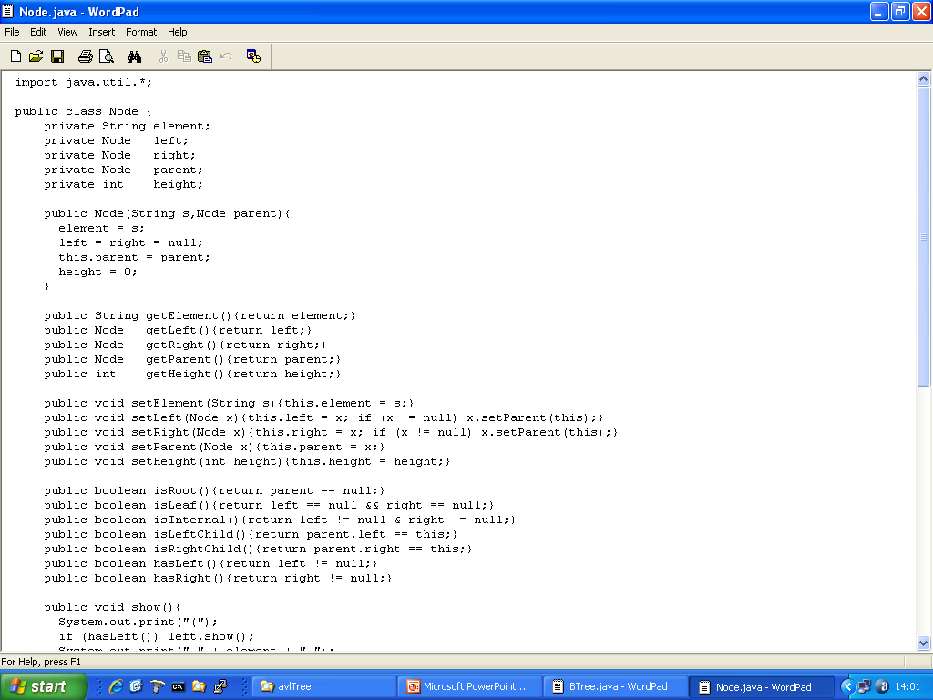
Node
height is a new property
get*, set*, is*

Slide 46
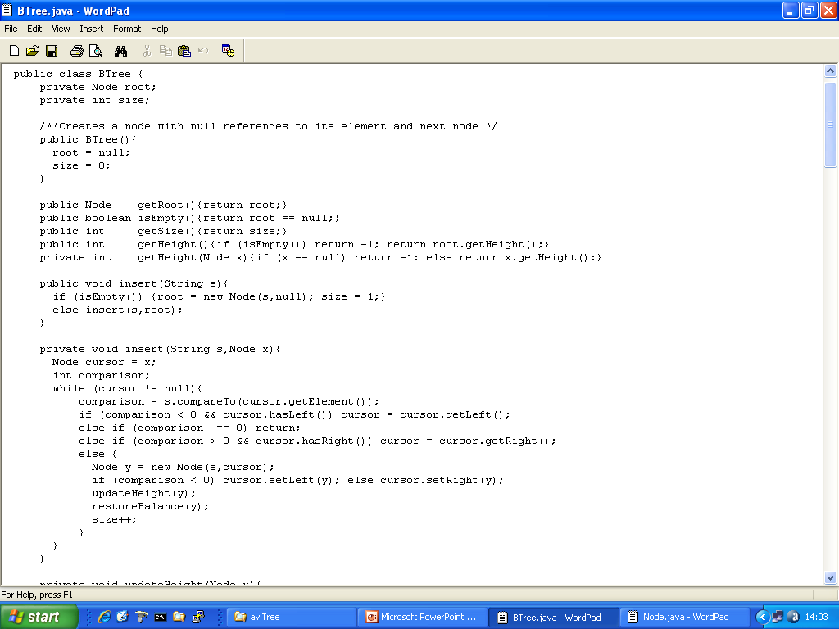
BTree

Slide 47
BTree

Slide 48
BTree

Slide 49
BTree
Previously we did this stuff in class Node
NOTE: iterative
Here’s the AVL stuff

Slide 50
BTree
There is a bug in insert.
Can you see it?
Hint: could we increment size twice?

Slide 51
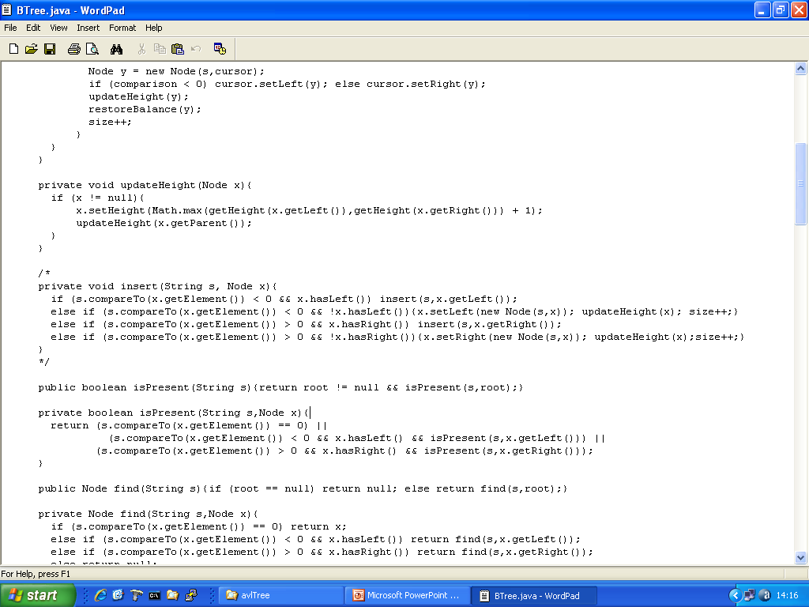
BTree
Recursive, but edited out
Compare & contrast?

Slide 52
BTree
We need this

Slide 53
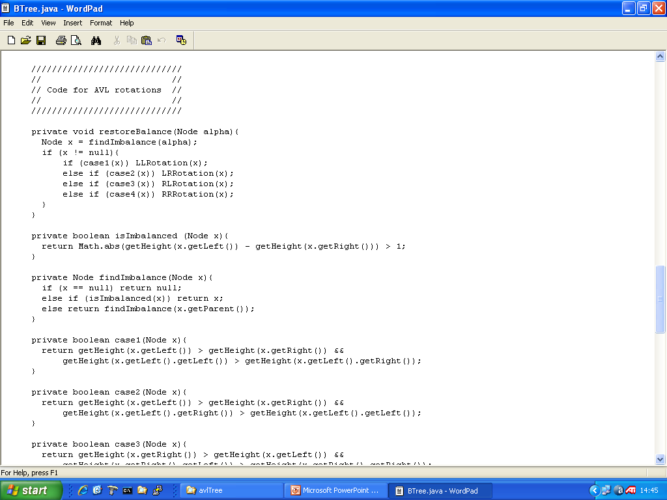
BTree

Slide 54
BTree

Slide 55
BTree

Slide 56
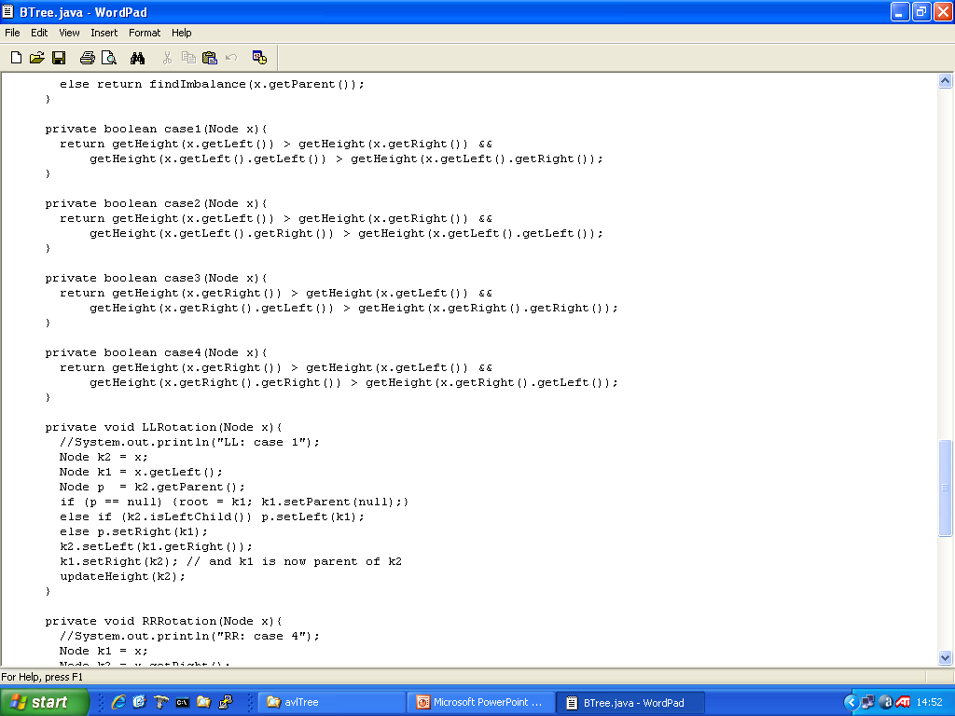
Restore balance by a LL Rotation
BTree
x

Slide 57
Restore balance by a LL Rotation
BTree
x
k2
k1
k1
k2
Z
X
X
Y
Y
Z

Slide 58
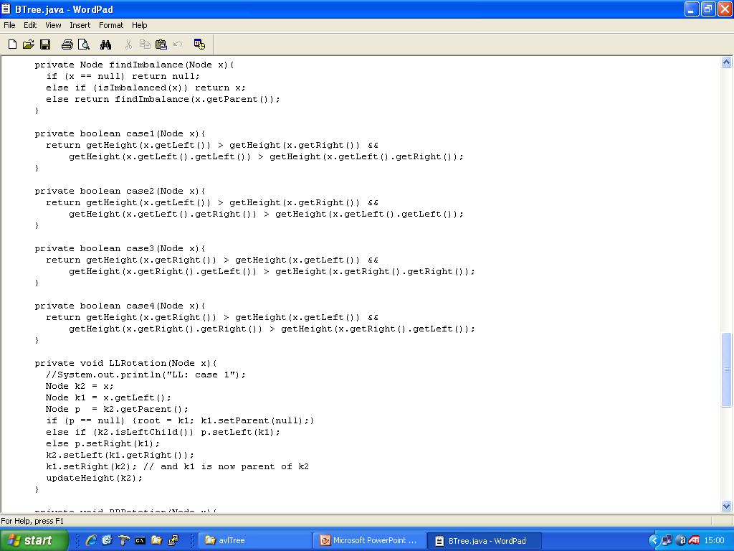
Restore balance by a LR (double) Rotation
BTree
Identifying Case 2:
imbalance(x) = 2
height(left.x) > height(right.x)
height(right.left.x) > height(left.left.x)

Slide 59
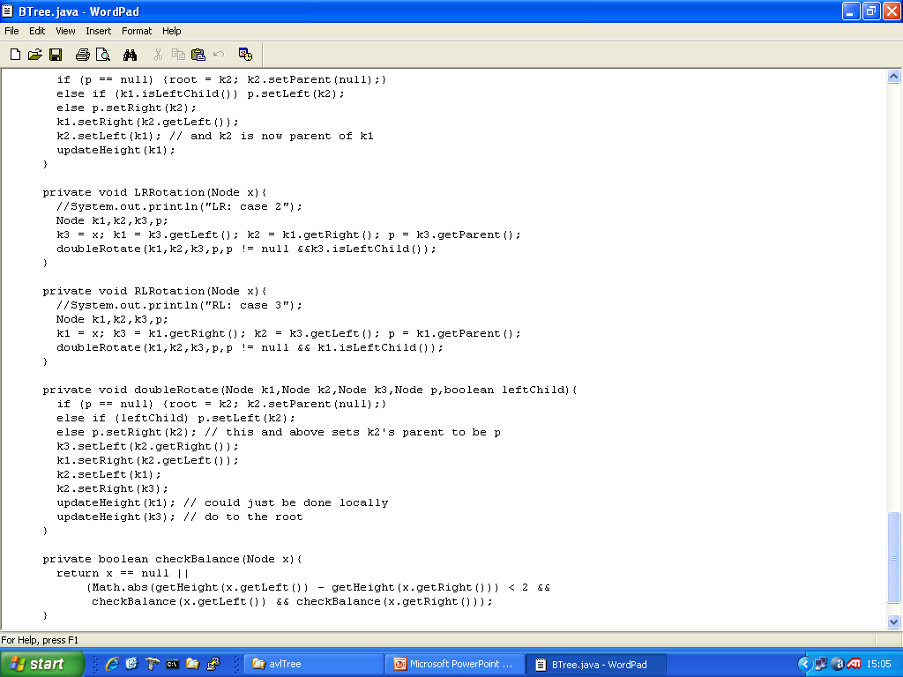
Restore balance by a LR (double) Rotation
BTree
k3
k2
k1
D
k1
k3
A
k2
A
B
C
D
B
C

Slide 60
Restore balance by a LR (double) Rotation
BTree
k3
k1
k2
D
A
B
C
k2
k1
k3
A
B
C
D

Slide 61
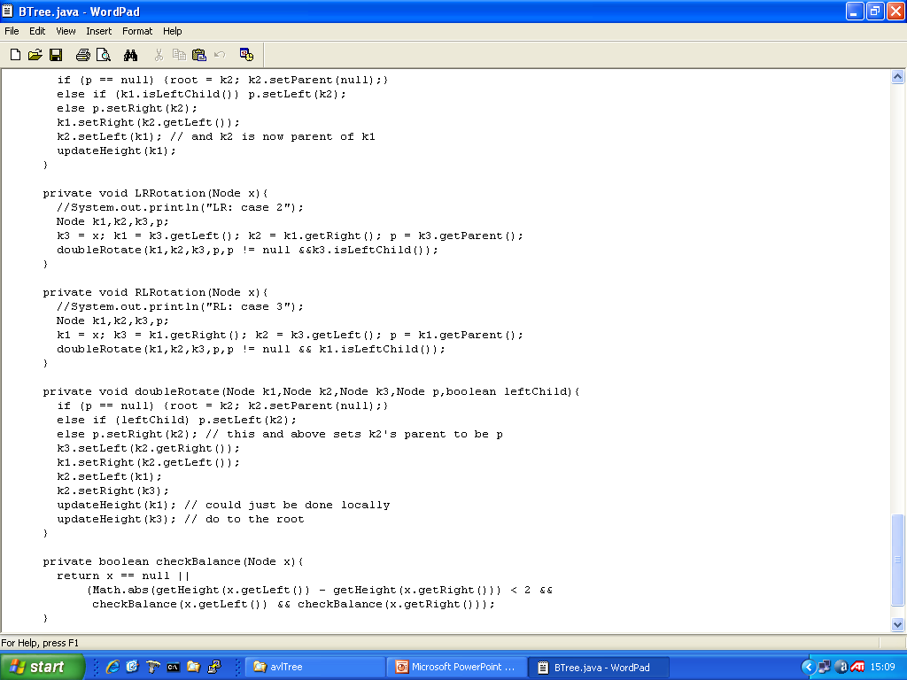

BTree

Slide 62
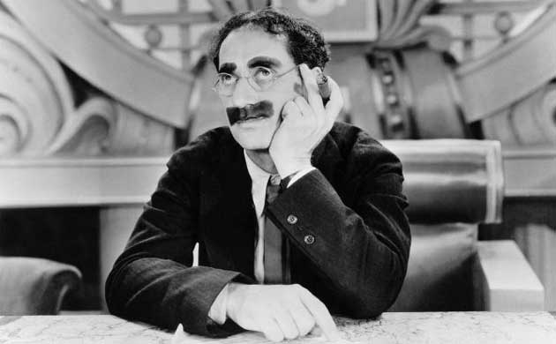
… and obviously we have code for cases3 and 4, code for RR-rotation and RL (double) rotation

Slide 63

Experiments … with “the email of doom”

Slide 64

emailOfDoom.txt

Slide 65
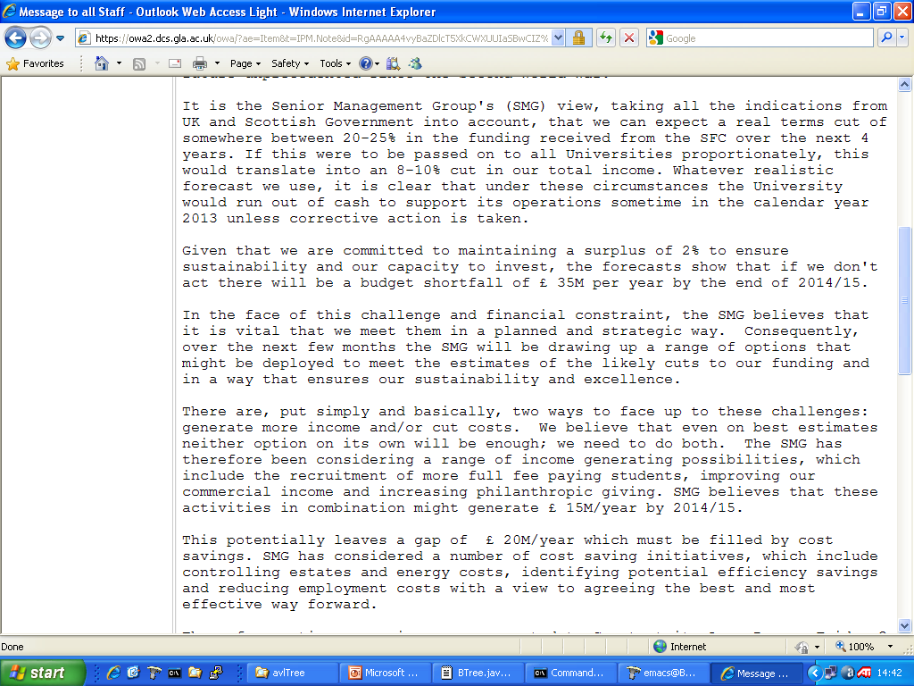
emailOfDoom.txt

Slide 66

emailOfDoom.txt

Slide 67

emailOfDoom.txt

Slide 68
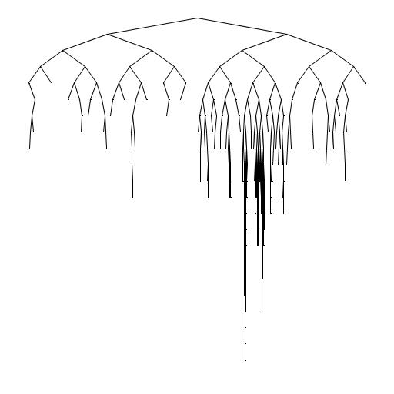
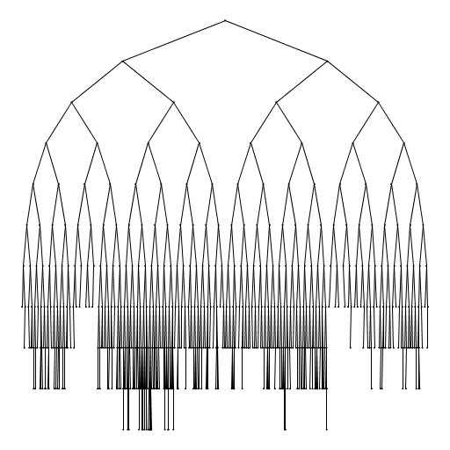
emailOfDoom.txt
BTree v AVLTree
run this and get stats

Slide 69
Still need to implement delete under the AVL property

Slide 70
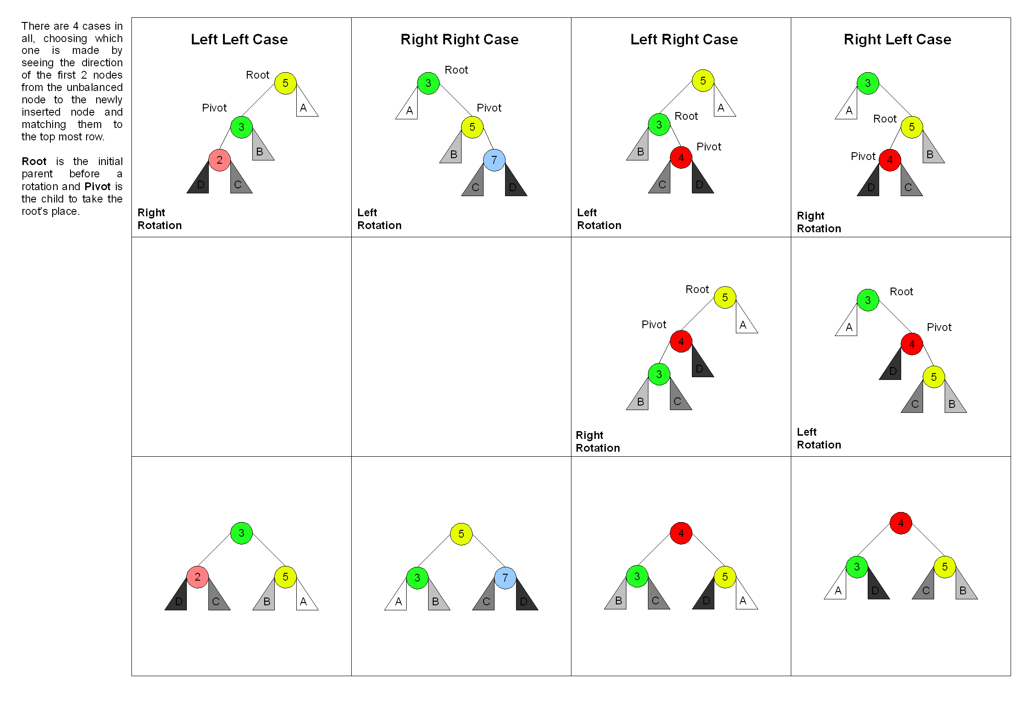
There are quite a few different descriptions of AVL
I have tried to keep mine simple & clear

Slide 71
