Slide 1
SOFTUNI - Team apo
Team members:
Mariyan Mlechenkov
Nikolay Stamenov
Nikoleta Shopova
Svetlana Apostolova
Teodora Ivanova

Slide 2
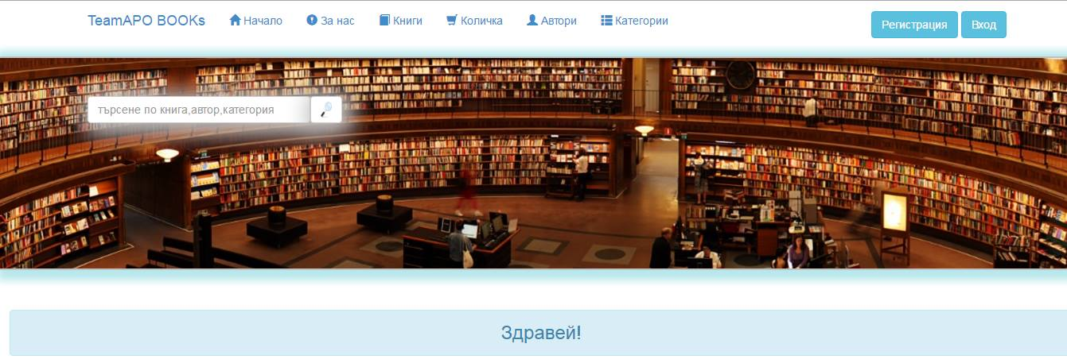
Our project

Slide 3
What we do?
SRS
Real Project Development
Test Cases
Test Automation

Slide 4
Todo:
Finish Development
Fix Bugs
Improve Test Coverage

Slide 5
Questions?

Slide 6
Thank you!

