Slide 1


Slide 2

QByte – A convenient Qualcomm dining app
Team BradyRocks
Dario Aranguiz
Eric Badger
Aswin Sivaraman
Jake Weiss
Our hero and guidance, Dr. Irwin M. Jacobs

Slide 3
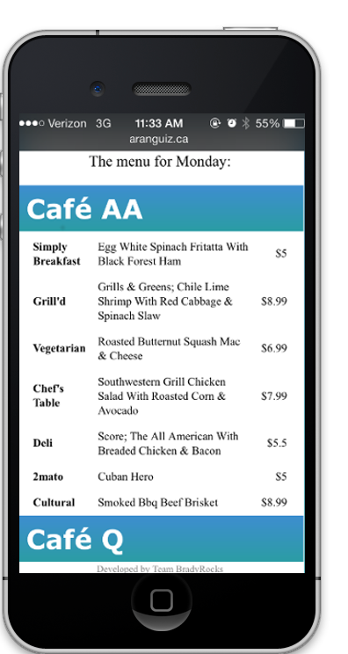
Search food by Cafeteria

Slide 4
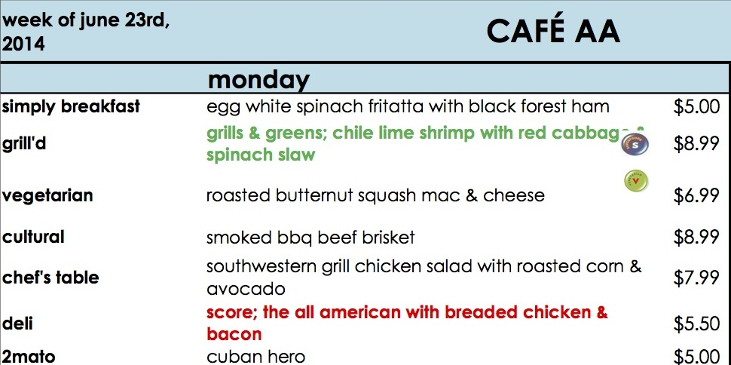
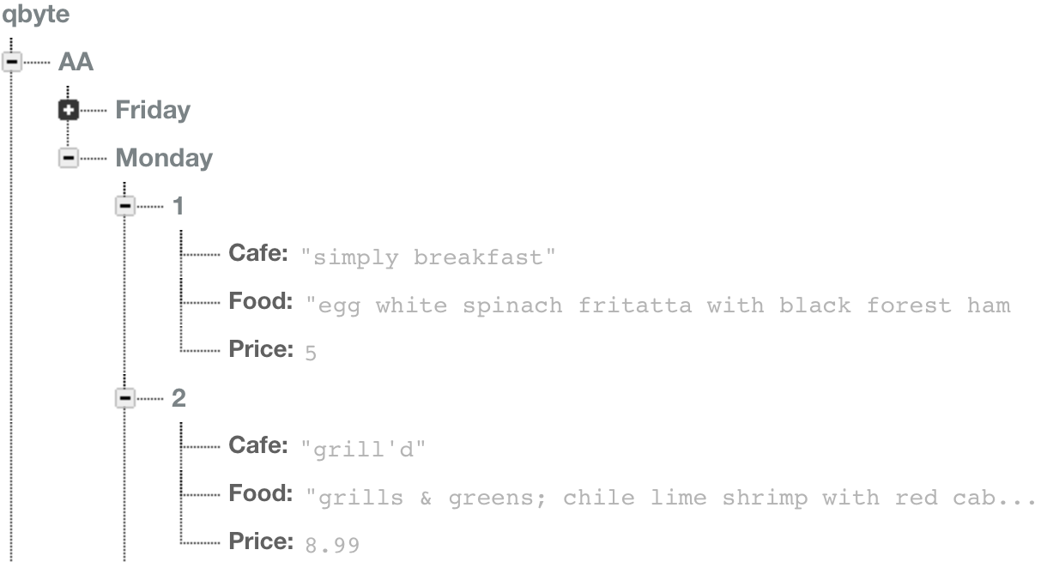
Transparency
Completely transparent to the café staff who create the menu PDFs because we parse the PDFs to get the menu data
Hosted using a Firebase database external to Qualcomm’s network
PDF from go/cafemenu
Firebase Database layout

Slide 5
Where do we go from here?
Implement a voting system to like/dislike certain dishes
Let users take pictures of dishes and share them to other users
“Like” a favorite dish and receive notification when it is offered
Set up lunch group invitations

