Slide 1
Certificate generation
Software for evaluating the form submitted by the student and generate the requested certificate.

Slide 2
Objective
To provide an easy interface for the applicants to fill in the required details .
To provide a simple interface for the concerned personnel to evaluate the details submitted by the applicants.
To generate the required certificate depending on the legitimate details and the reason for application specified by the applicants.

Slide 3
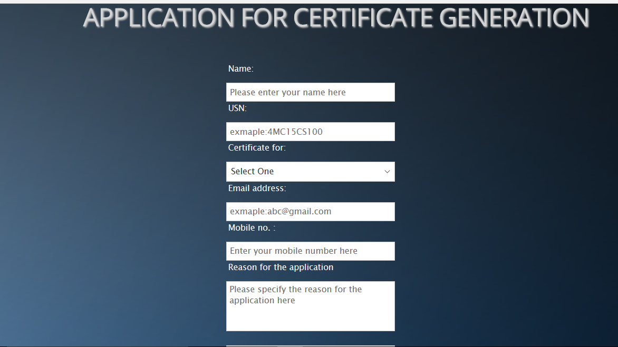
Form
Applicants have to fill in the required details specified in the form and click submit button for further processing.

Slide 4
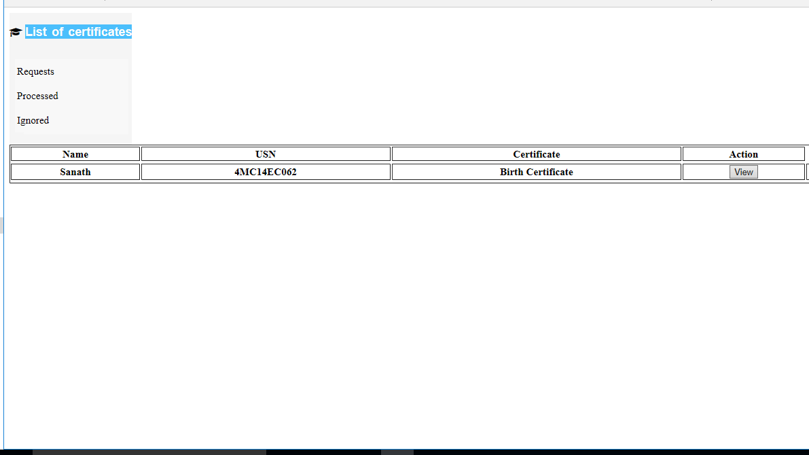
Admin page
The details sent by the student will be received here for further processing.

Slide 5
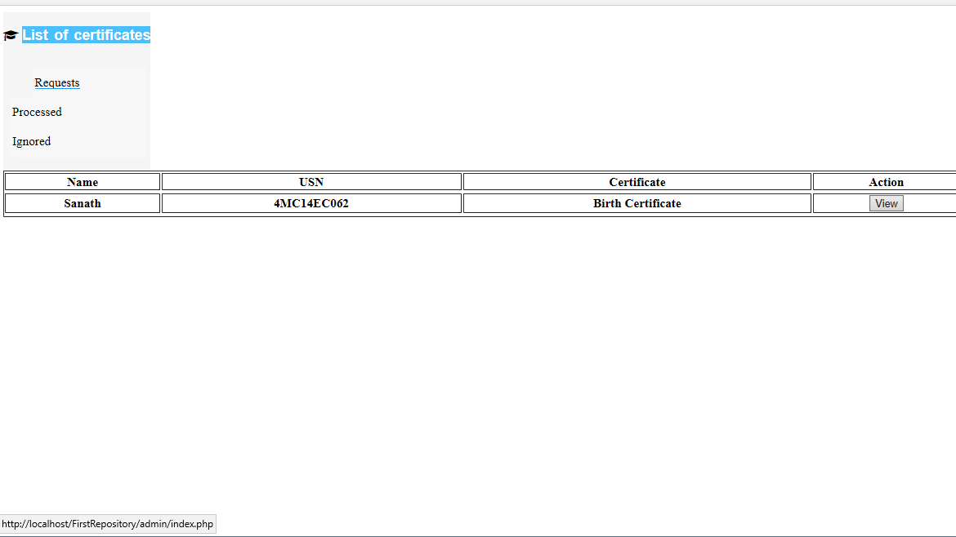
Request page
This page contains the list as well as the details of the applicant as submitted in the form.

Slide 6
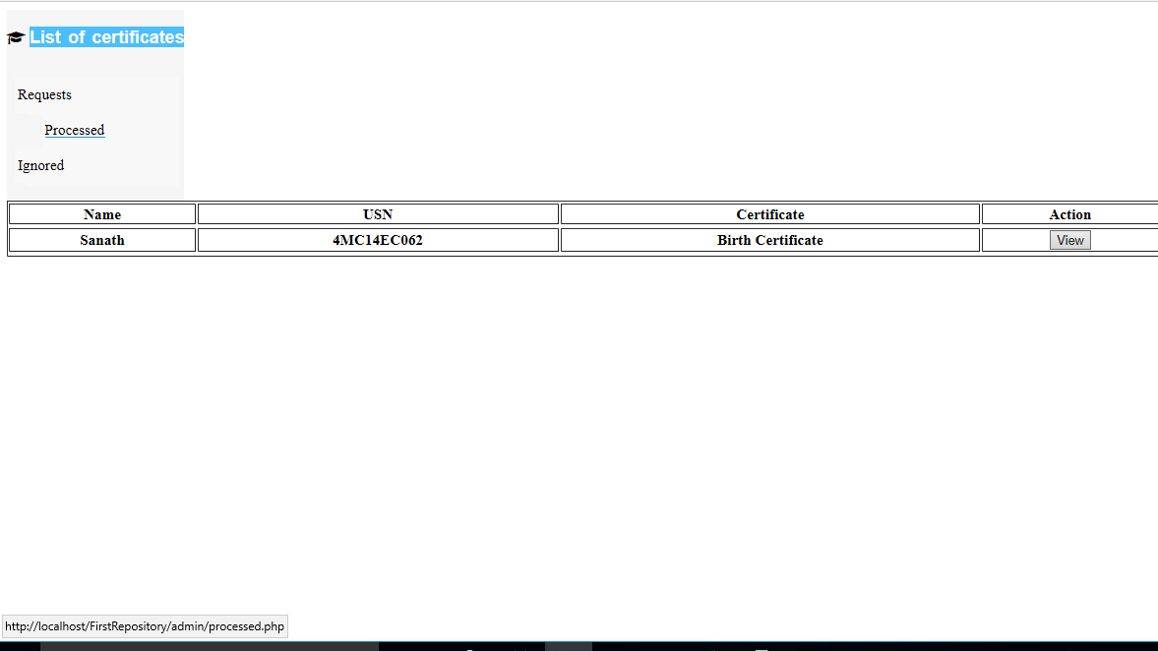
Processed page
This page contains the list of applications that are processed by the personnel and the specified are ready to be issued.

Slide 7
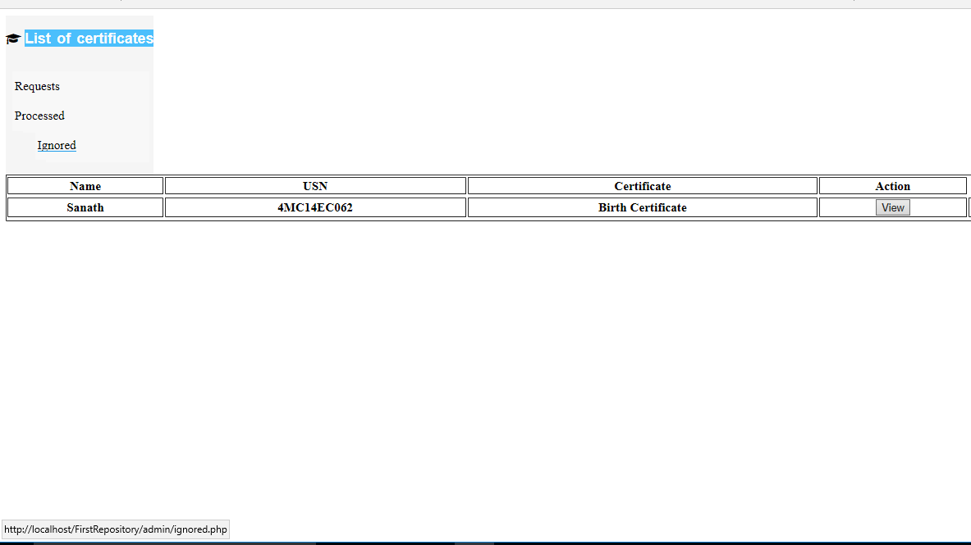
Ignore page
If the admin feels that the details submitted by the applicant are not legit , the form can be ignored by clicking the “Ignored” link , the form will be removed from the list.

Slide 8
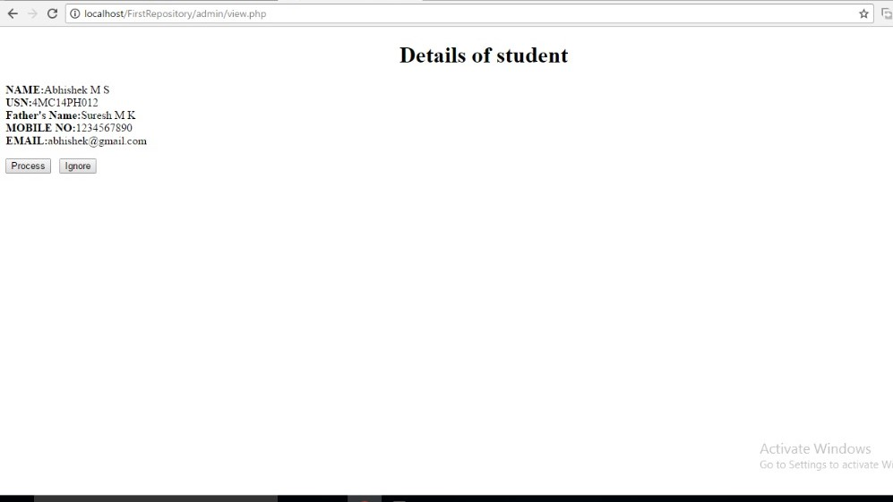
View page
This page contains all the details of the applicant whose application is received and is further processed if the application is accepted by clicking “Process” else rejected clicking “Ignore”

Slide 9
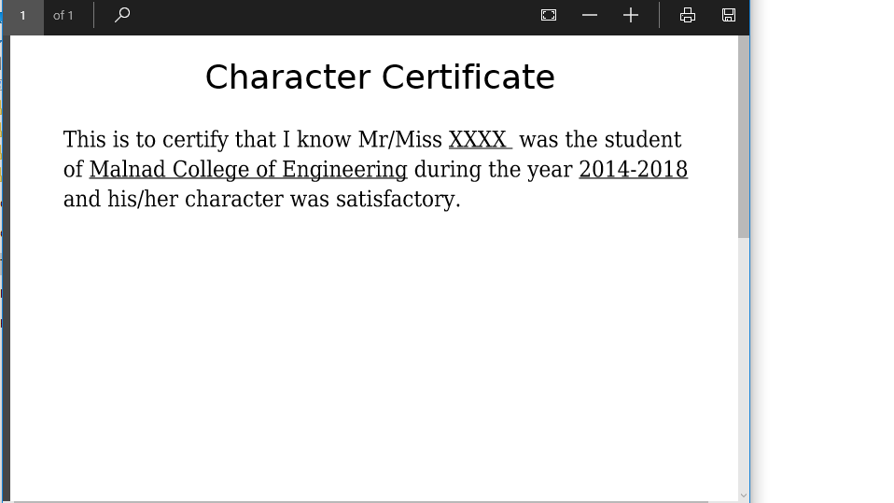
Certificate
After processing the details of the applicant, the requested certificate is issued which can be printed by the applicant.

Slide 10
Thank you
Software developed by,
DEVops team,
Sanath R Bharadwaj
Akshatha Sudarshan
Anirudh Iyengar
Vijeth Kashyap

