Slide 1
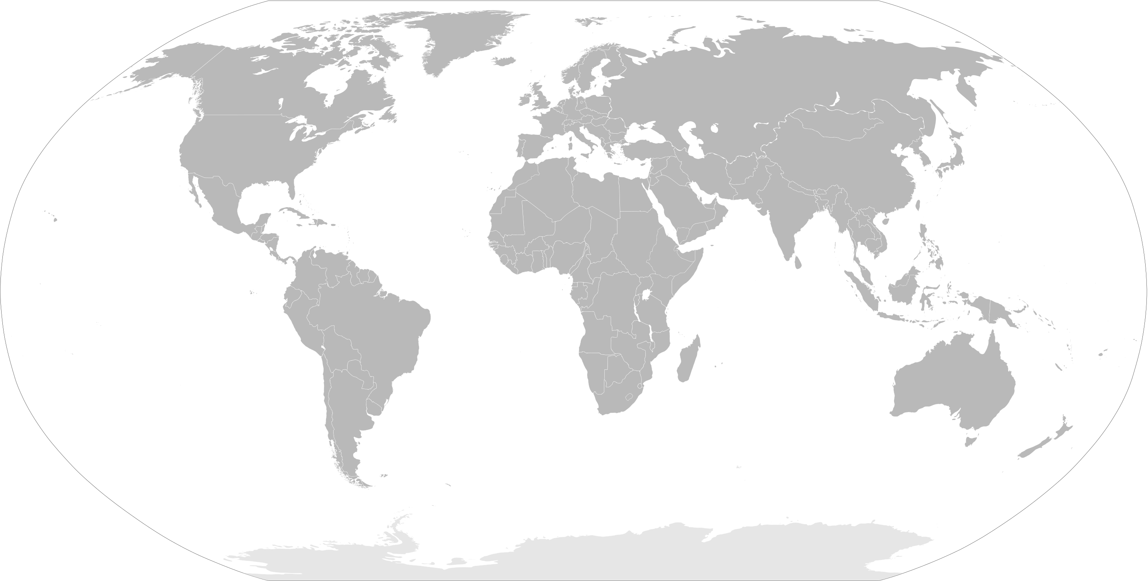
COMPAS Collaboration
COMPAS Collaboration
U. Washington
Tom Wagg
U. Washington
Tom Wagg
KU Leuven
Reinhold Willcox
U. of Oregon
JD Merritt
KU Leuven
Reinhold Willcox
U. of Oregon
JD Merritt
Harvard University
Lieke van Son
Floor Broekgaarden
Adam Boesky
UNSW Canberra
Nicolas Rodriguez-Segovia
Harvard University
Lieke van Son
Floor Broekgaarden
Adam Boesky
Monash University
Ilya Mandel (PI)
Jeff Riley
Ryosuke Hirai
Tim Riley
Teagen Clarke
Mike Lau
Monash University
Ilya Mandel (PI)
Jeff Riley
Ryosuke Hirai
Tim Riley
Teagan Clarke
Mike Lau
Johns Hopkins U.
Veome Kapil
Johns Hopkins U.
Veome Kapil
Cambridge U.
Isobel Ramero-shaw
Cambridge U.
Isobel Romero-Shaw
Swinburne U.
Simon Stevenson
Robert Song
U. of Amsterdam
Serena Vinciguerra
U. of Amsterdam
Serena Vinciguerra
U. of Auckland
Avi Vajpeyi
MPA Munich
Selma de Mink
Stephen Justham
Alejandro Vigna-Gomez
U. of Auckland
Avi Vajpeyi
MPA Munich
Selma de Mink
Stephen Justham
Alejandro Vigna-Gomez
Swinburne U.
Simon Stevenson
Robert Song
Past Developers: Lokesh Khandelwal, Jim Barrett, Poojan Agrawal, Kit Boyett, Debatri Chattopadhyay, Sebastian Gaebel, Fabian Howitt, Floris Kummer, Coen Neijssel
Past Developers: Lokesh Khandelwal, Jim Barrett, Poojan Agrawal, Kit Boyett, Debatri Chattopadhyay, Sebastian Gaebel, Fabian Gittins, George Howitt, Floris Kummer, Coen Neijssel

