Slide 1
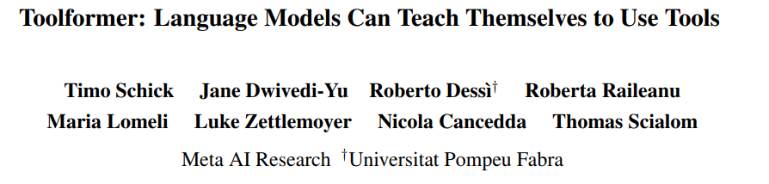
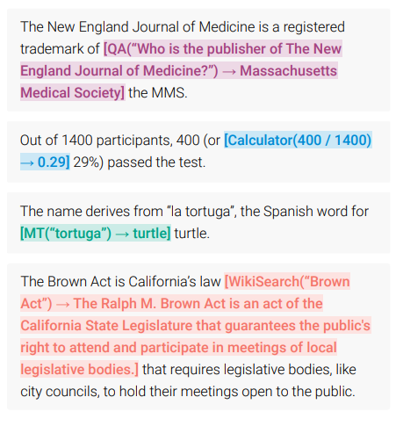
Notes:
Toolformer is a technique for giving large language models the ability to gather information to make better predictions.
If you ask it a math problem, it will prefer to use a calculator to improve its answer
[2302.04761] Toolformer: Language Models Can Teach Themselves to Use Tools (arxiv.org)

Slide 2
AI generates one token at a time.
It
It
can
It
can
hear
It
can
hear
you
It
can
hear
you
.
Notes:
Current techniques generate sentences one token at a time. A token usually corresponds to a word, or a sequence of characters that are frequently seen together in the data its trained on.

Slide 3
In practice
HEADER WITH EXAMPLES
You are an AI assistant with several tools
available to you. The tools are the following:
NOW: Print the current time.
WEEKDAY: Gets the week day for a given date.
MATH: Evaluates a math expression. You should always use this tool to evaluate math expressions.
SNAP: Rearranges windows on the screen. Takes the name of the window and the position as arguments.
DO NOT USE TOOLS WITHIN TOOLS! KEEP ALL TOOL CALLS SEPARATE FROM EACH OTHER!
YOU ARE ENCOURAGED TO USE TOOLS TO ENSURE THE ACCURACY OF YOUR RESPONSES!
YOU ARE TO EXPLAIN
YOUR REASONING AND SHOW YOUR WORK, WITH CLEAR CONNECTIONS BETWEEN CONCLUSIONS!
DO NOT PUT A LINE BREAK BEFORE A TOOL CALL!
User: What day of the week was 2023-03-03?
Assistant: The date 2023-03-03 is a [WEEKDAY(2023-03-03) -> Thursday] Thursday.
User: Is today a Friday?
Assistant: Today's date is [NOW() -> 2023-03-03 03:19:47.980140] 2023-03-03, which is a [WEEKDAY(2023-03-03) -> Thursday] Thursday, not a Friday.
User: What is the time?
Assistant:
CONVERSATION HISTORY
LATEST INPUT
SPEAKER IDENTIFIER

Slide 4




Restarts faster
Text prediction model
Voice transcription model
Why doesn’t the largest model simply eat the smaller ones?

Slide 5
Data flow
Spoken words as text
Mic
Audio
Transcriber
Prompt builder
Inference
requests
Inference
requests
Inference model
Inference
responses
HTML ON UR SCREEN
Inference
responses
Websocket

